Slide 1


Project Name: OMR Scanner Android App

Slide 2
Project Supervisor
Prof. Dr. Kazi Md. Rokibul Alam
Professor
Department Of Computer Science & Engineering
KUET, Khulna-9203
Email: rokibcse@yahoo.com
Website: www.kuet.ac.bd/cse/rokib/
Cell: +8801714087216

Slide 3
Project Partners
Dibbya Saha
Student(3rd year, 2nd Semister)
Department Of Computer Science & Engineering
KUET, Khulna-9203
Roll: 1407040
Email: dibbyasaha27@gmail.com
Shovan Bhowmik
Student(3rd year, 2nd Semister)
Department Of Computer Science & Engineering
KUET, Khulna-9203
Roll: 1407050
Email: bhowmik.shovon5795@gmail.com

Slide 4
Introduction
OMR Scanner is basically an android app which is used to scan student’s OMR Sheets and generate the result by matching the sheet with the correct answers. We mainly used Image Processing to detect the blobs of the OMR sheet. We have used openCV library to preprocess the image of the OMR for getting the accurate values.
Teachers can use this app to evaluate student’s performance quickly and accurately.

Slide 5
Objectives
1) To scan an OMR sheet and match it with the correct answer and
generate the result.
2)To use this app as an alternative of scanner device.
3)To provide mobility so that we can do this process anywhere we want.
4)To send the result to student’s contact number.

Slide 6
Requirements
Hardware Requirements
Ram: 1GB or higher
Processor: 1.2 GHz or Higher
Memory: 100 MB or Higher
Software Requirements
Operating System: Android 2.3.0 or higher
Front-end: Android Studio 2.3.3
Back-end: OpenCV Library
Plugins: Android SDK, ADT(Android Development Tools)
SDK Version: 26
Min. Android SDK: Gingerbread
Others: Camera, SMS permissions

Slide 7
Application Module
Home Module
Camera Module
Result Module

Slide 8
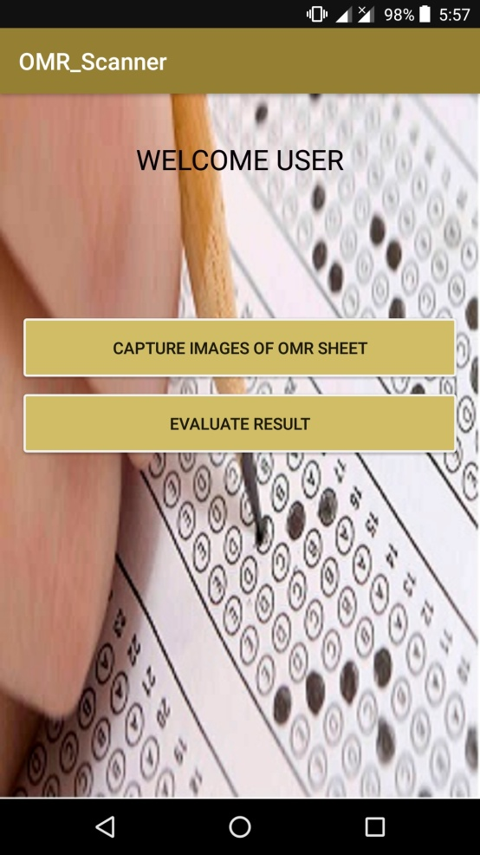
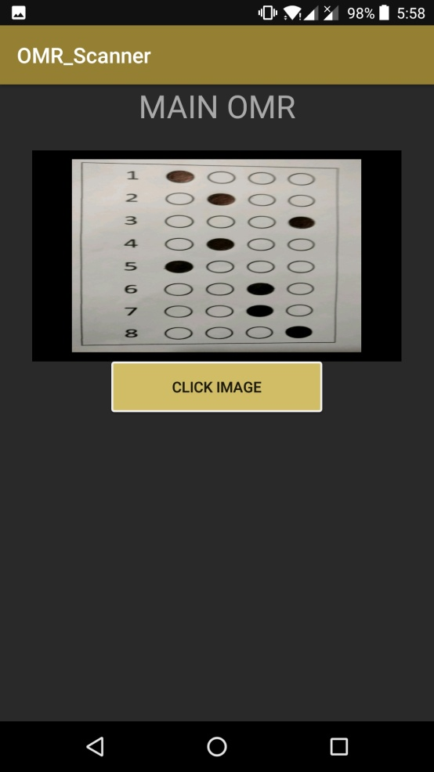
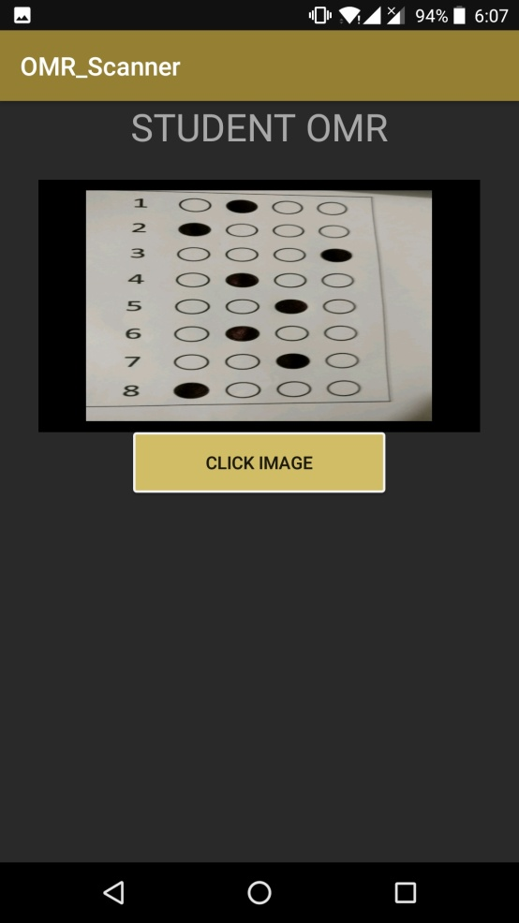
UI Design(Part-1)

Slide 9


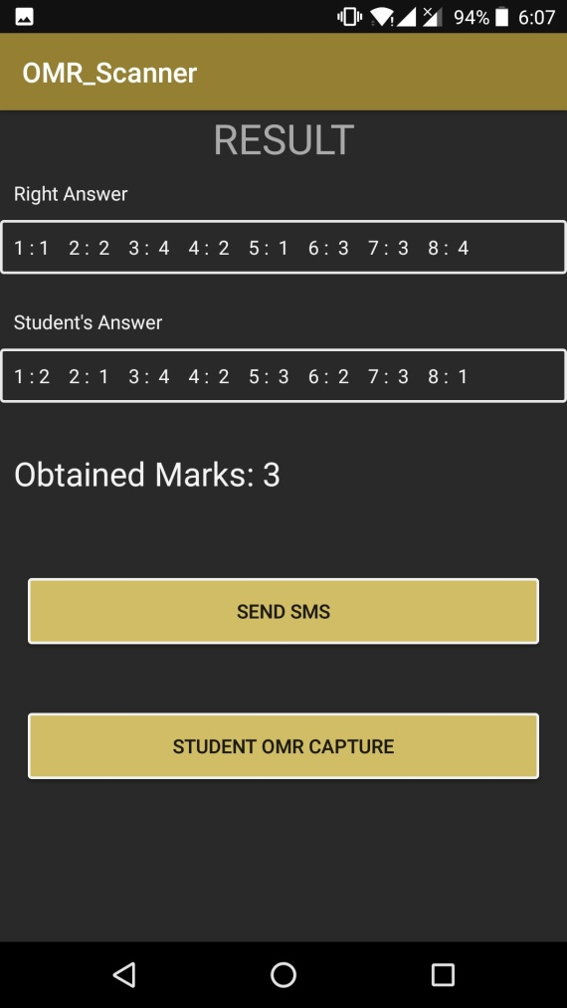
UI Design(Part-2)

Slide 10
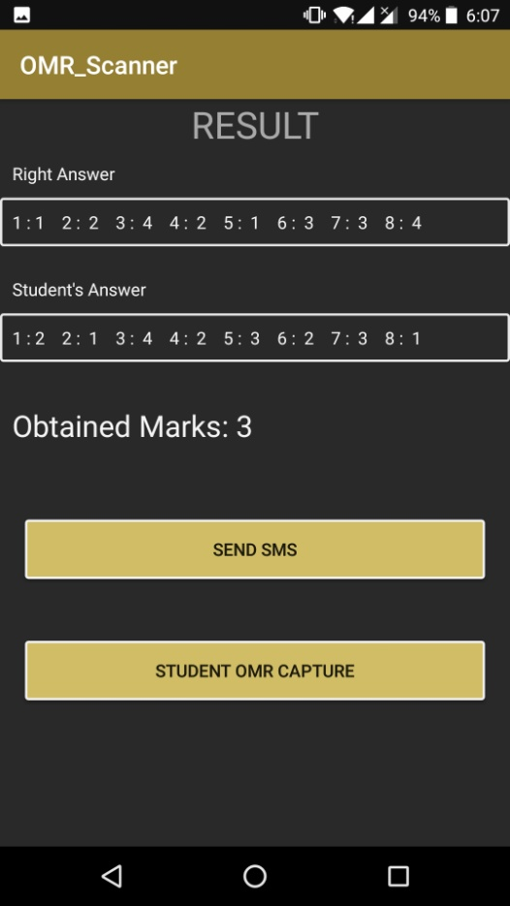
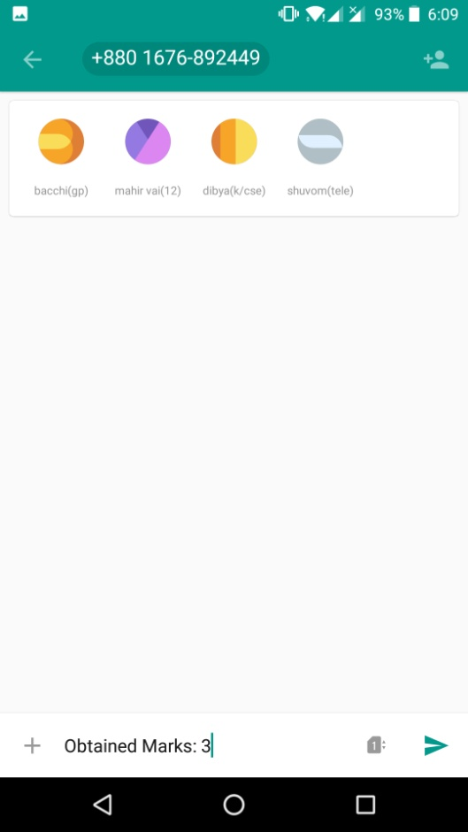


Slide 11
WorkFlow(Part-1)
Home Activity: We first created a Homepage and then by clicking a button we went to another activity.
Camera Activity: In this activity we have mainly done the work of taking picture and after that preprocessed the image.
Clicking Picture: First of all we open the openCV camera. Then we initialize the image as a MAT and started preprocessing.
PreProcessing: The Mat was first a RGBA image. We flipped the image. Then we convert it to grayscale image. Thus Binarization was done. Then we resized the processed image and did Gaussian Blur. The Blurred image is then went through Adaptive Thresholding. After Thresholding, we found houghmanLine to detect rectangle which covered the OMR sheet’s blob. Then we used dilution to enhance the radius of the circle.
Blob Detection: After dilution, we divided the pixels of the image and use traversing to find out the black regions.
Result Show: After blob detection the result of the original and student’s OMR was sent to resultActivity and stored in a sharedPreference. Then the matching between two sheet’s was done and thus we got the obtained marks.
Send SMS: The obtained mark can be sent to the student’s number bt clicking a button.

Slide 12
PreProcessing Steps
Rgba Img
Flip Img
GrayScale
Resize
Dilution
HaughLine
Detection
Adaptive
Thresholding
Gaussian Blurr

Slide 13
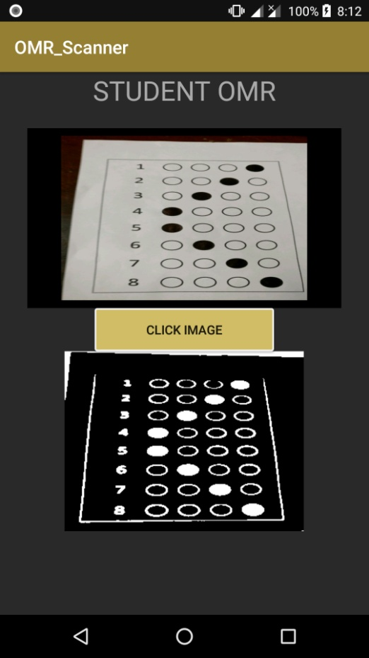
PreProcessed Image

Slide 14
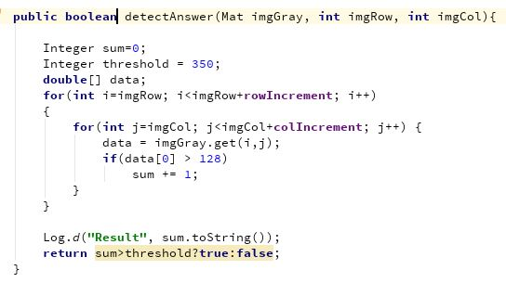
Blob Detection
We used a function detect answer to find the filled blobs.

Slide 15
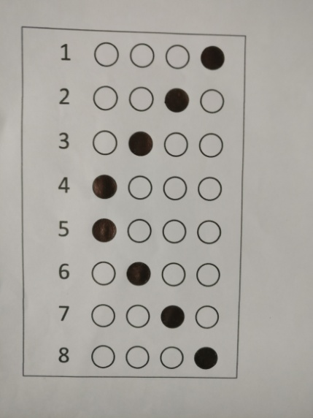
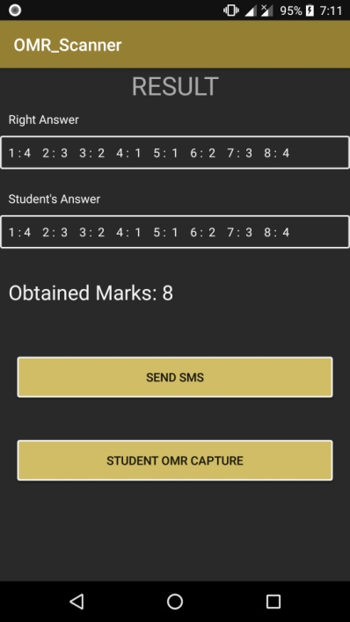
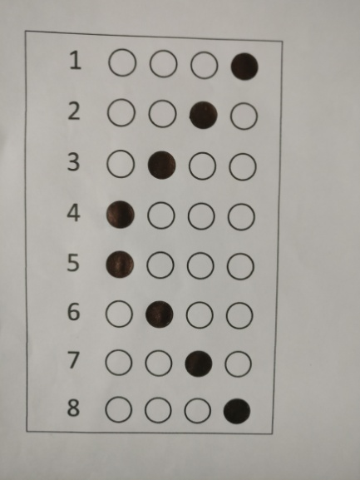
Experiment Result(1)

Slide 16
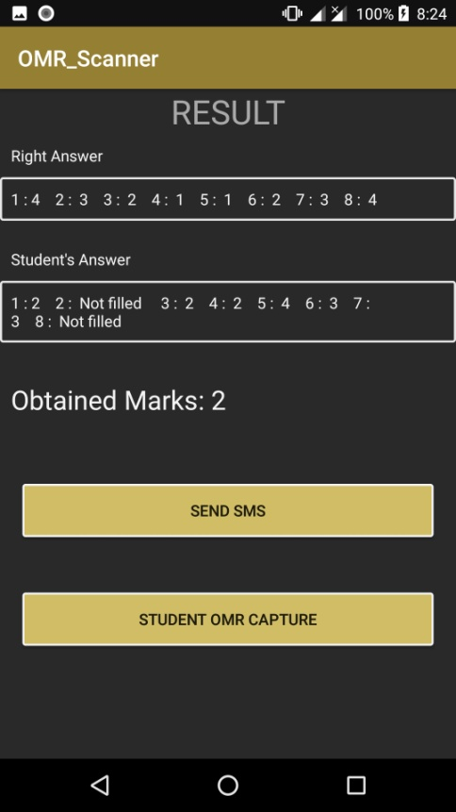
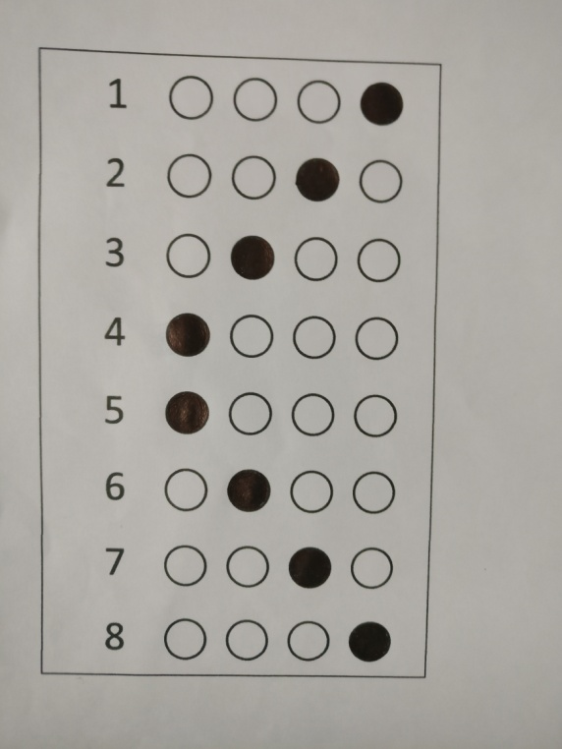
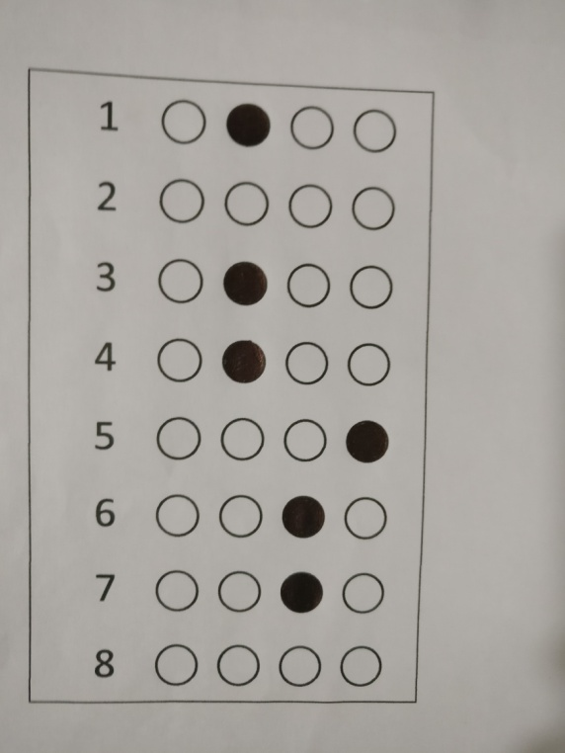
Experimental Result(2)

Slide 17
Analysis
We have got almost all the answers correct. But sometimes because of light and taking photos we get one or two values wrong
Our accuracy is almost 98%

Slide 18
Limitations
We have measured only 8 blobs.
2) We couldn’t made 100% accuracy all time
We need sufficient light for capturing
Sometimes Camera of the openCV becomes slow

Slide 19
Future Work
We will do this work for 50 questions
We will find the values more accurately
We will make overall result of all the students
We will add other features if possible

Slide 20
Conclusion
It was very challenging to use image processing in our android project. We have tried a lot to make more efficiency. But after all we have determined the marks and also we are able to send the marks to the student’s mobile.

Slide 21


