Slide 1
Research Paper: Intent Detection and Entity Extraction from BioMedical Literature
Author
Ankan Mullick1 *, Mukur Gupta2 *, Pawan Goyal1 1Computer Science and Engineering Department, IIT Kharagpur, India 2Computer Science Department, Columbia University, USA ankanm@kgpian.iitkgp.ac.in, mukur.gupta@columbia.edu, pawang@cse.iitkgp.ac.in
Slides prepared by
Shovon Raul, 2023CSM006

Slide 2
The Problem
What is the problem?
named entity recognition (NER) tasks from biomedical text
Why should this problem be solved?
Biomedical queries have become increasingly prevalent in web searches

Slide 3
Background Information
focus on two crucial natural language understanding tasks
intent detection
named entity recognition
from biomedical text

Slide 4
Workable Solutions
BinderPubMedBERT
BinderPubMedBERT is a pretrained model finetuned on biomedical text from PubMed and the MIMICIII dataset
RoBERTa
RoBERTa (Robustly Optimized BERT Approach) is a stateoftheart language representation model developed by Facebook AI.
PubMedBERT
PubMedBERT is a variant of the BERT (Bidirectional Encoder Representations from Transformers) model, finetuned on a large corpus of biomedical literature from PubMed.

Slide 5
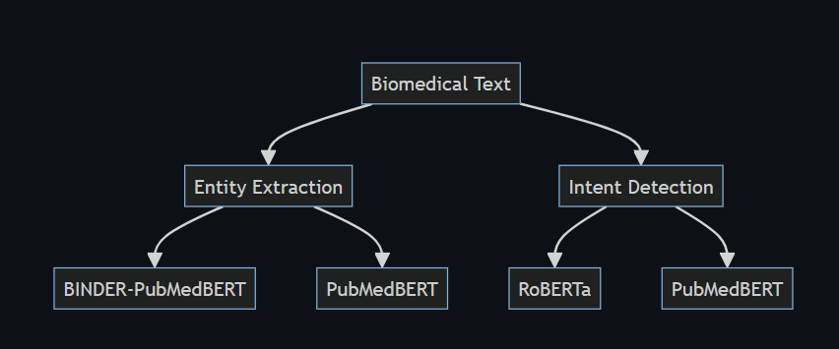
The FLOWCHART

Slide 6
Code implementation
Here's a condensed summary of the provided code:
Demonstrates biomedical intent detection and named entity recognition (NER) using pretrained models.
Utilizes BINDERPubMedBERT and PubMedBERT for NER, and RoBERTa for intent detection.
Sample text examples illustrate model functionality.
Entities are classified as medical or generic based on score thresholds.
Intent is classified as "Medical Inquiry" or "General Inquiry" using RoBERTa.
Results are serialized into JSON format for further analysis.

Slide 7
Reference
Mullick, A., Gupta, M., & Goyal, P. (2024). Intent Detection and Entity Extraction from BioMedical Literature. arXiv preprint arXiv:2404.03598.

