Slide 1
inFORM: The Future of Touchable 3D Displays
Speaker :Yamada Shota

Slide 2
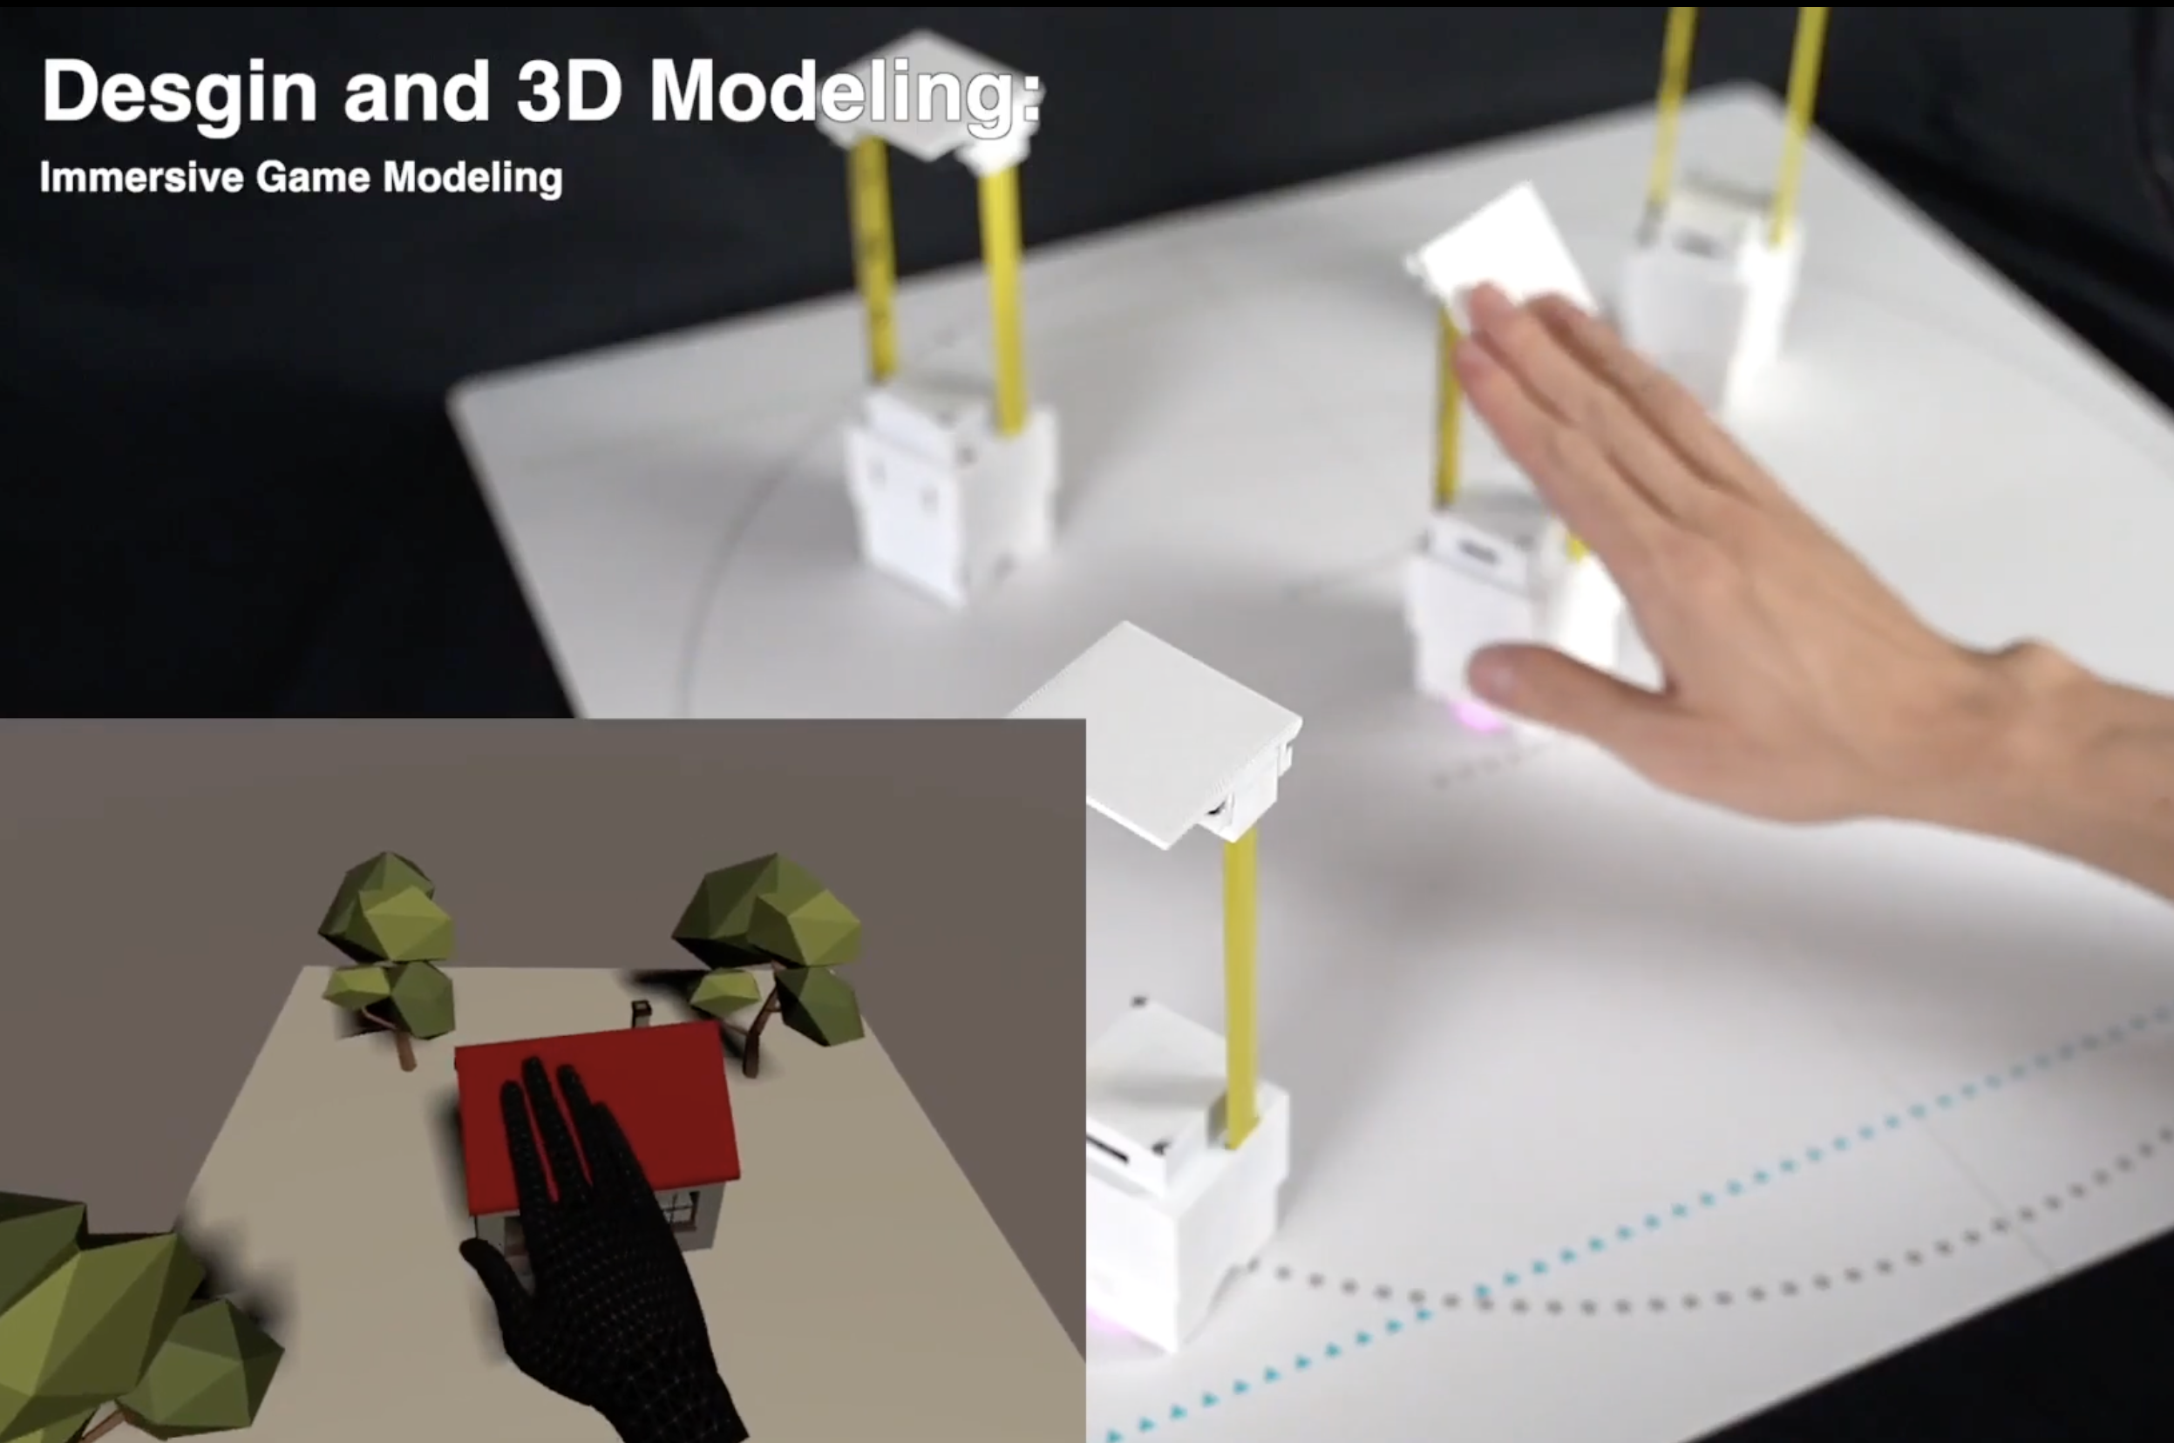
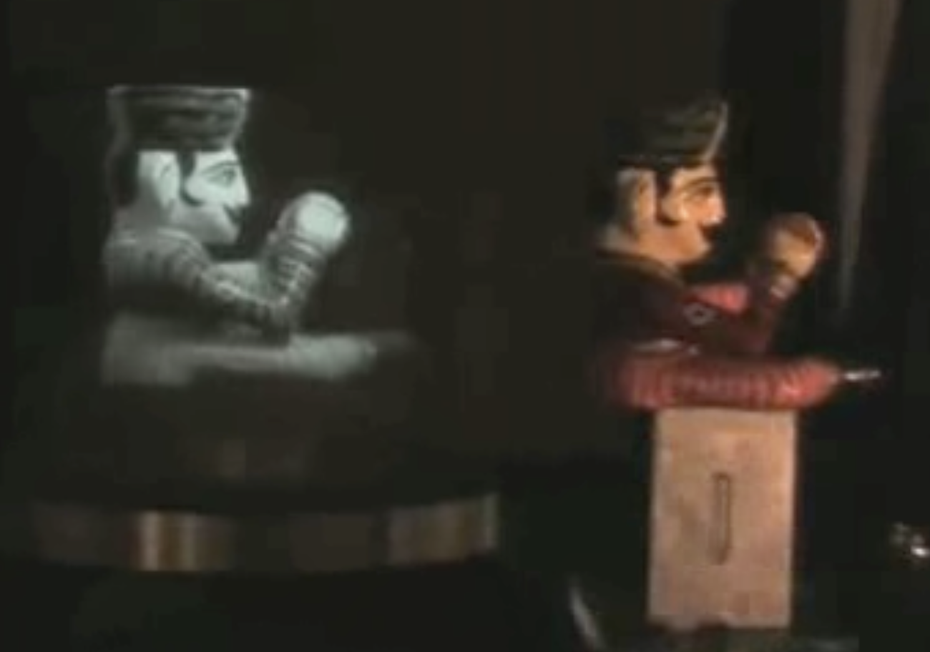
Introduction / Reason
3D displays have great potential
tactile feedback
3D visual information

Slide 3
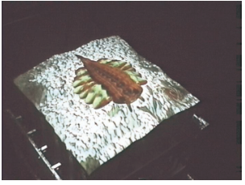
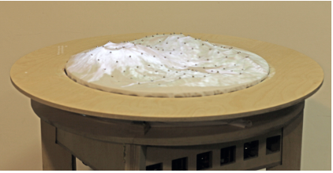
1. History & Description
Conventional 3D displays
・Only focused on showing the shape
inForm
・touchable UI and dynamic physical affordances

Slide 4
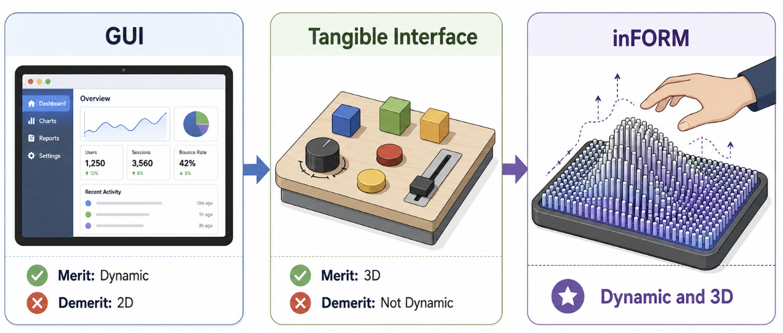
1. History & Description

Slide 5
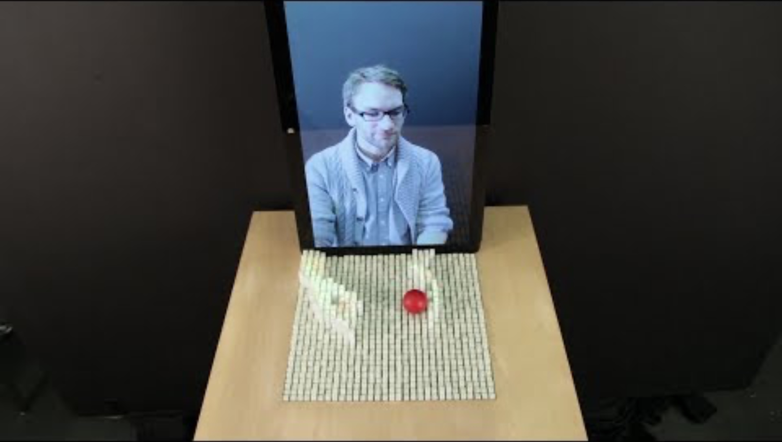
Procedure

Slide 6
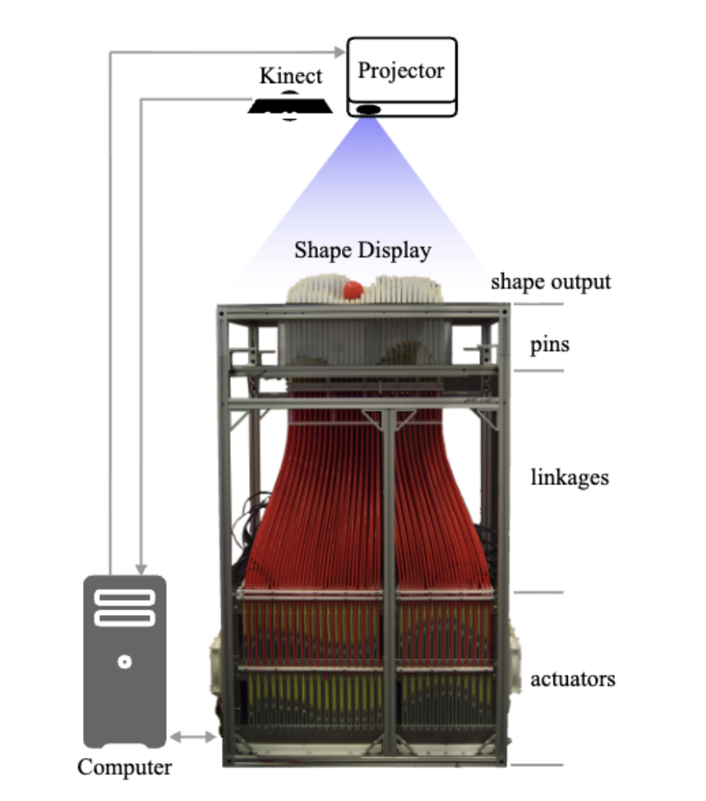
Features
Consisting of 30×30 pins and their size are 381 × 381mm
Each pin extends up to 100 mm
Each pin is moved by the actuator located below it
Not only does it move the pin, but it also tells you where it is

Slide 7
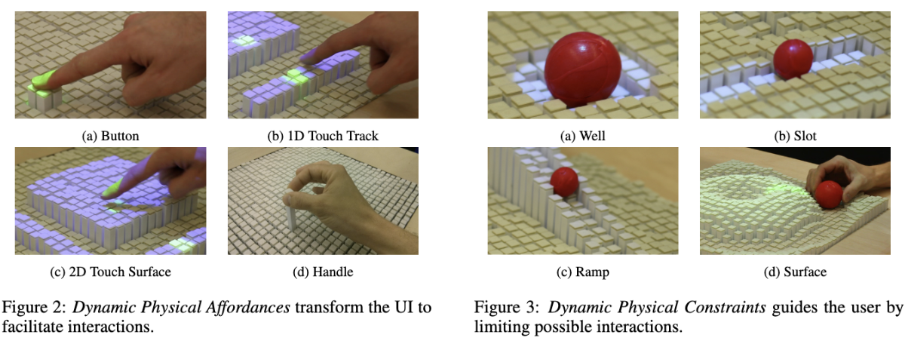
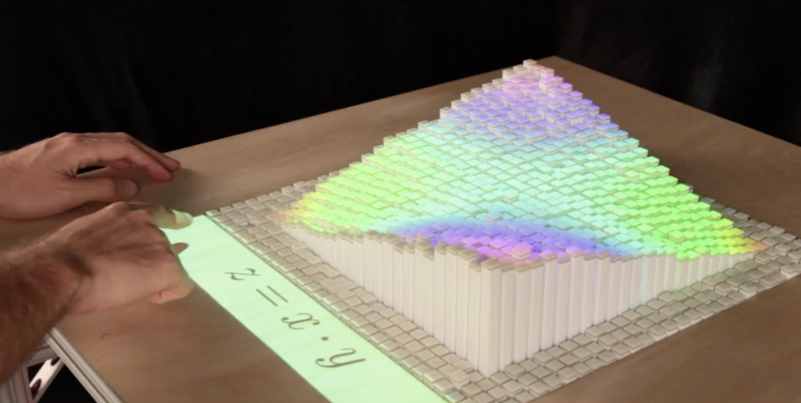
Applications
1. Dynamic Physical UI
UI can appear only when needed
2. Interactive Surfaces
Surfaces change shape depending on user actions.

Slide 8
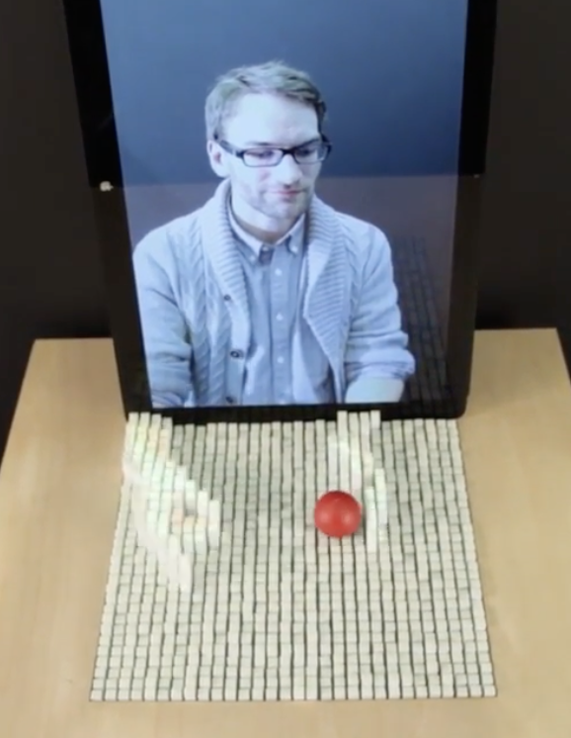
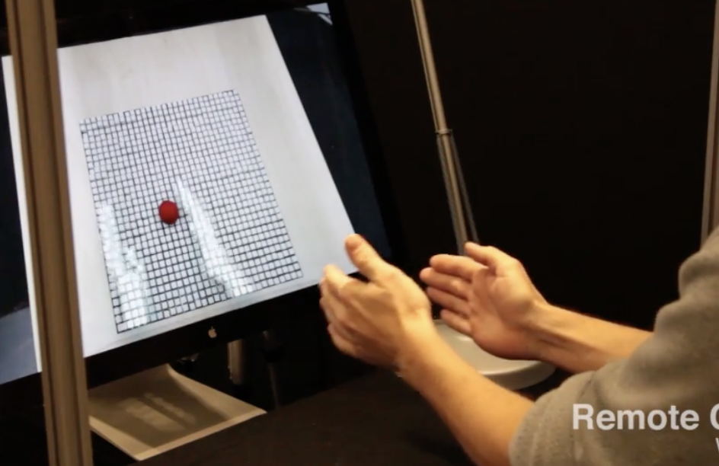
Applications
3. Dynamic Constraints
Guide or restrict object movement.
4. Remote Physical Interaction
Represent objects or movements from a distant location.

Slide 9
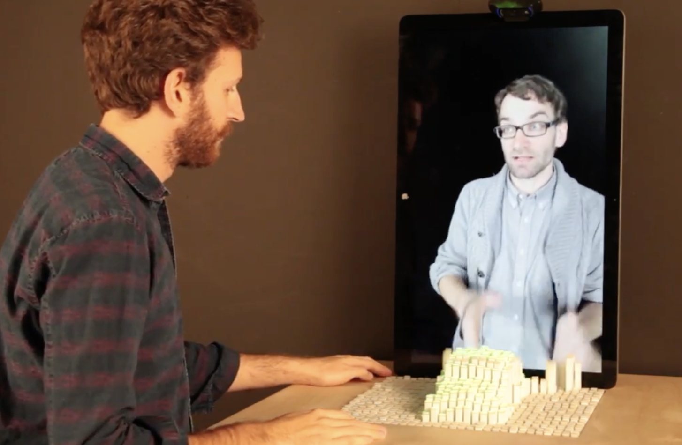
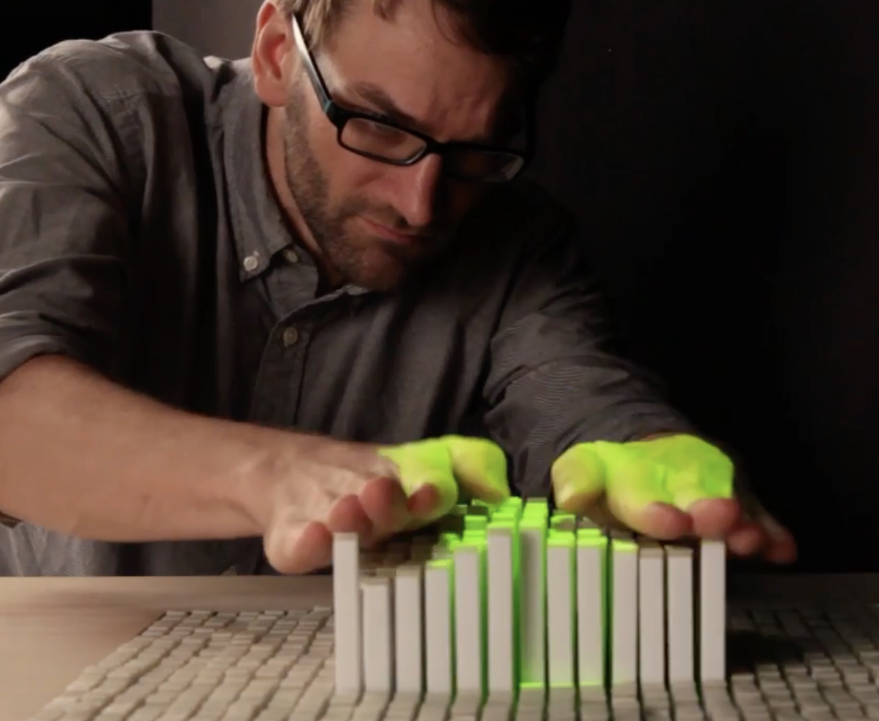
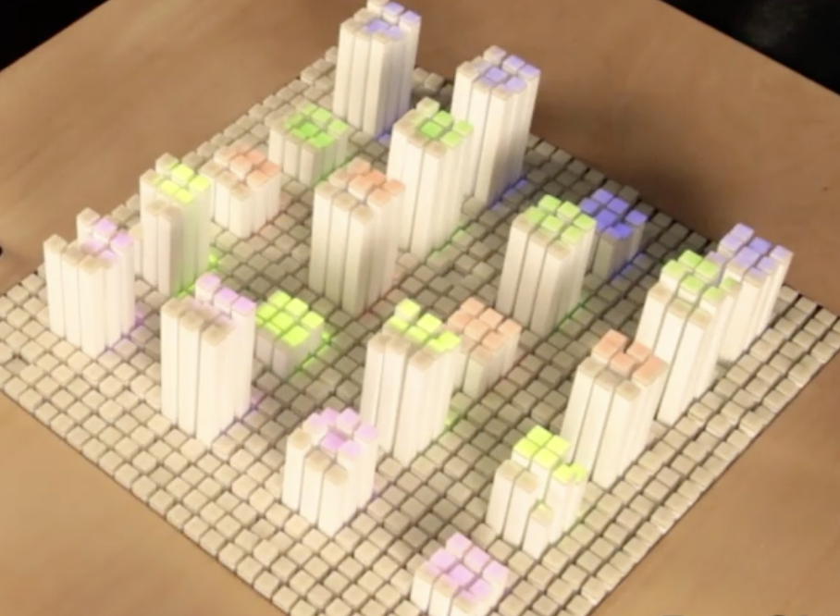
Impact on Society
New ways of remote collaboration
Better education and training systems
More intuitive human-computer interaction

Slide 10
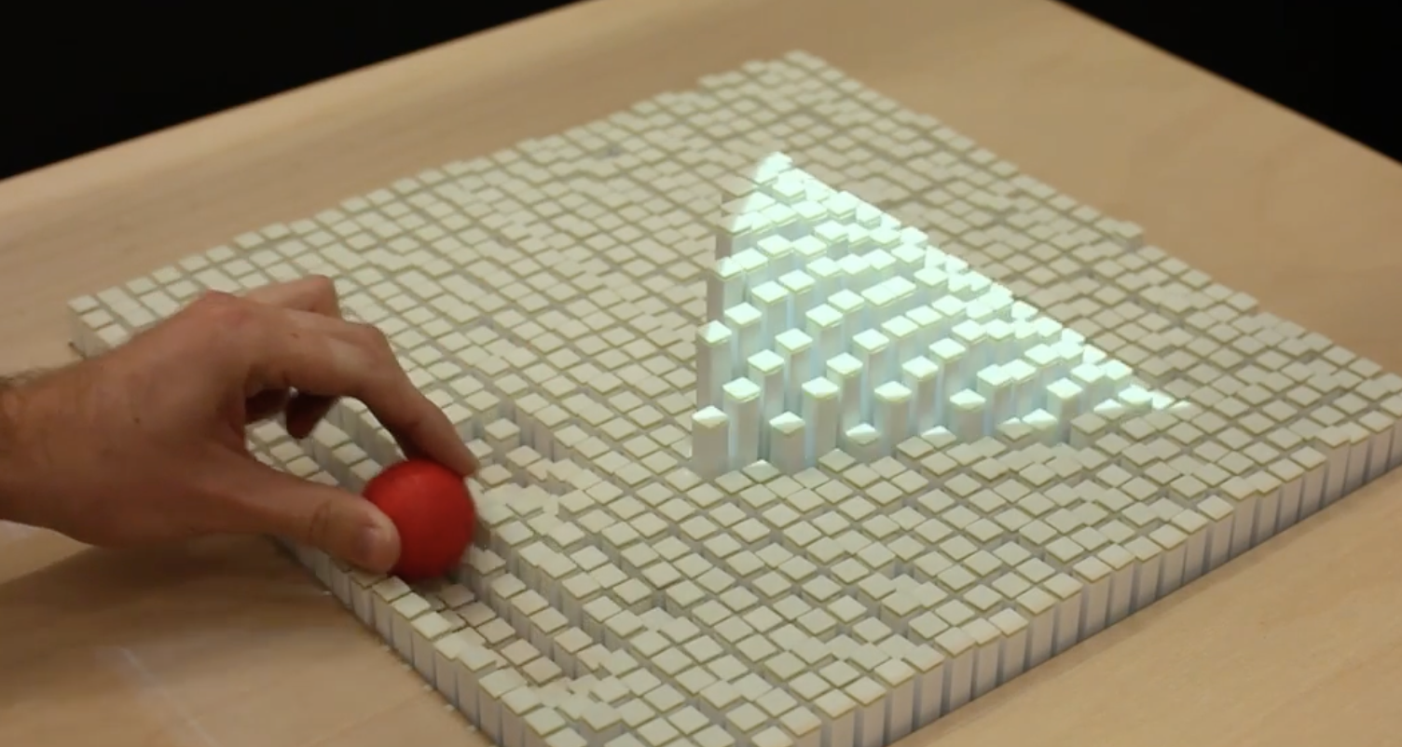
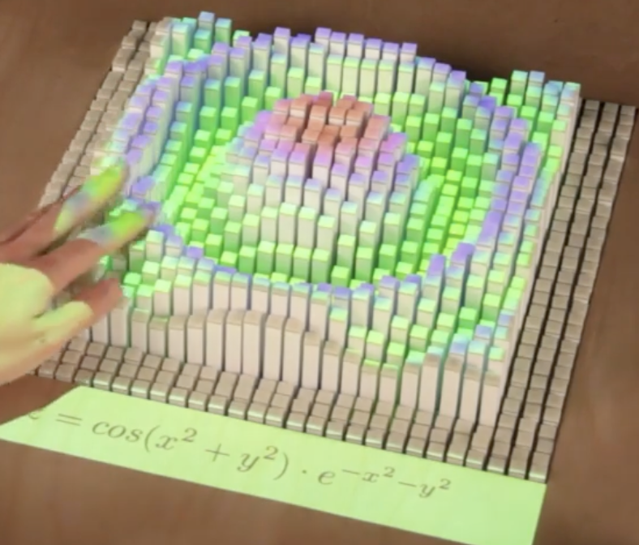
Conclusion
inFORM connects digital and physical.
Users can both see and touch information.
It demonstrates the future of tangible interfaces.

Slide 11
Information source
inFORM: Dynamic Physical Affordances and Constraints through Shape and Object Actuation ,UIST 2013,Page numbers: 417,423&424,URL: https://dl.acm.org/doi/abs/10.1145/2501988.2502032
B,hapticbots:Distributed Encountered-type Haptics for VR with Multiple Shape-changing Mobile Robots,UIST2021, URL:https://dl.acm.org/doi/10.1145/3472749.3474821?cid=81319495312

Slide 12
Information source
C, Rendering for an interactive 360° light field display, TOG Volume 26 Issue3, URL: https://dl.acm.org/doi/10.1145/1276377.1276427
D, Relief: A scalabale Actuated Shaped Display, Proceedings of the 4th International Conference on Tangible and Embedded Interaction 2010, URL: https://www.researchgate.net/publication/221308622_Relief_A_Scalable_Actuated_Shape_Display
E, Project FEELEX: adding haptic surface to graphics, SIGGRAPH '01: Proceedings of the 28th annual conference on Computer graphics and interactive techniques, URL: https://dl.acm.org/doi/10.1145/383259.383314

