Slide 1
Chapter 2
Sums

Slide 2






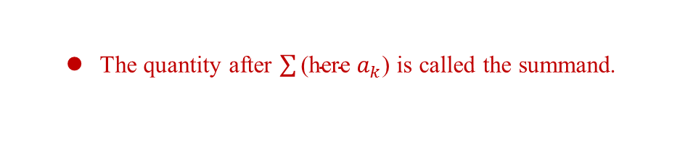

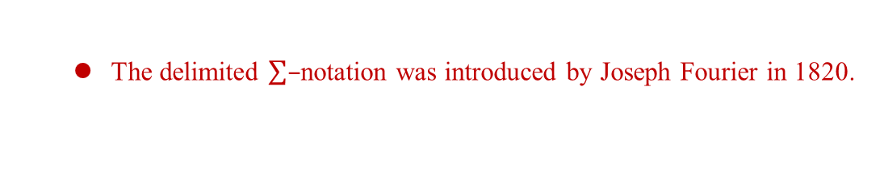

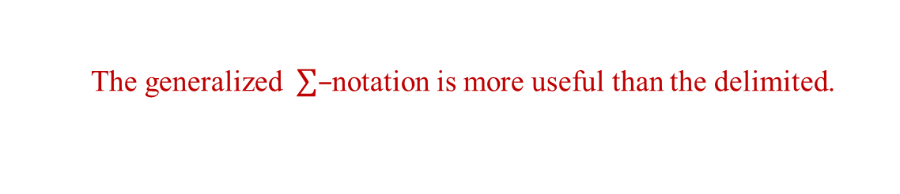
2.1 Notation
$a_{1}+a_{2}+⋯+a_{n}$
Each $a_{k}$ is called a term.
The delimited $\sum{–}$notation was introduced by Joseph Fourier in 1820.
The quantity after $\sum{\text{(}\text{here} a_{k}\text{)}}$ is called the summand.
The generalized $\sum{–}$notation is more useful than the delimited.
e.g.
clear. ( )
e.g.
easy ( )

Slide 3

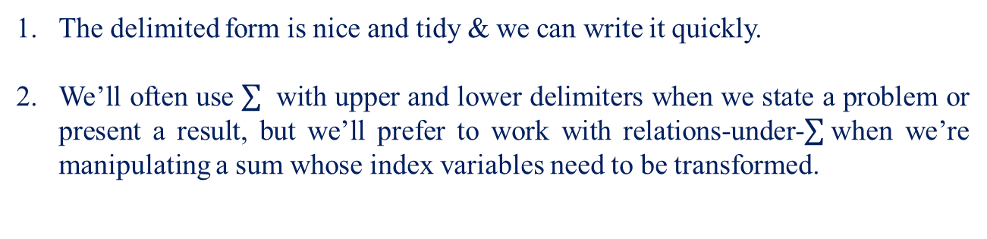



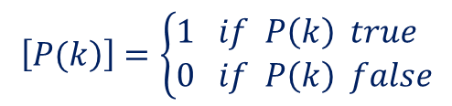
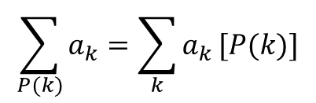

Note:
The delimited form is nice and tidy & we can write it quickly.
We’ll often use with upper and lower delimiters when we state a problem or present a result, but we’ll prefer to work with relations-under- when we’re manipulating a sum whose index variables need to be transformed.
: The sum of all terms $a_{k}$ s.t. k is an integer satisfying a given property P(k).
(Note: The value of an empty sum is defined to be zero.)
$$\sum_{P(k)}{a_{k}} \sum_{k=1}^{n}{a_{k}}$$
$$;$$
(When we want to confine the notation to a single line)
Iverson introduced:
$$\left[\left.P(k\right)\right]=\left\{\begin{aligned}&1 if P\left(k\right) true \\ &0 if P\left(k\right) false\end{aligned}\right.$$
$$\sum_{P(k)}{a_{k}}=\sum_{k}{a_{k}}[P(k)]$$
(if P(k) is false, $a_{k}\left[P(k)\right]=0$)
$$⟹$$

Slide 4



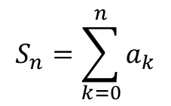




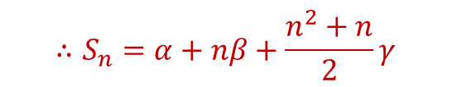
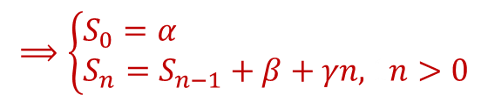
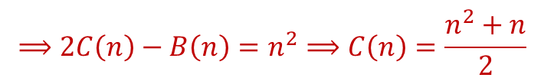
2.2 Sums and Recurrences
There’s an intimate relation between sums and recurrences.
$$S_{n}=\sum_{k=0}^{n}{a_{k}}$$
$$S_{0}=a_{0}$$
$$⇒$$
$$S_{n}={S_{n−1}+a}_{n},1n>0$$
e.g.$a_{0}=α, a_{n}=β+γn$.
$$⟹\left\{\begin{aligned}&S_{0}=α \\ &S_{n}=S_{n−1}+β+γn, 1n>0\end{aligned}\right.$$
Let $S_{n}=A\left(n\right)α+B\left(n\right)β+C\left(n\right)γ.$
$$S_{n}=1⟹α=1, β=γ=0⟹A\left(n\right)=1$$
$$S_{n}=n⟹α=0, β=1, γ=0⟹B\left(n\right)=n$$
$$S_{n}=n^{2}⟹α=0, β=−1, γ=2$$
$$⟹2C\left(n\right)−B\left(n\right)=n^{2}⟹C\left(n\right)=\frac{n^{2}+n}{2}$$
$$∴S_{n}=α+nβ+\frac{n^{2}+n}{2}γ$$

Slide 5



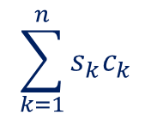
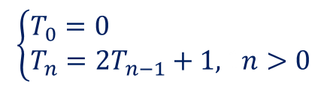
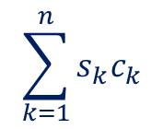
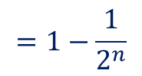



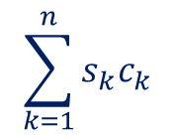


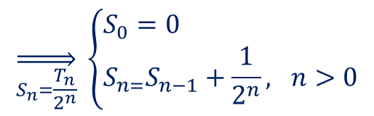
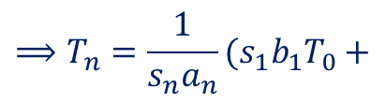

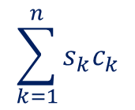
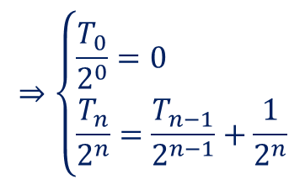


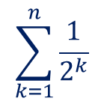
$$\left\{\begin{aligned}&T_{0}=0 \\ &T_{n}=2T_{n−1}+1, 1n>0\end{aligned}\right.$$
$$⇒\left\{\begin{aligned}&\frac{T_{0}}{2^{0}}=0 \\ &\frac{T_{n}}{2^{n}}=\frac{T_{n−1}}{2^{n−1}}+\frac{1}{2^{n}}\end{aligned}\right.$$
$$\overset{⇒}{S_{n}=\frac{T_{n}}{2^{n}}} \left\{\begin{aligned}&S_{0}=0 \\ &S_{n=}S_{n−1}+\frac{1}{2^{n}}, 1n>0\end{aligned}\right.$$
$$\sum_{k=1}^{n}{\frac{1}{2^{k}}}$$
$$=1−\frac{1}{2^{n}}$$
$$⇒S_{n}=$$
$$⇒T_{n}=2^{n}S_{n}=2^{n}−1$$
$$a_{n}T_{n}=b_{n}T_{n−1}+c_{n}$$
$$\overset{⇒}{choose S_{n}}s_{n}a_{n}T_{n}=s_{n}b_{n}T_{n−1}+s_{n}c_{n}$$
$$\& s_{n}b_{n}=s_{n−1}a_{n−1}$$
$$\sum_{k=1}^{n}{s_{k}c_{k}}$$
$$\overset{⇒}{S_{n}=s_{n}a_{n}T_{n}} S_{n}=S_{n−1}+s_{n}c_{n}$$
$$S_{n}=S_{0}+$$
$$\sum_{k=1}^{n}{s_{k}c_{k}}$$
$$\sum_{k=1}^{n}{s_{k}c_{k}}$$
$$⟹S_{n}=s_{0}a_{0}T_{0}+$$
$$=s_{1}b_{1}T_{0}+$$
$$⟹T_{n}=\frac{1}{s_{n}a_{n}}(s_{1}b_{1}T_{0}+$$
$$\sum_{k=1}^{n}{s_{k}c_{k}}$$

Slide 6
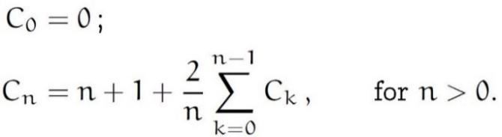

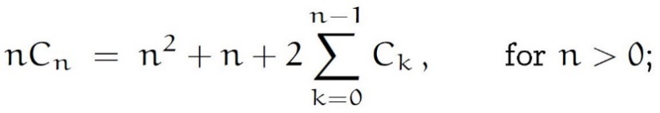

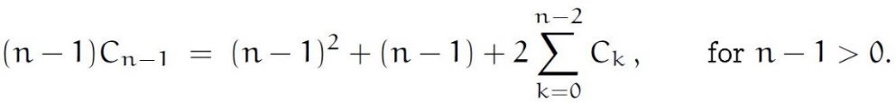


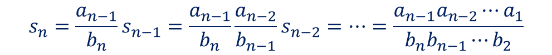


Note:
$$s_{n}=\frac{a_{n−1}}{b_{n}}s_{n−1}=\frac{a_{n−1}}{b_{n}}\frac{a_{n−2}}{b_{n−1}}s_{n−2}=⋯=\frac{a_{n−1}a_{n−2}⋯a_{1}}{b_{n}b_{n−1}⋯b_{2}}$$
e.g.
(The average no. of comparison steps made by quicksort.)
$$⇒$$
…①
(multiply both sides by n)
$$⇒$$
…②
(replace n by n-1)
①–②
$$⇒$$

Slide 7
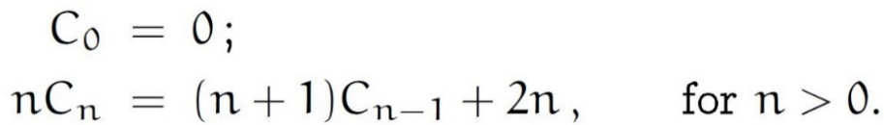



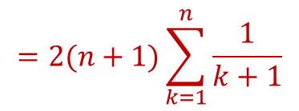
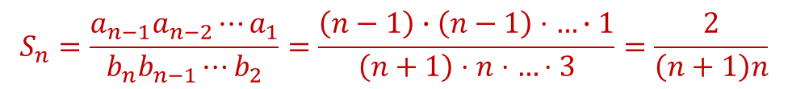



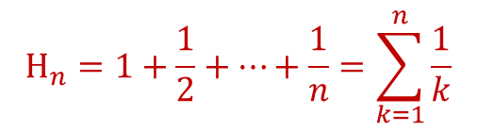


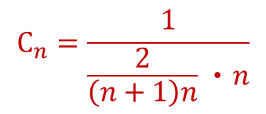
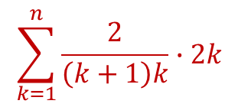
$$⇒$$
$$a_{n}=n, 1b_{n}=n+1,1c_{n}=2n$$
$$S_{n}=\frac{a_{n−1}a_{n−2}⋯a_{1}}{b_{n}b_{n−1}⋯b_{2}}=\frac{\left(n−1\right)∙\left(n−1\right)⋅…∙1}{\left(n+1\right)⋅n⋅…⋅3}=\frac{2}{\left(n+1\right)n}$$
$$C_{n}=\frac{1}{\frac{2}{\left(n+1\right)n}‧n}$$
$$\sum_{k=1}^{n}{\frac{2}{\left(k+1\right)k}∙2k}$$
$$=2(n+1)\sum_{k=1}^{n}{\frac{1}{k+1}}$$
$$⇒$$
$$1‧2‧0+$$
where
$$H_{n}=1+\frac{1}{2}+⋯+\frac{1}{n}=\sum_{k=1}^{n}{\frac{1}{k}}$$
($H_{n}→harmonic no.$)
$$⇒$$
$$C_{n}=2\left(n+1\right)H_{n}−2n$$

Slide 8
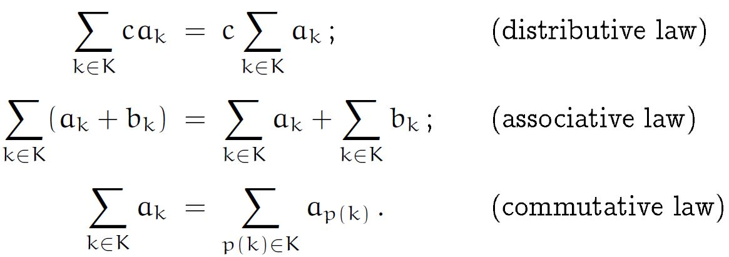
2.3 Manipulation of Sums
Let K be any finite set of integers.
Note:
p(k) is any permutation of the set of all integers.
The commutative law says that we can reorder the terms in any way we please.

Slide 9
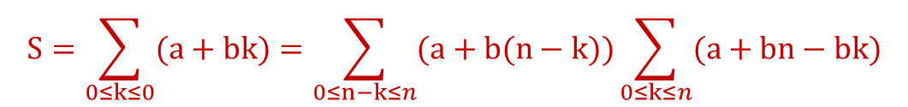

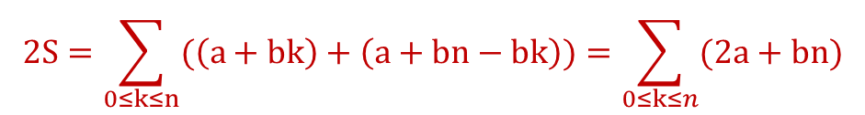
e.g.
$$S=\sum_{0≤k≤0}{(a+bk)}=\sum_{0≤n−k≤n}{(a+b(n−k))}\sum_{0≤k≤n}{(a+bn−bk)}$$
$$2S=\sum_{0≤k≤n}{(\left(a+bk\right)+\left(a+bn−bk\right))}=\sum_{0≤k≤n}{(2a+bn)}$$
$=(a+\frac{1}{2}bn)(n+1)$.

Slide 10
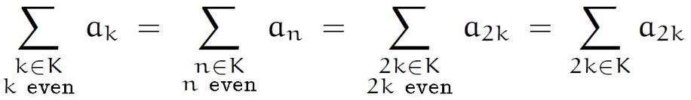
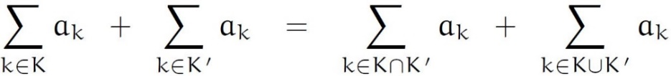
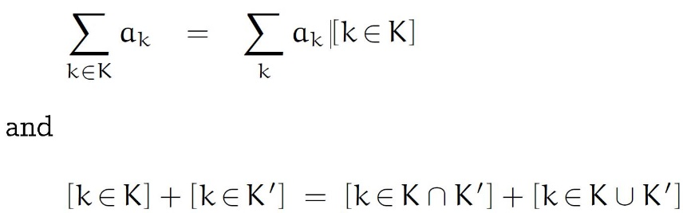

Note: We can relax the restriction of p(k):
We need to require only that there be exactly one integer k
with p(k)=n when n is an element of the index set K.
e.g.
If K and K’ are any sets of integers, then
$$∵$$

Slide 11
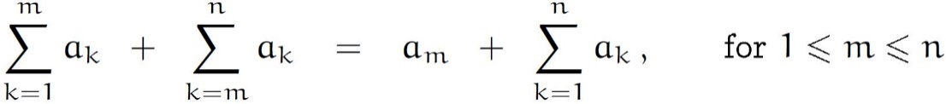
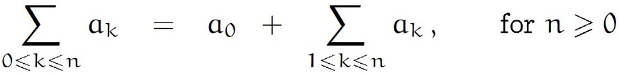
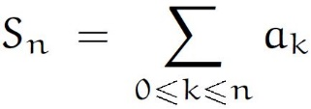
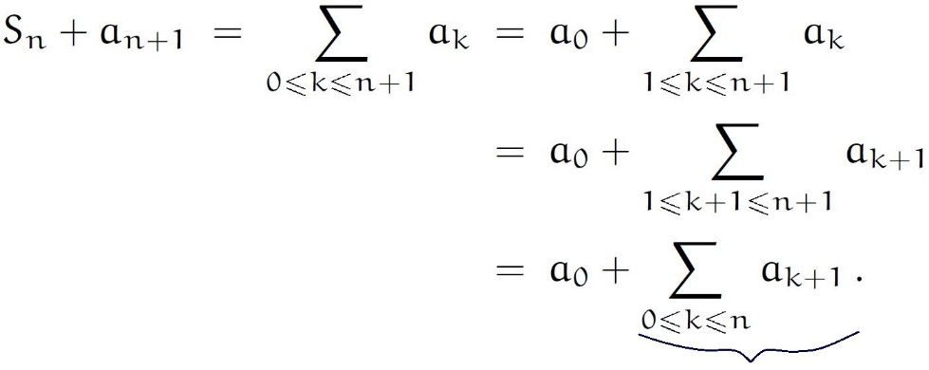

e.g.
Perturbation methods (splitting off a term)
Express it in terms of $S_{n}$

Slide 12
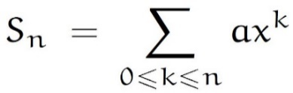
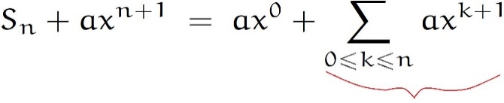

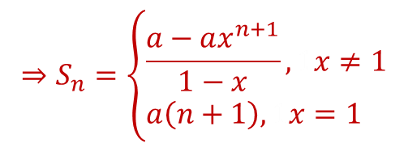


e.g.
①
$$⇒$$
$$∥$$
$$xS_{n}$$
$$⇒S_{n}=\left\{\begin{aligned}&\frac{a−ax^{n+1}}{1−x},1x≠1 \\ &a\left(n+1\right), 1x=1\end{aligned}\right.$$

Slide 13
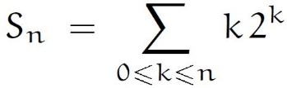

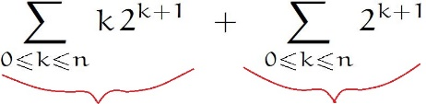



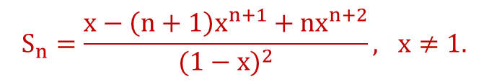


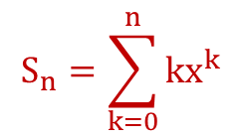
②
$$⇒$$
=
$$∥ ∥$$
$$2S_{n} 2^{n+2}−2$$
$$⇒S_{n}=\left(n−1\right)2^{n+1}+2$$
$$S_{n}=\sum_{k=0}^{n}{kx^{k}}$$
③
Solution1 :
$$S_{n}=\frac{x−\left(n+1\right)x^{n+1}+nx^{n+2}}{{(1−x)}^{2}},1x≠1.$$
$$⇒$$

Slide 14
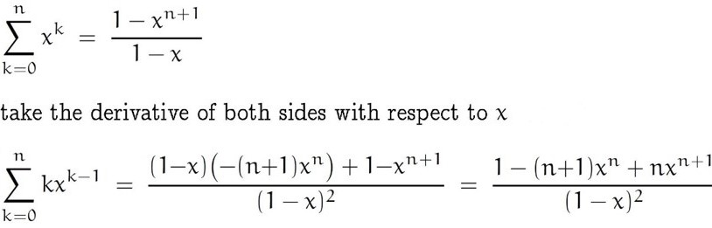


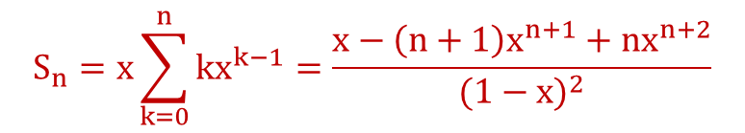
Solution2 :
$$⇒$$
$$S_{n}=x\sum_{k=0}^{n}{kx^{k−1}}=\frac{x−\left(n+1\right)x^{n+1}+nx^{n+2}}{{(1−x)}^{2}}$$
$$⇒$$

Slide 15
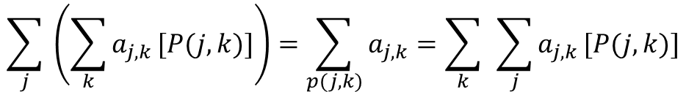
2.4 Multiple Sums
$$\sum_{j}{ \left(\sum_{k}{a_{j,k}}[P(j,k)]\right)=\sum_{p(j,k)}{a_{j,k}}=\sum_{k}{ }\sum_{j}{a_{j,k}}[P(j,k)]}$$
…. (*)
(interchanging the order of summation)
e.g.

Slide 16
(general distributive law)
(*) has many variations which come in two flavors, vanilla & rocky road.
vanilla version : (the ranges of j & k are indep. Of each other)
rocky-road version : (the range of an inner sum depends on the index variable of the outer sum)
here
e.g.

Slide 17






e.g.
 Consider the array
Find a simple formula for
=
=

Slide 18


②
(Chebyshev's summation inequalities)

Slide 19








We know by the commutative law that
is any permutation of the integers.
if
$$p(k)$$
But what happens when we replace
$$k$$
by
$$f\left(j\right)$$
where
$$f$$
is an arbitrary func.
,
$f : J→K$that take an integer $j⟵J$ into an integer$f\left(j\right)∈K ?$
general formula :
Where
no. of elements in the set
=
$$\#f^{−}(k)$$
Special case :
$$f$$
is one to one
$$⇒\#f^{−}(k)=1 ∀k$$

Slide 20

Example :
$$replace j by k−j$$
①
②
③

Slide 21




2.5 General Methods
Method 0 : You could look it up
CRC Standard Mathematical Tables p.72.
Method 1 : Guess the answer, prove it by induction
Guess :

Slide 22


Method 2 : Perturb the sum

Slide 23


Method 3 : Build a repertoire

Slide 24








Method 4 : Replace sums by integrals
$$⋮$$

Slide 25

Method 5 : Expand and contract
Method 6 : Use finite calculus
Method 7 : Use generating functions

Slide 26





2.6 Finite and Infinite Calculus
Infinite calculus is based on the properties of the derivative operator D, defined by
$$Df\left(x\right)=\lim_{h→0}{\frac{\left.f\left(x+h\right)−f(x\right)}{h}}$$
Finite calculus is based on the properties of the difference operator $Δ$, defined by
$$Δf\left(x\right)≡f\left(x+1\right)−f\left(x\right)$$
Note:
$$\frac{f\left(x+h\right)−f(x)}{h}$$
1$=Δf(x)$ when h=1
D and Δ are functions of functions.

Slide 27







(1)
(is called “x to the m falling”)
(is called “x to the m rising”)
These functions are also called falling(rising) factorial powers.
i.e.
1

Slide 28











(2)
$$\int{g\left(x\right)dx=f\left(x\right)+C}$$
($D⟷\int{ }$)
$$g\left(x\right)=Df(x)$$
$$⇔$$
$$g\left(x\right)=Δf(x)$$
$$⇔$$
$$\sum{g\left(x\right)δx}=f\left(x\right)+C$$
($Δ⟷\sum{ }$)
Note:
$\sum{g(x)δ(x)}$, the indefinite sum of $g(x)$, is the class of functions whose difference is $g\left(x\right);$
$δ↔Δ;d↔D$
“C” for indefinite integrals is an arbitrary constant; the “C” for indefinite sums is any function p(x)
s.t. $p\left(x+1\right)=p(x)$.
e.g. $C=a+b\sin{2πx}$.

Slide 29











(3)
If $g(x)=Df(x)⇒$
$$\int_{a}^{b}{g(x)δx}=f\left(x\right) \begin{matrix}b \\ \\ a\end{matrix}=f\left(b\right)−f(a)$$
If $g(x)=Δf(x)⇒$
$$\sum_{a}^{b}{g(x)δx}=f\left(x\right) \begin{matrix}b \\ \\ a\end{matrix}=f\left(b\right)−f(a)$$
$$what does \sum_{a}^{b}{g(x)δx} really mean, intuitively ?$$
$$∵$$
$$\sum_{a}^{a}{g(x)δx}=f\left(a\right)−f\left(a\right)=0$$
$$\sum_{a}^{a+1}{g(x)δx}=f\left(a+1\right)−f\left(a\right)=g\left(a\right)$$
$$\sum_{a}^{b+1}{g(x)δx}−\sum_{a}^{b}{g\left(x\right)δx}=\left(f\left(b+1\right)−f\left(a\right)\right)−\left(f\left(b\right)−f\left(a\right)\right)$$
$$=g(b)$$
$$⇒\sum_{a}^{b+1}{g(x)δx}=\sum_{a}^{b}{g\left(x\right)δx+g(b)}$$

Slide 30






$$⇒\sum_{a}^{b+1}{g(x)δx}=\sum_{a}^{b−1}{g\left(x\right)δ\left(x\right)+g(b−1)}$$
=
hypo.
$$\sum_{a}^{b−2}{g\left(k\right)}$$
$$=\sum_{a}^{b−1}{g\left(k\right)}$$
$$\sum_{a}^{b}{g\left(x\right)δx}=\sum_{k=a}^{b−1}{g(k)}=\sum_{a≤k<b}{g(k)},1for integer1b≥a.$$
$$∴$$
i.e. The definite sum is the same as an ordinary sum with limits, but excluding the value at the upper limit.
Note: When b < a,
$$\sum_{a}^{b}{g\left(x\right)δx}=f\left(b\right)−f\left(a\right)=−\left(f\left(a\right)−f\left(b\right)\right)=−\sum_{b}^{a}{g\left(x\right)δx}$$

Slide 31






(4)
$$\int_{a}^{b}{+\int_{b}^{c}{ }=\int_{a}^{c}{ }}$$
$$\sum_{a}^{b}{g\left(x\right)δx}+\sum_{b}^{c}{g\left(x\right)δx}=\sum_{a}^{c}{g\left(x\right)δx}. ∀ integers a, b, c$$
(5)
$$\int_{0}^{n}{x^{m}dx=\frac{n^{m+1}}{m+1}}$$
$$m=1⇒k^{\underline{1}}=k$$

Slide 32









$=\frac{1}{3}n(n+\frac{1}{2})(n+$1)
$$k^{3}=k^{2}+{3k}^{\underline{2}}++k^{\underline{1}}$$
Note:
1.
It’s always possible to convert between ordinary powers and factorial powers using Stirling numbers, in Chapter 6.
2.
$${\left(x+y\right)}^{m}=⋯$$
$${\left(x+y\right)}^{m}=⋯$$
(Ex 5.37.)

Slide 33














Define $x^{\underline{m}}$ for m < 0
$$x^{3}=x(x−1)(x−2)$$
$$=\frac{x^{3}}{x−2}$$
$$x^{2}=x(x−1)$$
$$=\frac{x^{2}}{x−1}$$
$$x^{1}=x$$
$$=\frac{x^{1}}{x}$$
$$x^{0}=1$$
$$x^{−1}=\frac{1}{x+1}$$
$$=\frac{x^{0}}{x+1}$$
$$x^{−2}=\frac{1}{(x+1)(x+2)}$$
$$=\frac{x^{−1}}{x+2}$$
$$⋮$$
$$x^{−m}=\frac{1}{(x+1)(x+2)⋯(x+m)} ,1m>0$$

Slide 34







(6)
(**)
e.g.
$$\frac{1}{x}$$
Note: If we define $x^{\underline{−1}}=$ then (**) fails.
Does $Δx^{\underline{m}}=mx^{\underline{m−1}}$ when m < 0 ?
Ans: Yes!
(the proof is easy as the argument in the following example)

Slide 35




e.g.
$$\sum_{a}^{b}{x^{m}δx}=\frac{x^{m+1}}{m+1} \begin{matrix}b \\ \\ a\end{matrix} ,1for m≠1.$$
$$⇒$$
(i.e. m<0 is also true)
But what about $m = −1$ ?

Slide 36










(7)
when $m = −1$
Find a function $f(x)$ s.t.
$$⇒$$
$$=H_{x}$$
Hence,
($H_{x}$ is the discrete analog of continuous $\ln{x}$)

Slide 37










(8)
$De^{x}=e^{x}$
Find a function $f(x)$ s.t.$Δf\left(x\right)=f(x)$.
$$∵Δf\left(x\right)=f\left(x+1\right)−f\left(x\right)$$
$$=f\left(x\right)$$
$$\left.⇔f\left(x+1\right)=2f(x\right)$$
$$⇒f\left(x\right)=2^{x}$$
$Δ2^{x}=2^{x}$
Note:
for arbitrary c.
$$⇒$$
Note: Some continuous notions have no discrete analog.
e.g. chain rule :$Δf(g(x))$ no nice form.

Slide 38








(9)
$$D\left(uv\right)=uDv+vDu$$
$$\int{uDv}=uv+\int{vDu}$$
Let $Ef\left(x\right)=f(x+1)$
↖
shift operator
$$⇒$$
$$Δ\left(uv\right)=uΔv+EvΔu$$
$$⇒$$
Note: This rule is useful when the sum on the left is harder to evaluate than the one on the right.

Slide 39






e.g. ①
$$,$$
$$,$$

Slide 40



②
$$∴$$

Slide 41





2.7 Infinite Sums
How can we get a negative no. by summing positive quantities ?
Def : Let K be a set (may be infinite) and $a_{k}≥01∀ k∈K.$
$$\sum_{k∈F}{a_{k}}≤A, 1∀ finite subest F≤k.$$
If there’s a bounding constant$A s.t.$
$$\sum_{k∈K}{a_{k}}≡$$
then
the least such A.
( It follows from well-known properties of the real numbers
that the set of all such A
contains a smallest elt. )
$$\sum_{k∈K}{a_{k}}≡∞$$
o.w.

Slide 42











Note : in the special case that K
is the set of nonnegative integers, & $a_{k}≥0.$
$$⇒\sum_{k≥0}{a_{k}}=\lim_{n→∞}{\sum_{k=0}^{n}{a_{k}}=A}$$
$$∵$$
if the limit is A & if F is any finite set of nonnegative integers
$$\sum_{k∈F}{a_{k}}≤\sum_{k=0}^{n}{a_{k}}≤A$$
whose elements are all $≤0⇒$
& if
$$A^{′}$$
is any
$$\sum_{k=0}^{n}{a_{k}}>A^{′}⇒let F=\left\{0,1,2,…,n\right\},1\sum_{k∈F}{a_{k}}>A^{′}$$
number$<A⇒∃n$
s.t.
e.g. (1)
$$a_{k}=x^{k}111(x≥0)$$
$$⇒S=2$$
(in the last page)
$$T=∞$$

Slide 43


(2)
Now, consider the case that the sum might have negative terms as well as nonnegative ones.
e.g. (1)

Slide 44

(2)

Slide 45










Any real number
can be written as the difference of its positive
& negative parts.
Def : Let k be any set & $a_{k}$ be a real-valued term defined for each $k∈K$
$$⇒\sum_{k∈K}{a_{k}}=\sum_{k∈K}{a_{k}^{+}}−\sum_{k∈K}{a_{k}^{−}}$$
unless the right-hand sums are both equal
$$\sum_{k∈K}{a_{k}}$$
to $∞$.
( In the latter case, we leave
undefined )
$$A^{+}=\sum_{k∈K}{a_{k}^{+}}1, 11A^{−}=\sum_{k∈K}{a_{k}^{−}}$$
Note : 1.
(i)
If
$$A^{+}<∞ \& A^{−}<∞$$
$$⇒\sum_{k∈K}{a_{k}}$$
is said to converge absolutely to
$$A=A^{+}−A^{−}$$
(ii)
$$A^{+}=∞ \& A^{−}<∞$$
$$⇒\sum_{k∈K}{a_{k}}$$
is said to diverge to$+∞$

Slide 46










(iii)
$$A^{+}<∞ \& A^{−}=∞$$
$$⇒\sum_{k∈K}{a_{k}}$$
is said to diverge to$−∞$
$$⇒\sum_{k∈K}{a_{k}}$$
(iv)
$$A^{+}=∞ \& A^{−}=∞$$
undefined
2. If $a_{k}$
are complex numbers $⇒$
$$\sum_{k∈K}{a_{k}}≡\sum_{k∈K}{R_{a_{k}}}+i\sum_{k∈K}{I_{a_{k}}}$$
where${R_{a_{k}}}_{ }\&{ I}_{a_{k}}$
are the real &
imaginary parts of $a_{k}$

Slide 47



The bad news : some infinite sums must be left ndefined
The good news : all of the manipulations of this chapter are perfectly valid
whenever we’re dealing with sums that converge absolutely.
Verify the good news by showing that each of our transformation rules preserves the value of all absolutely convergent sums.
(1)
distributive law :
$$if \sum_{k∈K}{a_{k}} = A \& c is any complex number.$$
conv. abso.
$$⇒\sum_{k∈K}{ca_{k} = cA}$$
conv. abso.
pf : breaking the sum into real & imaginary, positive & negative parts.
It suffices to prove the special case that $c>0 \& a_{k}≥0.$
$$∵\sum_{k∈K}{ca_{k}=c\sum_{k∈F}{a_{k}} ∀finite subsets F≤K}$$
& by induction on
the size of F
#

Slide 48






(2)
Associative law :
$$if\sum_{k∈K}{a_{k}} = A \&\sum_{k∈K}{b_{k}} = B ⇒\sum_{k∈K}{{(a}_{k}+b_{k})} = A+B$$
conv. abso.
conv. abso.
conv. abso.
(3)
Commutative law:
(4)
Absolutely convergent sums over 2 or more indices can always be summed first w.r.t. any one of those indices :
if J and the elements of $\left\{k_{j } j∈J\right\}$ are any sets of indices
s.t.
$$\sum_{\begin{aligned}j∈J \\ k∈K_{j}\end{aligned}}{a_{j,k}} = A$$
conv. abso.
$$then ∃ complex numbers A_{j}1∀j∈J$$
$$\sum_{\begin{aligned} \\ k∈K_{j}\end{aligned}}{a_{j,k}} = A_{j}$$
s.t.
conv. abso.
$$\sum_{\begin{aligned}j∈J \\ \end{aligned}}{A_{j}} = A .$$
conv. abso.

