Slide 1
Chapter 5
Binomial Coefficients

Slide 2
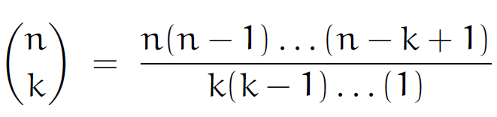




5.1 Basic Identities
$$\left(\begin{matrix}n \\ k\end{matrix}\right)$$
：binomial coefficient (so called because of the binomial thm)
$$\left(\begin{matrix}n \\ k\end{matrix}\right)$$
＝ numbers of ways to choose a k-element subset from an n-element set.
n choose k
e.g.
From the set {1,$1$2,$1$3,$1$4} we can choose 2 elements in 6 ways.
$$\left\{1, 2\right\},1\left\{1, 3\right\},1\left\{1, 4\right\},1\left\{2, 3\right\},1\left\{2, 4\right\},1\left\{3, 4\right\}$$
$$∴$$
$\left(\begin{matrix}4 \\ 2\end{matrix}\right)$ = 6
upper index
lower index

Slide 3
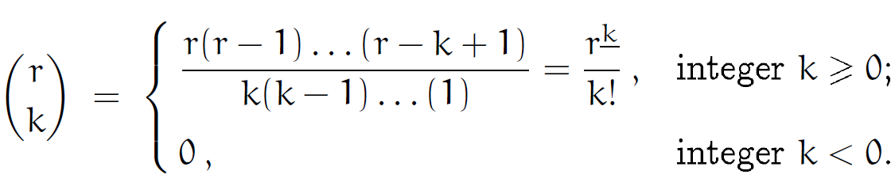





$$≝$$
Note: (1) r is an arbitrary real (or complex)
e.g.
$$\left(\begin{matrix}−1 \\ 3\end{matrix}\right)=\frac{ (−1)(−2)(−3)}{3∙2∙1}=−1$$
(2)
$$\left(\begin{matrix}r \\ k\end{matrix}\right)$$
can be viewed as a kth-degree polynomial in r
(3)
We haven’t defined binomial coefficients for noninteger lower index. a reasonable definition can be given, but actual applications are rare, so we will defer this generalization to later in the chapter.
(4)
We’ve listed the restrictions “integer k $≥0$” & “integer k$<$ 0” at the right of the definition.
e.g.
$$\left(\begin{matrix}n \\ n\end{matrix}\right)=\left\{\begin{matrix}1 n≥0 \\ 0 n<0\end{matrix} \right.$$

Slide 4
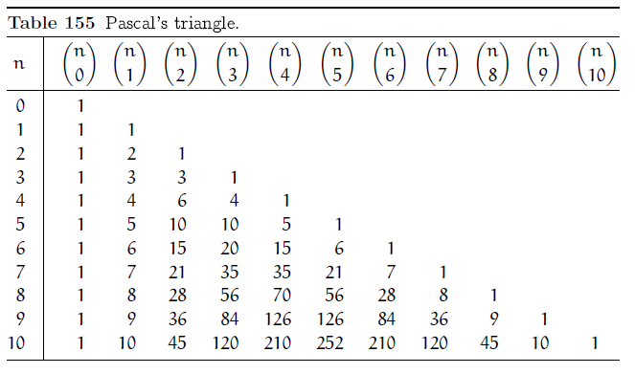


$$\frac{r(r−1)}{2}$$
$\left(\begin{matrix}r \\ 0\end{matrix}\right)=1,1\left(\begin{matrix}r \\ 1\end{matrix}\right)=$ r$,1\left(\begin{matrix}r \\ 0\end{matrix}\right)=$ $∀ real r$ . (first 3 columns)
“hexagon property”
56 $∙36∙210=28∙120∙126=423360$

Slide 5

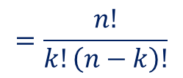
Goal：
learn a few simple rules by which we can salve the vast majority of practical problems involving binomial coefficients.
Pf:
$$\left(\begin{matrix}n \\ k\end{matrix}\right)=\frac{n(n−1)⋯(n−k+1)}{k!}=\frac{n(n−1)⋯\left(n−k+1\right)\left(n−k\right)!}{k!\left(n−k\right)!}$$
by def.
Multiply(n-k)!
$$=\frac{n!}{k!\left(n−k\right)!}$$
#

Slide 6






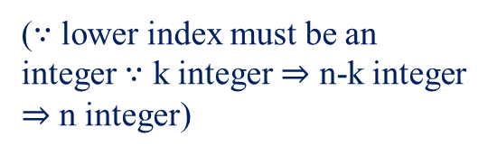
Symmetry identity：
$$\left(\begin{matrix}n \\ k\end{matrix}\right)=\left(\begin{matrix}n \\ n−k\end{matrix}\right), integer n≥0, integer k.$$
($∵$ lower index must be an integer $∵$ k integer $⇒$ n-k integer $⇒$ n integer)
Pf:
Combinatorial interpretation：
specify the k chosen things out of n
= specify the ($n−k$) unchosen things
#
Note: (1) n can’t be negative.
e.g.
$$n=−1$$
$$⇒$$
(2) true for all integers k

Slide 7



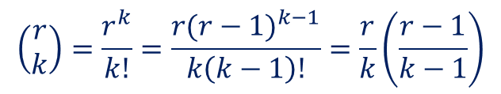



Absorprion identity：
$$\left(\begin{matrix}r \\ k\end{matrix}\right)=\frac{r}{k}\left(\begin{matrix}r−1 \\ k−1\end{matrix}\right), 1integer k≠ 0.$$
Pf:
($i$) $k>0$
$$\left(\begin{matrix}r \\ k\end{matrix}\right)=\frac{r^{k}}{k!}=\frac{{r(r−1)}^{k−1}}{k\left(k−1\right)!}=\frac{r}{k}\left(\frac{r−1}{k−1}\right)$$
$$∵$$
($ii$) $k<0$
both sides are zero
#
$$⇒$$
$$k\left(\begin{matrix}r \\ k\end{matrix}\right)=r\left(\begin{matrix}r−1 \\ k−1\end{matrix}\right),1integer k.$$

Slide 8
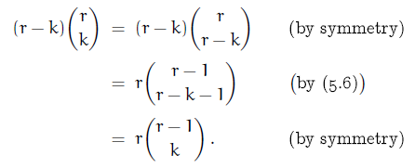






$$(r−k)\left(\begin{matrix}r \\ k\end{matrix}\right)=r\left(\begin{matrix}r−1 \\ k\end{matrix}\right),1integer k.$$
Pf:
($i$) $r≥0$
$$∵$$
$$\left(r−k\right)\left(\begin{matrix}r \\ k\end{matrix}\right)\& r\left(\begin{matrix}r−1 \\ k\end{matrix}\right) are polynomials in r of degree k+1 \&$$
($ii$)
$$they have>k+1 distinct zero (by (i))$$
$$⇒$$
$$they must be equal everywhere$$
#
Note: This proof technique is called the polynomial argument.

Slide 9












Addition formula：
Pf:
Method 1
(1) $r≥0 integer :k≥0 use combinatorial interpretation$
$$one bad egg$$
$$k<0,1LHS=0=RHS.$$
(2) $r :real :use polynomials argument. \&(1)$
#
Method 2
$$r\left(\begin{matrix}r \\ k\end{matrix}\right)=\left(r−k\right)\left(\begin{matrix}r \\ k\end{matrix}\right)+k\left(\begin{matrix}r \\ k\end{matrix}\right)$$
$$=$$
$$=$$
$$r\left(\begin{matrix}r−1 \\ k\end{matrix}\right)$$
$$r\left(\begin{matrix}r−1 \\ k−1\end{matrix}\right)$$
$$⇒$$
$$\left(\begin{matrix}r \\ k\end{matrix}\right)=\left(\begin{matrix}r−1 \\ k\end{matrix}\right)+\left(\begin{matrix}r−1 \\ k−1\end{matrix}\right)$$
$$(r=0,1ok! )$$
$$r≠0$$
#

Slide 10
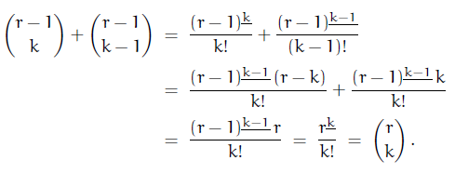
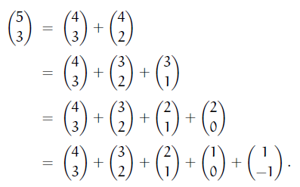


Method 3
$$k>0 :$$
$k≤0 :easy !$
#
Note: The addition formula is essentially a recurrence for the numbers
of Pascal’s triangle.
e.g.
(expanding the smallest lower index)
= 0

Slide 11
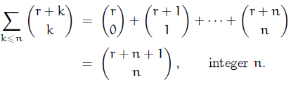
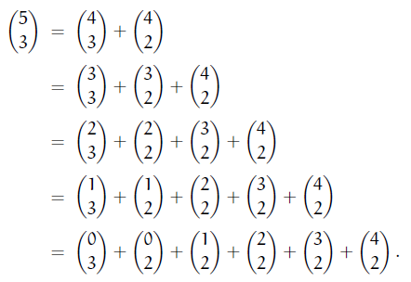
(5.9)
expanding the one with largest lower index
= 0

Slide 12
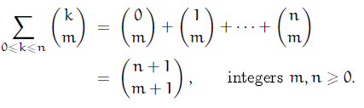
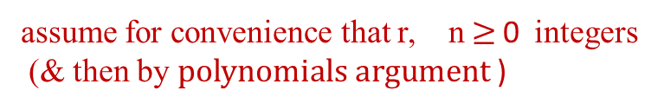


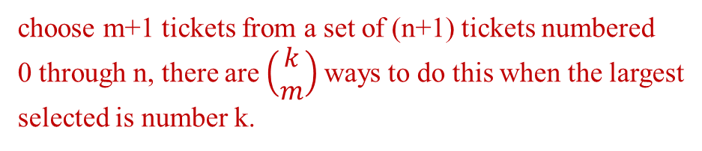
(5.10)
(Summation on the upper index)
Note: 1. (5.10) has an combinatorial interpretion :
choose m+1 tickets from a set of (n+1) tickets numbered
0 through n, there are$\left(\begin{matrix}k \\ m\end{matrix}\right)$ways to do this when the largest
selected is number k.
2. (5.9) & (5.10) can be proved by induction using the addition formula.
3. (5.9) $⇔$ (5.10)
e.g. (5.10) $⇒$ (5.9)
assume for convenience that r, n$≥$ 0 integers
(& then by $polynomials argument$ )

Slide 13
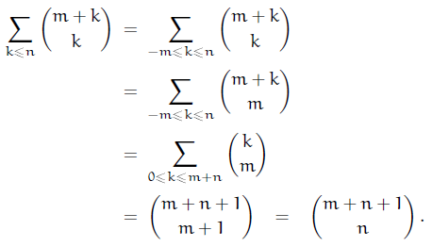

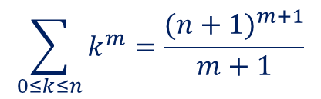


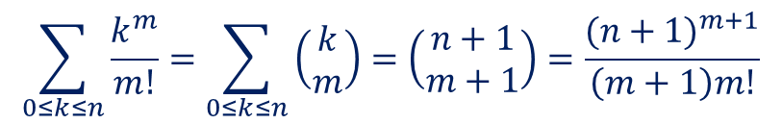
$$Let$$
$$r=m$$
symm
(5.10)
#
$$\sum_{0≤k≤n}{\frac{k^{m}}{m!}=\sum_{0≤k≤n}{\left(\begin{matrix}k \\ m\end{matrix}\right)=\left(\begin{matrix}n+1 \\ m+1\end{matrix}\right)=\frac{{(n+1)}^{m+1}}{\left(m+1\right)m!}}}$$
4.
$$\sum_{0≤k≤n}{k^{m}}=\frac{{(n+1)}^{m+1}}{m+1}$$
$$⇒$$
(Ch2 !)

Slide 14


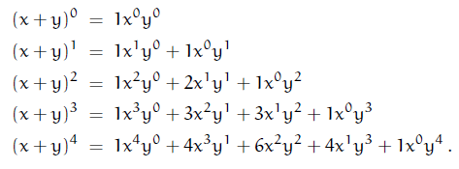
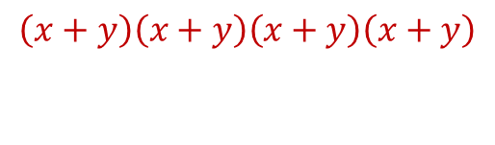


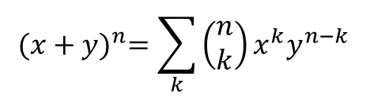

By addition formula
$$⇒$$
$$\left(x+y\right)\left(x+y\right)\left(x+y\right)\left(x+y\right)$$
$$=\left(\begin{matrix}4 \\ 1\end{matrix}\right)x^{3}y^{1}$$
$$⋮$$
$${(x+y)}^{n}=\sum_{k}{\left(\begin{matrix}n \\ k\end{matrix}\right)}x^{k}y^{n−k}$$

Slide 15




Binomial Theorem：
$$\left( x^{0}≡1,1∀x \right)$$
Note: 1. $when r≥0 integer, the sum is a finite sum.$
$$(∵all terms are zero except those with 0≤k≤r)$$
2. $Otherwise \left(r<0 integer or arbitrary real or complex numbers\right),$
$$the sum is infinite, we must have \left|\frac{x}{y}\right|<1 to guarantee$$
$$the sum^{′}s absolute convergence.$$

Slide 16







3. $Two special cases :$
$$x=y=1 \& r=n nonnegative⇒$$
$$2^{n}=\left(\begin{matrix}n \\ 0\end{matrix}\right)+\left(\begin{matrix}n \\ 1\end{matrix}\right)+⋯+\left(\begin{matrix}n \\ n\end{matrix}\right),1integer n≥0$$
$$\left(⇒the n th row of Pascal^{′}s triangle sums to 2^{n}\right)$$
-
$$x=−1,y=1,r=n≥0⇒$$
$$0^{n}=\left(\begin{matrix}n \\ 0\end{matrix}\right)−\left(\begin{matrix}n \\ 1\end{matrix}\right)+⋯+{\left(−1\right)}^{n}\left(\begin{matrix}n \\ n\end{matrix}\right),1integer n≥0$$
4. $When r is not a nonnegative integer, we must of ten$
$$use the binomial theorem in the special case y=1.$$
$$⇒$$
$$(if we set z=\frac{x}{y}\& multiply both sides by y^{r}⇒Binomial theorem)$$

Slide 17
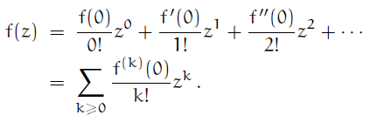

Pf:
$$We have proved the bimomial theorem only when r≥0 integer,$$
$$by using a combinatorial interpretation. We can^{′}t deduce the$$
$$general case from the nonnegative−integer case by using the$$
$polynomials argument\left(∵the sum is infinite in the general case\right).$
$$When r is arbitrary, we use Taylor series and the theory variables :$$
①
$$f\left(z\right)={(1+z)}^{r}⇒f^{\left(k\right)}\left(z\right)=r^{k}{(1+z)}^{r−k},1set z=0$$
②
$converges ∵\left(\begin{matrix}r \\ k\end{matrix}\right)=0\left(k^{−1−r}\right)$ (by 5.83)
#

Slide 18


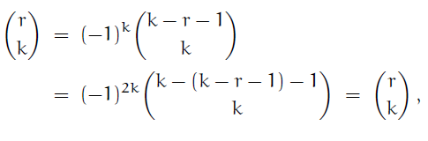





The relation of the values of $\left(\begin{matrix}n \\ k\end{matrix}\right) for n<0 \& n≥0 is :$
(is called negating the upperd index
or upper negation)
Pf:
$$k≥0$$
$$k<0$$
$$LHS=0=RHS.$$
#
e.g.
①
$$\left(\begin{matrix}−4 \\ 2\end{matrix}\right)={(−1)}^{2}\left(\begin{matrix}2+4−1 \\ 2\end{matrix}\right)=10$$
$$\left(\begin{matrix}−4 \\ 2\end{matrix}\right)=\left(\begin{matrix}5 \\ 2\end{matrix}\right)$$
②
negate the upper index twice：

Slide 19

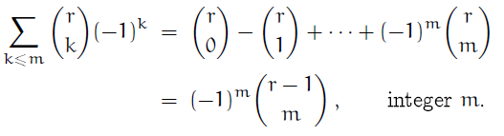
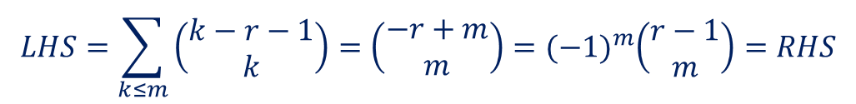

Pf:
$$LHS=\left(\begin{matrix}m+n \\ m\end{matrix}\right)=\left(\begin{matrix}m+n \\ n\end{matrix}\right)=RHS$$
#
upper
negation
Pf:
$$LHS=\sum_{k≤m}{\left(\begin{matrix}k−r−1 \\ k\end{matrix}\right)}=\left(\begin{matrix}−r+m \\ m\end{matrix}\right)={(−1)}^{m}\left(\begin{matrix}r−1 \\ m\end{matrix}\right)=RHS$$
#
upper
negation
(5.9)
upper
negation

Slide 20







Note: 1. $This formula is a partial sum of the rth row of {Pascal}^{′}s triangle,$
$$probided that the entries of the row have been given alternating signs.$$
e.g. r=5, m=2, 1-5+10=6=${(−1)}^{2}\left(\begin{matrix}4 \\ 2\end{matrix}\right)$
2. $If m≥r, the formula gives the alternating sum of the entire row \&$
$$this sum is zero when r is a postive integer.$$
(expanding ${(1−1)}^{r} by the binomial theorem$)
3. $Is there a closed form for the partial sum of a row of {Pascal}^{′}s triangle?$
$$\begin{matrix}? \\ =\end{matrix}$$
$$i.e$$
a closed form.
$$Ans :$$
$$No! We can do colums \left(\left(5.10\right)\right)but not rows.$$
$$However, ∃a way to partially sum the row elements$$
$$if they have been multiplied by their distance from center :$$
(prove by induction on row !)

Slide 21














A method by which it’s possible to determine whether
$$∃a closed form for the partial sums of a given series involving$$
$$binomial coefficients.$$
Pf:
Method 1 (By induction on m)
$$m<0 :$$
$$LHS=0=RHS$$
$$m=0 :$$
$$LHS=\left(\begin{matrix}r \\ 0\end{matrix}\right)=1=\left(\begin{matrix}−r \\ 0\end{matrix}\right)=RHS$$
$$m>0 :$$
$$let S_{m}≡LHS$$
$$by addition formula$$
$$=$$
$$=$$

Slide 22




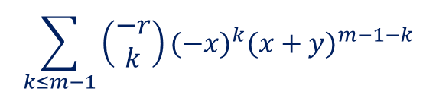
$$⇒$$
$$=$$
by induction hypo.
$$\sum_{k≤m−1}{\left(\begin{matrix}−r \\ k\end{matrix}\right){(−x)}^{k}{(x+y)}^{m−1−k}}$$
$$=RHS$$
#

Slide 23








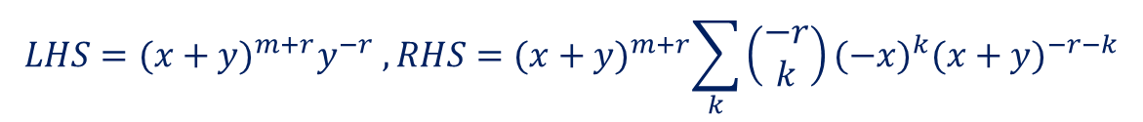
Method 2
($i$) $0≥r≥−m ,1r integer$
$$LHS={(x+y)}^{m+r}y^{−r} , RHS={(x+y)}^{m+r}\sum_{k}{\left(\begin{matrix}−r \\ k\end{matrix}\right)}{(−x)}^{k}{(x+y)}^{−r−k}$$
$$⇒$$
$$Binomial Thm$$
$$=$$
$${\left[(−x)+(x+y) \right]}^{−r}$$
$$={(x+y)}^{m+r}y^{−r}$$
$$∴LHS=RHS.$$
($ii$) $∵both sides are polynimial in r of degree≤m \& agreement$
$$at m+1 different valus, by polynomial argument OK!$$
#
$$(r=0,−1,−2,⋯,−m)$$

Slide 24





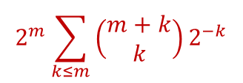






e.g.
(1) $x=−1 \& y=1$
$$⇒$$
(2) $x= y=1 \& r=m+1$
$$⇒$$
$$=$$
$$=$$
$$\frac{1}{2}2^{2m+1}$$
$$2^{m}\sum_{k≤m}{\left(\begin{matrix}m+k \\ k\end{matrix}\right)2^{−k}}$$
$$⇒$$

Slide 25

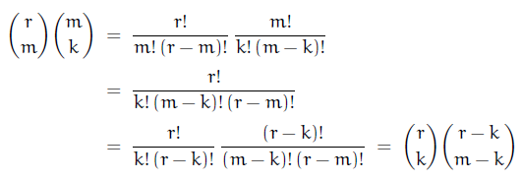





Note: 1. $The case of k=1⇔the absorption identity.$
2. One side of tem is easier to sum.
e.g.
$$replace \left(\begin{matrix}r \\ m\end{matrix}\right) \left(\begin{matrix}m \\ k\end{matrix}\right)by\left(\begin{matrix}r \\ k\end{matrix}\right)\left(\begin{matrix}r−k \\ m−k\end{matrix}\right) when suming on m.$$
Pf:
($i$) $r≥m≥k≥0 , all integer$s
($ii$) $m<k or k<0 ⇒RHS=0=LHS$
$$⇒ture for all integer m \& k.$$
($iii$) polynomial argument extends to all real r.
#

Slide 26
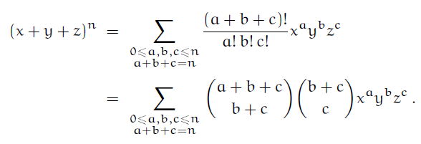
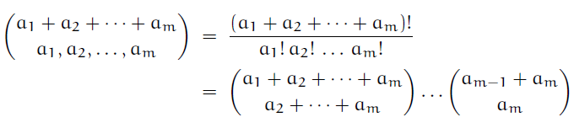


Trinomial theorem
$$trinomial coefficient$$
Note: 1. $\left(\begin{matrix}r \\ m\end{matrix}\right)\left(\begin{matrix}m \\ k\end{matrix}\right)is a trinomial coefficient in disguise0.$
2.
$$\frac{\left(a+b+c\right)!}{a!b!c!}≡\left(\begin{matrix}a+b+c \\ a,b,c\end{matrix}\right)$$
3. generalize to multinomial coefficient.

Slide 27





Sum of products of binomial coefficients.
Vandermonde’s convolution :
Pf:
$$replace k by k−m \& n by n−m \& we can assume m=0$$
$$⇒the indentity to be proved is$$
$$\sum_{k}{\left(\begin{matrix}r \\ k\end{matrix}\right)\left(\begin{matrix}s \\ n−k\end{matrix}\right)=\left(\begin{matrix}r+s \\ n\end{matrix}\right),1integer n.}$$
$$let r \& s ≥0 integers. (\& them using polynomial argument)$$
$$\left(\begin{matrix}r+s \\ n\end{matrix}\right)=numbers of ways to choose n people from among r men$$
$$\& s woman.$$
$$\left(\begin{matrix}r \\ k\end{matrix}\right)\left(\begin{matrix}s \\ n−k\end{matrix}\right)=numbers of ways to choose k of the men \&$$
$$n−k of woman.$$
#

Slide 28







Pf:
$$replace\left(\begin{matrix}l \\ m+k\end{matrix}\right) by \left(\begin{matrix}l \\ l−m−k\end{matrix}\right)\& apply(5.22)$$
#
$$apply$$
$$(∵symm. ∴l≥0)$$
Pf:
Method 1
By(5.22)
Method 2
$By induation on l$.
($i$) $l=0, all terms are zero except when k=−m.$
$$LHS={(−1)}^{m}\left(\begin{matrix}s−m \\ n\end{matrix}\right)=RHS.$$

Slide 29


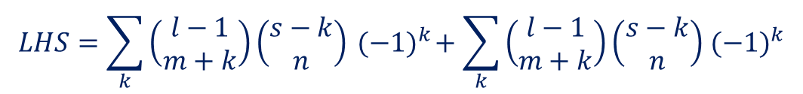






($ii$) $Suppose that the identity holds for <l , l>0.$
$$LHS=\sum_{k}{\left(\begin{matrix}l−1 \\ m+k\end{matrix}\right)}\left(\begin{matrix}s−k \\ n\end{matrix}\right){ (−1)}^{k}+\sum_{k}{\left(\begin{matrix}l−1 \\ m+k\end{matrix}\right)}\left(\begin{matrix}s−k \\ n\end{matrix}\right){ (−1)}^{k}$$
addition
formula
$$=$$
$$=$$
Induation hypo.
Induation hypo.
$${ (−1)}^{l−1+m}\left(\begin{matrix}s−m \\ n−l+1\end{matrix}\right)$$
$${ (−1)}^{l+m}\left(\begin{matrix}s−m+1 \\ n−l+1\end{matrix}\right)$$
$${=(−1)}^{l+m}\left[\left(\begin{matrix}s−m+1 \\ n−l+1\end{matrix}\right)−\left(\begin{matrix}s−m \\ n−l+1\end{matrix}\right)\right]$$
$${=(−1)}^{l+m}\left(\begin{matrix}s−m \\ n−l\end{matrix}\right)=RHS.$$
#

Slide 30


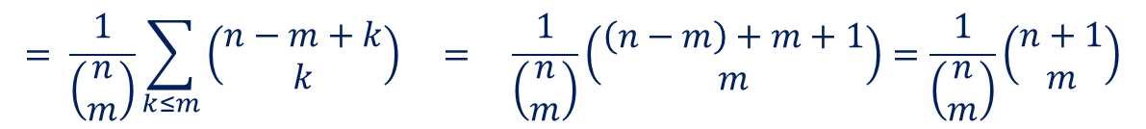

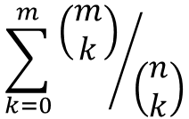
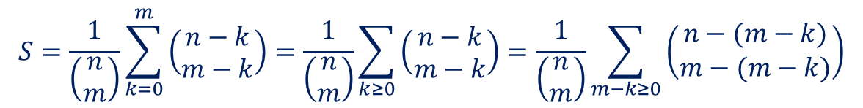


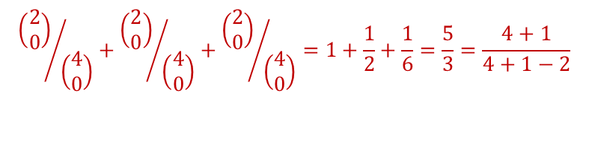
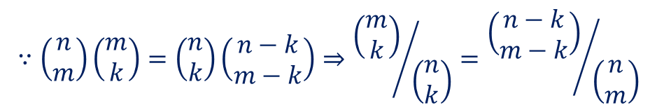
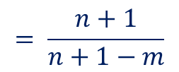
5.2 Basic Practice
Problem 1 : a sum of ratios
$$\sum_{k=0}^{m}{{\left(\begin{matrix}m \\ k\end{matrix}\right)}/{\left(\begin{matrix}n \\ k\end{matrix}\right)}}$$
$$, integers n≥m≥0$$
$$≡$$
S
$$∵\left(\begin{matrix}n \\ m\end{matrix}\right)\left(\begin{matrix}m \\ k\end{matrix}\right)=\left(\begin{matrix}n \\ k\end{matrix}\right)\left(\begin{matrix}n−k \\ m−k\end{matrix}\right)⇒{\left(\begin{matrix}m \\ k\end{matrix}\right)}/{\left(\begin{matrix}n \\ k\end{matrix}\right)}={\left(\begin{matrix}n−k \\ m−k\end{matrix}\right)}/{\left(\begin{matrix}n \\ m\end{matrix}\right)}$$
$$S=\frac{1}{\left(\begin{matrix}n \\ m\end{matrix}\right)}\sum_{k=0}^{m}{\left(\begin{matrix}n−k \\ m−k\end{matrix}\right)=\frac{1}{\left(\begin{matrix}n \\ m\end{matrix}\right)}\sum_{k≥0}{\left(\begin{matrix}n−k \\ m−k\end{matrix}\right)=\frac{1}{\left(\begin{matrix}n \\ m\end{matrix}\right)}}}\sum_{m−k≥0}{\left(\begin{matrix}n−(m−k) \\ m−(m−k)\end{matrix}\right)}$$
$$⇒$$
$$∵\left(\begin{matrix}n−k \\ m−k\end{matrix}\right)=0 ∀k>m$$
$$= \frac{1}{\left(\begin{matrix}n \\ m\end{matrix}\right)}\sum_{k≤m}{\left(\begin{matrix}n−m+k \\ k\end{matrix}\right) = \frac{1}{\left(\begin{matrix}n \\ m\end{matrix}\right)}}\left(\begin{matrix}\left(n−m\right)+m+1 \\ m\end{matrix}\right)=\frac{1}{\left(\begin{matrix}n \\ m\end{matrix}\right)}\left(\begin{matrix}n+1 \\ m\end{matrix}\right)$$
$$(5.9)$$
$$= \frac{n+1}{n+1−m}$$
e.g. m=2, n=4
#
$${\left(\begin{matrix}2 \\ 0\end{matrix}\right)}/{\left(\begin{matrix}4 \\ 0\end{matrix}\right)}+{\left(\begin{matrix}2 \\ 0\end{matrix}\right)}/{\left(\begin{matrix}4 \\ 0\end{matrix}\right)}+{\left(\begin{matrix}2 \\ 0\end{matrix}\right)}/{\left(\begin{matrix}4 \\ 0\end{matrix}\right)}=1+\frac{1}{2}+\frac{1}{6}=\frac{5}{3}=\frac{4+1}{4+1−2}$$

Slide 31
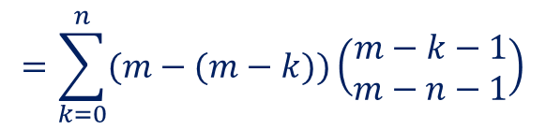

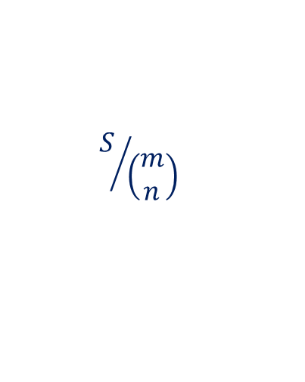
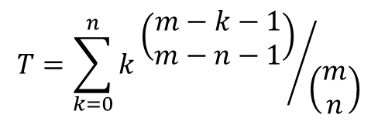



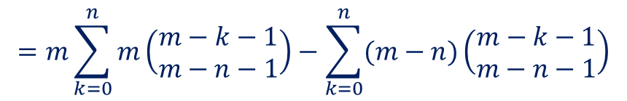
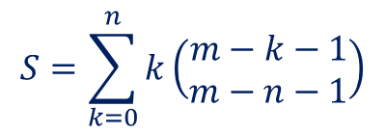
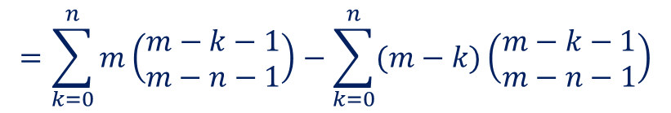
Problem 2 : From the literature of sorting.
$$T=\sum_{k=0}^{n}{k{\left(\begin{matrix}m−k−1 \\ m−n−1\end{matrix}\right)}/{\left(\begin{matrix}m \\ n\end{matrix}\right)}}$$
$$, integers m>n≥0.$$
$$S=\sum_{k=0}^{n}{k}\left(\begin{matrix}m−k−1 \\ m−n−1\end{matrix}\right)$$
$$S/{\left(\begin{matrix}m \\ n\end{matrix}\right)}$$
$$Let$$
$$\left(i.e. T= \right)$$
$$=\sum_{k=0}^{n}{(m−(m−k))\left(\begin{matrix}m−k−1 \\ m−n−1\end{matrix}\right)}$$
$$=\sum_{k=0}^{n}{m\left(\begin{matrix}m−k−1 \\ m−n−1\end{matrix}\right)}−\sum_{k=0}^{n}{(m−k)\left(\begin{matrix}m−k−1 \\ m−n−1\end{matrix}\right)}$$
abosoption
$$=m\sum_{k=0}^{n}{m\left(\begin{matrix}m−k−1 \\ m−n−1\end{matrix}\right)}−\sum_{k=0}^{n}{(m−n)\left(\begin{matrix}m−k−1 \\ m−n−1\end{matrix}\right)}$$
$$=mA−\left(m−n\right)B$$

Slide 32
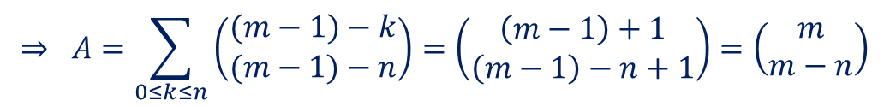
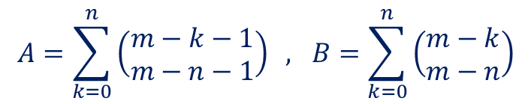


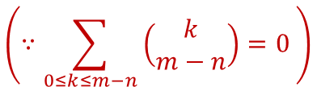
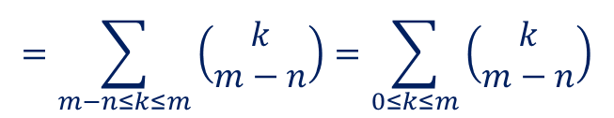
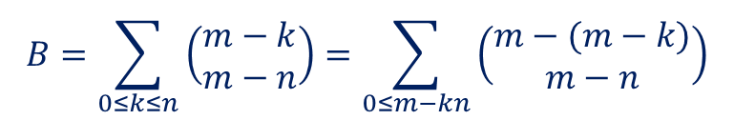
$$where$$
$$A=\sum_{k=0}^{n}{\left(\begin{matrix}m−k−1 \\ m−n−1\end{matrix}\right)} ,1B=\sum_{k=0}^{n}{\left(\begin{matrix}m−k \\ m−n\end{matrix}\right)}$$
$$B=\sum_{0≤k≤n}{\left(\begin{matrix}m−k \\ m−n\end{matrix}\right)=\sum_{0≤m−kn}{\left(\begin{matrix}m−(m−k) \\ m−n\end{matrix}\right)}}$$
$$=\sum_{m−n≤k≤m}{\left(\begin{matrix}k \\ m−n\end{matrix}\right)=\sum_{0≤k≤m}{\left(\begin{matrix}k \\ m−n\end{matrix}\right)}}$$
$$\left(∵\sum_{0≤k≤m−n}{\left(\begin{matrix}k \\ m−n\end{matrix}\right)}=0 \right)$$
$$=\left(\begin{matrix}m+1 \\ m−n+1\end{matrix}\right)$$
$$⇒ A=\sum_{0≤k≤n}{\left(\begin{matrix}(m−1)−k \\ (m−1)−n\end{matrix}\right)=\left(\begin{matrix}\left(m−1\right)+1 \\ \left(m−1\right)−n+1\end{matrix}\right)=\left(\begin{matrix}m \\ m−n\end{matrix}\right)}$$

Slide 33
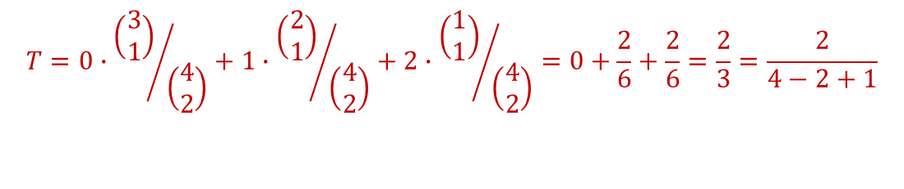






$$∵ S=mA−\left(m−n\right)B$$
$$=m\left(\begin{matrix}m \\ m−n\end{matrix}\right)−(m−n)\left(\begin{matrix}m+1 \\ m−n+1\end{matrix}\right)$$
$$=\left(m−(m−n)\frac{m+1}{m−n+1}\right)\left(\begin{matrix}m \\ m−n\end{matrix}\right)$$
$$=\left(\frac{n}{m−n+1}\right)\left(\begin{matrix}m \\ m−n\end{matrix}\right)$$
$$⇒ T=S/{\left(\begin{matrix}m \\ n\end{matrix}\right)}=\frac{n}{m−n+1}$$
e.g. m=4, $1$n=2
$$T=0∙{\left(\begin{matrix}3 \\ 1\end{matrix}\right)}/{\left(\begin{matrix}4 \\ 2\end{matrix}\right)}+1∙{\left(\begin{matrix}2 \\ 1\end{matrix}\right)}/{\left(\begin{matrix}4 \\ 2\end{matrix}\right)}+2∙{\left(\begin{matrix}1 \\ 1\end{matrix}\right)}/{\left(\begin{matrix}4 \\ 2\end{matrix}\right)}=0+\frac{2}{6}+\frac{2}{6}=\frac{2}{3}=\frac{2}{4−2+1}$$

Slide 34







Problem 3 : From an old exam.
$$Q_{1000000}= ?$$
try to find a recurrence for $Q_{n}$
$${(⇒Q}_{n}=R_{2})$$

Slide 35













addition
$$=$$
perturbation method (Ch2)
$$=$$
$$k←k+1$$
$$=$$
$$=$$
perturbation
$${(−1)}^{2m}$$
$$=$$
$$1$$
$$=R_{m−1}−R_{m−2}$$

Slide 36








$$⇒$$
by inspection
$$or$$
$$={−(−R}_{m−6})=R_{m−6}$$
$$⇒$$
$${∴Q}_{1000000}=R_{4}=−1$$
#

Slide 37













Problem 4 : a sum involving 2 binomial coefficients.
$$=$$
$$\left( S in Problem 2 \right)$$
$$=$$
$$\left( ∵\sum_{n<k≤m−1}{ }=0 \right)$$
$$(5.26)$$
$$=\left(\begin{matrix}m \\ m−n+1\end{matrix}\right)$$
$$l←m−1$$
$$m←m−n−1$$
$$n←1$$
$$g←0$$

Slide 38





Problem 5 : a sum with 3 factors.
absorption
$$=$$
$$(5.23)$$
$$\left(\begin{matrix}n+s−1 \\ n+1\end{matrix}\right)$$
Note：$If we have chosen in the first step to absorb k into \left(\begin{matrix}n \\ k\end{matrix}\right),$
$$not \left(\begin{matrix}s \\ k\end{matrix}\right),1we wo{uldn}^{′}t have been allowed to apply (5.23)$$
$$directly,1because n−1 might be nehative.$$

Slide 39

















Problem 6 : a sum with menacing characteristics.
multiplicative constants
are usually harder to remove
Than additive constants, but
We’re lucky here !
$$\left(\left(5.21\right) \left(\begin{matrix}r \\ m\end{matrix}\right)\left(\begin{matrix}m \\ k\end{matrix}\right)=\left(\begin{matrix}r \\ k\end{matrix}\right)\left(\begin{matrix}r−k \\ m−k\end{matrix}\right)\right)$$
$$\left( ∵absorption \&\sum_{k<0}{ } =0 \right)$$
亦可用symm. 但要注意$n+k≥0. (Ex6 ! )$
$$=\frac{1}{n+1}\left[n=0\right]$$
$$=$$
$$upper$$
$$(5.23)$$
$$negation$$
$$l←n+1$$
$$m←1$$
$$n←0$$
$$s←−n−1$$

Slide 40




Problem 7 : a new obstacle.
the difference between Problem 6 & 7.
$$Goal :replace\left(\begin{matrix}n+k \\ m+2k\end{matrix}\right)by a sum of terms like \left(\begin{matrix}l+k \\ 2k\end{matrix}\right) \& them use$$
$$the result of Problem 6.$$
$$\left(5.26\right)$$

Slide 41




$$if j≥n$$
$$⇒\left(\begin{matrix}n+k−1−2 \\ 2k\end{matrix}\right)=0$$
#

