Slide 1
Chapter 1
Recurrent Problems

Slide 2
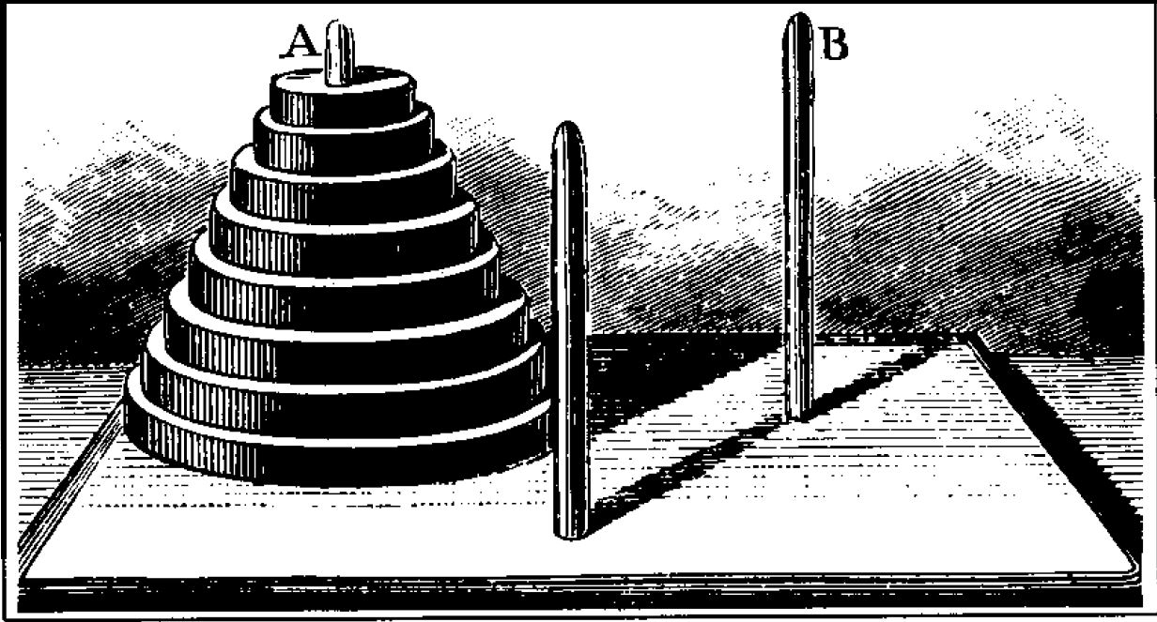
1.1 The Tower of Hanoi
Invented by the French mathematician Edouard Lucas (1883).
Objective: Transfer the entire tower to one of the other pegs, moving only one disk at a time and never moving a larger one onto a smaller.

Slide 3



Q: How many moves are necessary and sufficient to perform the task?
T_{n} = the minimum number of moves that will transfer n disks from one peg to another under Lucas’s rules.
T₀ = 0,1T₁ = 1,1T₂ = 3
T_{n}$≤$ 2T_{n-1} + 1
(transfer the n - 1 smallest to a different peg, then move the largest, and finally transfer the n - 1 smallest back onto the largest.)
T_{n}$≥$ 2T_{n-1} + 1
( we must move the largest disk. when we do, the n - 1 smallest must be on a single peg, after moving the largest disk, we must transfer the n-1 smallest disk back onto the largest.)
recurrence ( recurrence relation, recursion relation)

Slide 4

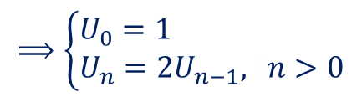






How do we solve a recurrence?
One way is to guess (by looking at small cases) the correct solution, then to prove (by math. induction) its correctness.
T₁ = 1,1T₂ = 3,1T₃ = 2·3+1=7, 1T₄ = 2·7+1=15, 1T₅ = 31, 1T₆ = 63
guess: T_{n} = 2^{n} – 1, 1n$≥$0
prove: n = 0 ok! & assume true for n – 1
$$T_{n}=2T_{n−1}+1=2\left(2^{n−1}−1\right)+1=2^{n}−1$$
#
$$T_{0}+1=1$$
$$T_{n}+1=2\left(T_{n−1}+1\right),\text{1}n>0$$
Let $U_{n}=T_{n}+1$
$$⟹\left\{\begin{aligned}&U_{0}=1 \\ &U_{n}=2U_{n−1},\text{1}n>0\end{aligned}\right.$$
$$⟹U_{n}=2^{n}$$
$${⟹T}_{n}=2^{n}−1$$
$$T_{64}= 2^{64}−1≑18‧{10}^{18}$$

Slide 5
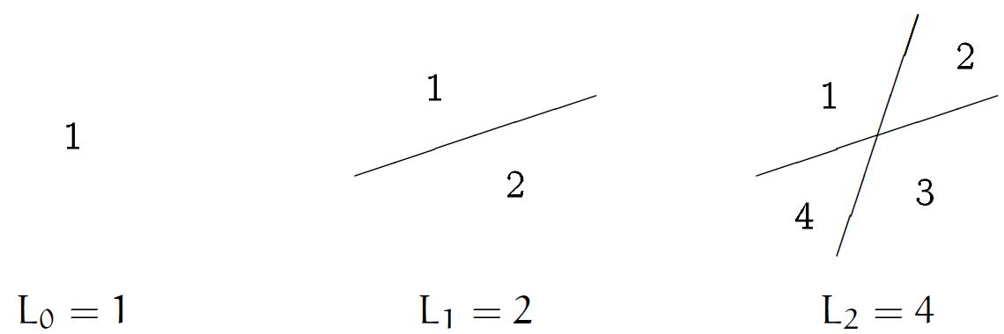
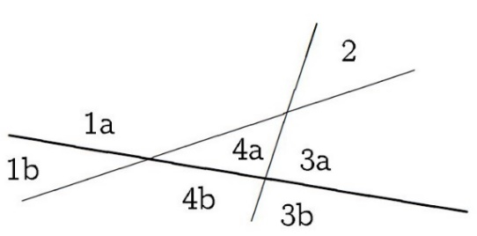
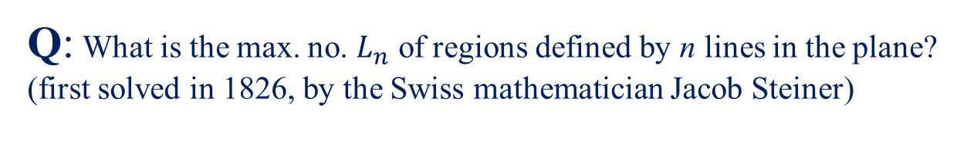

1.2 Lines in the Plane
Q: What is the max. no. $L_{n}$ of regions defined by n lines in the plane?
(first solved in 1826, by the Swiss mathematician Jacob Steiner)
$$L_{3}$$
=4+3=7

Slide 6
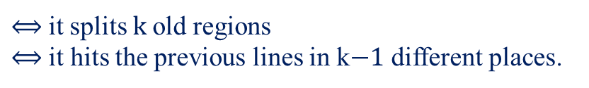
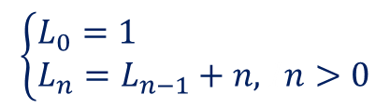


Observation:
The nth line(n > 0) increases the no. of regions by $k$
$⟺$it splits $k$old regions $⟺$ it hits the previous lines in k$−1$ different places.
$$L_{n}≤L_{n−1}+n$$
$$L_{n}≥L_{n−1}+n$$
(place the nth line in such a way that it’s not parallel to any of the others, hence it intersects them all.)
$$\left\{\begin{aligned}&L_{0}=1 \\ &L_{n}=L_{n−1}+n,\text{1}n>0\end{aligned}\right.$$

Slide 7
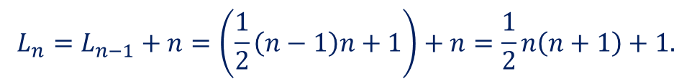


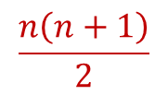


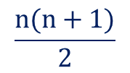


sol①${ L}_{n}=L_{n−1}+n$
$${=L}_{n−2}+\left(n−1\right)+n$$
$${=L}_{n−3}+\left(n−2\right)+\left(n−1\right)+n$$
$$⋮$$
$$=L_{0}+1+2+⋯+n$$
= $1+$
$$\frac{n(n+1)}{2}$$
sol② by induction
$$L_{n}=L_{n−1}+n=\left(\frac{1}{2}\left(n−1\right)n+1\right)+n=\frac{1}{2}n\left(n+1\right)+1.$$
Close form
$$\frac{n\left(n+1\right)}{2}$$
$2^{n}−1$, ,$\text{1} n!$ (Yes)
$1+2+⋯+n$, $1‧2‧⋯‧n$ (No)

Slide 8
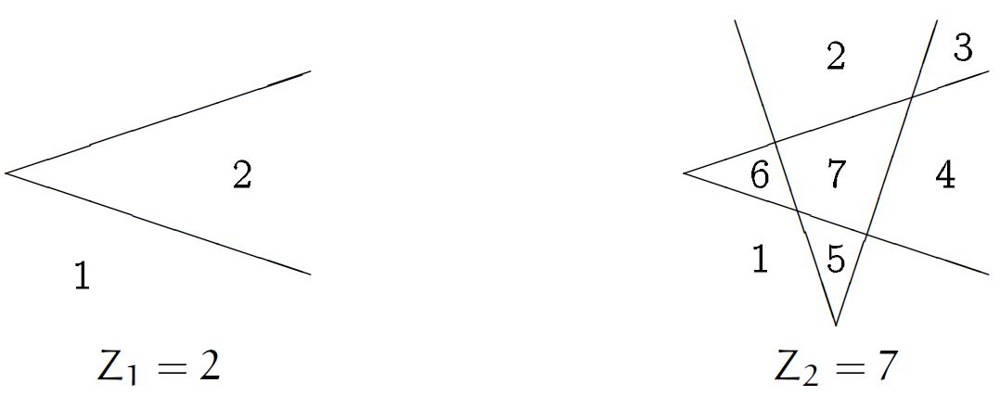
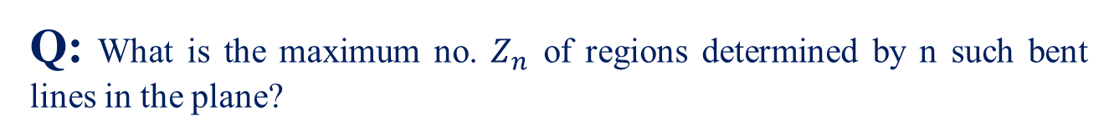
A variation of the lines-in-the-plane problem:
Suppose that instead of straight lines we use bent lines, each containing one “zig”.
Q: What is the maximum no. $Z_{n}$ of regions determined by n such bent lines in the plane?

Slide 9
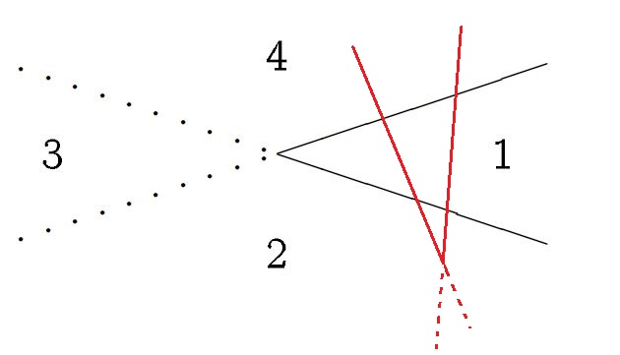



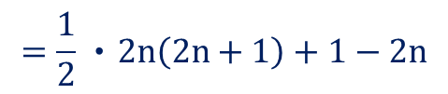
Observation:
A bent line is like 2 straight lines except that regions merge when the “2” lines don’t extend past their intersection point; we lose 2 regions.
If we arrange things properly, the zig point must lie “beyond” the intersections with the other lines, i.e. we lose only 2 regions per line.
$$Z_{n}=L_{2n}−2n$$
$$=\frac{1}{2}‧2n\left(2n+1\right)+1−2n$$
$$=2n^{2}−n+1,\text{1}n≥0$$
$$L_{n}∼\frac{1}{2}n^{2}$$
$$Z_{n}∼2n^{2}$$

Slide 10
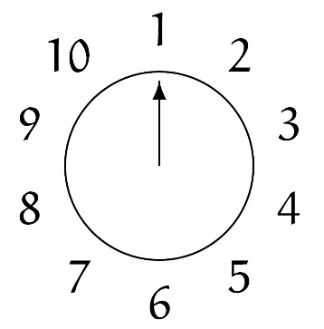
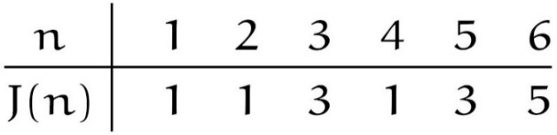





1.3 The Josephus Problem
Flavius Josephus, 1st century
$$⋮$$
In our variation, we start with n people numbered 1 to n around a circle, and we eliminate every second remaining person until only one survives.
e.g.
The elimination order is 2, 4, 6, 8, 10, 3, 7, 1, 9. So 5 survives.
The problem: Determine the survivor’s number, $\text{1}$ $J\left(n\right)$.
$$J\left(10\right)=5$$
$$\frac{n}{2}$$
Conjecture: $J\left(n\right)=$ when $n$ even
$J(n)$ always seems to be odd.

Slide 11
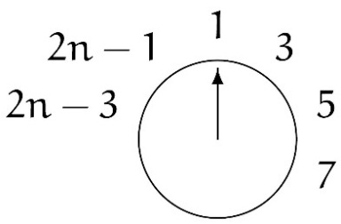



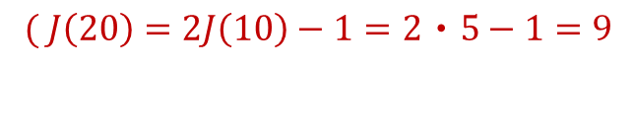

Even case ($2n$ people)
After the first go-round, we’re left with
$$J\left(2n\right)=2J\left(n\right)−1,1n≥1$$
$\begin{matrix}( J\left(20\right)=2J\left(10\right)−1=2‧5−1=9 \\ \\ \end{matrix}$
$$J\left(40\right)=17$$
$$J\left(5‧2^{m}\right)=2^{m+1}+1 )$$

Slide 12
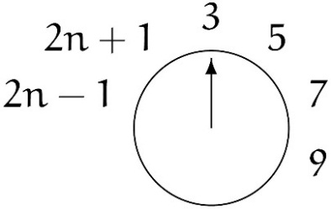
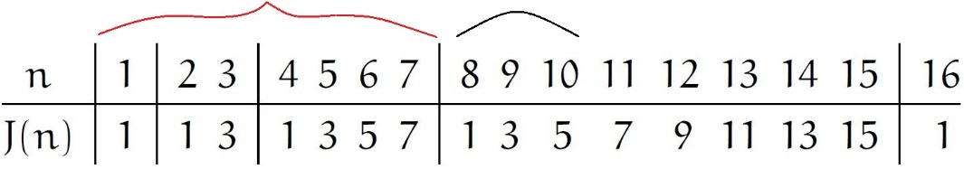

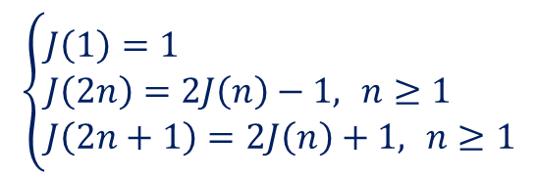

Odd case ($2n+1$ people)
No. 1 is wiped out just after person no. 2n & left with
$$J\left(2n+1\right)=2J\left(n\right)+1, n≥1$$
Hence, the recurrence is
$$\left\{\begin{aligned}&J\left(1\right)=1 \\ &J\left(2n\right)=2J\left(n\right)−1,1n≥1 \\ &J\left(2n+1\right)=2J\left(n\right)+1,1n≥1\end{aligned}\right.$$
2^{m} – 1 l+1

Slide 13
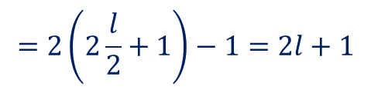
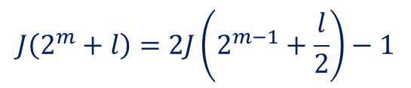

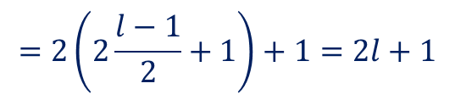

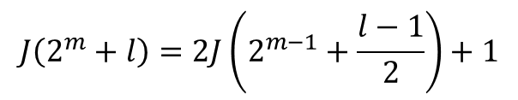


Guess: $n=2^{m}+l$, where $2^{m}$ is the largest power of $2≤n$.
$$J\left(2^{m}+l\right)=2l+1, m≥0 \& 0≤l<2^{m}$$
Prove:
By induction on $m$.
$$m=0 ⟹ l=0 ⟹ J\left(1\right)=1$$
OK!
$l$: even
$$J\left(2^{m}+l\right)=2J\left(2^{m−1}+\frac{l}{2}\right)−1$$
$$=2\left(2\frac{l}{2}+1\right)−1=2l+1$$
induc. hypo.
$l$: odd
$$J\left(2^{m}+l\right)=2J\left(2^{m−1}+\frac{l−1}{2}\right)+1$$
$$=2\left(2\frac{l−1}{2}+1\right)+1=2l+1$$
#
induc. hypo.
(e.g. $J\left(100\right)=J\left(2^{6}+36\right)=2‧36+1=73$)

Slide 14






Look at the radix 2 representations of n and $J(n)$.
Suppose
$n={\left(b_{m}b_{m−1}⋯b_{1}b_{0}\right)}_{2}$ i.e. $n=b_{m}2^{m}+⋯+b_{1}2+b_{0}$
where $b_{m}=1$ and each $b_{i}$ is either 0 or 1.
$$n={\left(1b_{m−1}⋯b_{1}b_{0}\right)}_{2}$$
$$l={\left(0b_{m−1}⋯b_{1}b_{0}\right)}_{2}$$
$$2l={\left(b_{m−1}b_{m−2}⋯b_{0}0\right)}_{2}$$
$$2l+1={\left(b_{m−1}b_{m−2}⋯b_{0}1\right)}_{2}$$
$$J\left(n\right)={\left(b_{m−1}⋯b_{0}b_{m}\right)}_{2}$$
$$⟹J\left({\left(b_{m}b_{m−1}⋯b_{1}b_{0}\right)}_{2}\right)={\left(b_{m−1}⋯b_{1}b_{0}b_{m}\right)}_{2}$$
one-bit cyclic shift left!
e.g. $n=100={(1100100)}_{2}$
$$J\left(n\right)=J\left({\left(1100100\right)}_{2}\right)={\left(1001001\right)}_{2}=64+8+1=73$$

Slide 15
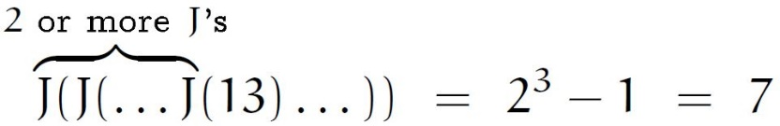
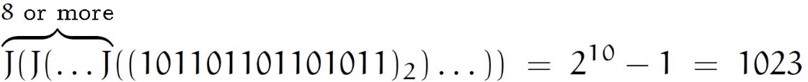

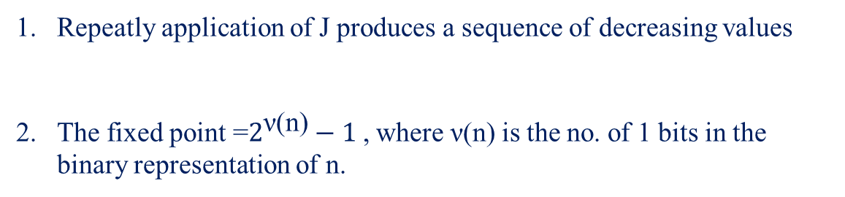


Note:
Repeatly application of J produces a sequence of decreasing values
The fixed point =$2^{\text{ν}\text{(}\text{n}\text{)}}−1$, where ν(n) is the no. of 1 bits in the binary representation of n.
that eventually reach a “fixed point”,
where $J\left(n\right)=n$.
e.g. ① $13={\left(1101\right)}_{2}$
$$ν\left(13\right)=3$$
②

Slide 16
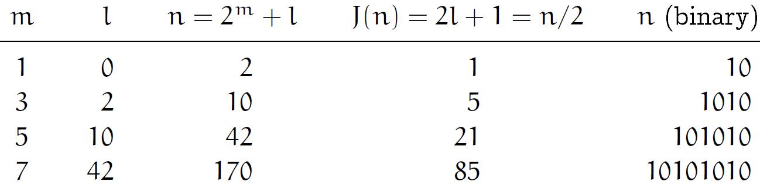









When n is even
Determine when $J\left(n\right)=\frac{n}{2}$ is true:
$$J\left(n\right) = \frac{n}{2}$$
$$∥ ∥$$
$2l+1$ $(2^{m}+l)/2$
$$n=2^{m}+l$$
$⟹l=\frac{1}{3}\left(2^{m}−2\right)$.
$∴$if $l=\frac{1}{3}\left(2^{m}−2\right)$ is an integer,
then $n=2^{m}+l$ will be a sol..
Ex! ( $\frac{1}{3}(2^{m}−2)$ is an integer $⟺$ m odd )
shift left
=shift right

Slide 17
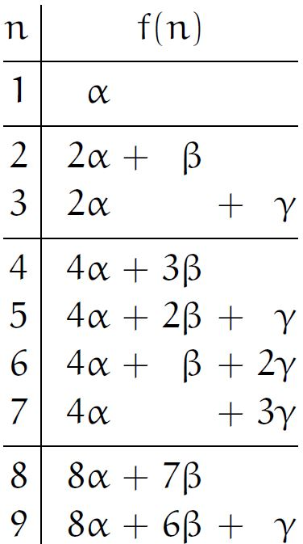


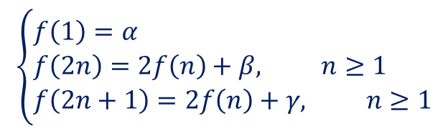



More genenal recurrence
$$\left\{\begin{aligned}&f\left(1\right)=α \\ &f\left(2n\right)=2f\left(n\right)+β, n≥1 \\ &f\left(2n+1\right)=2f\left(n\right)+γ, n≥1\end{aligned}\right.$$
(Our original recurrence : $α=1, β=−1, γ=1$)
Guess: $f\left(n\right)=A\left(n\right)α+B\left(n\right)β+C(n)γ$
where $A\left(n\right)=2^{m}$
$B\left(n\right)=2^{m}−1−l$
$C\left(n\right)=l$.
,
$$n=2^{m}+l,10≤l<2^{m}.$$

Slide 18



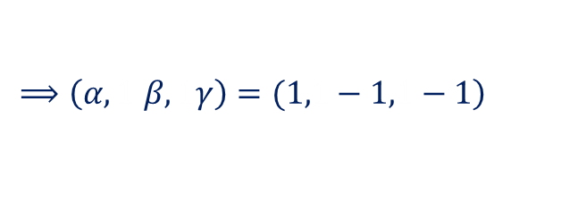








Prove:(1) by induction (messy!)
(2) repertoire method.
(i). $α=1, β=γ=0$ (i.e. $f\left(n\right)=A(n)$)
$$⟹$$
$⟹A\left(2^{m}+l\right)=2^{m}$ (by induction on m.)
(ii). Let $f\left(n\right)=1$
$$1=α$$
$$1=2‧1+β$$
$$1=2‧1+γ$$
$$\left.⟹\left(α,1 β,1γ\right)=(1,1−1,1−1\right)$$
$$⟹A\left(n\right)−B\left(n\right)−C\left(n\right)=1$$

Slide 19
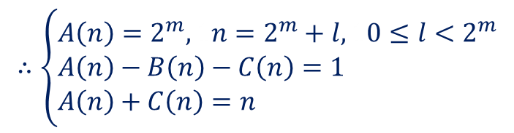





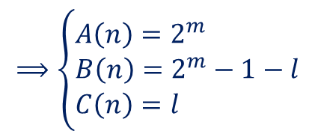

(iii). Let $f\left(n\right)=n$
$$1=α$$
$$2n=2‧n+β$$
$$2n+1=2‧n+γ$$
$$\left.⟹\left(α,1β,1γ\right)=(1,10,11\right)$$
$$⟹A\left(n\right)+C\left(n\right)=n$$
$$∴\left\{\begin{aligned}&A\left(n\right)=2^{m},1n=2^{m}+l,10≤l<2^{m} \\ &A\left(n\right)−B\left(n\right)−C\left(n\right)=1 \\ &A\left(n\right)+C\left(n\right)=n\end{aligned}\right.$$
(We need as many independent special solutions as there are independent parameters. In this case 3, for $α$, $β$, and $γ$)
$$⟹\left\{\begin{aligned}&A\left(n\right)=2^{m} \\ &B\left(n\right)=2^{m}−1−l \\ &C\left(n\right)=l\end{aligned}\right.$$
#

Slide 20
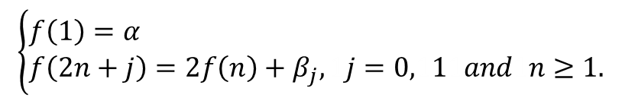





We know that the original J-recurrence has a magical solution, in binary:
$$J{\left((b_{m}b_{m−1}⋯b_{1}b_{0}\right)}_{2})={\left(b_{m−1}⋯b_{1}b_{0}b_{m}\right)}_{2}, {1b}_{m}=1$$
Does the generalized J-recurrence admits of such magic?
Rewrite the generalized recurrence as
$$\left\{\begin{aligned}&f\left(1\right)=α \\ &f\left(2n+j\right)=2f\left(n\right)+β_{j}, 1j=0,111and1n≥1.\end{aligned}\right.$$
where $β_{0}=β, β_{1}=γ$
$$⟹$$
$f{((b_{m}b_{m−1}⋯b_{1}b_{0})}_{2})=$ $2f\left({\left(b_{m}b_{m−1}⋯b_{1}\right)}_{2}\right)+β_{b_{o}}$
$$=4f\left({\left(b_{m}b_{m−1}⋯b_{2}\right)}_{2}\right)+2β_{b_{1}}+β_{b_{0}}$$
$$=2^{m}f\left({\left(b_{m}\right)}_{2}\right)+2^{m−1}β_{b_{m−1}}+⋯+2β_{b_{1}}+β_{b_{0}}$$
$=2^{m}α+2^{m−1}β_{b_{m−1}}+⋯+2β_{b_{1}}+β_{b_{0}}$.
$$={\left(αβ_{b_{m−1}}β_{b_{m−2}}⋯β_{b_{1}}β_{b_{0}}\right)}_{2}$$

Slide 21
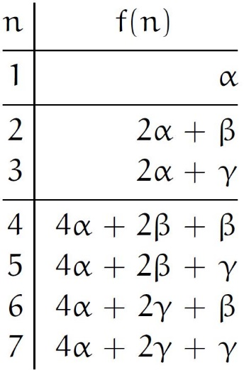


e.g. $n={ (1 1 0 0 1 0 0)}_{2}=100$
(original:$α=1,1β=−1,1γ=1)$
$$f\left(n\right)={\left( 1 1 −1 −1 1 −1 −1\right)}_{2}$$
$$=64+32−16−8+4−2−1=73$$

Slide 22



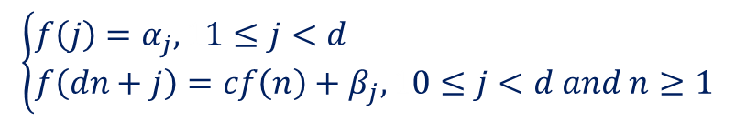





Generalize even more
$$\left\{\begin{aligned}&f\left(j\right)=α_{j},11≤j<d \\ &f\left(dn+j\right)=cf\left(n\right)+β_{j},10≤j<d and n≥1\end{aligned}\right.$$
$$⟹f(\left({\left.b_{m}b_{m−1}⋯b_{1}b_{0}\right)}_{d}\right)=({\left.α_{b_{m}}β_{b_{m−1}}⋯β_{b_{1}}β_{b_{0}}\right)}_{c}$$
$$e.g.$$
$$f\left(1\right)=34$$
$$f\left(2\right)=5$$
$$f\left(3n\right)=10f\left(n\right)+76,1n≥1$$
$$f\left(3n+1\right)=10f\left(n\right)−2,1n≥1$$
$$f\left(3n+2\right)=10f\left(n\right)+8,1n≥1$$
$$⟹f\left(19\right)=f\left({\left(201\right)}_{3}\right)={\left(5 76 −2\right)}_{10}$$
$$=5‧{10}^{2}+76‧10−2‧1=1258$$

