Slide 1
Chapter 4
Number Theory

Slide 2
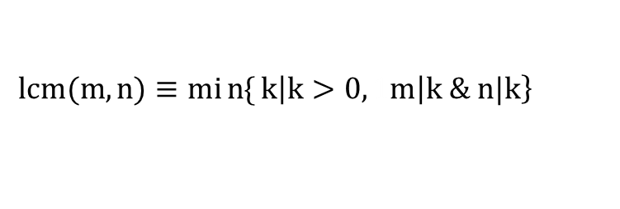

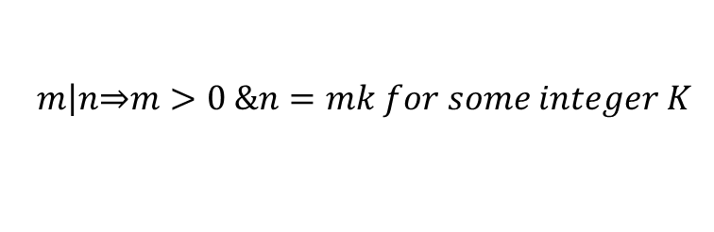
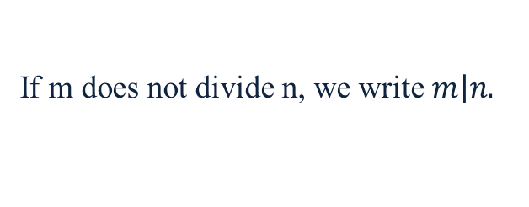
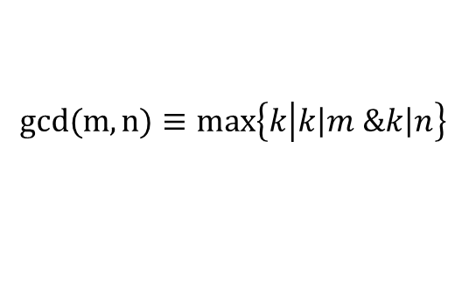
4.1 Divisibility
$$m\left|n\underset{⇒}{ }m>0 \&n=mk for some integer K\right.$$
(m divides n)
If m does not divide n, we write $\left.m\right|n.$
Note: There’s a similar relation, ”n is a multiple of m”, which means almost
the same thing except m doesn’t have to be positive.
$$gcd(m,n)≡max\left\{k\left|k\left|m\right. \&k\left|n\right.\right.\right\}$$
greatest common divisor
Note:$if n>0$, $gcd(0,n)=n;gcd(0,0)$ is undefined.
$$\left.lcm(m,n)≡min{\{}k\left|k>0, 1m\right|k \& n|k\right\}$$
(m$≤$0 or n$≤$0 undefined)
least common multiple

Slide 3
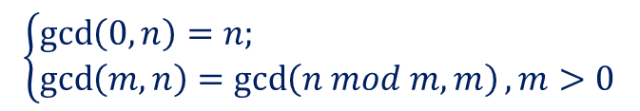
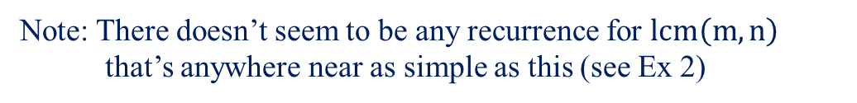


One of the nicest properties of the gcd is that it is easy to compute,
using a 2300-year-old method called Euclid’s algorithm
Euclid’s algorithm: $(0≤m<n)$
$$\left\{\begin{aligned}&\gcd\left(0,n\right)=n; \\ &\gcd\left(m,n\right)=\gcd\left(n mod m,m\right), m>0\end{aligned}\right.$$
e.g. $gcd\left(12,18\right)=\gcd\left(6,12\right)=\gcd\left(0,6\right)=6$
correctness of Euclid’s algorithm:
$$∵any common divisor of m \& n is a common divisor of m \& n mod m$$
$$n−\left\lfloor \frac{n}{m}\right\rfloor m$$
Note: There doesn’t seem to be any recurrence for $lcm\left(m,n\right)$
that’s anywhere near as simple as this (see Ex 2)

Slide 4



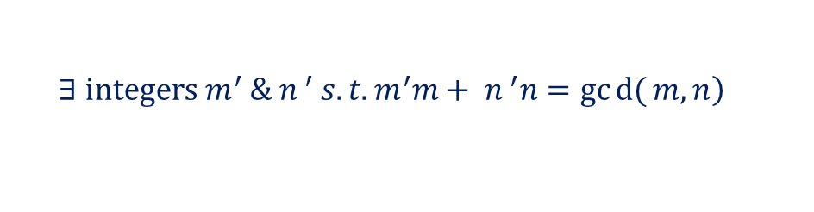

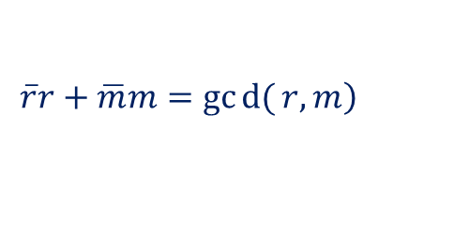



From Euclid’s algorithm, we have
$$\left.∃ integers m^{′} \&{ n}^{ ′} s.t. m^{′}m+{ n}^{ ′}n=gcd{(}m,n\right)$$
pf: $if m=0, take m^{′}=0 \&{ n}^{ ′}=1$
o.w. let $r=n mod m \& by induction hypo.$
$$\left.\overline{r}r+\overline{m}m=gcd{(}r,m\right)$$
$$\left.∵r=n−\left\lfloor \frac{n}{m}\right\rfloor m \& gcd\left(r,m\right)=\gcd{(}m,n\right)$$
$$\left.∴\overline{r}\left(n−\left\lfloor \frac{n}{m}\right\rfloor m\right)+ \overline{m}m=gcd{(}m,n\right)$$
$$\left.\underset{⇒}{ }\left(\overline{m}−\left\lfloor \frac{n}{m}\right\rfloor \overline{r}\right)m+\overline{r}n=gcd(m,n\right)$$
$$\underset{⇒}{ }m^{′}=\overline{m}−\left\lfloor \frac{n}{m}\right\rfloor \overline{r} \&{ n}^{ ′}=\overline{r}$$
e.g. $m=12, n=18,$
$$6=0∙0+1∙6=1∙6+0∙12=(−1)12+1∙18$$

Slide 5
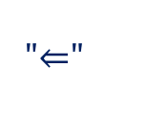

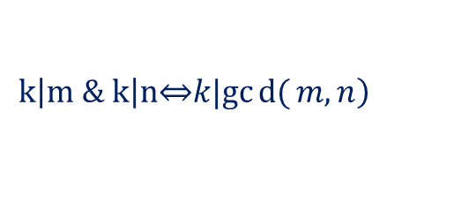
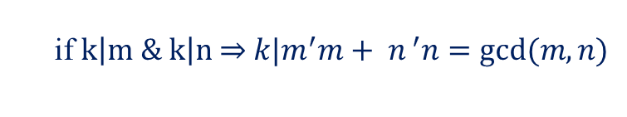

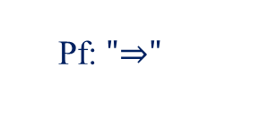
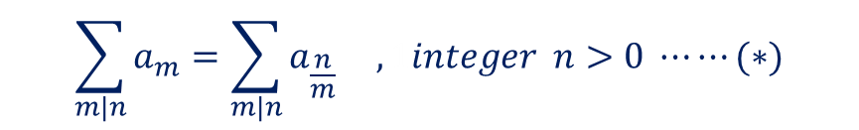
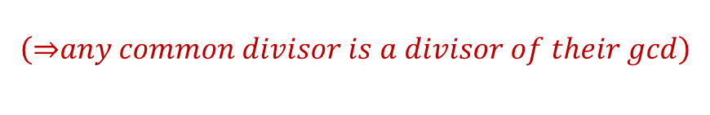
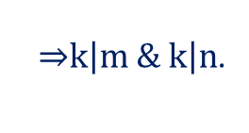

$$\left.k\left|m \& k\right|n\underset{⇔}{ }k|gcd{(}m,n\right)$$
$$\left(\underset{⇒}{ }any common divisor is a divisor of their gcd\right)$$
Pf: $"\underset{⇒}{ }"$
if $k\left|m \& k\right|n \underset{⇒}{ } k|m^{′}m+{ n}^{ ′}n=gcd⁡(m,n)$
$$"\underset{⇐}{ }"$$
if
$$k|\gcd\left(m,n\right)\underset{⇒}{ }k divides a divisor if m \& a divisor of n$$
$\underset{⇒}{ }k\left|m \& k\right|n$.
#
$$\sum_{m|n}{a_{m}=\sum_{m|n}{a_{\frac{n}{m}}}} , 1integer n>0 ⋯⋯(∗)$$
$$\left(∵\frac{n}{m} runs through all divisors of n when m does\right)$$
e.g. $n=12$
$$LHS=a_{1}+a_{2}+a_{3}+a_{4}+a_{6}+a_{12}$$
$$RHS=a_{12}+a_{6}{+a}_{4}+a_{3}+a_{2}+a_{1}$$

Slide 6


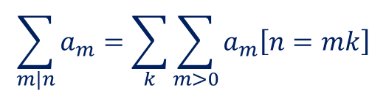

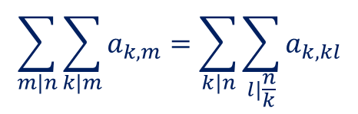
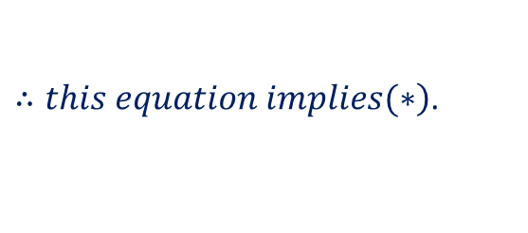
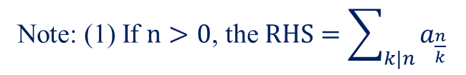
$$\sum_{m|n}{a_{m}=\sum_{k}{\sum_{m>0}{a_{m}\left[n=mk\right]}}}$$
Note: (1) If $n>0$, the $RHS=\sum_{k|n}{a_{\frac{n}{k}}}$
$\left.∴this equation implies(∗\right)$.
(2) The equation works when n is negative.
$$\sum_{m|n}{\sum_{k|m}{a_{k,m}}}=\sum_{k|n}{\sum_{l|\frac{n}{k}}{a_{k,kl}}}$$
e.g. $n=12$
$$LHS=$$

Slide 7







$$RHS=$$
$$LHS=RHS$$
#
pf:
$$LHS=$$
$$RHS=$$
$$∴LHS=RHS$$
#

Slide 8
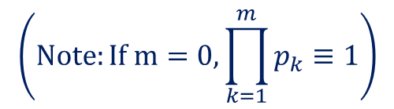

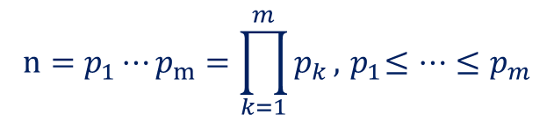
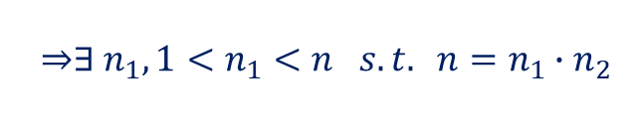


4.2 Primes
Def: A positive integer p is called prime if it has just 2 divisors, 1& p.
e.g. 2,3,5,7,11,
Any positive integer n can be written as a product of primes,
$$n=p_{1}⋯p_{m}=\prod_{k=1}^{m}{p_{k}}, { p}_{1}≤⋯≤p_{m}$$
.
$$\left(Note:If m=0, \prod_{k=1}^{m}{p_{k}}≡1\right)$$
pf: $n=1$, OK!
$$n>1 \& not prime$$
$$\underset{⇒}{ }∃ n_{1}, 1<n_{1}<n s.t. n=n_{1}∙n_{2}$$
By induction on $n_{1 }\& n_{2}$
#

Slide 9
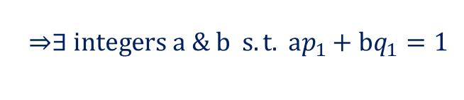
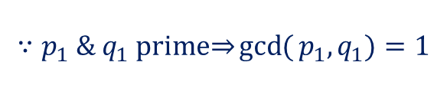



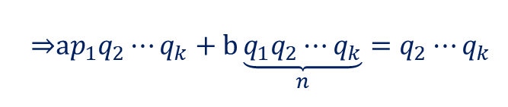
Note: The expansion is unique, i.e. There’s only one way to write n as
a product of primes in nondecreasing order.
(the Fundamental Theorem of Arithmetic )
pf: By induction on n
$$n=1$$
OK!
$$n>1 \& suppose we have 2 factorizations$$
$$n=p_{1}⋯p_{m}=q_{1}⋯q_{k} , { p}_{1}≤⋯≤p_{m} \& q_{1}≤⋯≤q_{k}$$
where p’s & q’s are all prime
claim: $p_{1}=q_{1}$
if not, assume $p_{1}<q_{1},$
$$∵p_{1} \& q_{1} prime\underset{⇒}{ }\gcd{(}p_{1},q_{1})=1$$
$$\underset{⇒}{ }∃ integers a \& b s.t. ap_{1}+bq_{1}=1$$
$$\underset{⇒}{ }ap_{1}q_{2}⋯q_{k}+b\underset{n}{\underbrace{q_{1}q_{2}⋯q_{k}}}=q_{2}⋯q_{k}$$

Slide 10
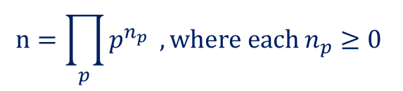

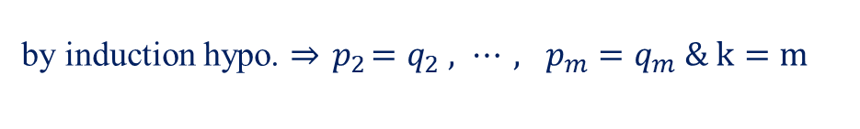
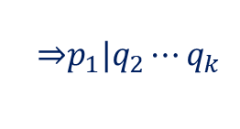
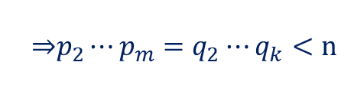



$$\underset{⇒}{ }p_{1}|q_{2}⋯q_{k}$$
$∵q_{2}⋯q_{k}<n \& by induction hypo.$,
$$q_{2}⋯q_{k} has a unique factiorization$$
hence, $p_{1}=q_{1}$
$$\underset{⇒}{ }p_{2}⋯p_{m}=q_{2}⋯q_{k}<n$$
by induction hypo. $\underset{⇒}{ }{ p}_{2}=q_{2} , ⋯, p_{m}=q_{m} \& k=m$
#
Every positive integer can be written uniquely in the form
$$n=\prod_{p}{p^{n_{p}}} , where each n_{p}≥0$$
Note: (1) The RHS is a product over infinite many primes, but for
any particular n all but a few exponents are 0.
(2) We can think of the sequence $〈n_{2},n_{3},n_{5},⋯〉$ as a number
system for positive integer n.
e.g. the prime-exponent representation of 12 is $〈2,1,0,0,⋯〉$
18 is $〈1,2,0,0,⋯〉$

Slide 11
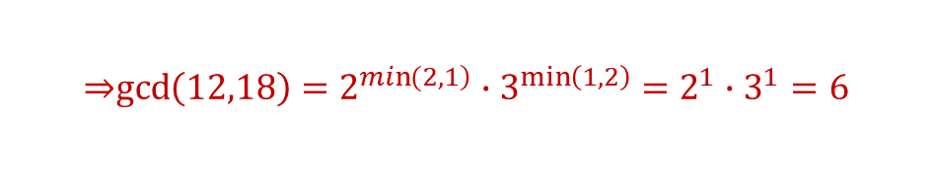


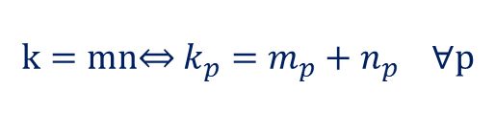
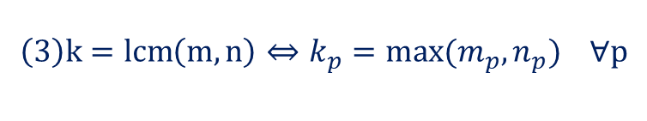
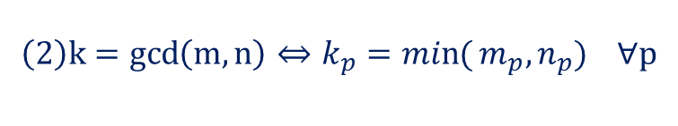
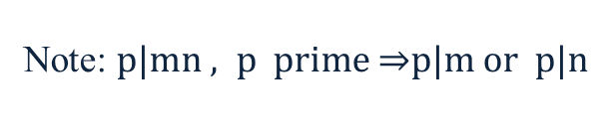
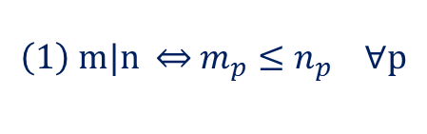
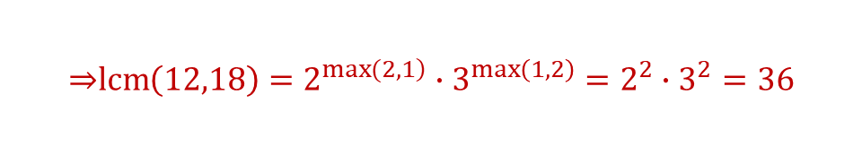
To multiply 2 numbers, we simply add their representation
i.e.
$$k=mn\underset{⇔}{ } k_{p}=m_{p}+n_{p} ∀p$$
$$\left(1\right) m|n \underset{⇔}{ } m_{p}≤n_{p} ∀p$$
$$\left(2\right)k=\gcd\left(m,n\right) \underset{⇔}{ } k_{p}=\min{(}m_{p},n_{p}) ∀p$$
$$\left(3\right)k=\operatorname{lcm}\left(m,n\right) \underset{⇔}{ } k_{p}=max(m_{p},n_{p}) ∀p$$
e.g. $12=2^{2}{∙3}^{1} , 18=2^{1}{∙3}^{2}$
$$\underset{⇒}{ }\gcd\left(12,18\right)=2^{\left.\min{(}2,1\right)}∙3^{\min\left(1,2\right)}=2^{1}∙3^{1}=6$$
$$\underset{⇒}{ }\operatorname{lcm}\left(12,18\right)=2^{\left.\max{(}2,1\right)}∙3^{\max\left(1,2\right)}=2^{2}∙3^{2}=36$$
Note: $p|mn , p prime \underset{⇒}{ }p|m or p|n$

Slide 12


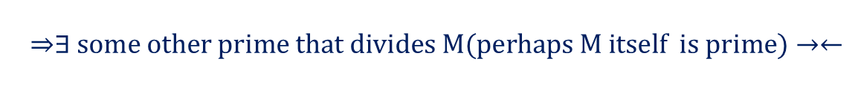

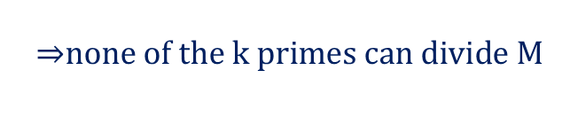
4.3 Prime examples
How many primes are there?
Infinite many!
pf: Suppose there were only finitely many primes,
say k of them$−2,3,5,⋯,P_{k}.$
Consider the number
$$M=2∙3∙5⋯P_{k}+1$$
$$\underset{⇒}{ }none of the k primes can divide M$$
$$\left(∵each divides M−1\right)$$
$$\underset{⇒}{ }∃ some other prime that divides M(perhaps M itself is prime)→←$$
#

Slide 13







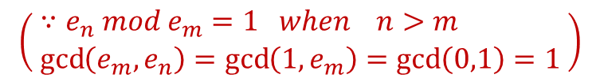


Def: define Euclid number by the recurrence
$$e_{n}=e_{1}e_{2}⋯e_{n−1}+1, n≥1$$
$$e.g.$$
$${ e}_{1}=1+1=2$$
$${ e}_{2}=2+1=3$$
prime
$${ e}_{3}=2∙3+1=7$$
$${ e}_{4}=2∙3∙7+1=43$$
$${ e}_{5}=2∙3∙7∙43+1=1807=13∙139 not prime$$
$${ e}_{6}=3263443 prime$$
$${ e}_{7}、{ e}_{8} not prime$$
Note:
(1) the Euclid number ${ e}_{n}$ may be prime, may be not.
(2) the Euclid numbers are all relatively prime to each other.
i.e. $\gcd\left(e_{m},e_{n}\right)=1 ∀m≠n$
$$\left( \begin{aligned}&∵e_{n} mod e_{m}=1 when n>m \\ &\gcd\left(e_{m},e_{n}\right)=\gcd\left(1,e_{m}\right)=\gcd\left(0,1\right)=1\end{aligned} \right)$$

Slide 14



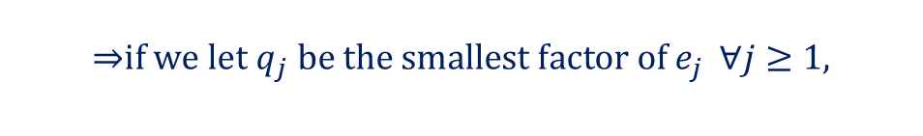

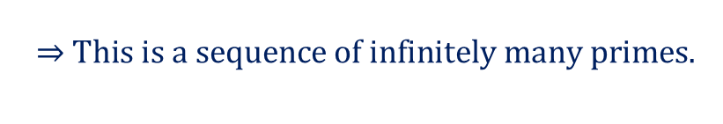
$$\underset{⇒}{ }if we let q_{j} be the smallest factor of{ e}_{j} ∀j≥1,$$
$$the prime q_{1},q_{2},⋯are all different.$$
$$\underset{⇒}{ } This is a sequence of infinitely many primes.$$
(3)
$$\overset{⇒}{Ex 37}$$
where $E≈1.264$

Slide 15

Nobody knows any useful formula that gives arbitrarily large primes out only primes.
the largest prime known in 1984 is $2^{216091}−1$
testing by a new Cray X-MP
supercomputer, it is much harder to prove it.
Def: Numbers of the form $2^{p}−1$ (p is prime) are called Mersenne numbers.
Note: (1) The Mersenne primes known to date occur for
$$p=2, 3, 5, 7, 13, 17, 19, 31, 61, 89, 107, 127, 521, 607, 1279, 2203,$$
$$2281, 3217, 4253, 4423, 9689, 9941, 11213, 19937, 21701,$$
$$23209, 44497, 86243, 110503, 132049, 216091, 756839$$
(2) $2^{n}−1 {can}^{′}t possibly be prime if n is composite,$
$\left(∵ 2^{km}−1=\left(2^{m}−1\right)\left(2^{m\left(k−1\right)}+2^{m\left(k−2\right)}+⋯+1\right)\right)$
(3) $2^{p}−1 {isn}^{′}t always prime when p is prime.$
$$e.g. 2^{11}−1=2047=23∙89$$

Slide 16
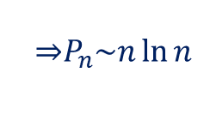


Factoring and primality testing of large numbers are hot topics nowadays.
for most of the last 200 years, the largest known prime has been a
Mersenne prime, although only 32 Mersenne primes are known.
$$P_{n}≡the nth prime$$
$$\underset{⇒}{ }P_{n}\sim n\ln{n}$$
$$π\left(x\right)≡the number of primes not exceeding x$$
$$\underset{⇒}{ }π\left(x\right)\sim \frac{x}{\ln{x}}$$
(Proving these 2 facts is beyond the scope of this book)

Slide 17

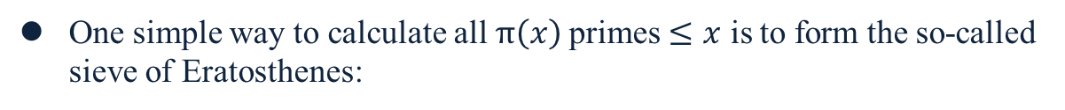
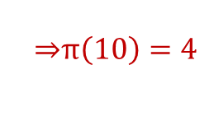
One simple way to calculate all$π\left(x\right)$ primes $≤x$ is to form the so-called sieve of Eratosthenes:
write down all integer from 2 through x.
circle 2, marking it prime, & cross out all other multiples of 2.
repeatedly circle the smallest uncircled, uncrossed number & cross out its other multiples.
when everything has been circled or crossed out, the circled numbers are the primes.
e.g. $x=10$
2 3 4 5 6 7 8 9 10
$$\underset{⇒}{ }π\left(10\right)=4$$

Slide 18







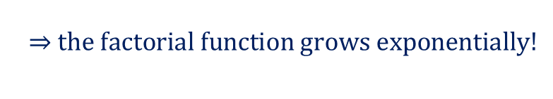

4.4 Factorial factors
number of ways to arrange n things in a row.
Note: number of digits in n! exceeds n when $n≥25$
$$∵$$
i.e.
$$\underset{⇒}{ } the factorial function grows exponentially!$$

Slide 19

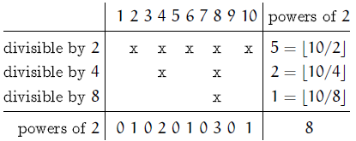

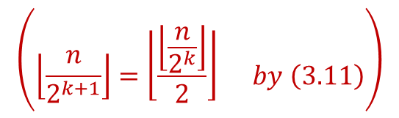

Note:
(ch 9)
For any given prime, determine the largest power of p that divides n!.
i.e. the exponent of p in n!’s unique factorization.$(≡ε_{p}\left(n!\right))$
e.g. $ε_{2}\left(10!\right)=8$
$$\left(\left\lfloor \frac{n}{2^{k+1}}\right\rfloor =\left\lfloor \frac{\left\lfloor \frac{n}{2^{k}}\right\rfloor }{2}\right\rfloor by \left(3.11\right)\right)$$

Slide 20
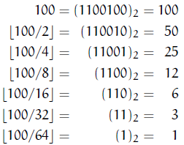

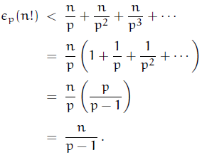

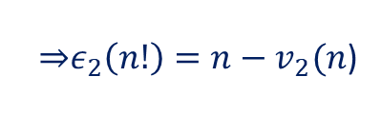
$\underset{⇒}{ }ε_{2}\left(n!\right)=n−v_{2}(n$)
where $v_{2}(n)$ is the number of 1’s in the binary representation of n
e.g. $p=2, n=100, ε_{2}\left(100!\right)=97<100$

Slide 21













$$\underset{⇒}{ }p^{ε_{p}\left(n!\right)}<p^{\frac{n}{p−1}}<2^{n}$$
$$∵p≤2^{p−1}$$
$$\underset{⇒}{ }we can use this observation to get another proof that there$$
$$are infinitely many primes.$$
pf: Suppose that there are only the k primes $2,3,⋯,P_{k}$
$\underset{⇒}{ }n!<{\left(2^{n}\right)}^{k}=2^{nk} ∀n>1 (∵p^{ε_{2}\left(n!\right)}<2^{n}$)
let $n=2^{2k}$
$\underset{⇒}{ } n!<2^{nk}=2^{2^{2k}k}=2^{\left.2k(2^{2k−1}\right)}=n^{\frac{n}{2} } (∵n!≥n^{\frac{n}{2} }$)
#
$$n!<2^{nπ\left(n\right)}$$
$$\left( π\left(n\right)=number of primes ≤n\right)$$
$$\underset{⇒}{ } \sqrt{2πn}{\left(\frac{n}{e}\right)}^{n}<2^{nπ\left(n\right)}$$
$$\left(∵n!\sim \sqrt{2πn}{\left(\frac{n}{e}\right)}^{n} \right)$$
$$lower bound$$
$$\underset{⇒}{talke log.} nπ\left(n\right)>n\log\left(\frac{n}{e}\right)+\frac{1}{2}\log\left(2πn\right)$$

Slide 22


$$\underset{⇒}{ }π\left(n\right)>\log\left(\frac{n}{e}\right)$$
$$\left(\begin{aligned}&This lower bound is quite weak, compared \\ &with π\left(n\right)\sim \frac{n}{\ln{n}} , ∵\log{n}≪ \frac{n}{\ln{n}}\end{aligned}\right)$$

Slide 23






4.5 Relative primality
Def:$m⊥n \underset{⇔}{ } m,n are integers \& gcd⁡(m,n)=1$
relatively prime
$$\left(\frac{m}{n} is in lowest terms iff m⊥n \right)$$
$$\frac{m}{\left.\gcd{(}m,n\right)}⊥\frac{n}{\left.\gcd{(}m,n\right)}$$
$$m⊥n\underset{⇔}{ }\min\left(m_{p},n_{p}\right)=0 ∀p$$
$$\underset{⇔}{ }m_{p}∙n_{p}=0 ∀p$$
$$k⊥m \& k⊥n \underset{⇔}{ } k⊥mn$$

Slide 24









A way to construct the set of all nonnegative fractions $\frac{m}{n}$ with $m⊥n$ (called the Stern-Brocot tree).
Start with the 2 fractions $\left(\frac{0}{1},\frac{1}{0}\right)$ and then to repeat the following operation
as many times as desired:
$$\frac{m+m^{′}}{n+n^{′}}$$
$$\frac{m}{n}\&\frac{m^{′}}{n^{′}}$$
Insert
between 2 adjacent fractions
the mediant of
$$\frac{m}{n}\&\frac{m^{′}}{n^{′}}$$
e.g.
$$⋮$$
$$⋮$$

Slide 25



The entire array can be regarded as an infinite binary tree structure whose top levels look like this:
Why does this construction work?
e.g. $\frac{m+m^{′}}{n+n^{′}}$ in lowest terms?
All possible $\frac{m}{n}$ occur exactly once?

Slide 26






fact1:
$$if \frac{m}{n}\&\frac{m^{′}}{n^{′}} are consecutive fractions at any stage of the$$
$$construction\underset{⇒}{ }m^{′}n−mn^{′}=1$$
pf: initially, $1∙1−0∙0=1$
$$\frac{m+m^{′}}{n+n^{′}} :check\left\{\begin{aligned}&\left(m+m^{′}\right)n−m\left(n+n^{′}\right)=1 \\ &m^{′}\left(n+n^{′}\right)−\left(m+m^{′}\right)n^{′}=1\end{aligned}\right.$$
insert
$$\left(clearly,from m^{′}n−mn^{′}=1\right)$$
fact2: if $\frac{m}{n}<\frac{m^{′}}{n^{′}} \underset{⇒}{ } \frac{m}{n}<\frac{m+m^{′}}{n+n^{′}}<\frac{m^{′}}{n^{′}}$
(by fact1)
$$∴the construction preserves order \& we {couldn}^{′}t possibly$$
get the same fraction in 2 different places.

Slide 27









fact3: any positive fraction $\frac{a}{b}$ with $a⊥b$ occurs in this construction.
pf: Initially, $\frac{m}{n}=\frac{0}{1}<(\frac{a}{b})<\frac{1}{0}=\frac{m^{′}}{n^{′}}$
at some stage, $\frac{m}{n}<\left(\frac{a}{b}\right)<\frac{m^{′}}{n^{′}}$
case1: $\frac{m+m^{′}}{n+n^{′}}=\frac{a}{b} , OK!$
case2: $\frac{m+m^{′}}{n+n^{′}}<\frac{a}{b} :m\underset{←}{ }m+m^{′},n\underset{←}{ }n+n^{′}$
case3: $\frac{m+m^{′}}{n+n^{′}}>\frac{a}{b} :m^{′}\underset{←}{ }m+m^{′}, n^{′}\underset{←}{ }n+n^{′}$
This process cannot go on indefinitely,
$$∵\frac{a}{b}−\frac{m}{n}>0 \& \frac{m^{′}}{n^{′}}−\frac{a}{b}>0$$
$$\underset{⇒}{ }an−bm≥1 \& bm^{′}−an^{′}≥1$$
$$\underset{⇒}{ }\left(m^{′}+n^{′}\right)\left(an−bm\right)+\left(m+n\right)\left(bm^{′}−an^{′}\right)≥m^{′}+n^{′}+m+n$$
$$\left(a+b\right)\left(m^{′}n−n^{′}m\right)=a+b$$
fact1
1

Slide 28


$$\underset{⇒}{ }a+b≥m^{′}+n^{′}+m+n$$
$$∵m or n or m^{′}or n^{′} increases at each step, we must stop$$
$$after at most a+b steps$$
#
Def: The Farey series of order N, denoted by $F_{N},$ 1is the set of all reduced fractions
between 0 & 1 whose denominators $≤N,$1arranged in increasing order.
e.g.

Slide 29





obtain $F_{N}$：
method 1.
$$F_{1}=\frac{0}{1}, \frac{1}{1}$$
start with & then inserting mediants whenever it’s
possible to do so without getting a denominator that is too large.
i.e. $\text{1} F_{N}$ defines a subtree of the stern-Brocot tree, obtained by
pruning off unwanted branches.
method 2.
$$\frac{m+m^{′}}{N}$$
$$\frac{m}{n}, 1\frac{m^{′}}{n^{′}}$$
insert between consecutive fractions of $F_{N−1}$
whose denominators sum to N
e.g.
Note: when N is prime, N-1 new fractions will appear,otherwise,
we’ll have $<N−1$, because this process generates only
numerators that are relatively prime to N.

Slide 30





Note: We can use Farey series to prove that $∃ integers a \& b$
s.t. $ma−nb=1$ when $m⊥n \& 0<m≤n$
Pf :
$$Let \frac{b}{a} be the fraction that precedes \frac{m}{n} in F_{n}$$
$$\underset{⇒}{ } am−bn=1$$
$$(m≤n)$$
#
$$\left(if 0≤n<m \& m⊥n, 1letting \frac{a}{b} be the fraction that follows\right.$$
$$\left.\frac{n}{m} in F_{m}\right)$$
Regard the Stern-Brocot tree as a number system for representing rational numbers
$$\left(∵each positive, reduced fraction occurs exactly once\right)$$
Let’s use L & R to stand for going down to the left or right branch as we proceed from the root of the tree to a particular fraction, then a string of L’s & R’s uniquely identifies a place in the tree.

Slide 31







$$\frac{5}{7}$$
e.g. LRRL is a representation of
$$\frac{1}{1}$$
L
$$\frac{1}{2}$$
R
$$\frac{2}{3}$$
R
$$\frac{3}{4}$$
$$\frac{5}{7}$$
L
$$\frac{1}{1}$$
Note: The fraction corresponds to the empty string, use the notation I for it.

Slide 32








Q: (1) Given positive integer m & n with $m⊥n$ , what is the string of L’s
$$\frac{m}{n}$$
and R’s that corresponds to ?
(2) Given a string of L’s and R’s, what fraction correspond to it ?
$$f\left(S\right)≡fraction corrsponding to S$$
where S is a string of L’s & R’s
$$\frac{5}{7}$$
e.g. $f\left(LRRL\right)=$
$=of (LR)$1$(LRR)$
$$\frac{m}{n}$$
$$\frac{m^{′}}{n^{′}}$$
$$\frac{m+m^{′}}{n+n^{′}}$$
$$\underset{⇒}{ }f\left(S\right)=\frac{m+m^{′}}{n+n^{′}} if \frac{m}{n} \& \frac{m^{′}}{n^{′}} are the closest fractions preceding$$
$$and following S in the upper levels of the tree$$

Slide 33








$$M\left(S\right)=\left(\begin{matrix}n & n^{′} \\ m & m^{′}\end{matrix}\right)$$
$$\left(M\left(I\right)=\left(\begin{matrix}1 & 0 \\ 0 & 1\end{matrix}\right)\right)$$
Let
$$∴$$
$$\underset{⇒}{ }M\left(S\right)=S$$
e.g.
$$f\left(S\right)=\frac{2+3}{3+4}=\frac{5}{7}$$

Slide 34



Hence, the answer to Q(2) is :
where $M\left(S\right)=\left(\begin{matrix}n & n^{′} \\ m & m^{′}\end{matrix}\right)$
#
The answer to Q(1) is the outputs in the following algorithms:
①
#
or

Slide 35









②
$$∵$$
$$LS= \left(\begin{matrix}n+m & {n^{′}+m}^{′} \\ m & m^{′}\end{matrix}\right)$$
$$∴f\left(S\right)=\frac{m{+m}^{′}}{{n+n}^{′}}=\frac{\left.\left(m+n\right)+(m^{′}{+n}^{′}\right)}{{n+n}^{′}}−1=f\left(RS\right)−1$$
$$\frac{1}{f\left(S\right)}=\frac{{n+n}^{′}}{m{+m}^{′}}=\frac{\left.\left(m+n\right)+(m^{′}{+n}^{′}\right)}{m{+m}^{′}}−1=\frac{1}{f\left(LS\right)}−1$$

Slide 36




e.g.
$$\frac{m}{n}=\frac{5}{7}$$
output L R R L
Irrational numbers don’t appear in the Stern-Brocot tree, but all the rational numbers that are “close” to them do.
e.g.
$$e=2.718281828459⋯has a regular pattern in the$$
$$Stern−Brocot system :$$
are the simplest rational upper and lower approximations to e.

Slide 37


The infinite representation of an irrational number $α$ by a simple modification of the matrix-free binary search procedure:

Slide 38




4.6 ‘Mod’ : the congruence relation
$a≡b\left(mod m\right) \underset{⇔}{ } a mod m=b mod m$
e.g.
$$9≡−16\left(mod 5\right) ∵9 mod 5=4=\left(−16\right)mod 5$$
Note:
1.
$‛a≡b{\left(mod m\right)’}^{ } can be read “a is congruent to$
$b modulo m$”.
the definition makes sense when a, b & m are arbitrary real numbers, but we almost always use it with integers only.
2.
$$a≡b\left(mod m\right)\underset{⇔}{ } a−b is a multiple of m$$
The congruence sign $‛≡’$ looks conveniently like $‛{=’}^{ },$ because congruences are almost like equation.

Slide 39











e.g.
(1)
Congruence is an equivalence relation;
i.e.
it satisfies the reflexive law ‘$a≡a$’.
the symmetric law ‘$a≡b \underset{⇒}{ } b≡a$’.
the transtive law
$\text{‘}a≡b≡c \underset{⇒}{ } a≡c$’.
$$a≡b \& c≡d \underset{⇒}{ }\left\{\begin{aligned}&\left.a+c≡b+d (mod m\right) \\ &\left.a−c≡b−d (mod m\right)\end{aligned}\right.$$
(2)
$$∵a−b \& c−d are both multiples of m, so are$$
$$\begin{matrix}\left(a+c\right)−\left(b+d\right)=\left(a−b\right)+\left(c−d\right) \& \\ \left(a−c\right)−\left(b−d\right)=\left(a−b\right)−\left(c−d\right) \end{matrix}$$
$$a≡b \& c≡d \underset{⇒}{ } ac≡bd \left(mod m\right), 2integers b,c$$
(3)
$$\left.∵ac−bd=\left(a−b\right)c+b(c−d\right)$$
(4)
$$a≡b\underset{⇒}{ }a^{n}≡b^{n} \left(mod m\right), integers a,b , integer n≥0$$
$$\left.∵(3\right)$$
e.g.
$2≡−1\left(mod 3\right)\underset{⇒}{ }2^{n}={\left(−1\right)}^{n} (mod 3$)
i.e.
$$2^{n}−1 is a multiple of 3\underset{⇔}{ } n is even.$$

Slide 40










Most of the algebraic operations that we customarily do with equations can also be done with congruences.
most, but not all.
e.g.
$$ad≡bd \left(mod m\right) \underset{⇒}{ } a≡b (mod)$$
$$3∙2≡5∙2\left(mod 4\right) 3≡5 (mod 4)$$
$$ad≡bd \underset{⇔}{ } a≡b (mod m)$$
$$integers a,b,d,m \& d⊥m$$
Proof :$"\underset{⇐}{ }"$ OK!
$$“\underset{⇒}{ }”$$
let $d^{′} \& m^{′} such that d^{′}d+m^{′}m=1$
$$∵ad≡bd\underset{⇒}{ }ad^{′}d≡bd^{′}d$$
$$\&∵d^{′}d≡1 \underset{⇒}{ } ad′d≡a \& bd′d≡b$$
$$hence, 1a≡b$$
#
Note:
the number $d^{′}$ is called the “inverse of d modulo m.”

Slide 41











$$ad≡bd\left(mod md\right) \underset{⇔}{ } a≡b\left(mod m\right), 1d≠0$$
pf: $∵\left(a mod m\right)d=ad mod md$
distributive law
$$∴\underset{\left.a≡b(mod m\right)}{\underbrace{a mod m=b mod m}}\underset{⇔}{ }\left(a mod m\right)d=(b mod m)d$$
$$\underset{⇔}{ }\underset{\left.ad≡bd(mod md\right)}{\underbrace{ad mod md=bd mod md}}$$
#
$$ad≡bd\left(mod m\right) \underset{⇔}{ } a≡b\left(mod \frac{m}{\gcd\left(d,m\right)}\right), 1integers a,b,d,m$$
pf: Let $d^{′}d+m^{′}m=\gcd\left(d,m\right)$
$$∵ad≡bd\underset{⇒}{ }ad^{′}d≡bd^{′}d$$
$$\& ∵d^{′}d≡gcd\left(d,m\right)$$
$$\underset{⇒}{ }ad^{′}d≡a∙\gcd\left(d,m\right)\& bd^{′}d=b∙\gcd{(}d,m)$$
$$\left(mod m\right)$$
$$\underset{⇒}{ }a∙\gcd\left(d,m\right)≡b∙\gcd\left(d,m\right)$$
$$\underset{⇒}{ }a≡b \left(mod \frac{m}{\gcd\left(d,m\right)}\right)$$
#

Slide 42










$$a≡b \left(mod md\right) \underset{⇒}{ } a≡b \left(mod m\right), 1integer d.$$
$$∵any multiple of md is a multiple of m.$$
$$a≡b \left(mod m\right) \& a≡b \left(mod n\right)$$
$$\underset{⇔}{ } a≡b \left(mod lcm\left(m,n\right)\right), 1integers m,n>0$$
$$a≡b \left(mod mn\right)$$
$$\underset{⇔}{ } a≡b \left(mod m\right) \& a≡b \left(mod n\right) if m⊥n$$
$$a≡b \left(mod m\right)$$
$$\underset{⇒}{ }a≡b\left(mod p^{m_{p}}\right) ∀p , 1if the prime factorization of m$$
$$=\prod_{p}{p^{m_{p}}}$$

Slide 43




4.7 Independent residues
residue number system
$$Res\left(x\right)=\left(x mod m_{1},⋯,x mod{ m}_{r}\right), m_{j}⊥m_{k} ∀1≤j<k≤r$$
Note: 1. $Knowing x mod m_{1},⋯, x mod { m}_{r} doesn^{′}t tell us everything$
$$about x.$$
But it allow us to determine x mod m, $m=m_{1}⋯{ m}_{r}$
2. In applications we’ll often know that x lies in a certain range;
then we’ll know everything about x if we know x mod m & if m is large enough.
e.g.
each ordered pair $(x mod 3,x mod 5)$ is different
$$∵x mod 3=y mod 3 \& x mod 5=y mod 5$$
$$\underset{⇔}{ }x mod 15=y mod 15$$

Slide 44





We can perform addition, subtraction, and multiplication on the components independently, because of the rules of congruences.
e.g. In above example,
$$7=\left(1,2\right)$$
$$\left.13=(1,3\right)$$
$$7∙13\left(mod 15\right)=\left(1∙1 mod 3, 12∙3 mod 5\right)=\left(1, 1\right)=1$$
$$\left.∵7≡1\left(mod 3\right), 17≡2(mod 5\right)$$
$$\left.13≡1\left(mod 3\right), 113≡3(mod 5\right)$$
$$\left.\underset{⇒}{ }7∙13≡1∙1\left(mod 3\right), 17∙13≡2∙3\left(mod 5\right)=1(mod 5\right)$$
The independence principle is useful in computer applications, because different components can be worked on separately.
(e.g. by different computer)

Slide 45









$$\left(x mod m_{1},⋯,x mod m_{r}\right)\underset{→}{ }x mod m= ? m=m_{1}⋯m_{r}$$
Illustrate it in the situation ($x mod 3, x mod 5$)
The key idea : solve the 2 cases (1, 0) & (0, 1)
$$∵if \left(1, 0\right)=a \& \left(0, 1\right)=b$$
$$\underset{⇒}{ }\left(x,y\right)=\left(ax+by\right) mod 15$$
$$e.g. in our case, a=10 , b=6$$
$$if x=2, y=3$$
$$\underset{⇒}{ }\left(2,3\right)=\left(2‧10+3‧6\right)mod 15=8$$
how to find a & b such that
$$a mod m=1, 1a mod n=0,$$
$$b mod m=0, 1b mod n=1, m⊥n ?$$
$$∵m⊥n, ∃ integers m^{′}, {, n}^{′}$$
$$such that m^{′}{m+n}^{′}n=1$$
$$take a=n^{′}n \& b=m′m$$
$$\left(reducing them both mod mn if desired\right)$$
Note: Further tricks can be found in references 174(p.274)

Slide 46








How many solutions are there to the congruence
$$\left.x^{2}≡1(mod m\right)$$
if we consider 2 solutions $x \& x′$ to be the same when $x≡x′$ ?
(1) $m=p^{k} , k>0$
$\underset{⇒}{ }\left(x−1\right)\left(x+1\right)≡0 (mod p^{k}$)
$$\underset{⇒}{ }p\left|x−1 or p\right|x+1 but not both unless p=2$$
$$\left(\begin{matrix}∵if p|x−1 \underset{⇒}{ } x=kp+1 \\ \underset{⇒}{ }x+1=kp+2 \\ ∴p | x+1 unless p=2\end{matrix}\right)$$
(i) $p>2$
$$p^{k}\left|\left(x−1\right)\left(x+1\right) \underset{⇔}{ }{ p}^{k}\right|x−1 or p^{k}\left|x+1\right.$$
$$\underset{⇒}{ } there are exactly 2 solutions , x≡+1 \& x≡−1$$

Slide 47







(ii) $p=2$
$$2^{k}\left|\left(x−1\right)\left(x+1\right)\underset{⇒}{ } 2\right|x−1 or 2\left|x+1\right.$$
$$but if 4\left|x−1 \underset{⇒}{ } x=4l+1 \underset{⇒}{ } x+1=4l+2 \underset{⇒}{ } 4 \right| x+1$$
$$∴2^{k−1}\left|x+1 or 2^{k−1}\right|x−1$$
$$\underset{⇒}{ }there are 4 solutions when k≥3$$
$$x≡±1 and x≡2^{k−1}±1$$
$$\left.e.g. { p}^{k}=8 \underset{⇒}{ } x≡1,3,5,7 (mod 8\right)$$

Slide 48








(2)
if m has exactly r different prime divisors, the total number of solutions to $x^{2}≡1$ is $2^{r}$, except for a correction when m is even.
The exact number in general is
e.g. (1) $m=12=2^{2}‧3$
$$\underset{⇒}{ }4 solutions :x mod 4=±1 \& x mod 3=±1$$
$$x=1,5,7,11$$
(2) $m=15=3‧5$
$$\underset{⇒}{ }4 solutions :x mod 3=±1, x mod 5=±1$$
(1,1)=1 (1,4)=4 (2,1)=11 (2,4)=14
#

Slide 49







4.8 Additional applications
The m numbers
$$0 mod m, n mod m, 2n mod m , ⋯,\left(m−1\right)n mod m$$
consist of precisely d copies of the $\frac{m}{d}$ numbers
$$\left.0, d , 2d , ⋯, m−d in some order, where d=\gcd{(}m,n\right)$$
$$e.g. m=12, n=8 \underset{⇒}{ } d=4 \& the numbers are$$
$$0, 8, 4, 0, 8, 4, 0, 8, 4, 0, 8, 4$$
show that we get d copies of the first $\frac{m}{d}$ values
∵
$$\underset{⇒}{ }we get d copies of the values that occur when 0≤k<\frac{m}{d}$$
$$Show that those \frac{m}{d} numbers are \left\{0, d, 2d,⋯,m−d\right\}$$
(2)
$let m=m^{′}d \& n=n^{′}d \underset{⇒}{ } kn mod m=d({kn}^{′} mod m′$)
$$\underset{⇒}{ }the values that occur when 0≤k<m^{′}$$
$$are d times the number$$

Slide 50






$$∵n^{′}⊥m^{′}$$
$$\underset{⇒}{ } there numbers are just \left\{0,11,1…,1m^{′}−1\right\}in some order.$$
#
Fermats’s Last Theorem :
$$a^{n}+b^{n}≠c^{n} ∀ a, 1b,1c,1n ∈Z^{+} \& n>2$$
(This conjecture has been verified for all n$≤150000 in 1987$)
Andrew Wiles 1993
Fermat’s (Little) Theorem : (1640)
……(*)
$$∵p is a prime \& n⊥p$$
$$\underset{⇒}{ } the p−1 numbers n mod p,12n mod p,1… ,1\left(p−1\right) mod p$$
are the numbers 1,12,1… ,1p-1 in some order.

Slide 51








(mod p)
$$\left.n^{p−1}≡1 (mod p)(∵p | \left(p−1\right)!\right)$$
#
Note: An alternative form of Fermat’s theorem:
$$n^{p}≡n \left(mod p\right), 1integer n$$
$$\left(\begin{matrix}∵if n⊥p\underset{⇒}{ }multiply \left(∗\right) by n \\ o.w. \underset{⇒}{ } p|n \underset{⇒}{ }{ n}^{p}≡0≡n\end{matrix} \right)$$

Slide 52













Fermat suspected that the number
$$f_{n}=2^{2^{n}}+1$$
was prime. $∀ n≥0$
He knew that the first 5 cases gave primes:
$$2^{1}+1=3,$$
$$2^{2}+1=5,$$
$$2^{4}+1=17,$$
$$2^{8}+1=257,$$
$$2^{16}+1=65537$$
but he couldn’t see how to prove that the next case,
$$2^{32}+1=4294967297$$
would be prime.
Prove that $2^{32}+1$ is not prime.
$$\left.let n=3 in (∗\right)$$
$$n^{p−1}$$
≡ 1 (mod p), n ⊥ p
$$\underset{⇒}{ }3^{2^{32}}≡1\left(mod 2^{32}+1\right) if 2^{32}+1 is prime$$
test this relation by hand, beginning with 3 and squaring 32 times,
keeping only the remainders mod $2^{32}+1$

Slide 53










$$∴2^{32}+1 {isn}^{′}t prime.$$
#
$$\left.△\left(p−1\right)!≡−1(mod p\right)$$
Nilson’s theorem :
“ ”
if n>1 is not prime, it has a prime divisor p that appears as a
factor of (n-1)! i.e. $\left(n−1\right)!≡0(mod p)$
$$\underset{⇒}{ }\left(n−1\right)! ≢−1\left(mod n\right)$$
$$\left. (∵if not by \left(4.40\right),\left(n−1\right)!≡−1\left(mod p\right)∗\right)$$
“ ”
(i.e. check : $\left(p−1\right)!≡−1(mod p)$)
$$if n⊥p\underset{⇒}{ }∃ n^{′} such that n^{′}n≡1\left(mod p\right)$$
here $n’$is the inverse of n & n is also the inverse of n’
(Note: Any 2 inverses of n must be congruent to each other,
$∵nn′≡nn′′ \underset{⇒}{ } n′≡n^{′′}(∵n⊥p)$)

Slide 54




pair up each number between 1 & p-1 with its inverse except for
those that their inverses are themselves.
determine which numbers are their own inverse :
if x is its own invers, $x^{2}≡1(mod p)$
$$\underset{⇒}{ }x≡1 or p−1 if p>2$$
$$\left(if p=2,\left(p−1\right)!≡−1\left(mod p\right)done!\right)$$
hence,
$$\left.\left(p−1\right)!≡1∙\left(p−1\right)≡−1(mod p\right)$$
#
Note: Wilson’s theorem is of no use as a practical test for primality.
It’s just a theorem.

Slide 55







4.9 PHI and MU
$$φ\left(m\right)≡number of integers$$
$$∈\left\{0,1,…,m−1\right\}$$
$$which are relatively prime to m.$$
Euler’s totient function
(Ex 32! , from Fermat thm.)
$$m=p^{k}$$
$$∵n⊥p^{k}⟺p∤n$$
the multiples of p in {0, 1, …, $p^{k}$-1} are {0, p, 2p, …, ($p^{k}$-1)p}
$$⇒φ\left(p^{k}\right)= p^{k}−p^{k−1}$$
( k = 1 $⇒φ\left(p\right)=p−1$)

Slide 56










$$m=m_{1}m_{2}>1, { m}_{1}⊥m_{2}$$
n $⊥$m $⇔$ n mod $m_{1}⊥m_{1}$ & n mod $m_{2}⊥m_{2}$
($∵n⊥m_{1} \& n⊥m_{2}, 1\& gcd\left(m,n\right)$
$$=\gcd\left(n mod m_{i},m_{i}\right), i=1, \left.2\right)$$
$$φ\left(m\right)=φ\left(m_{1}\right)φ\left(m_{2}\right)$$
e.g. $φ\left(12\right)=φ\left(3\right)φ\left(4\right)=2∙2=4$
Def: A function $f(m)$ of positive integers is called multiplicative if
e.g. $φ\left(m\right); f\left(m\right)=m^{α};…$
f multiplicative

Slide 57








$$∴$$
$$\frac{m}{n}$$
Def: The fraction is basic if $0≤m<n$.
$φ\left(n\right)$ is the number of reduced basic fractions with denominator
n; the Farey series $F_{n}$ contains all the reduced basic fractions with
denominator$≤$n, as well as the non-basic fraction $\frac{1}{1}$ .
$$φ\left(1\right) φ\left(2\right) φ\left(3\right) φ\left(4\right) φ\left(5\right)$$
$$F=\frac{0}{1} \frac{1}{2} \frac{1}{3} \frac{2}{3} \frac{1}{4} \frac{1}{4} \frac{1}{5} \frac{2}{5} \frac{3}{5} \frac{4}{5} \frac{1}{1}$$
1
Reduction to lowest terms
$$⇒$$
Group
$$⇒$$

Slide 58








Hence,
If f is any function s.t. g(m)$=\sum_{d|m}{f(d)}$ is multiplicative
$$⇒$$
f is multiplicative.
$$\underset{⇐}{ } (EX33!)$$
Pf: By induction on m
f(1) = g(1) = 1
$$f\left(m_{1}m_{2}\right)=f\left(m_{1}\right)f\left(m_{2}\right)$$
let m > 1 & assume
$$when m_{1}⊥m_{2} \& m_{1}m_{2}< m$$
if $m=m_{1}m_{2}$ & $m_{1}⊥m_{2}$
$⇒$ g($m_{1}m_{2}$)$=\sum_{d|m_{1}m_{2}}{f(d)}= \sum_{d|m_{1}}{\sum_{d|m_{2}}{f(d_{1}d_{2})}}$ , $d_{1}⊥d_{2}$
by induction hypo., $f\left(d_{1}d_{2}\right)=f\left(d_{1}\right)f\left(d_{2}\right)$ except possibly
when $d_{1}=m_{1}$, $d_{2}{=m}_{2}$

Slide 59




$$\sum_{d|m_{1}}{f\left(d_{1}\right)\sum_{d|m_{2}}{f(d_{2}))−}}f\left(m_{1}\right)f\left(m_{2}\right)+ f\left(m_{1}m_{2}\right)$$
⇒
(
=$g\left(m_{1}\right)g\left(m_{2}\right)−f\left(m_{1}\right)f\left(m_{2}\right)+ f\left(m_{1}m_{2}\right)=$ g($m_{1}m_{2}$)
⇒
$$f\left(m_{1}m_{2}\right)=f\left(m_{1}\right)f\left(m_{2}\right)$$
#
Def: The Möbius function $μ(m)$ is defined $∀ m≥1$ by the equation
Note:
this equation is a recurrence
2.

Slide 60





pf: $"⇒"$
$"⇐"$ Similarly! (See Ex.12!)
$$μ\left(m\right)=?$$
When m large

Slide 61









$$\sum_{d|m}{μ\left(d\right)}=[m=1$$
$m=p^{k}$,
]
$$⇒$$
($∵$ the divisors of $p^{k}$ are 1, …, $p^{k}$)
$$⇒$$
$$⇒$$
($∵g\left(m\right)=[m=1]$ is multiplicative, so is $μ$)

Slide 62







Known:
Solve the recurrence by applying Möbius‘s rule
$$⇒$$
$$⇒$$
How many fractions are in the Farey series $F_{n}$ ?
Ans:
$$Φ\left(n\right)+1$$

Slide 63















$$\frac{m}{n}$$
Pf: RHS = # of both reduced and unreduced fractions with
$$0≤m<n≤x$$
$$\frac{1}{2}$$
= $\left\lfloor x\right\rfloor \left\lfloor 1+x\right\rfloor$
$$∵Φ\left(\frac{x}{d}\right)=$$
$$\frac{m}{n}$$
# of both reduced and unreduced fractions with
$$0≤m<n≤x$$
& gcd(m,n) = d
$$\frac{m^{′}}{n^{′}}$$
$$\frac{x}{d}$$
($∵$such fractions are with $0≤m^{′}<n^{′}≤$ )
$$⇒\sum_{d≥1}{Φ\left(\frac{x}{d}\right)}=RHS=\frac{1}{2}\left\lfloor x\right\rfloor \left\lfloor 1+x\right\rfloor$$
#

Slide 64


Note: The definition of $Φ\left(x\right)⇒Φ\left(x\right)=Φ\left(\left\lfloor x\right\rfloor \right)$. But it turns out
To be convenient to define $Φ\left(x\right)$ $∀ real x$.
e.g.

Slide 65





Another beautiful property of the Möbius function:
pf: $"⇒"$
Suppose $g\left(x\right)=\sum_{d≥1}{f\left(\frac{x}{d}\right)}$
$"⇐"$ Similarly!
#

Slide 66



Hence,
Note:
This is always a finite sum.
2.
(ch9)

Slide 67



Suppose we have beads of n different colors.
goal: count how many different ways there are to string them into
circular necklaces of length m.
$≡$N(m,n)
e.g. N(4,2) = 6
Note: There's no obvious recurrence for N(m,n), but we can count
the necklaces by breaking them into linear strings in m ways.
e.g.
each of the $n^{m}$ possible patterns appears at least once &
some pattern appear more than once.

Slide 68








How many times does a pattern $a_{0}…a_{m−1}$ appear?
Ans: number of cyclic shifts $a_{k}…a_{m−1}a_{0}…a_{k−1}$ that
produce the same pattern as $a_{0}…a_{m−1}$.
e.g. BRBR occurs twice.(BRBR, RBRB, BRBR, RBRB)
$$⇒$$
$∵$for a given k, e.g. m = 12, k = 8
$$⇒$$
$$⇒$$

Slide 69









In general,
$$a_{j}=a_{\left(j+k\right)} mod m ⇒ a_{j}=a_{\left(j+kl\right)} mod m ∀ l=1, 2, …$$
$∵$ the multiple of k mod m = {0, d, 2d, …, m-d}.
$$d=gcd{(k,m)}$$
$⇒$ the general solution is to choose $a_{0}$, …, $a_{d−1 }$
independently
& then to set${ a}_{j}$ = ${ a}_{j−d}$ for d $≤$ j $<$ m.
$n^{d}$ solutions.
$$⇒$$
$$⇒$$
$$⇒$$
$φ(\frac{m}{d})$ by def
e.g. m = 4, n = 2. $\frac{1}{4}\left(1∙2^{4}+1∙2^{2}+2∙2^{1}\right)=6$

Slide 70







Note:
$∵N(m,n)$ is an integer.
$$∴$$
Prove directly that
pf:
m is prime (m = p)
$$\sum_{d|p}{φ\left(d\right)n^{\frac{p}{d}}}=φ\left(1\right)n^{p}+φ\left(p\right)n=n^{p}+\left(p−1\right)n$$
$≡0(mod p)$
$$(∵n^{p}≡n\left(mod p\right) by Fermats thm.)$$
$$n^{3}−n≡0\left(mod 3\right)$$
(2) m = 4
+3n
check:
(i) n even: OK!
(ii) n odd: $n^{4} \& n^{2}$ each congruent to 1, 2n is congruent to 2.
OK!

Slide 71











(3) m = 12
check:
i.e. check:
by(4.42)
$∵$(1) m = 3 holds
$$∴$$
$$⇒$$
$∵$(2) m = 4 holds
$$∴$$
$$⇒$$

Slide 72














(4) m =
$$p^{3}$$
check:
$$\left.≡0(mod p^{3}\right)$$
i.e. check:
$$p^{3}│n^{p^{3}}−n^{p^{2}}$$
$$p^{2}│n^{p^{2}}−n^{p^{ }}$$
$$p│n^{p^{ }}−n^{ }$$
by Fermat’s thm. $n^{p}≡n\left(mod p\right)$
$$⇒$$
$$p│n^{p^{ }}−n^{ }$$
$$⇒$$
$$⇒$$
$$⇒$$

Slide 73



$$⇒$$
(5) m =
$$p^{k}$$
as above, we have that
$$n^{p^{k}}=n^{p^{k−1}}+p^{k}R$$
for some integer R.
$$⇒$$
$$∴\sum_{d|p^{k}}{φ\left(d\right)n^{\frac{p^{k}}{d}}}=$$
$$\left.≡0(mod p^{k}\right)$$

Slide 74










(6) m = $m_{1}m_{2}$
, $m_{1}{⊥m}_{2}$
Assume the congruence is true for $m_{1}{ \& m}_{2}$.
is multiplicative,
$$∵φ$$
$$\left.≡0(mod { m}_{2}\right)$$
$$≡$$
$$\left.0(mod { m}_{2}\right)$$
$$\left.≡0(mod { m}_{1}\right)$$
by a symm. Argument
$$∴$$
$$\left.≡0(mod m\right)$$
#

