Slide 1
Generic class

Slide 2
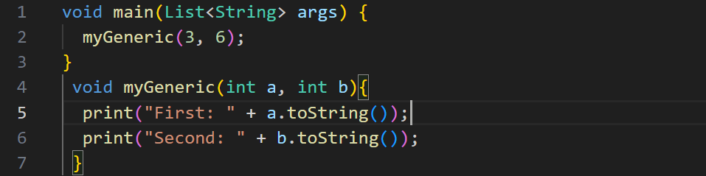
Simple fuction

Slide 3
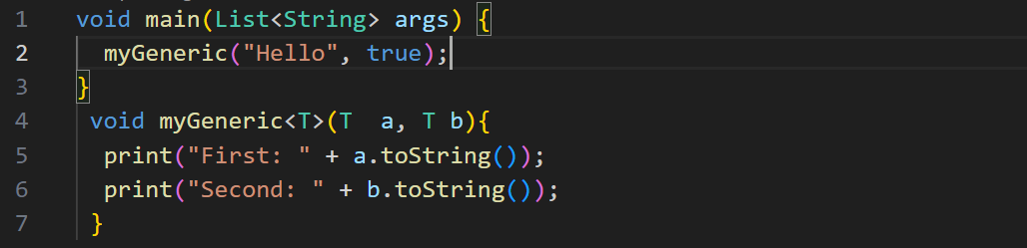
Generic function 1

Slide 4
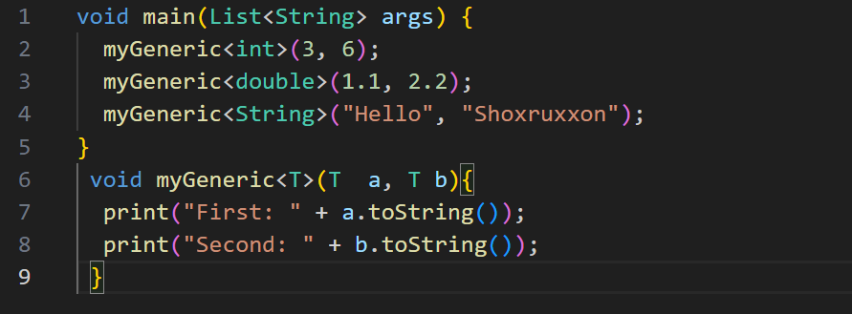
Generic function 2

Slide 5
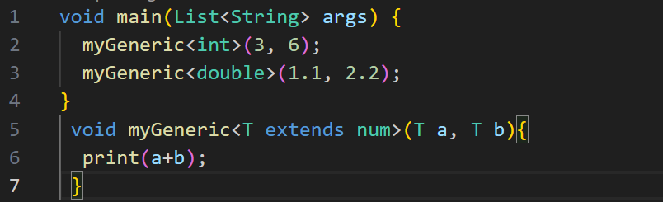
Generic function 3

Slide 6
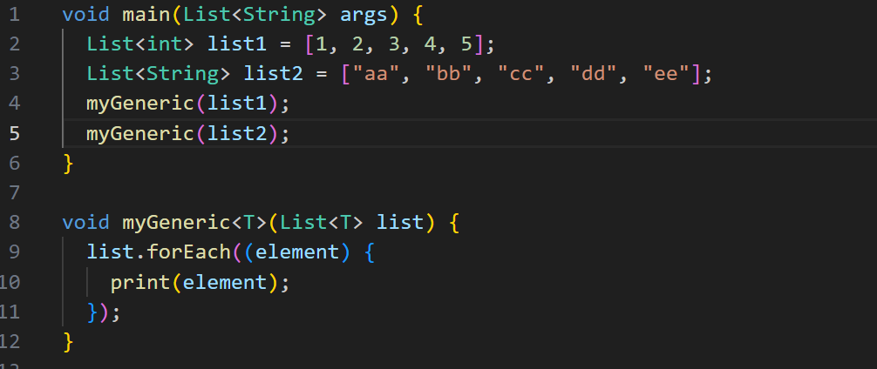
Generic function 4

Slide 7
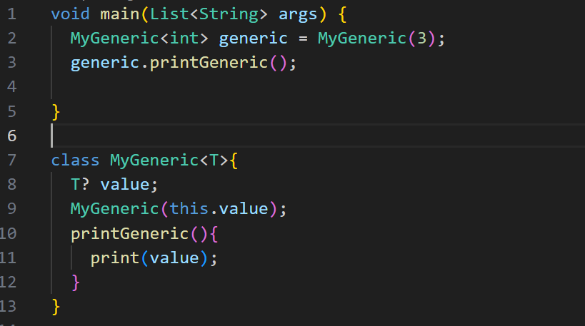
Generic class 1

Slide 8
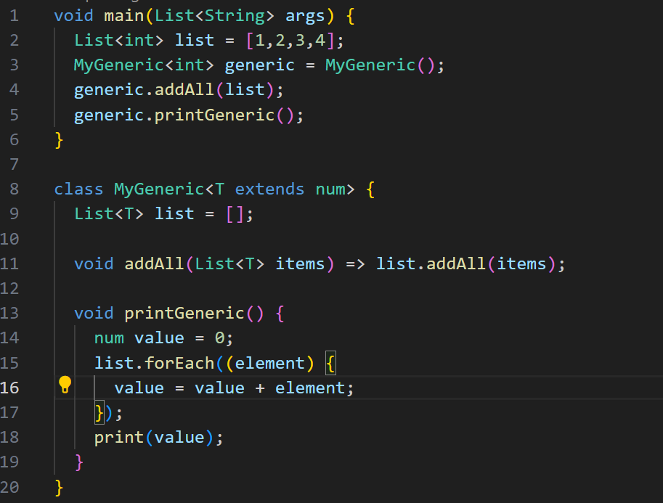
Generic class 2

Slide 9
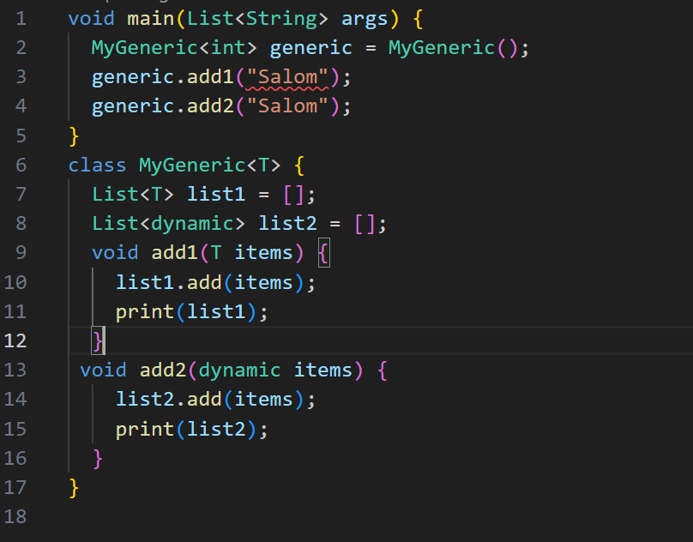
Generic vs dynamic
Generic – qat’iy tipli shablon.
Dynamic – type chekkingni o’chiradi ya’ni qat’iy emas.

