Slide 1
Vector in R^{n}
An ordered n-tuple :
a sequence of n real numbers
R^{n}-space
the set of all ordered n-tuples
n = 1
R¹-space = set of all real numbers
(R¹-space means geometrically by the x-axis)
n = 2
R²-space = set of all ordered pair of real numbers
(R²-space means geometrically by the xy-plane)
n = 3
R³-space = set of all ordered triple of real numbers
(R³-space means geometrically by the xyz-space)
n = 4
R⁴-space = set of all ordered quadruple of real numbers

Slide 2
Notes:
(1) An n-tuple can be viewed as a point in R^{n} with the x_{i}’s as its coordinates
(2) An n-tuple can be viewed as a vector
in R^{n} with the x_{i}’s as its components
For Example:
or
a point
a vector
A vector on the plane is expressed as a directed line segment whose initial point is the origin and terminal point is the point (x₁, x₂)

Slide 3
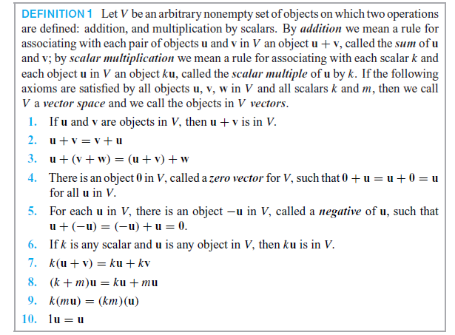
Vector Spaces
Definition: Let (F ,+, . ) be a field. The elements of F are called scalars. If V is a non-empty set, whose elements are called vectors, then it is said to form a vector space over a field F if following postulates hold:

Slide 4
Note: In brief - A vector space consists of four entities:
V: nonempty set of vectors
c: any scalar
vector addition
scalar multiplication
is called a vector space
Example: n-tuple space: R^{n}
(vector addition)
(scalar multiplication )
Matrix space:
(m×n matrices with real-number entries: Ex 2X2)
matrix addition)
(scalar multiplication for matrices)

Slide 5
n-th degree or less polynomial space
(the set of all real-valued polynomials of degree n or less)
( polynomial addition)
(scalar multiplication for polynomials)
Set of real numbers is closed under addition and multiplication, and we can show that P_{n} satisfies the ten axioms and thus is a vector space
Continuous function space :
(the set of all real-valued continuous functions defined on the entire real line)
(addition for functions)
(scalar multiplication for functions)
Sum of two continuous function is continuous and the product of a scalar and a continuous function is still a continuous function, is a vector space

Slide 6
Note: To show that a set is not a vector space, you need only find one axiom that is not satisfied
Example: The set of all integers is not a vector space
scalar
noninteger
integer
Example: The set of all (exact) second-degree polynomial functions is not a vector space
Let and

Slide 7
Sub Space
A subset W of a vector space V is called sub space of V if W is itself a vector space under the addition and scalar multiplication defined on V.
If u and v are vectors in W then u + v is in W.
If k is any scalar and u is any vector in W, then ku is in W.
Trivial subspace : Every vector space V has at least two subspaces
(1) Zero vector space {0} is a subspace of V
(2) V is a subspace of V
Any subspaces other than these two are called proper (or nontrivial) subspaces

Slide 8
Example: Let W be the set of all 2×2 symmetric matrices of M_{2×2} . Show that W is a subspace of the vector space M_{2×2}, with the standard operations of matrix addition and scalar multiplication
(Since A^{T} = A)
Example: The set of singular matrices is not a subspace of M_{2×2}
Let W be the set of singular (noninvertible) matrices of order 2. Show that W is not a subspace of M_{2×2} with the standard matrix operations
(W is not closed under vector addition)

Slide 9
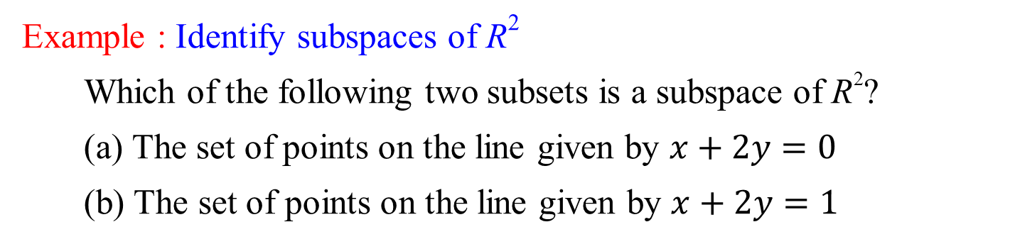
Example: The set of first-quadrant vectors is not a subspace of R²
Show that , with the standard
operations, is not a subspace of R²
(W is not closed under scalar multiplication)
Example : Identify subspaces of R²
Which of the following two subsets is a subspace of R²?
(a) The set of points on the line given by $x+2y=0$
(b) The set of points on the line given by $x+2y=1$
Solution:
(Note: the zero vector (0,0) is on this line)
(closed under vector addition)
(closed under scalar multiplication)

Slide 10
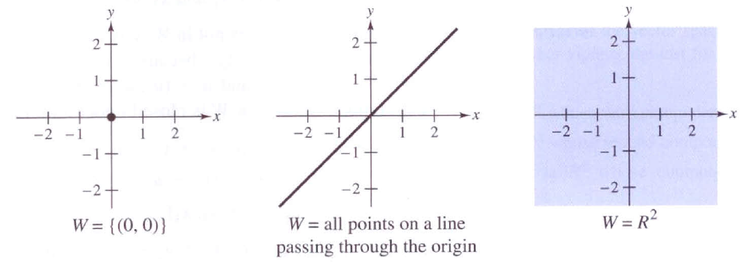
(b)
(Note: the zero vector (0, 0) is not on this line)
Note: Subspaces of R²
(trivial subspace)
(trivial subspace)

Slide 11
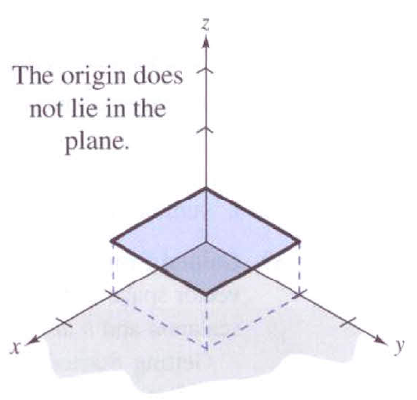
Example : Identify subspaces of R³
(Note: the zero vector is not in W)
(Note: the zero vector is in W)
Solution:

Slide 12
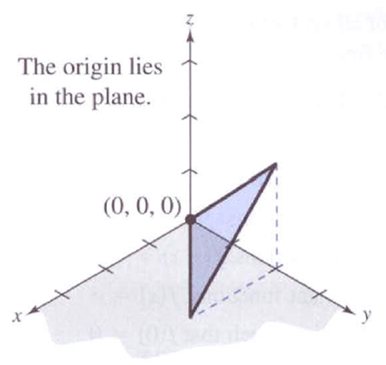
Note: Subspaces of R³
(trivial subspace)
(trivial subspace)

Slide 13
Linear combination:
Example: Finding a linear combination, given
Solution:

Slide 14

Using row operation

Slide 15
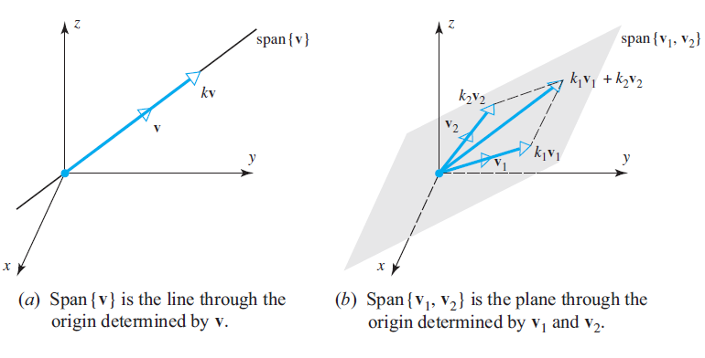
Span of a set
The subspace of a vector space V that is formed from all possible linear combinations of the vectors in a non- empty set S is called the span of S, and we say that the vectors in S span that subspace. If , then we denote the span of S by

Slide 16
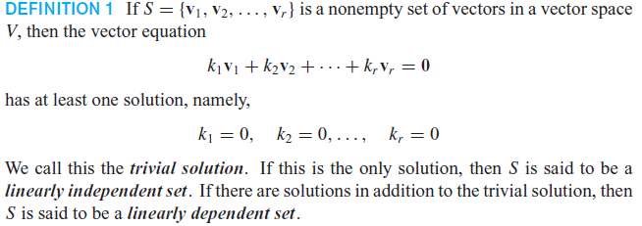
Linear Independence

Slide 17
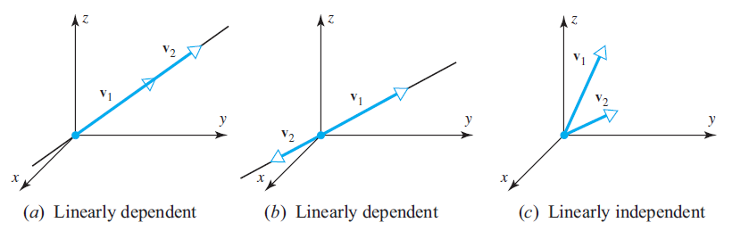
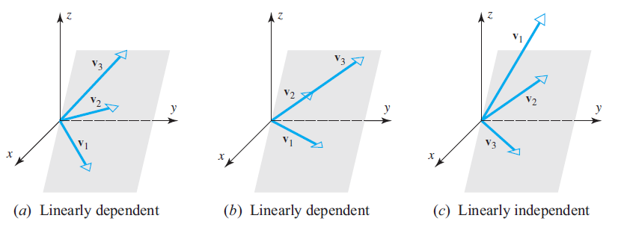
Examples

Slide 18
Example: Determine whether the following set of vectors in R³ is Linearly independent or Linearly dependent.
Solution:

Slide 19
Example: Determine whether the following set of vectors in P₂ is Linearly independent or Linearly dependent.
Solution:
c₁v₁+c₂v₂+c₃v₃ = 0
i.e.,
c₁(1+x – 2x²) + c₂(2+5x – x²) + c₃(x+x²) = 0+0x+0x²
c₁+2c₂ = 0
c₁+5c₂+c₃ = 0
–2c₁– c₂+c₃ = 0
⇒
⇒
⇒ This system has infinitely many solutions
(i.e., this system has nontrivial solutions, e.g., c₁=2, c₂= – 1, c₃=3)
⇒ S is (or v₁, v₂, v₃ are) linearly dependent

Slide 20
Example: Determine whether the following set of vectors in the 2×2 matrix space is Linearly independent or Linearly dependent.
Solution:
c₁v₁+c₂v₂+c₃v₃ = 0
2c₁+3c₂+ c₃ = 0
c₁ = 0
2c₂+2c₃ = 0
c₁+ c₂ = 0
⇒
⇒
⇒
c₁ = c₂ = c₃= 0
(This system has only the trivial solution)
⇒
S is linearly independent

Slide 21
Dimension: The maximum number of linearly independent vectors in V is called the dimension of V and is denoted by dim V.
Basis: A linearly independent set in V consisting of a maximum possible number of vectors in V is called basis for V. Thus the number of vectors of a basis for V equals dim V.
Or
A non-empty subset B of V is called a basis for V if it satisfies the following two properties:
B is linearly independent set V
B generates V ( i.e., every element of V can be expressed as a linear combination of B)

Slide 22
Rank and Nullity
Note: Now rank(A) is the maximum number of linearly independent row vectors of A. This number does not change if we change the order of these rows, or multiply one of them by a nonzero c, or take a linear combination by adding a multiple of a row to another row. Hence rank is invariant under elementary row operation.
The rank of a matrix A is the maximum number of linearly independent row vectors of A. It is denoted by rank(A).
The solution set of the homogeneous system AX = 0 is a vector space, called the null space of A, and its dimension is called the nullity of A .

Slide 23
Example: Finding the solution space (or the null space) of a homogeneous system with the coefficient matrix A as follows.
Solution: The null space of A is the solution space of Ax = 0
⇒ x₁ = –2s – 3t, x₂ = s, x₃ = –t, x₄ = t

Slide 24
Example: Let the column vectors of the matrix A be denoted by a₁, a₂,
a₃, a₄, and a_{5 .} Find the rank, nullity and dimension of A
a₁ a₂ a₃ a₄ a₅
Solution: Derive B to be the reduced row-echelon form of A.
a₁ a₂ a₃ a₄ a₅ b₁ b₂ b₃ b₄ b₅
Rank(A) = 3 Nullity(A) = 2 Dimension= 5

Slide 25
Problems
Are the following sets of vectors linearly independent or dependent ?
1) [1 0 0], [1 1 0], [ 1 1 1]
2) [7 -3 11 -6], [-56 24 -88 48]
3) [-1 5 0], [16 8 -3], [-64 56 9]
4) [1 -1 1], [1 1 -1], [-1 1 1], [0 1 0]
5) [2 -4], [1 9], [3 5]
6) [3 -2 0 4], [5 0 0 1], [-6 1 0 1], [2 0 0 3]
7) [3 4 7], [2 0 3], 8 2 3], [5 5 6]
8) [6 0 3 1 4 2], [0 -1 2 7 0 5], [12 3 0 -19 8 -11]

Slide 26
Thank You

