Slide 1
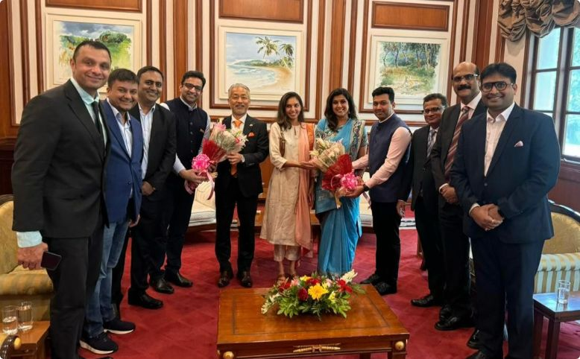
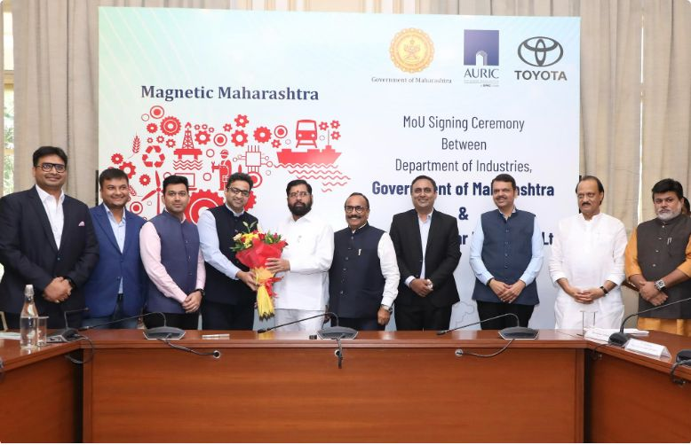
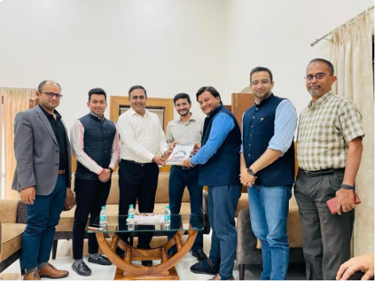
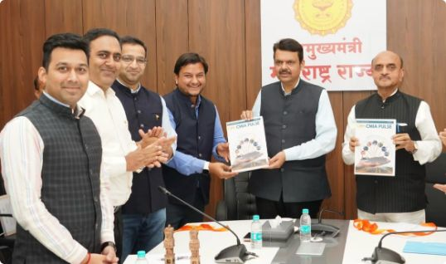
CMIA IN ACTION
Anchoring Investments in CSN
CMIA's leadership has been present at every critical milestone — from boardrooms to factory floors.
Toyota Kirloskar Motors
Ather Energy
18+ Months of active facilitation
10+ Delegations to CSN led by CMIA
₹25k Cr
₹2k Cr
25+ TKM members (70% Japanese)
250+ kms / visit
Investment
Investment
16k
4k
Employment
Employment

Slide 2
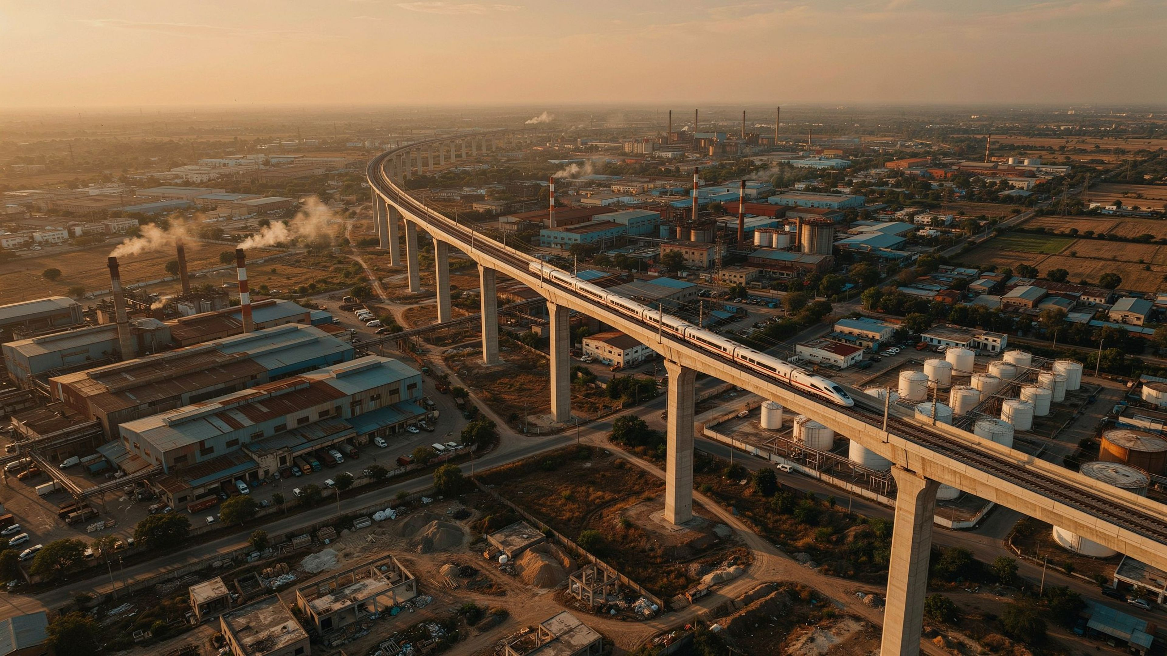







NATIONAL AGENDA
Strategic National Demands: What We Seek
Catalytic Interventions to Anchor Maharashtra's Central Growth Hub
Ease of Compliance
PLI & MIME — Import Substitution
Faster & Centralised Clearances
Defence Sister Location — CSN
Industrial Township Program
High-Speed Data Network
Clean Admin Manufacturing Zone

Slide 3









CMIA'S COMMITMENT
What We Pledge to Deliver
A high-accountability partnership between CMIA and the Government of India for Viksit Bharat 2047.
We Will Invest
We Will Employ & Build Talent
We Will Develop Local Suppliers & MSMEs
We Will Invest in Innovation, R&D & IP
We Will Take CSN Products to Global Markets
We Will Build the Wider Ecosystem
We Will Partner with Government on Reform

