Slide 1

LastPrice
🎤 Mehedi
Frictionless Silent Auction & Escrow Marketplace
Presented By
Supervised By
Mehedi Hassan Bhuiyan (0432320005101080) Md. Masud Rahman (0432320005101064) Hasib Al Mahmud Siddique (0432320005101095) Rudro Antony Mrong (0432320005101059)
Dhrubo Barua & Md. Faysal Faculty Members, Dept. of CSE University of Information Technology & Sciences Software Engineering & System Analysis Lab
UITS • CSE Department • 2024

Slide 2
The Market Gap & Our Challenge
🎤 Mehedi
Why we built LastPrice and the hurdles we faced
💬 Haggling Fatigue
🛡️ Handover Fraud
⚖️ The Penny-Bid Problem
Traditional marketplaces rely on endless texts, low-ball offers, and uncommitted buyers, causing huge frustration.
Physical peer-to-peer meetups provide zero proof of exchange, leaving parties vulnerable to scams.
When we designed the silent auction, buyers just bid $1 incrementally to find the reserve. This broke the system. Our solution? Cap bids to exactly 3 chances.

Slide 3
A Real Scenario: Selling a MacBook
🎤 Masud
How Display Price and Reserve Price work together
The Seller's Setup
• You want to sell a MacBook Pro. • You hope to get $1,500 for it. • But you're willing to accept $1,200 as your absolute minimum. In LastPrice, you set TWO prices: 1. Display Price ($1,500): What everyone sees on the marketplace. 2. Secret Reserve Price ($1,200): The vault threshold hidden from buyers.
Why two prices?
It mimics real-life bargaining but automates it. The buyer thinks they are negotiating down from $1,500, while the seller is guaranteed to never sell below $1,200.

Slide 4
A Real Scenario: The Buyer's Journey
🎤 Masud
Bidding in the 3-Chance Arena
The Buyer's Perspective
A buyer sees the MacBook listed for $1,500. They know they have 3 chances to find the secret reserve.
Round 1: The Low-ball
Round 2: The Adjustment
Round 3: The Win
Buyer bids $800. System says: RED (Cold). The buyer realizes they need to be serious.
Buyer bids $1,100. System says: YELLOW (Hot!). They are within 70% of the hidden reserve!
Buyer bids $1,250. System says: GREEN (Matched!). The $1,200 floor is breached.
Mutual Satisfaction: The buyer feels great for negotiating $250 off the display price. The seller is happy because they got $50 more than their minimum floor without ever replying to a single message.

Slide 5
Final Step: Escrow & Handover
🎤 Masud
Securing the physical exchange
🤝
How it works:
1. Once the bid matches, unique 6-digit cryptographic codes are generated for both parties.
2. They meet up in person to exchange the MacBook.
3. Both parties open the LastPrice portal and enter their respective codes.
4. The system validates both codes instantly, confirming the exchange is genuine and complete.
Result: Tamper-proof proof of exchange. No scams. No disputes.

Slide 6
Technical Details: The RGB Feedback System
🎤 Hasib
How the Arena calculates and displays tension
The Core Algorithm:
🔴 RED (Cold)
Instead of a simple pass/fail, the system calculates the percentage of the buyer's bid relative to the Secret Reserve Price. Percentage = (Bid / Reserve Price) * 100
Bid < 70% of Reserve. UI shakes, screen glows red, indicating the bid is significantly too low.
🟡 YELLOW (Hot)
Bid >= 70% and < 100% of Reserve. UI pulses yellow, indicating the buyer is getting very close.
🟢 GREEN (Matched)
Bid >= 100% of Reserve. Screen flashes green, confetti triggers, and the escrow process initiates.

Slide 7
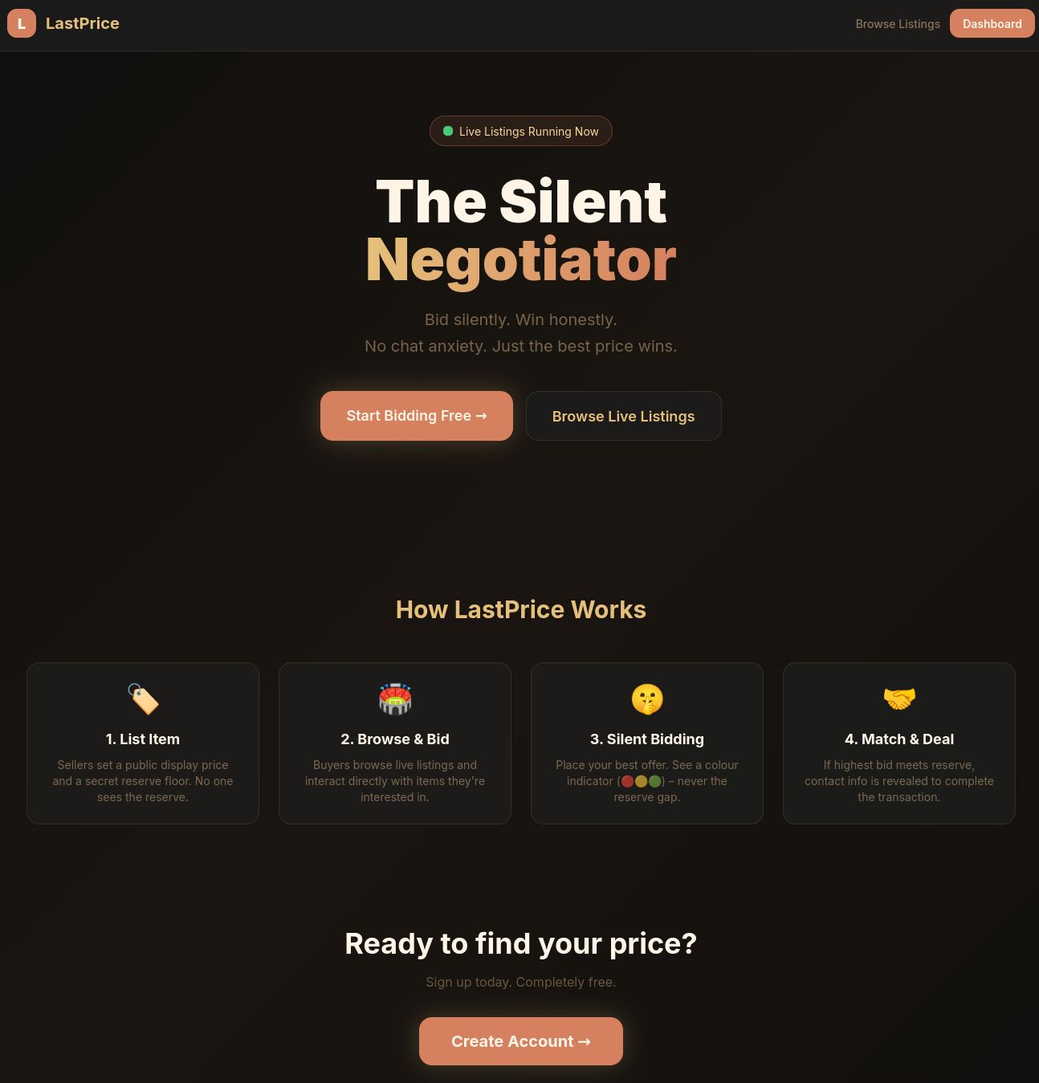
Platform Walkthrough — Landing Page
🎤 Hasib

Slide 8
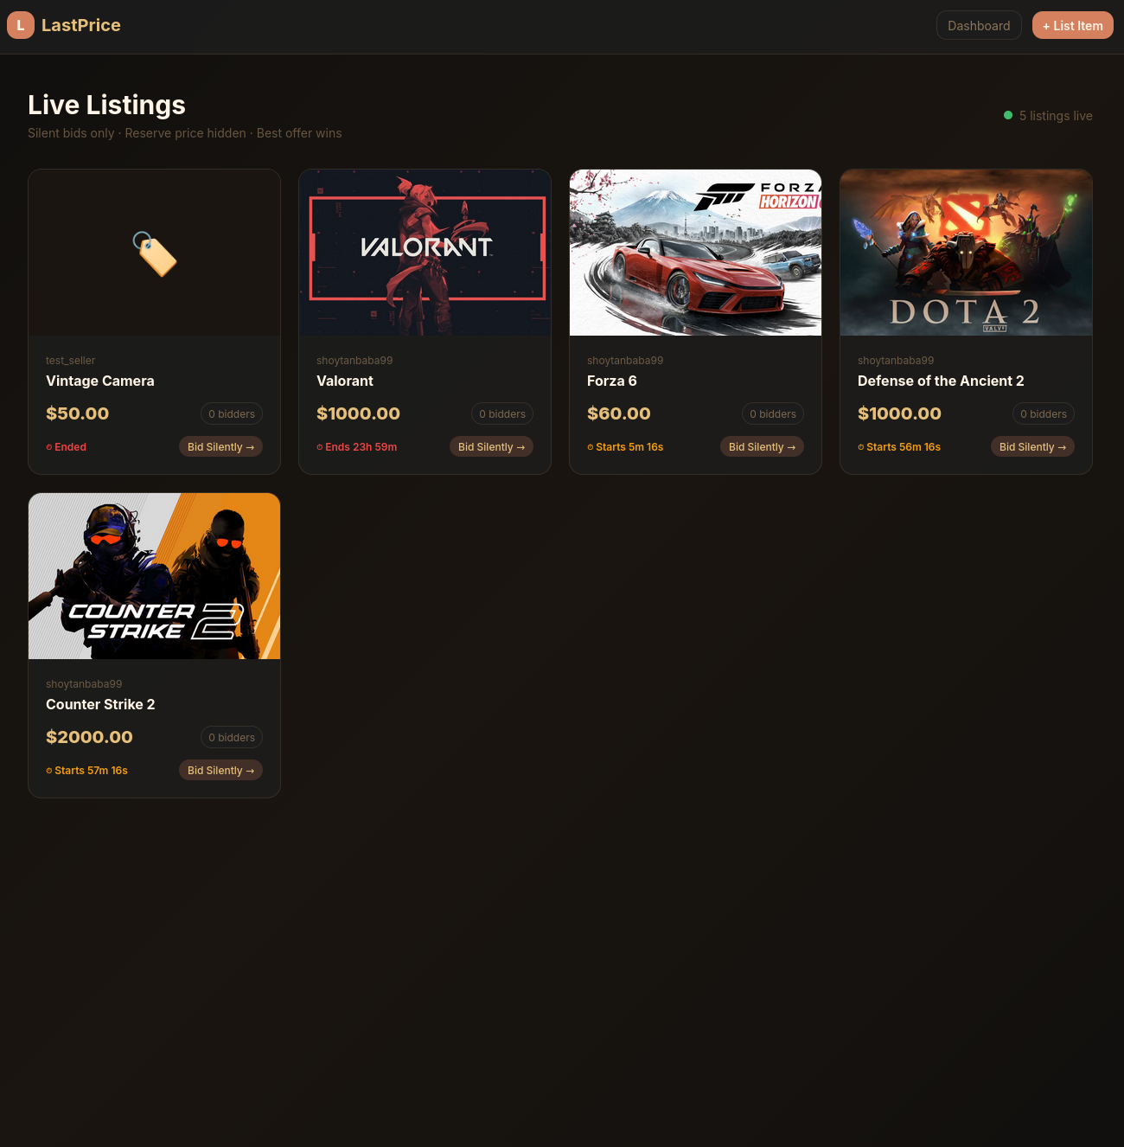
Platform Walkthrough — Marketplace
🎤 Hasib

Slide 9
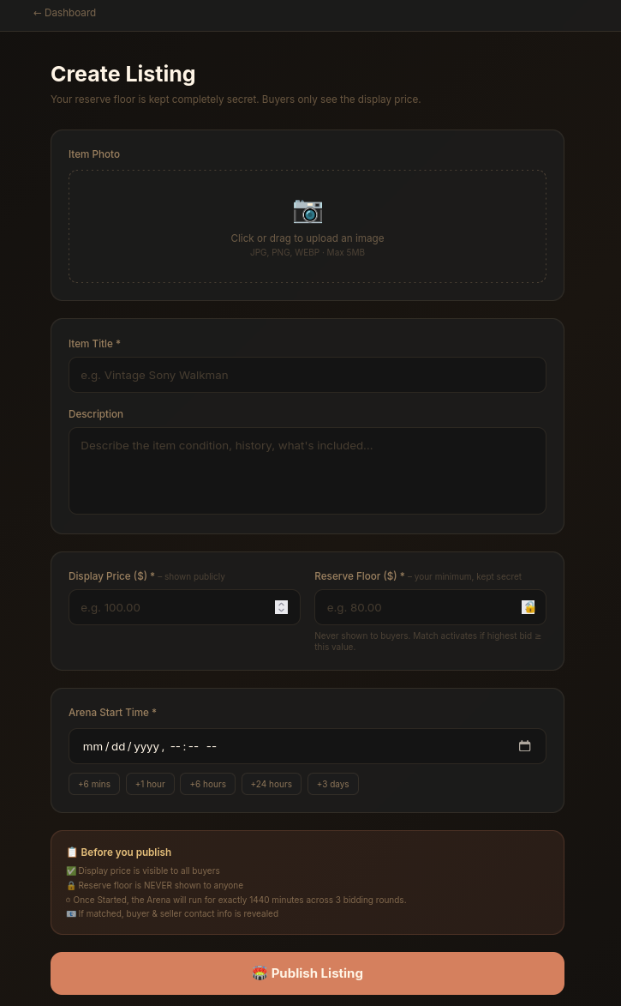
Platform Walkthrough — Creating an Auction
🎤 Hasib

Slide 10
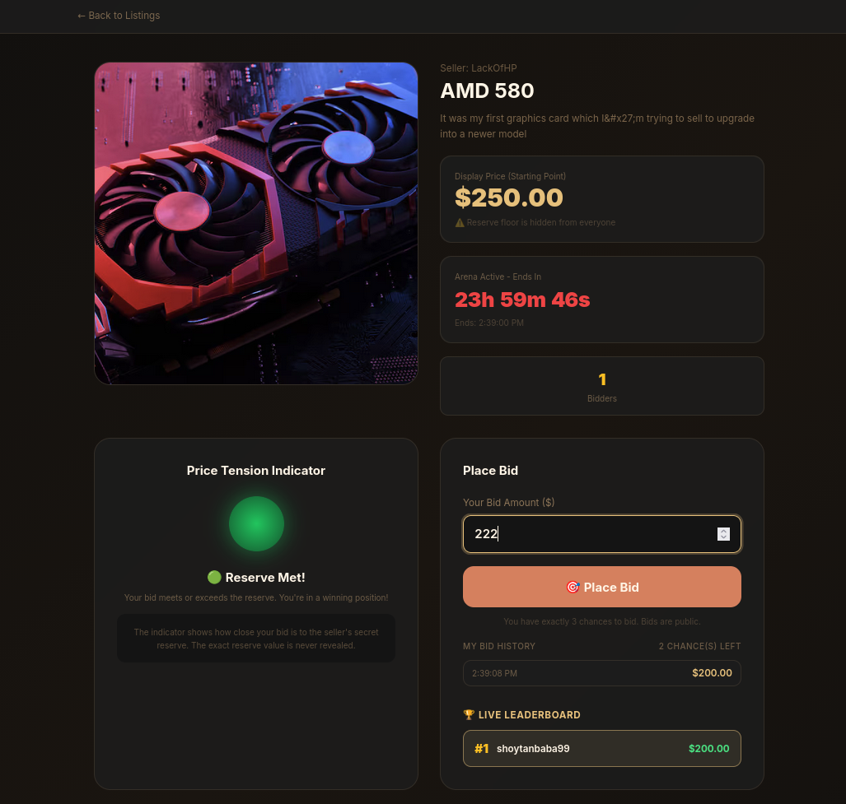
Platform Walkthrough — The Bidding Arena
🎤 Hasib

Slide 11
Limitations & What We Learned
🎤 Rudro
Challenges faced during development
⚠️ Current Limitations
💡 What We Could Have Done Better
1. Front-End Responsiveness: The UI is currently optimized for desktop; mobile scaling needs further refinement. 2. Real-Time Sync: The countdown timer occasionally desyncs between client and server due to latency. 3. Single-Item Checkout: Escrow currently only supports one item at a time per meeting.
1. WebSockets: We relied heavily on REST polling. We should have used WebSockets for real-time bid updates. 2. User Onboarding: More in-app tooltips explaining the 3-bid rule would prevent initial user confusion. 3. Test Coverage: We should have prioritized automated testing for edge cases in the auction logic.

Slide 12
Future Scope
🎤 Rudro
Where LastPrice goes next
⚙️ Customizable Limits
👤 Buyer Selection
⭐ Trust Points
Let sellers choose exactly how many bid chances to allow (e.g. 2 to 5), giving them full control over the speed.
Allow sellers to manually pick the winning buyer from the matched pool based on reputation or location.
A gamified reputation system that awards points to users for every successful verified physical handover.

Slide 13
Thank You!
LASTPRICE MARKETPLACE
❓ Questions & Answers
🎤 Rudro

