Slide 1
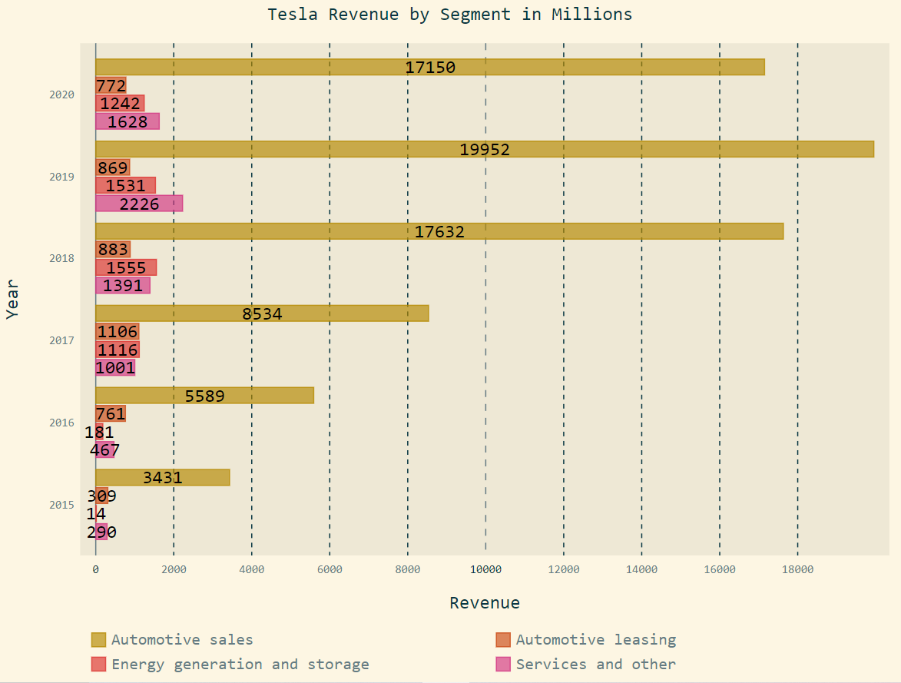
Tesla possible future incomes:
In-house car insurance
Robo-taxi
Ride-hailing Vehicles and Services
FSD & Software as a service
Industry batteries
Computer chips for FSD

