Slide 1
EV Outbreaks , from 2020 to 2040:
EV cars in road in 2020
Percent of global passengers will use Evs by 2040.
500,000 e-buses
400,000 electric delivery vans and trucks
184 million electric mopeds, scooters and motorcycles on the road globally.
source: Bloomberg
EVs hit global passenger vehicle sales 10% in 2025 .
It will be increased by 28% in 2030.
It will be increased by 58% in 2040.
source: Bloomberg
Green Hydrogen cost cut
Evs performance by 2040.
Green hydrogen costs will fall by up to 64% by 2040.
Source: wood Mackenzie
By 2040, 500 million passenger uses EVs on the road
31% of the world's passenger cars are electric
source: Bloomberg

Slide 2
EV Outbreaks , from 2020 to 2040
Ev charging unit in North America and Europe.
Ev impact on Americans private house hold incomes
In North America and Europe 500,000 charger units in 2022 and its reach over 1.25 million by 2025,
Sources Wood Mackenzie
USA private house hold can save $ 255 to $791 per year
In total, the private benefits for the main Aggressive and Low Cost scenarios range from $18.6 billion to $27.3 billion per year by 2035.
source: NREL

Slide 3
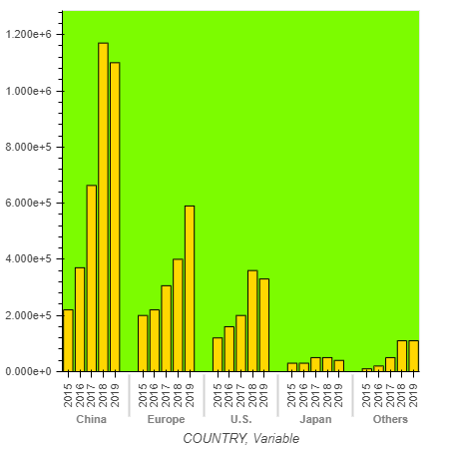
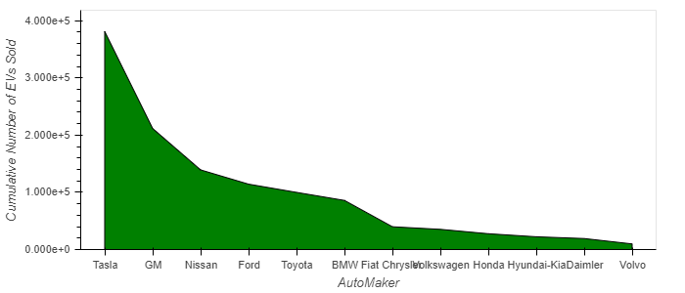
EV Outbreaks , from 2020 to 2040
TOP 10 Ev Automaker 2019
EV sale globally 2015 to 2019

