Slide 1


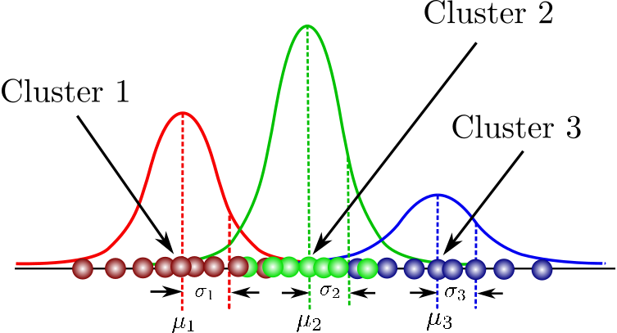
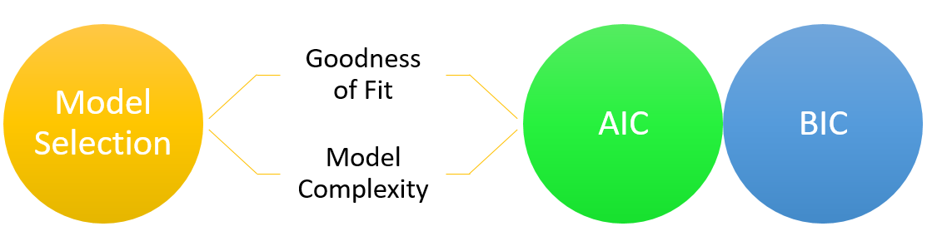

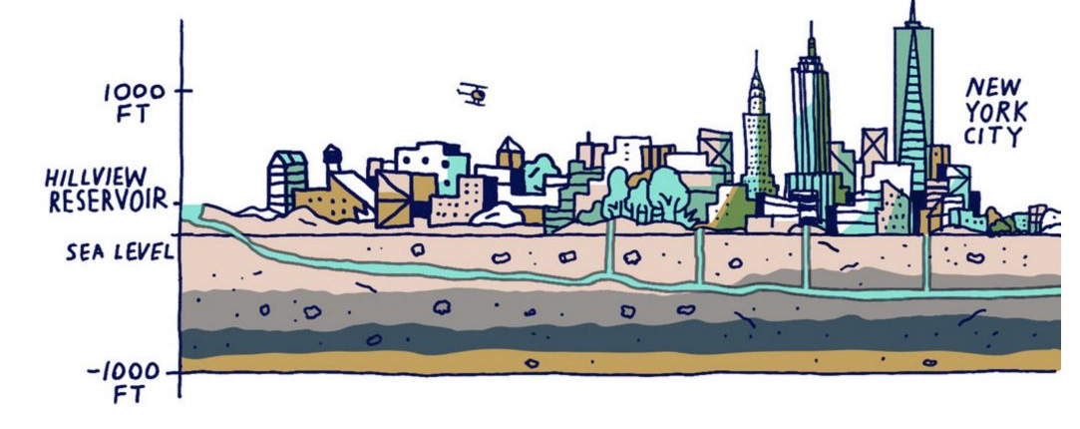
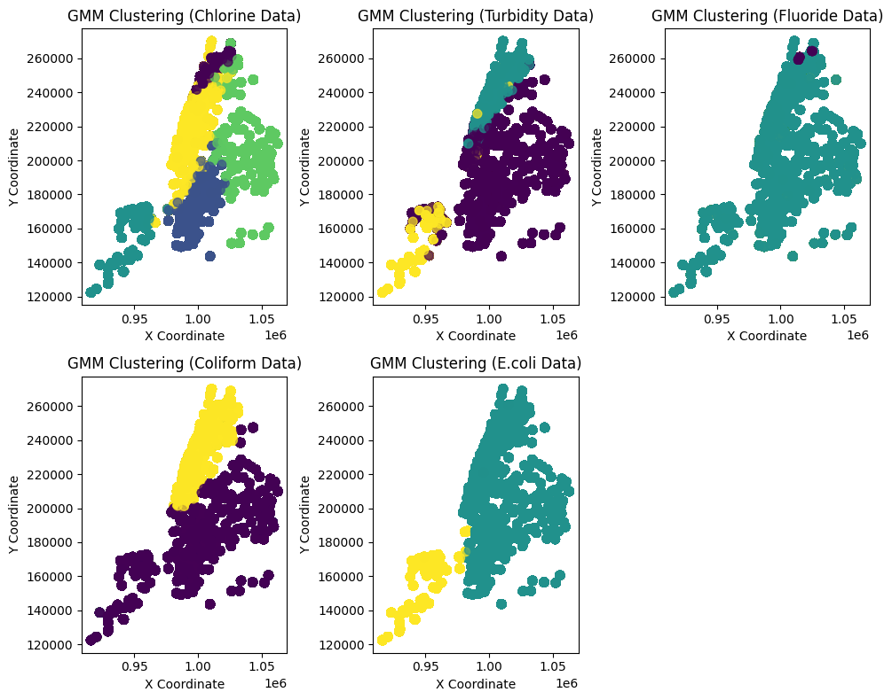
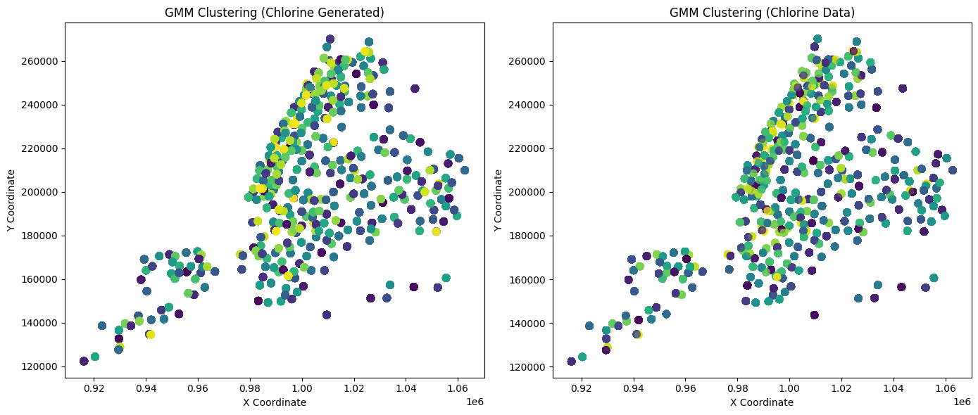
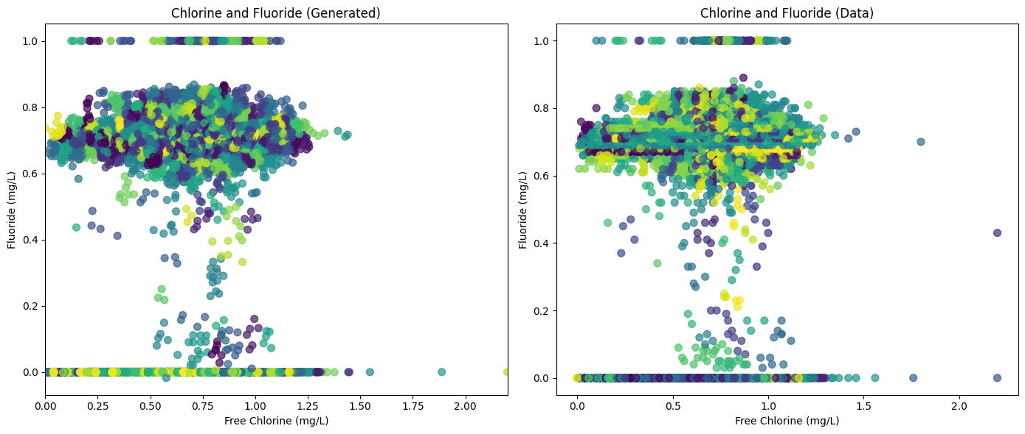
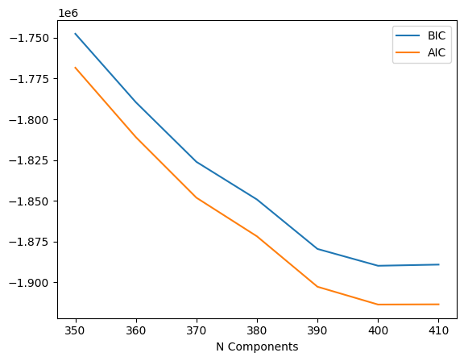
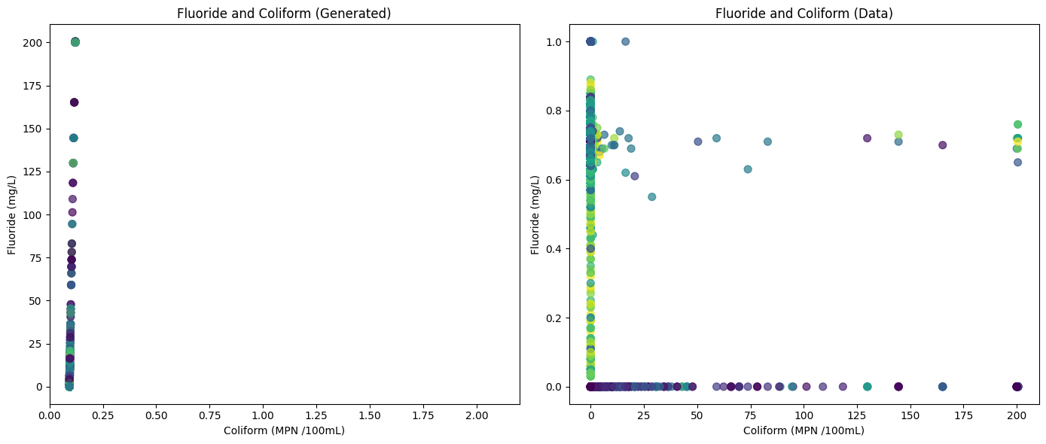
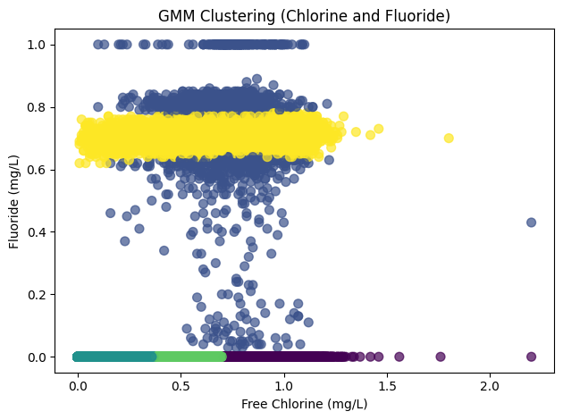
Exploring Gaussian Mixture Models (GMM) as a tool for understanding urban water quality.
Tetsuya Andrew Kawatika* and Susie Park
Department of Chemical Engineering, Columbia University, New York, NY 10027
Abstract
Background Information
Model Selection and Criticism
Gaussian Mixture Models are a powerful tool in data science and engineering. Especially as we live in a more data driven world, we need to understand the tools we have to actually parse through these data. To explore the uses and limitations of GMM we applied it to water quality data from New York. We seeked to identify clustering between spatial and contaminant features within the data. As this could reveal localized vs centralized issues with water quality. Our aim was to see if GMM could help us cluster water quality features such as Chlorine, turbidity, fluoride, and coliform levels by location or borough. However, model criticism using AIC and BIC revealed that minimizing error required as many clusters as data points, indicating a poor model. This study provides insights into the challenges of applying GMM to real world environmental data.
Gaussian Mixture Models (GMM) are a statistical clustering technique that is valuable to applications such as material design, signal processing, and environmental analysis.
In the context of urban engineering, we hoped to patterns between spatial and contaminant features as this would give us insight on localized challenges. Differences in infrastructure across boroughs or landscape might necessitate specific adjustments to water management. This study was not only an investigation into NYC’s water quality but also a test of GMM’s application for real world data.
GMM was used for its ability to identify clusters in data with multi parameters. Our data set included spatial coordinates (X and Y) and water quality features (Chlorine, Turbidity, Fluoride, and Coliform concentrations) with the hypothesis that GMM could help cluster the data in a way that is location specific to NYC’s boroughs.
We used Principal Component analysis (PCA) to help reduce the dimensionality of the data to more easily achieve convergence for GMM while maintaining the variance in the data. It can also tell us preliminary key features.
Model criticism was performed using the Akaike Information Criterion (AIC) and Bayesian Information Criterion (BIC). Both criteria will tell us how many clusters we will need to minimize prediction error allowing us to determine an ideal amount of clusters for the data without overfitting.
Initial Prediction:
Results and Discussion
Conclusion and Future work
Data Generation:
This study highlights the challenges of applying Gaussian Mixture Modeling to real-world environmental data sets. While GMM is a powerful tool, its effectiveness depends on the data’s structure and variability. In the case of NYC water quality, the model’s inability to make meaningful clusters might be indicative of two things:
There were not enough sampling sites for GMM to make meaningful predictions
There was no cluster or pattern to discover as the water treatment strategy NYC employed is uniform and strategized.
Future Work will focus on:
Exploring alternative categorical techniques
Exploring GMM as a technique with a different data set that might yield more meaningful patterns
Expanding the data set so that GMM can pick up on a meaningful pattern.
Implications for Water Quality Data:
The inability to cluster effectively may indicate uniformity in NYC’s water treatment strategy.
This suggests that the water treatment management of NYC is centralized and not localized.
There is probably a treatment plant closer to the source and the water simply gets delivered to the boroughs and not further treated based on location.
GMM Performance:
PCA reduced dataset from 148936 by 7 to 148936 by 2
5 cluster guess for 5 boroughs
Acknowledgements
Image Sources:
Ajitesh KumarI (2023, November 10). AIC & BIC for selecting regression models.
Carrasco, O. C. (2020, February 21). Gaussian mixture models explained. Medium.
New York City water supply: Animated history. Myles Zhang. (2021a, March 28).
Code Sources:
Kyle Bishop, (2024 Sept-Dec). Courseworks.
Data Source:
“Drinking Water Quality Distribution Monitoring Data.” NYC Open Data, Database, 18 Oct. 2024, Accessed Nov. 2024.
Model Performance:
AIC and BIC calculations determined that prediction errors were minimized at approximately 400 clusters.
The required number of clusters is nearly equal to the number of sample sites (401).
This suggests that GMM may not be suitable for datasets with small sample sizes as data points are too unique
Lessons on GMM as a tool:
A poor GMM fit doesn’t mean that the data or the model is bad. It means that it is not the right tool to be used for this data set.
Real-world urban data sets, like water quality, may require alternative clustering techniques to reveal meaningful patterns.

