Slide 1
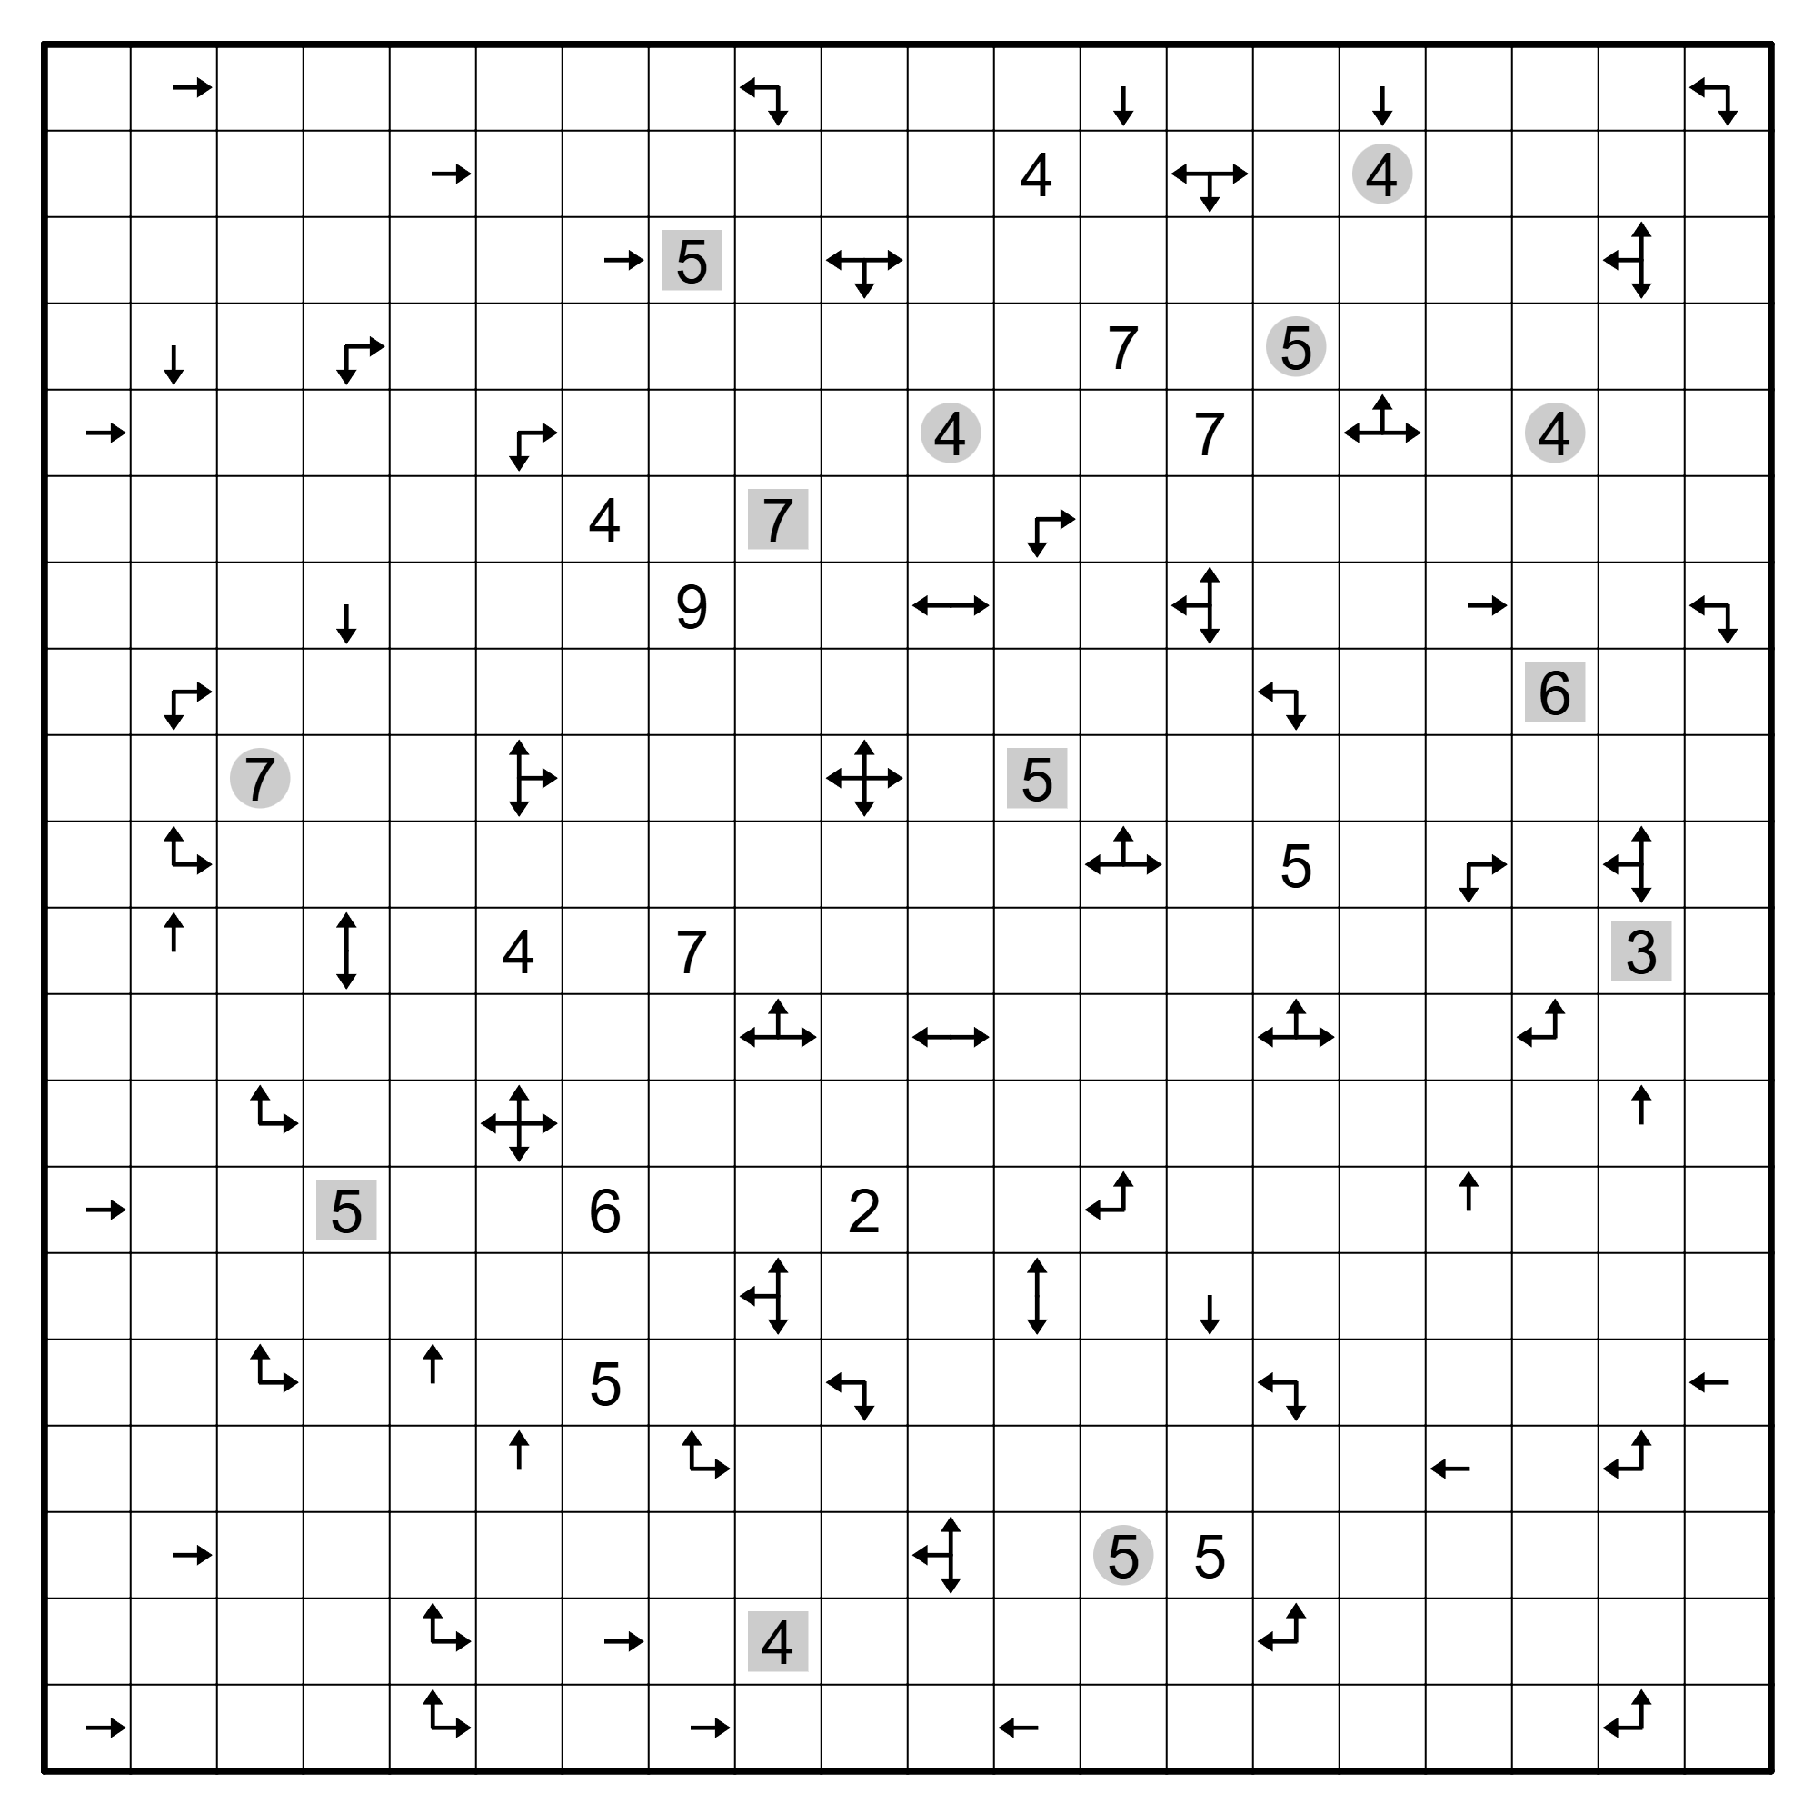

Slide 2
. | R | . | . | . | . | . | . | LD | . | . | . | D | . | . | D | . | . | . | LD
. | . | . | . | R | . | . | . | . | . | . | 4 | . | LRD | . | o4 | . | . | . | .
. | . | . | . | . | . | R | q5 | . | LRD | . | . | . | . | . | . | . | . | LUD | .
. | D | . | RD | . | . | . | . | . | . | . | . | 7 | . | o5 | . | . | . | . | .
R | . | . | . | . | RD | . | . | . | . | o4 | . | . | 7 | . | LRU | . | o4 | . | .
. | . | . | . | . | . | 4 | . | q7 | . | . | RD | . | . | . | . | . | . | . | .
. | . | . | D | . | . | . | 9 | . | . | LR | . | . | LUD | . | . | R | . | . | LD
. | RD | . | . | . | . | . | . | . | . | . | . | . | . | LD | . | . | q6 | . | .
. | . | o7 | . | . | RUD | . | . | . | LRUD | . | q5 | . | . | . | . | . | . | . | .
. | RU | . | . | . | . | . | . | . | . | . | . | LRU | . | 5 | . | RD | . | LUD | .
. | U | . | UD | . | 4 | . | 7 | . | . | . | . | . | . | . | . | . | . | q3 | .
. | . | . | . | . | . | . | . | LRU | . | LR | . | . | . | LRU | . | . | LU | . | .
. | . | RU | . | . | LRUD | . | . | . | . | . | . | . | . | . | . | . | . | U | .
R | . | . | q5 | . | . | 6 | . | . | 2 | . | . | LU | . | . | . | U | . | . | .
. | . | . | . | . | . | . | . | LUD | . | . | UD | . | D | . | . | . | . | . | .
. | . | RU | . | U | . | 5 | . | . | LD | . | . | . | . | LD | . | . | . | . | L
. | . | . | . | . | U | . | RU | . | . | . | . | . | . | . | . | L | . | LU | .
. | R | . | . | . | . | . | . | . | . | LUD | . | o5 | 5 | . | . | . | . | . | .
. | . | . | . | RU | . | R | . | q4 | . | . | . | . | . | LU | . | . | . | . | .
R | . | . | . | RU | . | . | R | . | . | . | L | . | . | . | . | . | . | LU | .

Slide 6
Notes:
2(ab+bc+ca)=SA=# of squares.

Slide 7
Notes:
2(ab+bc+ca)=SA=# of squares.

Slide 8
Notes:
2(ab+bc+ca)=SA=# of squares. 138

