Slide 1
Routers Learn the Geometry of Their Experts?
Why Sparse MoE Routers Collapse Before They Specialize
An audit of expert-spectrum initialization and early routing amplification
邓星宇 Deng Xingyu | Student ID: 250010109
Notes:
Timing: 35s.
Hello everyone, before my presentation, since I was majored in computational mathematics and the content I did before had nothing to do with AI, and now I haven’t gotten fruits in the current problem, so I will just present a mechanism audit of sparse MoE routing. The goal is not to claim a finished routing method. The question is why a top-1 router can concentrate many tokens onto a few experts before useful specialization forms. The final part tests an expert-spectrum initialization idea and shows that initialization alone is not enough.

Slide 2
02/15
Agenda
A mechanism audit, then a method stress test
01
Motivation
02
Research Question
03
Mechanism Evidence
Why routing geometry matters for sparse MoE scaling.
Which hidden-state geometry is amplified first?
Common-logit bias in controlled and real-text settings.
04
Training Dynamics
05
Init Stress Test
06
Claim Boundary
Why step-10 concentration is not gate-only.
Expert-spectrum initialization improves step 0 but fails by step 10.
What can be claimed, what remains open.
Notes:
Timing: 35s.
The talk has six parts. I first motivate why routing geometry matters for sparse MoE scaling. Then I define the research question. The middle part gives the common-logit mechanism and training-dynamics evidence. The last part presents the expert-spectrum stress test, the claim boundary, and the next decision.

Slide 3
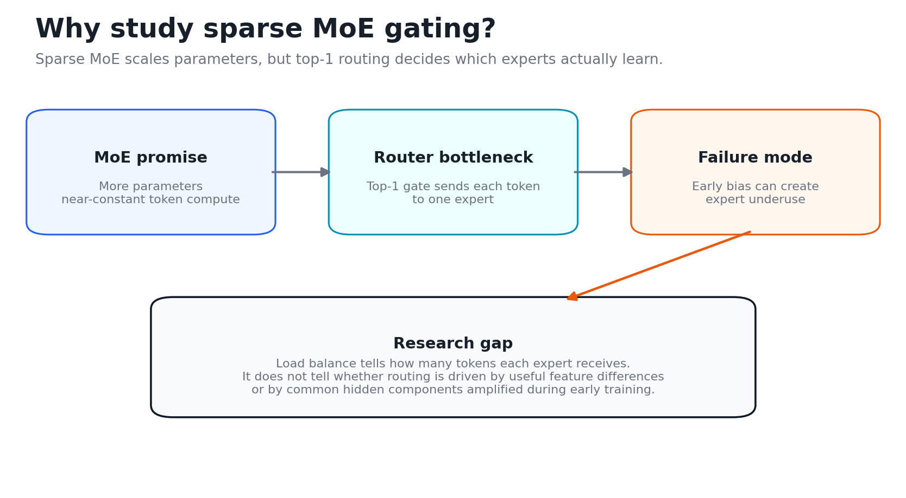
03/15
MoE scaling is router-limited, not only expert-limited
Router controls who learns
Geometry before expertise
Our audit target
Sparse MoE activates few experts per token, so routing decides data and gradient flow.
Recent papers warn: routing patterns often reflect hidden-state geometry, not clean domains.
Which geometry does top-1 routing amplify before useful specialization forms?
MoE promise -> router bottleneck -> early concentration failure
Refs: Shazeer et al., 2017; Fedus et al., 2021; Wang et al., 2026; Ahrac et al., 2026.
Notes:
Timing: 50s.
Sparse MoE increases parameter count while activating only a few experts per token. That makes the router the bottleneck: it controls which experts see data and receive gradients. Prior MoE work studies scaling and load balance. Recent geometry work adds a warning: routing patterns can reflect hidden-state geometry rather than semantic expertise. I use that boundary throughout this talk.

Slide 4
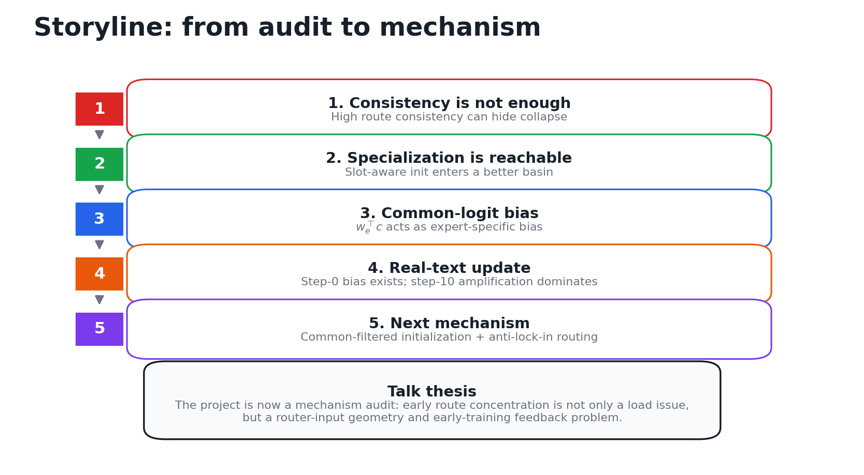
04/15
Question: which geometry does top-1 routing amplify first?
Working thesis
- Hidden states contain useful residual structure.
- They also contain a shared common direction.
- Top-1 routing can turn the shared direction into expert-specific offsets.
Current question
Can expert-aware initialization reduce early bias, or does training re-amplify it?
Seven-day story: from false specialization signal to expert-spectrum stress test
Notes:
Timing: 45s.
The working thesis is simple. Hidden states may contain useful residual structure, but they also contain a shared common direction. A linear top-1 router can convert that shared direction into expert-specific offsets. The research question is whether expert-aware initialization can reduce the early bias, or whether training quickly amplifies it again.

Slide 5
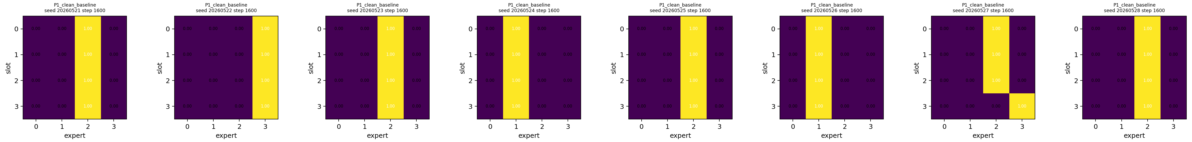
05/15
High route consistency can hide collapse
- A feature can route consistently while many features still share one expert.
- Consistency alone is not evidence of useful specialization.
- Track load, assignment structure, and intervention response together.
false positive
metric set
claim
same-looking consistency can coexist with collapsed expert usage
max load + heatmap + intervention, not route consistency alone
specialization requires distributed and meaningful expert use
Notes:
Timing: 45s.
This slide explains why route consistency alone is not enough. A feature may route consistently, but many different features can still share one expert. That is a false positive for specialization. So I track three things together: expert load, assignment structure, and whether an intervention changes the routing pattern.

Slide 6
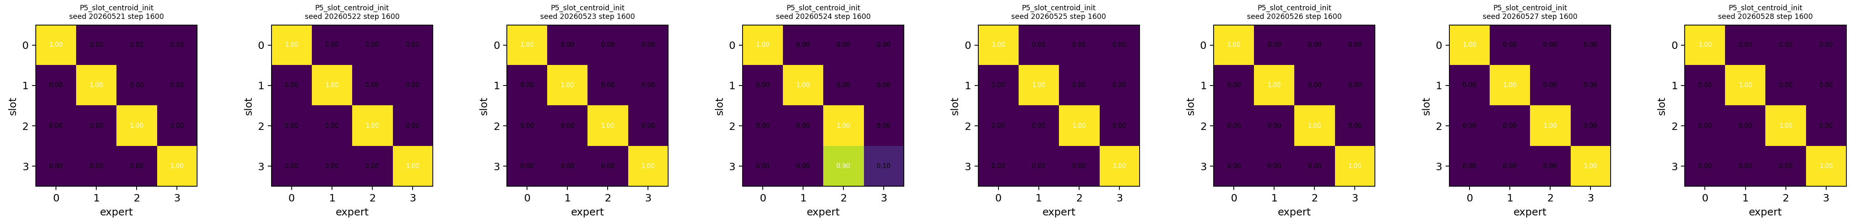
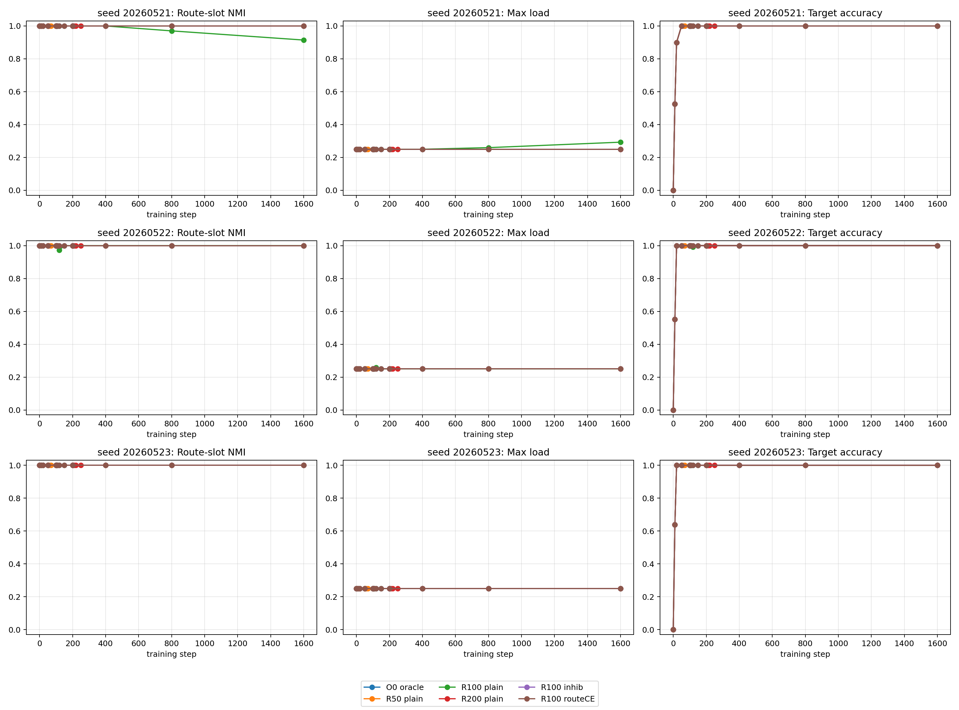
06/15
Specialization is reachable, but random top-1 often misses the basin
- Slot-aware initialization produces stable slot-to-expert structure.
- Oracle-to-trainable release can preserve specialization after basin entry.
- The bottleneck is early basin entry, not impossibility of specialization.
Positive control
The model can specialize when the early routing basin is controlled.
release preserves specialization
Notes:
Timing: 50s.
This positive control rules out a weak explanation. The model is not fundamentally unable to specialize. When the early routing basin is controlled by slot-aware initialization or oracle release, stable slot-to-expert structure can appear. Therefore the bottleneck is basin entry during early training, not the impossibility of specialization.

Slide 7
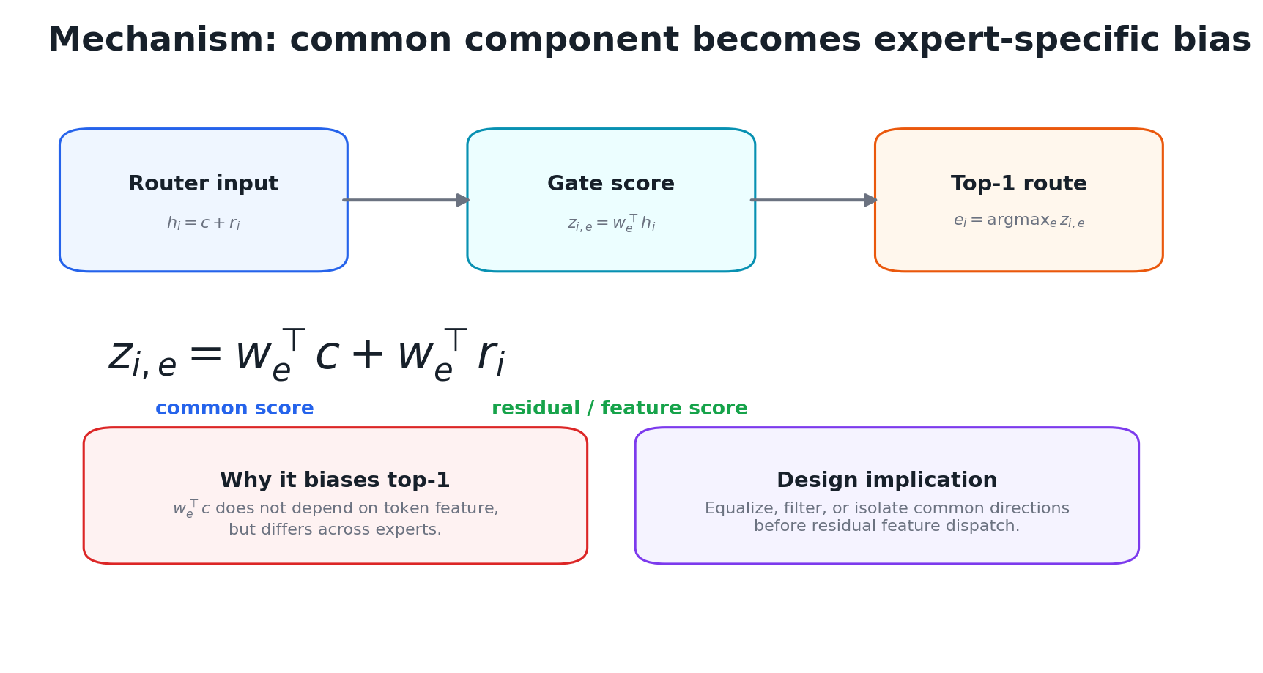

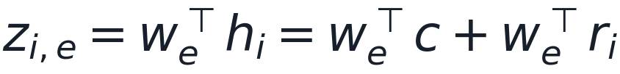
07/15
Common-logit bias acts like an expert-specific offset
Common-logit decomposition
The common term is shared by tokens but differs across experts; under top-1, it can act like an effective expert bias.
Mechanism candidate: shared input geometry becomes unequal expert scores
boundary
target
routing geometry is not automatically semantic expertise
audit which geometry is amplified first
Related claim boundary: Wang et al., The Myth of Expert Specialization in MoEs, 2026.
Notes:
Timing: 60s.
The mechanism is common-logit bias. I decompose the hidden state as h_i equals c plus r_i. The gate score then contains a common term and a residual term. The common term is shared across tokens, but its value differs across experts because each expert has a different router weight. Under top-1 routing, this term can act like an expert-specific offset.

Slide 8
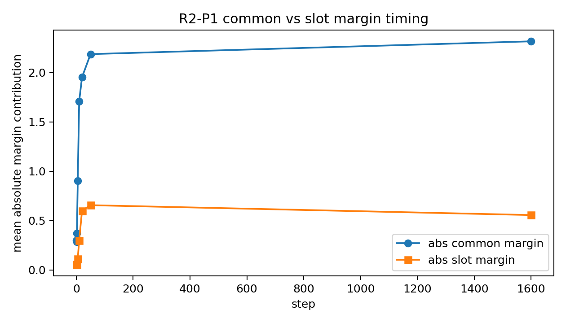
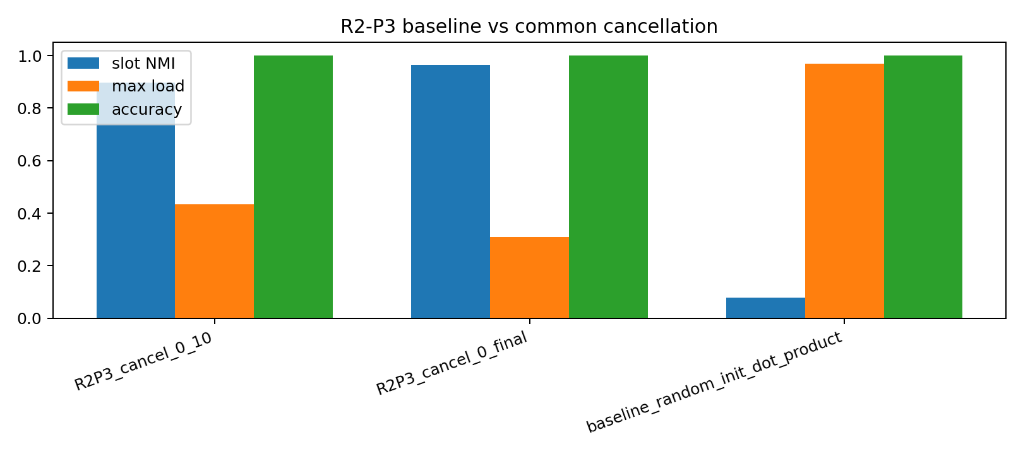
08/15
Controlled evidence: common-logit appears early
- Common margin rises before slot margin becomes decisive.
- Common-logit cancellation improves slot NMI while preserving accuracy.
- This supports common-logit as intervention-relevant in the controlled setting.
common margin timing
cancellation improves slot structure
Intervention result: slot NMI improves while accuracy stays at 1.000
Notes:
Timing: 50s.
In the controlled setting, common-logit appears before the slot margin becomes decisive. More importantly, cancelling the common-logit improves slot NMI while preserving accuracy. This makes the mechanism intervention-relevant, not just descriptive. It supports the idea that a shared direction can distort early top-1 routing.

Slide 9
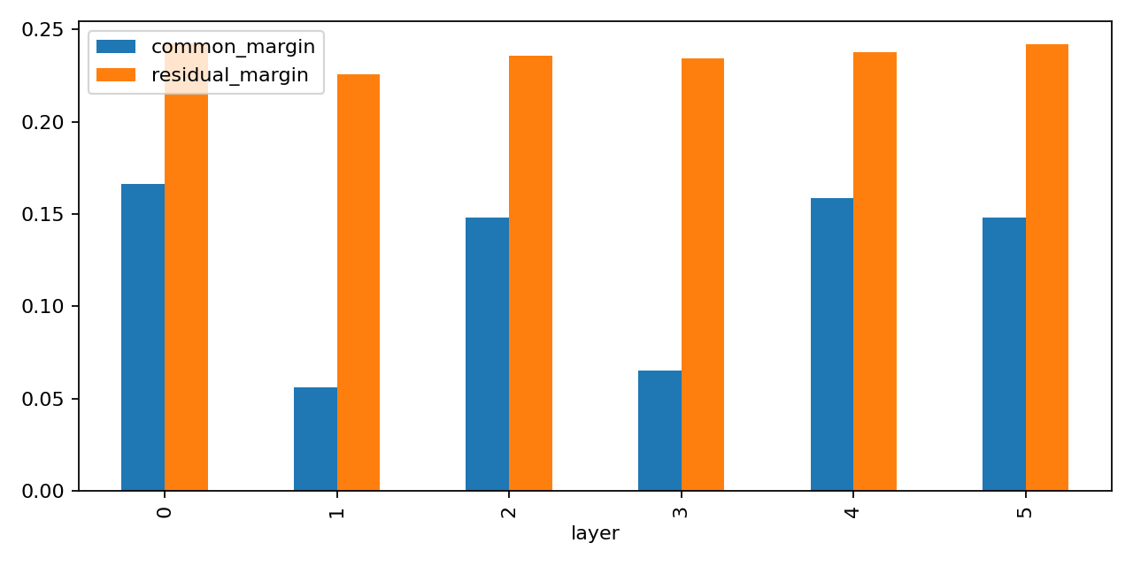
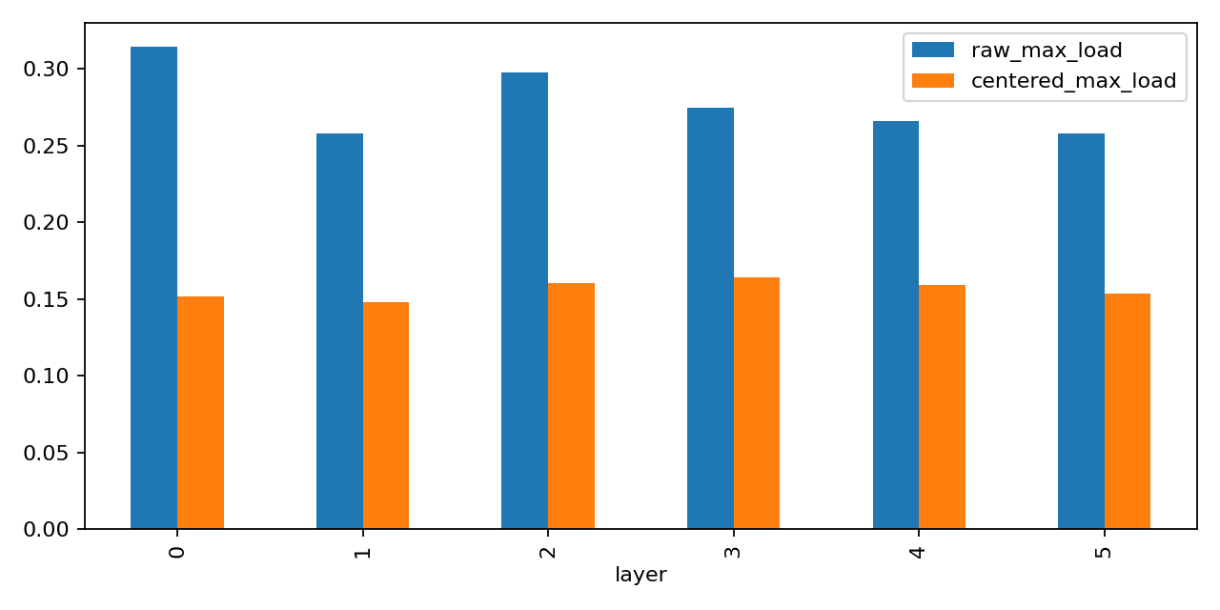
09/15
Real-text step 0: common direction matters, but is incomplete
- After removing top-1% high-frequency tokens, random linear routers still show step-0 load bias.
- Centering / common removal reduces the bias, but does not eliminate all structure.
- This moves the question from static bias to early training amplification.
common vs residual
raw vs centered load
narrower claim 鈥?common removal helps, but is incomplete on real text
Notes:
Timing: 50s.
Real text narrows the claim. After removing the top one percent high-frequency tokens, random linear routers still show step-zero load bias. Centering or common removal reduces that bias, but it does not remove all structure. So the real problem is not only static initialization bias; it is how early training amplifies or reshapes that bias.

Slide 10
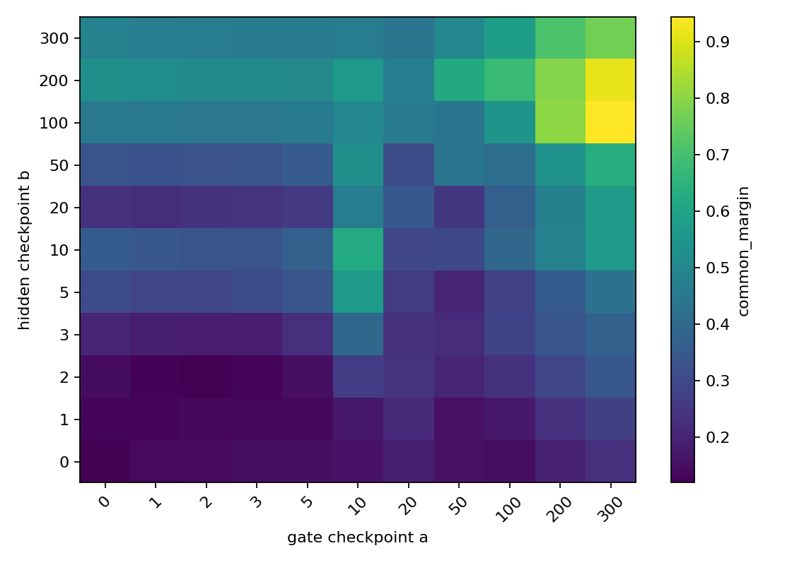
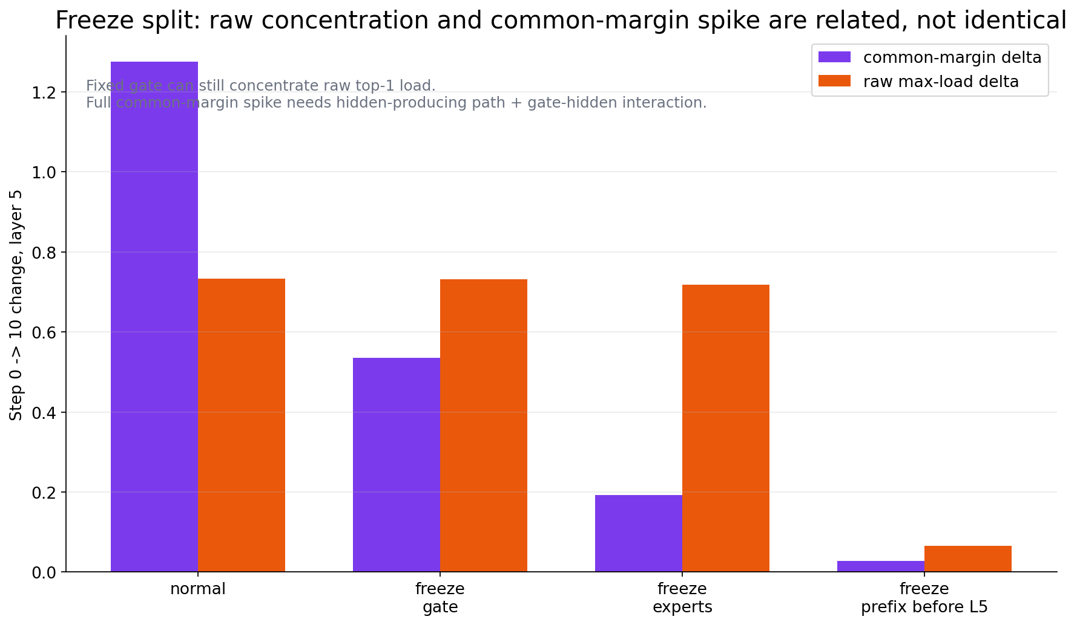
10/15
Step-10 concentration is a coupled gate-hidden effect
- Freezing only the router or only experts does not explain the full spike.
- Freezing the prefix before layer 5 suppresses most early amplification.
- Replay shows a large interaction between router updates and hidden-state changes.
freeze split
cross-checkpoint replay
Update: step-10 route concentration is not gate-only; it is a coupled router-hidden-state amplification.
Notes:
Timing: 55s.
The training-dynamics audit shows that step-ten concentration is not gate-only. Freezing only the router or only experts does not explain the full spike. Freezing the prefix before layer 5 suppresses most amplification, and replay shows a large router-hidden-state interaction. This predicts that a purely linear initialization may help at step zero but fail after updates.

Slide 11
11/15
Expert-spectrum test: initialize the router from expert input geometry
- Expert principal input subspaces are measurable and differ across experts.
- Their overlap with the hidden-state common direction is low.
- The idea is computationally meaningful, but not yet a specialization claim.
Expert input matrices
gate_proj + up_proj
Principal subspaces
top eigen-directions
Common filtering
remove shared direction
Linear top-1 router
current bridge
0.0116
0.0166
0.2328
expert-expert subspace overlap
expert-common overlap
raw spectrum utility correlation
Related framing: Ahrac et al., Routers Learn the Geometry of Their Experts, 2026.
Notes:
Timing: 55s.
The expert-spectrum test initializes the router from each expert's principal input geometry. These expert subspaces are measurable, differ across experts, and have low overlap with the hidden-state common direction. That makes the idea computationally meaningful. But it is still not a claim of semantic specialization; it is a routing-geometry initialization test.

Slide 12
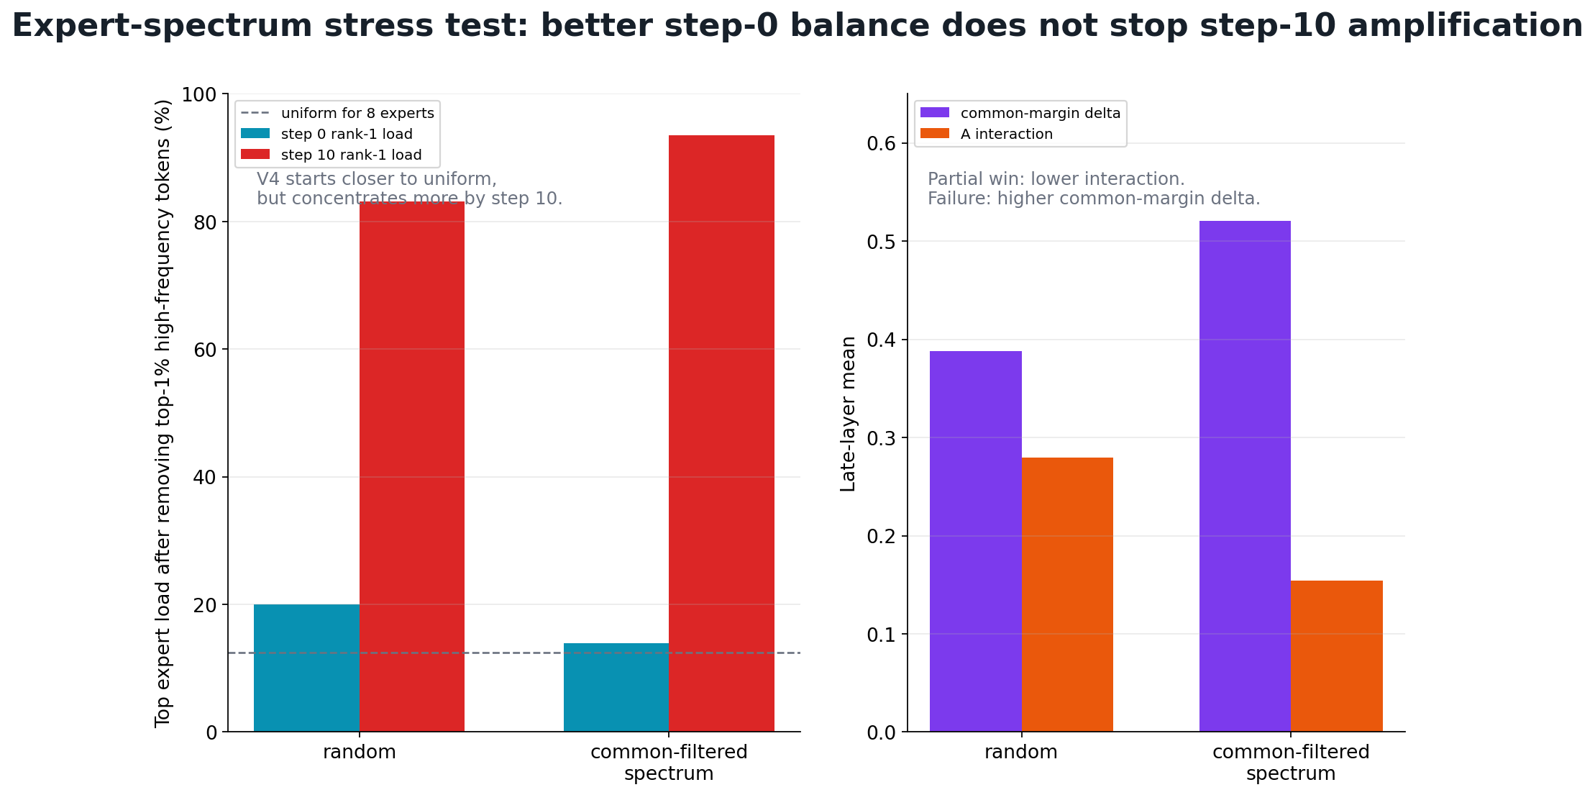
12/15
Common-filtered spectrum improves step 0, but fails by step 10
Init stress test
Step 0 improves after filtering common direction, but step 10 becomes worse than random initialization.
Main metric: max expert load
Step 0: 19.98% -> 13.97%
Step 10: 83.16% -> 93.51%
better step-0 balance does not stop step-10 amplification
Source: internal meeting brief on expert-spectrum initialization and early route concentration.
Notes:
Timing: 60s.
The result is mixed and informative. After filtering the common direction, step-zero balance improves: max expert load drops from about 20 percent to 14 percent. But after ten steps, max load becomes worse: about 94 percent compared with 83 percent for random initialization. The conclusion is precise: better initial balance does not control early training amplification.

Slide 13
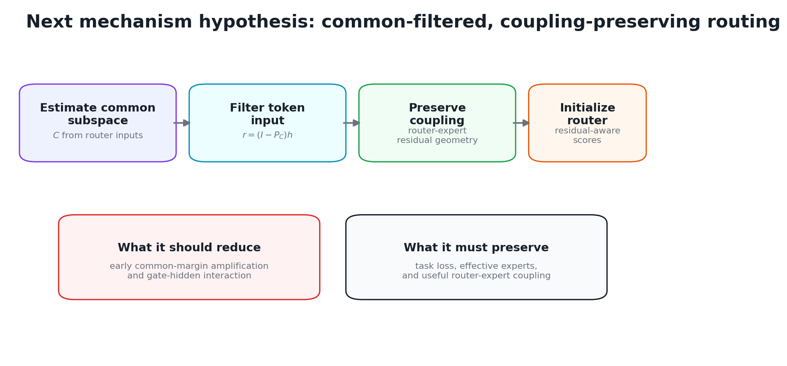
13/15
Three conclusions: geometry is useful, but initialization is not enough
01
Expert geometry exists
Input subspaces differ and are not the common direction.
02
Step-0 bias can improve
Common-filtered spectrum reduces initial max load.
03
Step-10 needs dynamics
next mechanism hypothesis
Router-hidden-state amplification dominates initialization alone.
Next decision: audit whether step-0 route winners are reinforced by early hidden-state change and router updates; then test a stronger oracle or learned bridge.
Notes:
Timing: 60s.
The updated conclusion has three parts. First, expert geometry exists and is not identical to the common direction. Second, common-filtered initialization improves step-zero balance. Third, step-ten concentration is driven by router-hidden-state amplification, not initialization alone. The next decision is to audit whether early route winners are reinforced by hidden-state change and router updates.

Slide 14
15/15
Backup: references
- Shazeer et al., Outrageously Large Neural Networks: The Sparsely-Gated Mixture-of-Experts Layer, 2017.
- Fedus et al., Switch Transformers: Scaling to Trillion Parameter Models with Simple and Efficient Sparsity, 2021.
- Zoph et al., ST-MoE: Designing Stable and Transferable Sparse Expert Models, 2022.
- Wang et al., The Myth of Expert Specialization in MoEs, 2026.
- Ahrac et al., Routers Learn the Geometry of Their Experts, 2026.
Thank you!
Notes:
Backup only.
These references position the project. The classical MoE papers define sparse routing and load-balancing concerns. The recent geometry papers motivate the claim boundary: routing geometry is meaningful, but it should not be confused with semantic domain expertise.

