Slide 1
CHOLESTEROL PREDICTION
PROJECT BY- GOWRI KISHORE AND SHRIYA KANSAL

Slide 2

PROBLEM STATEMENT
There's a growing number of cardiovascular diseases around the world. One of the most common symptoms is high cholesterol levels. Is there any way to predict the cholesterol using age, heart rate and blood pressure?

Slide 3
AGENDA
01
04
AIM
IMPLEMENTATION
02
05
METHODOLOGY
CHALLENGES
03
06
INFERENCES
IMPROVEMENTS/CONCLUSION

Slide 4
AIM
To create a model that can predict your cholesterol levels using age, blood pressure and heart rate as data inputs with multiple linear regression analysis

Slide 5
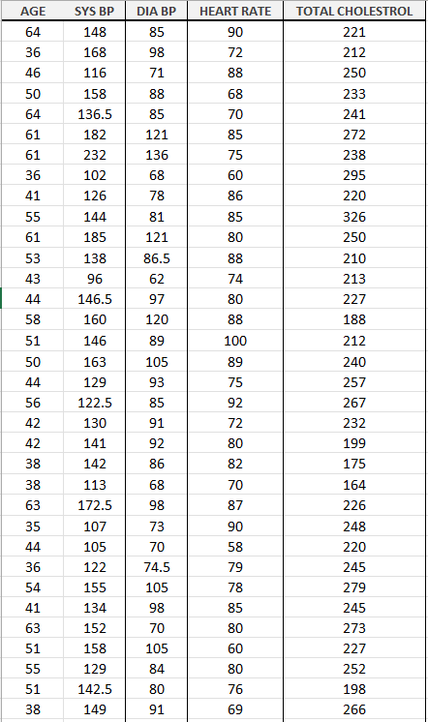
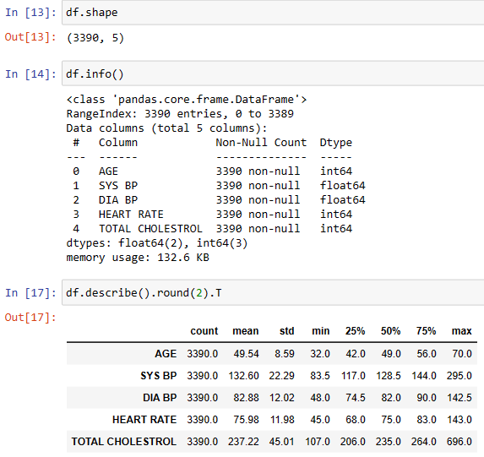
METHODOLOGY

Slide 6
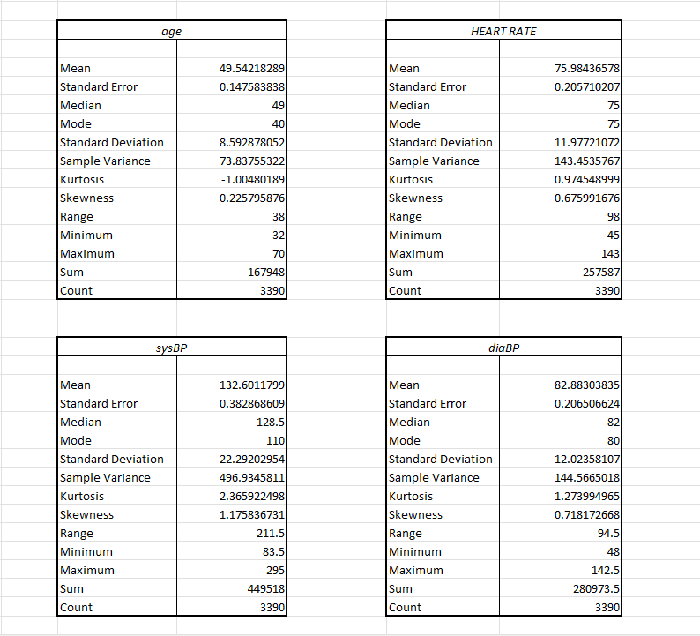
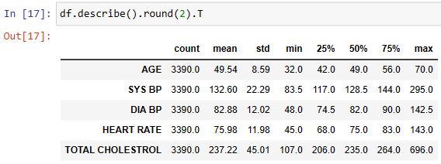

Slide 7
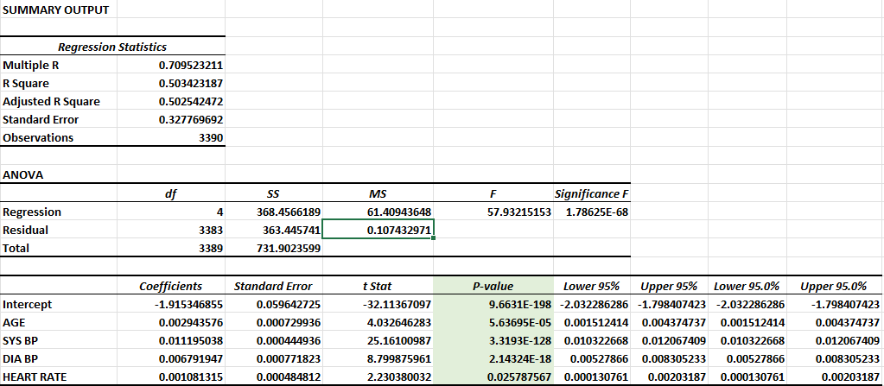

Slide 8
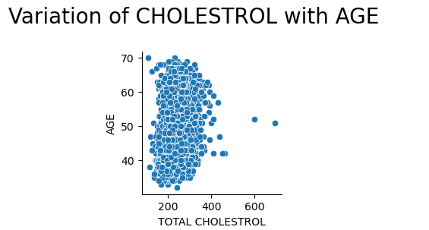
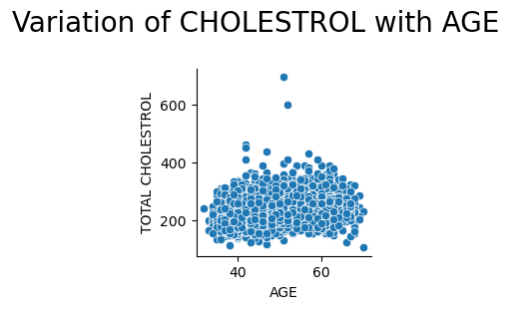
INFERENCES
TOTAL CHOLESTROL= 0.0029*AGE + 0.01119*SYSTOLIC BLOOD PRESSURE + 0.0067*DIASTOLIC BLOOD PRESSURE + 0.001.08*HEART RATE - 1.915

Slide 9
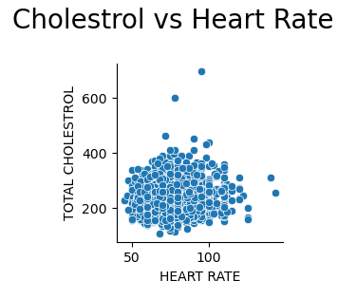
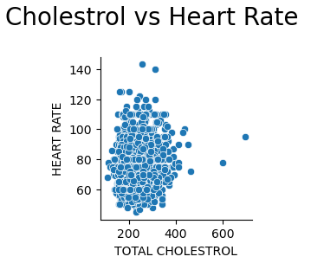
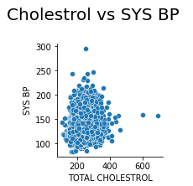
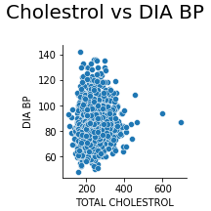

Slide 10
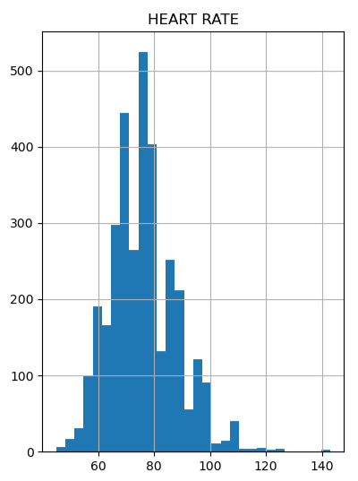
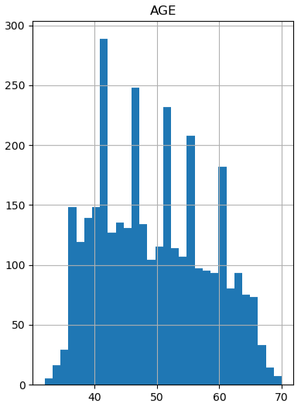

Slide 11
IMPLEMENTATION

Slide 12
CHALLENGES
PROBLEM 1
PROBLEM 2
We found it difficult to find a proper dataset for our issue. Most of the datasets required logical regression or the R square value would be really low.
Importing different modules through anaconda navigator on our devices was time consuming as some of the modules were not found or had trouble importing.

Slide 13
IMPROVEMENTS
We could improve the working of our chatbot to make it more user-friendly. We could also add more locations to popup more hospitals.
We could improve our dataset to increase the R square value and the accuracy of the model.

Slide 14
CONCLUSION
Estimated Cholesterol Level (ECL)
Risk of Heart Diseases based on ECL
What should you do?
Lessons Learnt

Slide 15

THANK YOU!
+123-456-7890
123 Anywhere St., Any City
@reallygreatsite
hello@reallygreatsite.com

