Slide 1

K S INSTITUTE OF TECHNOLOGY
DEPARTMENT OF ARTIFICIAL INTELLIGENCE & MACHINE LEARNING
PROJECT PHASE -2
REVIEW 1- BAI786
PRESENTATION ON
Automated Brain Tumour Detection and Classification from MRI Scans Using Deep Learning
BATCH 4
Harshavardhan K (1KS23AI014)
Kharanshu P S (1KS23AI022)
Shreyas M (1KS23AI051)
Dr. Suresh M B
H.O.D, Department of AIML
K.S.I.T

Slide 2

INTRODUCTION
Problem Statement: Develop an automated machine learning system to accurately detect and classify brain tumours from MRI scans to support early diagnosis and clinical decision-making.
Abstract: This project proposes a machine learning-based system for detecting and classifying brain tumours from MRI images. Using Convolutional Neural Networks (CNNs) and segmentation models such as U-Net, the system aims to improve diagnostic accuracy and speed. Image preprocessing techniques enhance model performance, and evaluation is conducted using metrics like accuracy and Dice coefficient. The solution is designed to support radiologists in clinical decision-making.
2

Slide 3
OBJECTIVES & METHODOLOGY
To develop a robust deep learning model (3D U-Net) for accurate multi-class segmentation of brain tumour regions from multi-modal MRI scans.
To enhance segmentation performance by applying advanced preprocessing techniques and optimizing training using Dice loss functions and specialized evaluation metrics.
To assist doctors with classifying the tumour and identifying its edges.
Pre-processed multi-modal MRI data is fed into a 3D U-Net model for voxel-wise tumour segmentation. The model uses skip connections for spatial accuracy and is trained with Dice loss, and performance evaluated using Dice score and Haus Dorff distance.
3

Slide 4
PROPOSED SYSTEM
We propose a deep learning–based system that processes multi-modal MRI scans and performs voxel-wise multi-class tumour segmentation using a 3D U-Net architecture. The system integrates preprocessing, feature extraction, and spatial reconstruction to accurately identify tumour regions while preserving fine anatomical details.
4

Slide 5
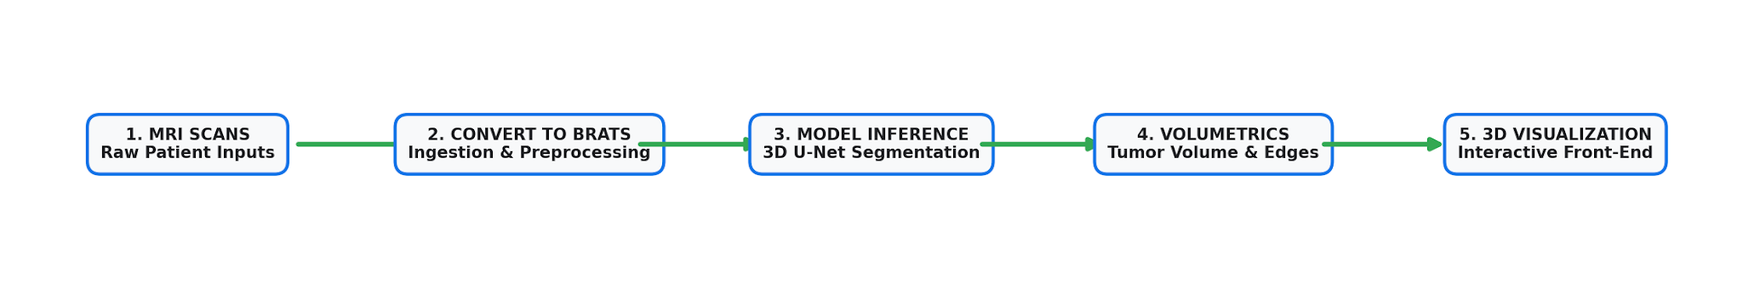
FLOWCHART
5

Slide 6
ALGORITHM
Predicates:
Modality(x, m) means patient x has modality m
SameShape(x) means all four modality volumes have the same 3D shape
SameOrientation(x) means all four modality volumes are spatially aligned
Valid(x) means the scan is acceptable for inference
Preprocessed(x) means brain-mask crop + resample + normalization has been applied
ModelReady means the network exists and is loaded
Segmented(x, y) means the model outputs class map y from patient x
Class(y, c) means voxel belongs to tumour class c
VoxelVolume(x,c,v) means the voxel has volume v and the tumour is of class c
Volume(x, c, v) means tumour class c has volume v
6

Slide 7
ALGORITHM
Rules:
1. Completeness
∀x (
Modality(x, t1) ∧ Modality(x, t1ce) ∧ Modality(x, t2) ∧ Modality(x, flair)
→ Valid(x)
)
2. Structural validity
∀x (
Valid(x) ∧ SameShape(x) ∧ SameOrientation(x)
→ Preprocessed(x)
)
3. Inference
∀x, y (
Preprocessed(x) ∧ ModelReady
→ Segmented(x, y)
)
7

Slide 8
ALGORITHM
4. Tumour presence
∀x, y, c (
Segmented(x, y) ∧ Class(y, c)
→ Tumour(x, c)
)
5. Volume calculation
∀x, c, v (
Tumour(x, c) ∧ VoxelVolume(x, c, v)
→ Volume(x, c, v)
)
8

Slide 9
ALGORITHM
Equivalent logic in one sentence
A scan is usable iff it has all four MRI modalities and consistent geometry; once it is preprocessed and fed to the 3D U-Net, the resulting class map yields tumour volumes for necrotic core, edema, and enhancing tumour.
9

Slide 10
TECH STACK
Python
The main programming language used throughout the project.
It handles loading MRI data, preprocessing images, running the model, and building the app.
MRI data handling
NIfTI files: common medical image format for brain scans.
DICOM files: another medical imaging format, often used in hospitals and scanners.
dicom2nifti: converts DICOM scan series into a 3D NIfTI volume.
Deep learning / AI model
PyTorch: used to define and load the 3D U-Net model.
ONNX: used to export the trained model so it can run efficiently in production.
ONNX Runtime: runs the exported model for inference.
10

Slide 11
TECH STACK
Image processing
NumPy: handles the volumetric arrays and numeric operations.
SciPy: used for resizing, filtering, and spatial resampling.
scikit-image: used for mask and surface-related image processing.
nibabel: reads and writes medical image formats like NIfTI.
Web app / UI
Gradio: creates the user interface where a user uploads MRI files and sees results.
Plotly: builds the interactive 3D tumour visualisation and view overlays.
Validation and testing
pytest: runs automated tests to check the ingestion and preprocessing pipeline.
pydicom: reads DICOM metadata and series information.
11

Slide 12
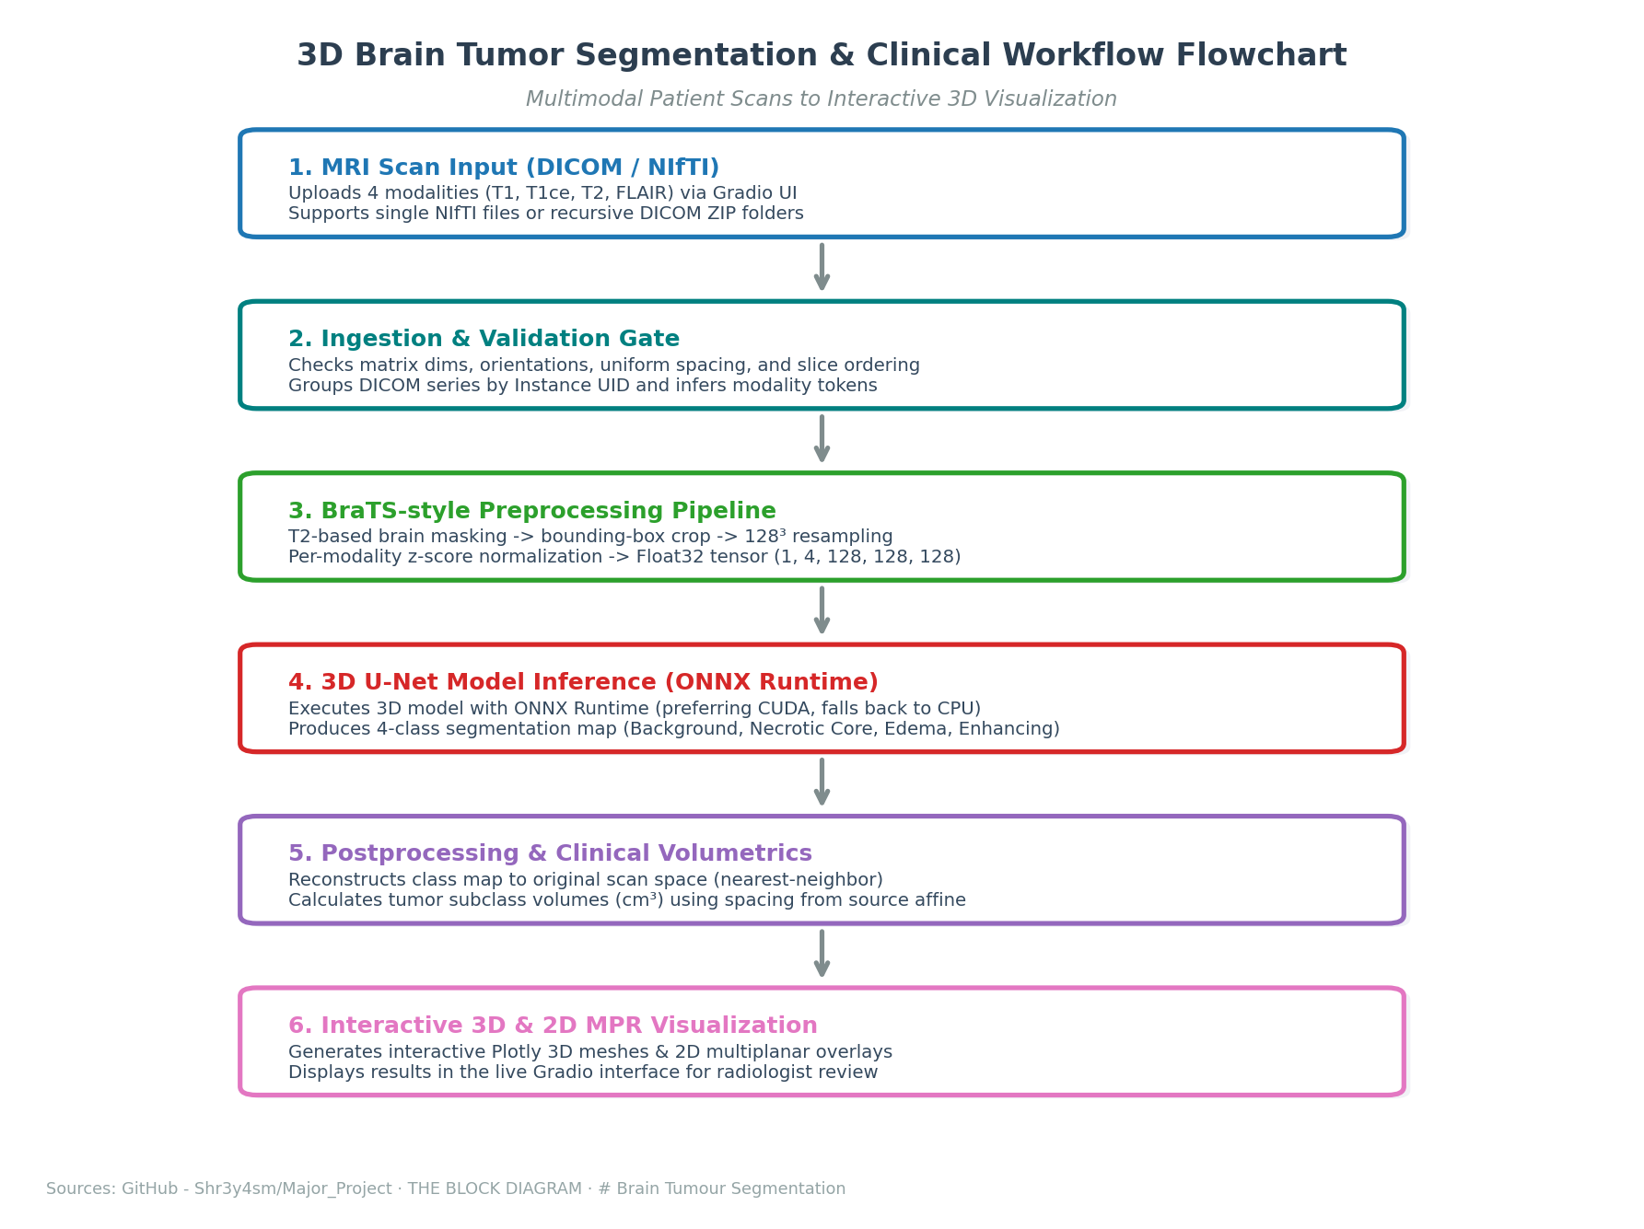
USER FLOW DIAGRAM
12

Slide 13
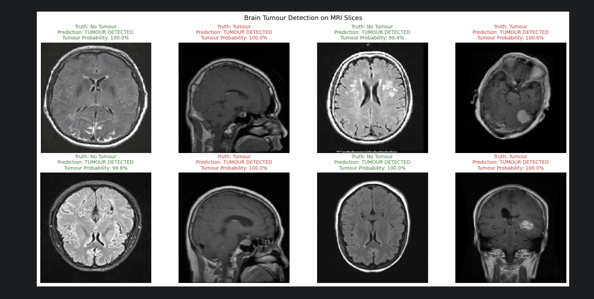
PROGRESS ACHIEVED
13

Slide 14
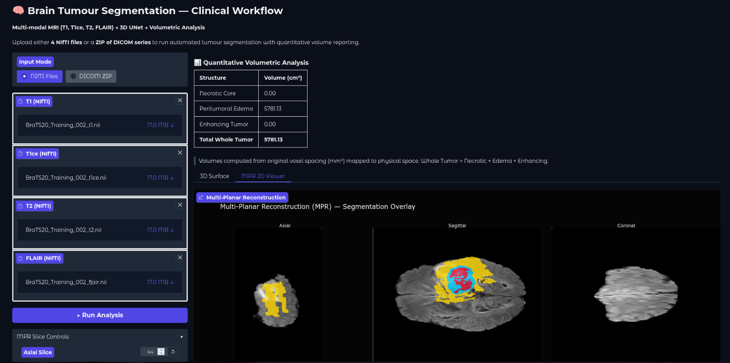
PROGRESS ACHIEVED
14

Slide 15
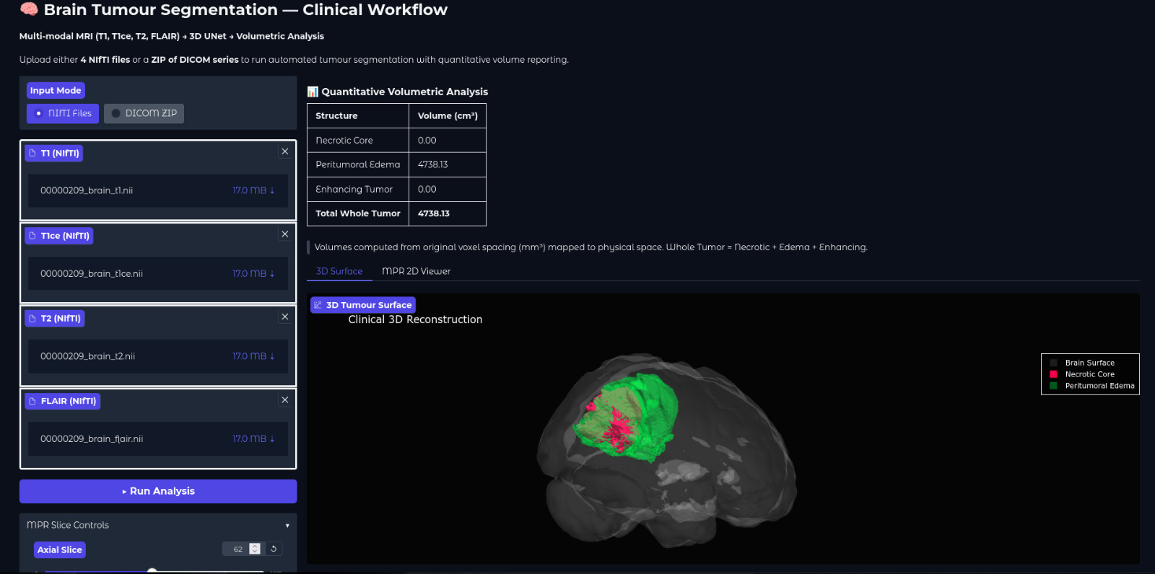
PROGRESS ACHIEVED
15

Slide 16
PRELIMINARY RESULTS
GRADIO INTERACTION INTERFACE
User-Friendly Dashboard: Enables local hosting at http://localhost:7860, providing clinical radiologists with a lightweight, browser-accessible interface.
Flexible Ingestion Control: Supports simple drag-and-drop file inputs for NIfTI modality-to-file mapping as well as DICOM archive folders.
Automated Backend Execution: Executes validations, cropping, resampling, model inference, and physical back-projection behind a single 'Run' trigger.
16

Slide 17
PRELIMINARY RESULTS
VOLUMETRICS & VISUALIZATIONS
Physical Volume Measurements: Calculates physical tumour volumes (in cm³) using source scan voxel spacings from the input affine matrix.
Tumour Multi-Class Labels: Reports distinct volume totals for Necrotic Core (Class 1), Peritumoral Edema (Class 2), Enhancing Tumour (Class 3), and Total Whole Tumour.
2D Multiplanar Reconstruction: Integrates interactive MPR overlays, letting users slice across axial, sagittal, and coronal orthogonal views.
Plotly 3D Meshes: Generates interactive 3D surface meshes of the segmented tumour regions for rotational structural examination.
17

Slide 18
WORK PLAN
Milestone 1
Dataset & Model
Find a suitable dataset for training and develop a model using 3D U-Net.
Milestone 2
Tumour Detection and Volumetric Analysis
Detect the tumour in the scans and calculate the physical measurements
Milestone 3
Classification & Tumour Edges
Classify the tumour and implement HD95 for boundary detection.
Milestone 4
Clinical Paper
Compile a paper detailing the end-to-end 3D validation workflow and submit for peer-review in clinical AI journals and conferences.
18

Slide 19
EXPECTED OUTCOMES
CLINICAL DIAGNOSTIC UTILITY | Accelerated Radiologist Workflow
Delivers rapid, automated tumour localization and multi-class segmentation in under a minute, significantly reducing tedious manual contouring hours. Precise volume calculations in cm³ provide objective metrics for longitudinal monitoring of treatment response and radiation therapy planning.
ACADEMIC DISSEMINATION | Open baselines & Research Publications
Represents a reproducible multimodal 3D medical image segmentation workflow with a live visualization front-end. The codebase, complete with synthetic data tests and validation gates, serves as an academic baseline. Research findings will be compiled for journal publication.
19

