Slide 1

K S INSTITUTE OF TECHNOLOGY
DEPARTMENT OF ARTIFICIAL INTELLIGENCE & MACHINE LEARNING
PROJECT PHASE -2
REVIEW 2- BAI786
PRESENTATION ON
Automated Brain Tumour Detection and Classification from MRI Scans Using Deep Learning
BATCH 4
Harshavardhan K (1KS23AI014)
Kharanshu P S (1KS23AI022)
Shreyas M (1KS23AI051)
Dr. Suresh M B
Prof. and Head, Department of AIML
K.S.I.T

Slide 2

INTRODUCTION
Problem Statement: Develop an automated machine learning system to accurately detect and classify brain tumours from MRI scans to support early diagnosis and clinical decision-making.
Abstract: This project proposes a machine learning-based system for detecting and classifying brain tumours from MRI images. Using Convolutional Neural Networks (CNNs) and segmentation models such as U-Net, the system aims to improve diagnostic accuracy and speed. Image preprocessing techniques enhance model performance, and evaluation is conducted using metrics like accuracy and Dice coefficient. The solution is designed to support radiologists in clinical decision-making.
2

Slide 3
LITERATURE SURVEY
Sl. no | Title of the paper | Author | Name of the Journal and Publication Year | Methodology | Drawback
1 | A Deep Learning approach for Brain Tumour classification and detection in MRI images using YOLOv7 | Ramya Nimmagadda, P. Kalpana Devi | Frontiers in Oncology, 2025 | YOLOv7-based detection with preprocessing (resizing, normalization); bounding box-based tumour localization | Lower performance for small tumours; moderate mAP score; requires parameter tuning
2 | Brain Tumour Classification using MRI Images and Deep Learning Techniques | Yuki Wong, Eileen Lee Ming Su, Che Fai Yeong, William Holderbaum, Chenguang Yang | PLOS One, 2025 | CNN with pretrained VGG16; data augmentation; multiclass classification with web-based deployment | Requires large dataset; overfitting risk; limited interpretability

Slide 4
LITERATURE SURVEY
Sl. no | Title of the paper | Author | Name of the Journal and Publication Year | Methodology | Drawback
3 | A Hybrid Deep Learning and Language Model Framework or Brain Tumour Detection and Personalized Diagnostic Assistance via Medical Chatbots | Pooja Panapana, Balajee Maram, Kishor Kumar Reddy | IEEE, 2025 | Combines CNN for tumour detection with LLM-based chatbot using NLP for personalized medical assistance; includes preprocessing, classification, and conversational AI | Requires large datasets and computational resources; chatbot accuracy depends on NLP training quality
4 | NeuroNet Diagnostics: Brain Tumour Detection and Segmentation using Deep Learning | Anurag Singh, Akshika Agarwal, Kavyansh Srivastava, Dr. Rashmi Sharma | IEEE, 2025 | Uses VGG-19 based CNN with preprocessing (adaptive filtering, augmentation) for segmentation and classification; integrates treatment recommendation system | High computational cost; performance depends on dataset quality; limited scalability

Slide 5
LITERATURE SURVEY
Sl. no | Title of the paper | Author | Name of the Journal and Publication Year | Methodology | Drawback
5 | Detection of Brain Tumour from MRI Images using Novel Deep CNN | Mohebbanaaz, P. Deepthi Jordhana, G Vamsi Krishna | IEEE, 2025 | 23-layer CNN with transfer learning (VGG16 backbone), preprocessing, and data augmentation; classification into tumour types | Struggles with imbalanced datasets; requires fine-tuning; performance depends on dataset size

Slide 6
LITERATURE SURVEY
Sl. no | Title of the paper | Author | Name of the Journal and Publication Year | Methodology | Drawback
6 | Automated Segmentation of Brain Tumor MRI Images Using Deep Learning | Surendran Rajendran, Suresh Kumar Rajagopal, Tamilvizhi Thanarajan, K. Shankar, Sachin Kumar, Najah M. Alsubaie, Mohamad Khairi Ishak, Samih M. Mostafa | IEEE, 2023 | Ensemble deep learning using U-Net + 3D CNN, with GLCM feature extraction and VPT-based selection for MRI tumor segmentation | High computational complexity; depends on dataset quality; risk of overfitting
7 | Automated Brain Tumor Segmentation and Classification in MRI Using YOLO-Based Deep Learning | Maram Fahaad Almufareh, Muhammad Imran, Abdullah Khan, Mamoona Humayun, Muhammad Asim | IEEE Access, 2024 | YOLO-based deep learning (YOLOv5 & YOLOv7) with preprocessing (mask alignment) for tumor detection, segmentation, and classification | High computational cost; relies on single dataset; lower performance for glioma class

Slide 7
LITERATURE SURVEY
Sl. no | Title of the paper | Author | Name of the Journal and Publication Year | Methodology | Drawback
8 | A Hybrid Approach to Brain Tumor Detection Using Deep Learning and Explainable AI | Saurav Kundu, Maruf Hasan, Suman Saha | 2025 International Conference on Quantum Photonics, Artificial Intelligence, and Networking (QPAIN), 2025 | Hybrid deep learning with feature extraction and Explainable AI (LIME, Grad-CAM, Integrated Gradients) for MRI tumor classification | High model complexity; requires multiple pretrained models; computationally intensive
9 | Brain Tumor Detection Using AI and Machine Learning: A Comparative Analysis of Models and Explainable AI Integration | Fairy Rupareliya, Aarohi Gulhane, Naina Warjurkar, Santosh Kumar, Yashwant Ingle, Gitangali Yadav | 2025 International Conference on Information, Implementation, and Innovation in Technology (I2ITCON), 2025 | Comparative deep learning approach using CNN, with preprocessing and Grad-CAM for explainability | High computational requirements; multiple models increase complexity; performance varies across models

Slide 8
LITERATURE SURVEY
Sl. no | Title of the paper | Author | Name of the Journal and Publication Year | Methodology | Drawback
10 | Brain Tumor Detection Based on Deep Learning Approaches and Magnetic Resonance Imaging | Akmalbek Bobomirzaevich Abdusalomov, Mukhriddin Mukhiddinov, Taeg Keun Whangbo | Cancers (MDPI), 2023 | Improved YOLOv7-based deep learning model with preprocessing, data augmentation, and enhancements for MRI tumor detection | Struggles with detecting small tumors; high model complexity; requires large annotated dataset

Slide 9
OBJECTIVES & METHODOLOGY
To develop a robust deep learning model (3D U-Net) for accurate multi-class segmentation of brain tumour regions from multi-modal MRI scans.
To enhance segmentation performance by applying advanced preprocessing techniques and optimizing training using Dice loss functions and specialized evaluation metrics.
To assist doctors with classifying the tumour and identifying its edges.
Pre-processed multi-modal MRI data is fed into a 3D U-Net model for voxel-wise tumour segmentation. The model uses skip connections for spatial accuracy and is trained with a Dice loss, and performance evaluated using Dice score and Haus Dorff distance.
9

Slide 10
PROPOSED SYSTEM
We propose a deep learning–based system that processes multi-modal MRI scans and performs voxel-wise multi-class tumour segmentation using a 3D U-Net architecture. The system integrates preprocessing, feature extraction, and spatial reconstruction to accurately identify tumour regions while preserving fine anatomical details.
10

Slide 11
FLOWCHART
MRI SCANS
Raw Patient Inputs
CONVERT TO BRATS
Ingestion & Preprocessing
MODEL INFERENCE
3D U-Net Segmentation
VOLUMETRICS
Tumor Volume & Edges
3D VISUALIZATION
Interactive Front-End
11

Slide 12
ALGORITHM
Predicates:
Modality(x, m) means patient x has modality m
SameShape(x) means all four modality volumes have the same 3D shape
SameOrientation(x) means all four modality volumes are spatially aligned
Valid(x) means the scan is acceptable for inference
Preprocessed(x) means brain-mask crop + resample + normalization has been applied
ModelReady means the network exists and is loaded
Segmented(x, y) means the model outputs class map y from patient x
Class(y, c) means voxel belongs to tumour class c
VoxelVolume(x,c,v) means the voxel has volume v and the tumour is of class c
Volume(x, c, v) means tumour class c has volume v
12

Slide 13
ALGORITHM
Rules:
1. Completeness
∀x (
Modality(x, t1) ∧ Modality(x, t1ce) ∧ Modality(x, t2) ∧ Modality(x, flair)
→ Valid(x)
)
2. Structural validity
∀x (
Valid(x) ∧ SameShape(x) ∧ SameOrientation(x)
→ Preprocessed(x)
)
3. Inference
∀x, y (
Preprocessed(x) ∧ ModelReady
→ Segmented(x, y)
)
13

Slide 14
ALGORITHM
4. Tumour presence
∀x, y, c (
Segmented(x, y) ∧ Class(y, c)
→ Tumour(x, c)
)
5. Volume calculation
∀x, c, v (
Tumour(x, c) ∧ VoxelVolume(x, c, v)
→ Volume(x, c, v)
)
14

Slide 15
ALGORITHM
Equivalent logic in one sentence
A scan is usable iff it has all four MRI modalities and consistent geometry; once it is preprocessed and fed to the 3D U-Net, the resulting class map yields tumour volumes for necrotic core, edema, and enhancing tumour.
15

Slide 16
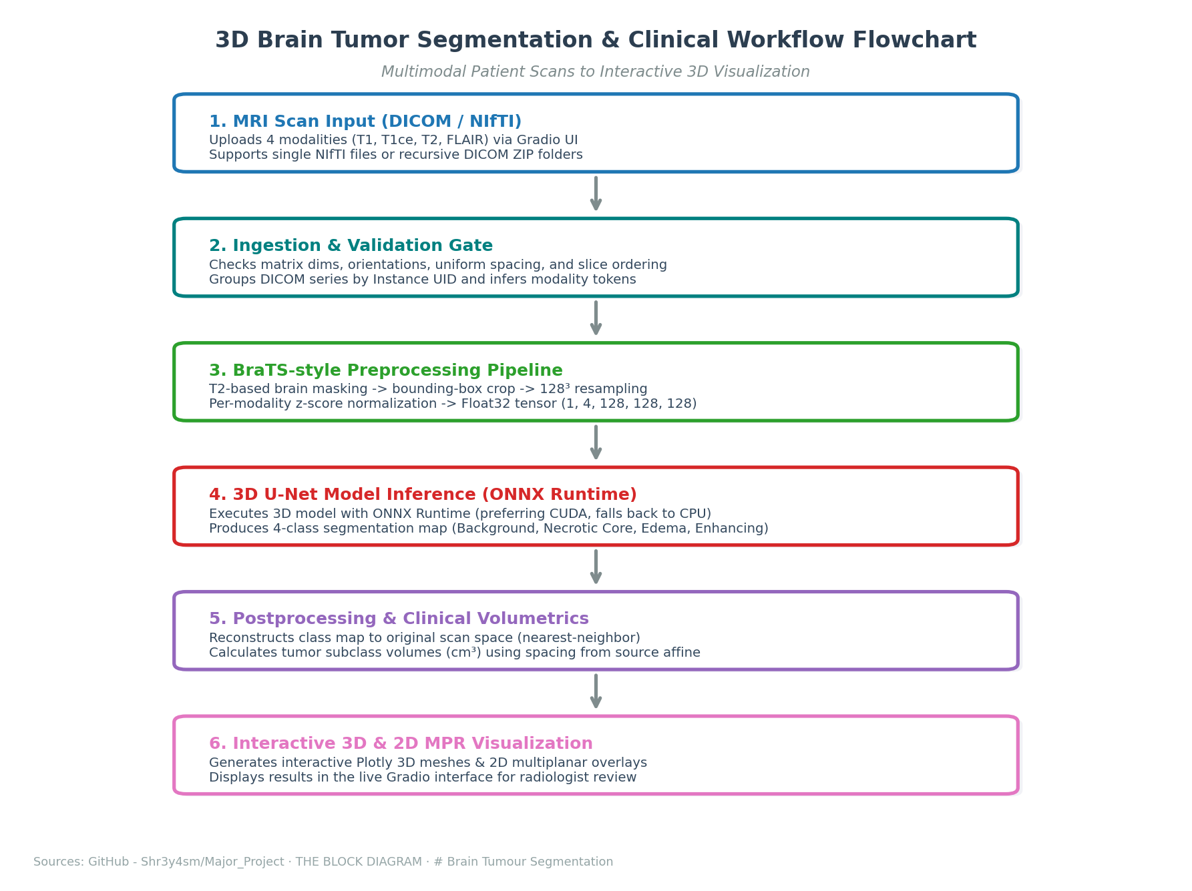
USER FLOW DIAGRAM
16

Slide 17
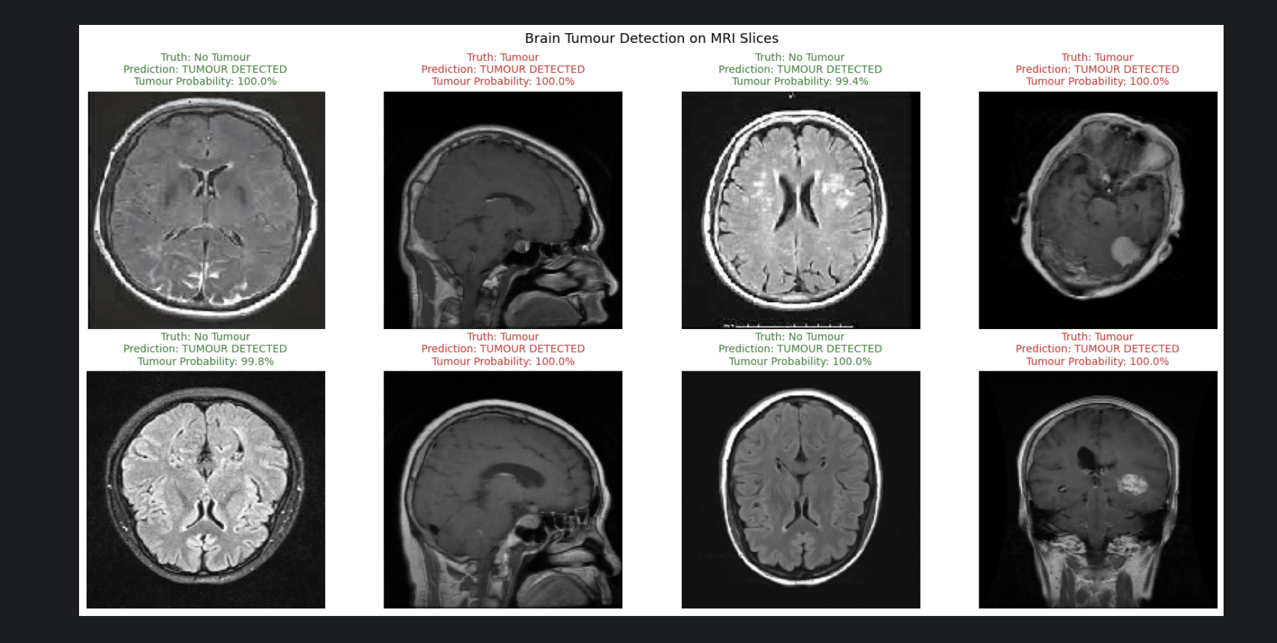
PROGRESS ACHIEVED
17

Slide 18
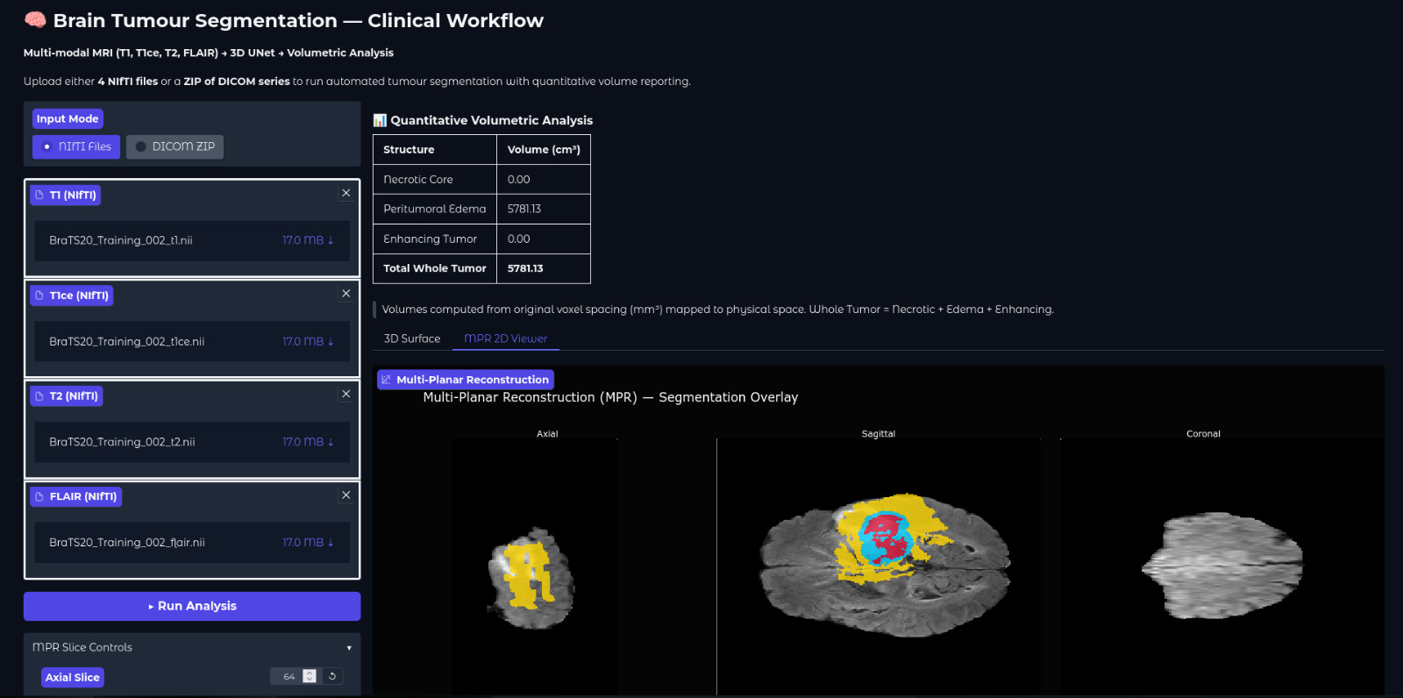
PROGRESS ACHIEVED
18

Slide 19
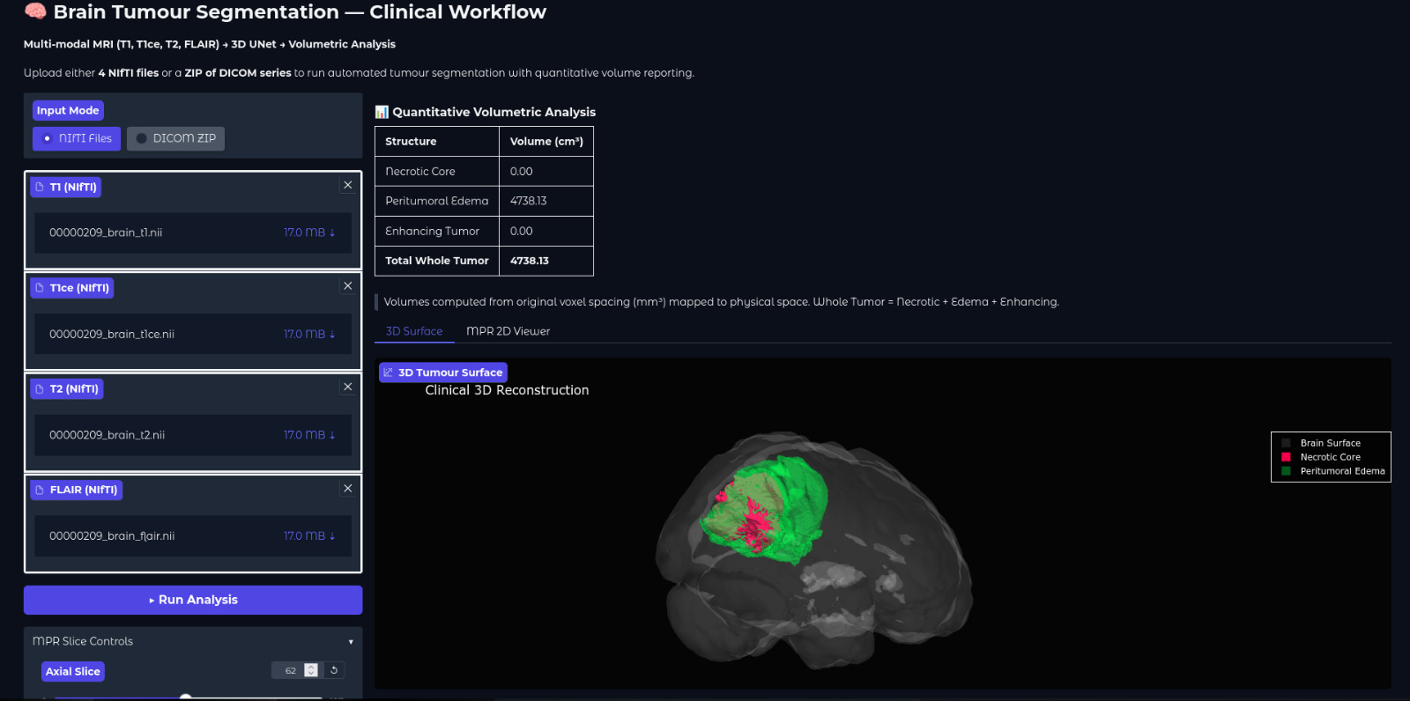
PROGRESS ACHIEVED
19

Slide 20
RECENT PROGRESS ACHIEVED
1. DICOM to NIfTI Toolkit Integration
  Integrated an automated DICOM-to-NIfTI ingestion pipeline, enabling seamless multi-modal data harmonization for volumetric spatial reconstruction.
2. Paper Submitted to ICTAGI 2026
  Authored and formally submitted a peer-reviewed research manuscript to ICTAGI 2026, documenting our end-to-end multimodal 3D medical imaging architecture.
3. Radiologist Meeting on Clinical Workflow & Pain Points
  Established targeted expert interviews to align product capabilities with real-world radiological diagnostic pipelines and clinical usability requirements.
20

Slide 21
RECENT PROGRESS ACHIEVED
DICOM to NIfTI Toolkit Integration
DICOM Input Folder / ZIP (Series of 2D Slices)
Ingestion Module:
• Read DICOM Series Metadata & Sort Slices
• Reorient Spatial Direction Matrix to RAS
• Write Unified 3D NIfTI Volume (.nii.gz)
21

Slide 22
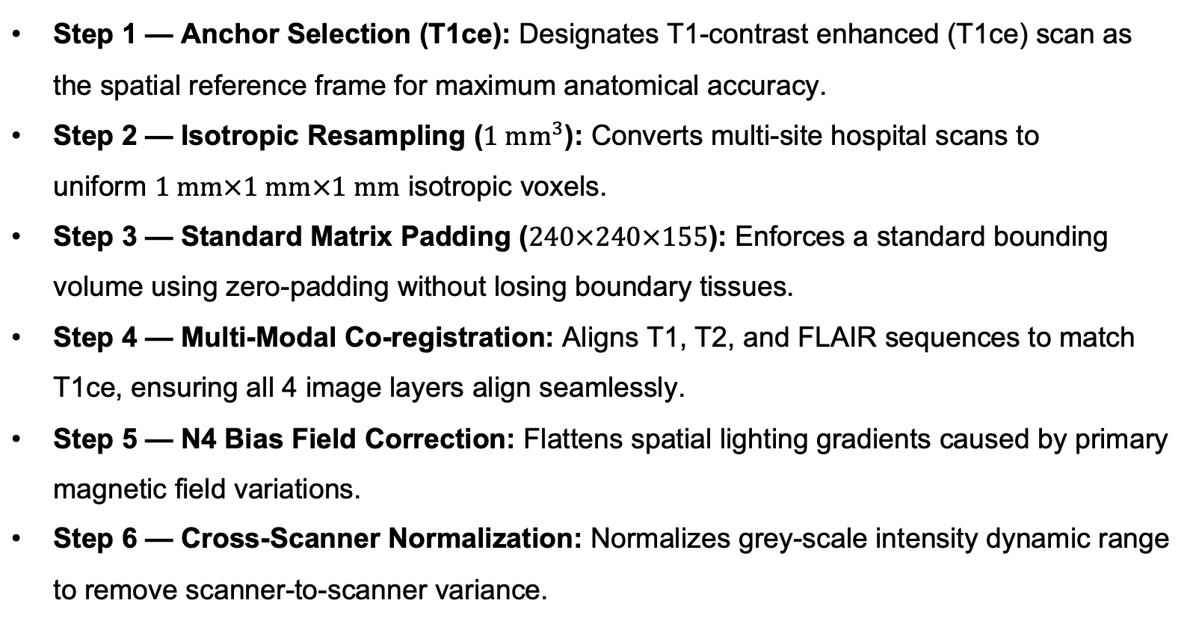
RECENT PROGRESS ACHIEVED
DICOM to NIfTI Toolkit Integration
21

Slide 23
PRELIMINARY RESULTS
GRADIO INTERACTION INTERFACE
User-Friendly Dashboard: Enables local hosting at http://localhost:7860, providing clinical radiologists with a lightweight, browser-accessible interface.
Flexible Ingestion Control: Supports simple drag-and-drop file inputs for NIfTI modality-to-file mapping as well as DICOM archive folders.
Automated Backend Execution: Executes validations, cropping, resampling, model inference, and physical back-projection behind a single 'Run' trigger.
22

Slide 24
PRELIMINARY RESULTS
VOLUMETRICS & VISUALIZATIONS
Physical Volume Measurements: Calculates physical tumour volumes (in cm³) using source scan voxel spacings from the input affine matrix.
Tumour Multi-Class Labels: Reports distinct volume totals for Necrotic Core (Class 1), Peritumoral Edema (Class 2), Enhancing Tumour (Class 3), and Total Whole Tumour.
2D Multiplanar Reconstruction: Integrates interactive MPR overlays, letting users slice across axial, sagittal, and coronal orthogonal views.
Plotly 3D Meshes: Generates interactive 3D surface meshes of the segmented tumour regions for rotational structural examination.
23

Slide 25
MILESTONES ACHIEVED
Milestone 1
Dataset & Model
Find a suitable dataset for training and develop a model using 3D U-Net.
Milestone 2
Tumour Detection and Volumetric Analysis
Detect the tumour in the scans and calculate the physical measurements
Milestone 3
File support for DICOM and NIfTI
Both DICOM and NIfTI files can be uploaded for analysis
Milestone 4
Clinical Paper
Compile a paper detailing the end-to-end 3D validation workflow and submit for peer-review in clinical AI journals and conferences.
24

Slide 26
TO DO
Milestone 5
Implement concerns by experts
Understand and implement modal changes based on expert pain points and concerns
Milestone 6
Polished UI/UX
Develop a simpler and efficient UI/UX to aid radiologists.
25

Slide 27
EXPECTED OUTCOMES
CLINICAL DIAGNOSTIC UTILITY | Accelerated Radiologist Workflow
Delivers rapid, automated tumour localization and multi-class segmentation in under a minute, significantly reducing tedious manual contouring hours. Precise volume calculations in cm³ provide objective metrics for longitudinal monitoring of treatment response and radiation therapy planning.
ACADEMIC DISSEMINATION | Open baselines & Research Publications
Represents a reproducible multimodal 3D medical image segmentation workflow with a live visualization front-end. The codebase, complete with synthetic data tests and validation gates, serves as an academic baseline. Research findings will be compiled for journal publication.
26

