Slide 1
Performance Evaluation & Prediction (PEP)
The Power of Data

Slide 2







Meet the team
George Harris
Purnachandra Rao Pulikonda
Dinesh Kumar
Senior Software Developer TPM Integration, US
Principal Application Developer TPM Integration, India
Senior Principal Consultant Oracle 5G PCF Product, US
Shreyash Bhatkar
Brett Bronson
Garcia Milord
Associate Consultant GTC-DBX Asset Developer, India
Senior Software Developer TPM Integration, US
Application Developer TPM Integration, US
Harshul Soni
Team Member (Analysis + UX)
Software Development Consultant Customer Solutions for Industries, India

Slide 3

Project Summary
What problem or opportunity are you trying to address? Why is it important for our customer or colleagues?
PEP (Performance Evaluation & Prediction) aims to provide insights into the performance of a product and predict future performance challenges.
Performance is an important factor in any product because it directly affects the time and resources for the product to function. An inadequate performance improvement can lead to a significant loss in revenue as well. Especially in an age where AI is widely used, product performance is critical.
PEP not only analyzes and gives you information about the areas to improve performance, but it also gives you the ability to predict how the product may behave in certain conditions. Project Managers, Developers, Customer Support Teams, Sales Consultants, etc. can use this tool to analyze, predict and drill into the data as well as generate reports for the same.
Notes:
Tell us about your project. What problem or opportunity have you identified? What solution are you proposing?
Don’t forget to highlight why this is important. If you’ve chosen a theme that’s focused on our customer, it must talk to the customer value.
Or for themes that are internally focused, talk about why it’s valuable for your colleagues.

Slide 4
User Goal
As a Product Manager, I need to get insights about the performance of my product as well as understand the performance risks so that I can take necessary actions to improve the product as well as set expectations about the product.
Matilda
Product Manager
Product Development
Notes:
A good user goal is…
Solution agnostic
Explores multiple ideas
Durable over time
Broad enough to be broken down into many smaller tasks
User = Who are you solving a problem for?
Goal = What are they trying to achieve?
Motivation = Why do they need to accomplish this goal?

Slide 5
Shape of Data
Question
Answer
What are the downsides of a low-performance product?
How do the consumers respond to product performance issues?
What are the risks of a low-performance product?
How can we increase the revenue of an organization that uses the product by increasing the product performance and by predicting the risks?
Resources (memory, network bandwidth etc.) can burnout.
Network bandwidth can be clogged.
Time delay.
Revenue loss.
It can create less confidence in the product and also effect the revenue of the organization which produces the product and consumes the product.
Unexpected product execution failures resulting in customer relationship, revenue and credibility.
A better performance increases customer satisfaction and reliability. It reduces the risk too.

Slide 6
How Might We?
These are the options that we explored for creating this tool.
Using Elastic Search and Kibana + PEP
Using Prometheus and Grafana + OCI
Use PEP to do all things
Use Elastic Search and Kibana to collect data and analyze it. Bring the results after analysis to the App and let app to do the prediction.
Use Prometheus and Grafana to collect data and analyze it. Bring the results to OCI Analytics to predict and forecast.
Create the PEP app with Flask (Python) backend and OJET frontend to do the analysis and prediction.

Slide 7
Current State
Matilda just completed a product implementation with the customer. However, she is concerned about how the product will work if the product processes too much data.
She wanted to avoid a risk and wanted her team to investigate the performance of the product.
Matilda assigns the task to Rahul, who is a developer. Rahul does some investigation and produces a fix.
The fix works, but it still does not fully address all aspects of the performance.
The risk of unknown product failure due to performance still exists.
Matilda implements a new patch for the product with the fix, but shortly the worst thing happened: there was an unexpected surge in data consumption. The product crashes!
The management gets involved, and Matilda’s team works round the clock to address the issue. This brings effort, revenue, and credibility loss for the product company.
The customer decides not to continue with the product because of the risks involved.

Slide 8
Future State
Matilda makes sure all her products use PEP for analysis and prediction.
Soon enough she sees a considerable increase in efficiency of all products.
Her company gets a great review. It boosts employee morale and the company revenue too!
A better product means happy customers. Now the customer knows what to expect in case.
Customers can now take preventive actions as they know the limitations of the product.

Slide 9


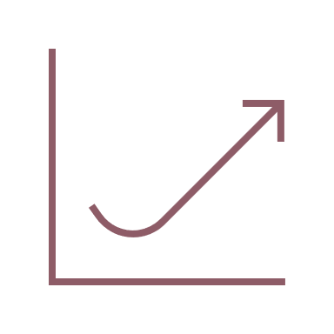
Market Opportunity
How will this project be differentiated in the market? What is the projected market size and revenue potential?
Performance delays in applications can create significant challenges for both users and businesses.
When delays occur, it can lead to frustration and a drop in satisfaction. Eg: Google found that even a half-second delay in search results can decrease traffic by 20%. According to Akamai, 47% of users expect a webpage to load in 2 seconds or less, and 40% will leave a site that takes longer than 3 seconds to load.
If a site is slow to respond, users are more likely to abandon it without interacting. Eg: Amazon reported that every 100 milliseconds of latency could cost them 1% in sales. A study by the Nielsen Norman Group found that if a site takes more than 3 seconds to load, 57% of mobile users will leave.
Differentiation in the Market:
Advanced Predictive Analytics: Cutting-edge machine learning and precise performance forecasts.
Real-Time Monitoring: We offer live updates and interactive dashboards, enabling quicker decisions.
More Control The user can provide the desired parameters, which gives more control.
$10 B
Total Addressable Market (Annual)
15 % increase
Annual Revenue Potential
20 %
Estimated Efficiency Increase
Notes:
Potential metrics:
Cost
Time
Error reduction
Accuracy
Safety
Health or well-being
Profit

Slide 10
Competitive Analysis
Who else might already be operating in the space this project has identified? What do they do well today and where are there opportunities?
Prometheus and Grafana
Elastic Search and Kibana
Does well: Helps extraction, visualization and alert-based motioning.
Missing: No analytics and ML. Less granular control for the user.
Does well: Helps extraction, visualization, and alert-based motioning with minimal or no coding experience.
Missing: No analytics and ML. Less granular control for the user.

Slide 11
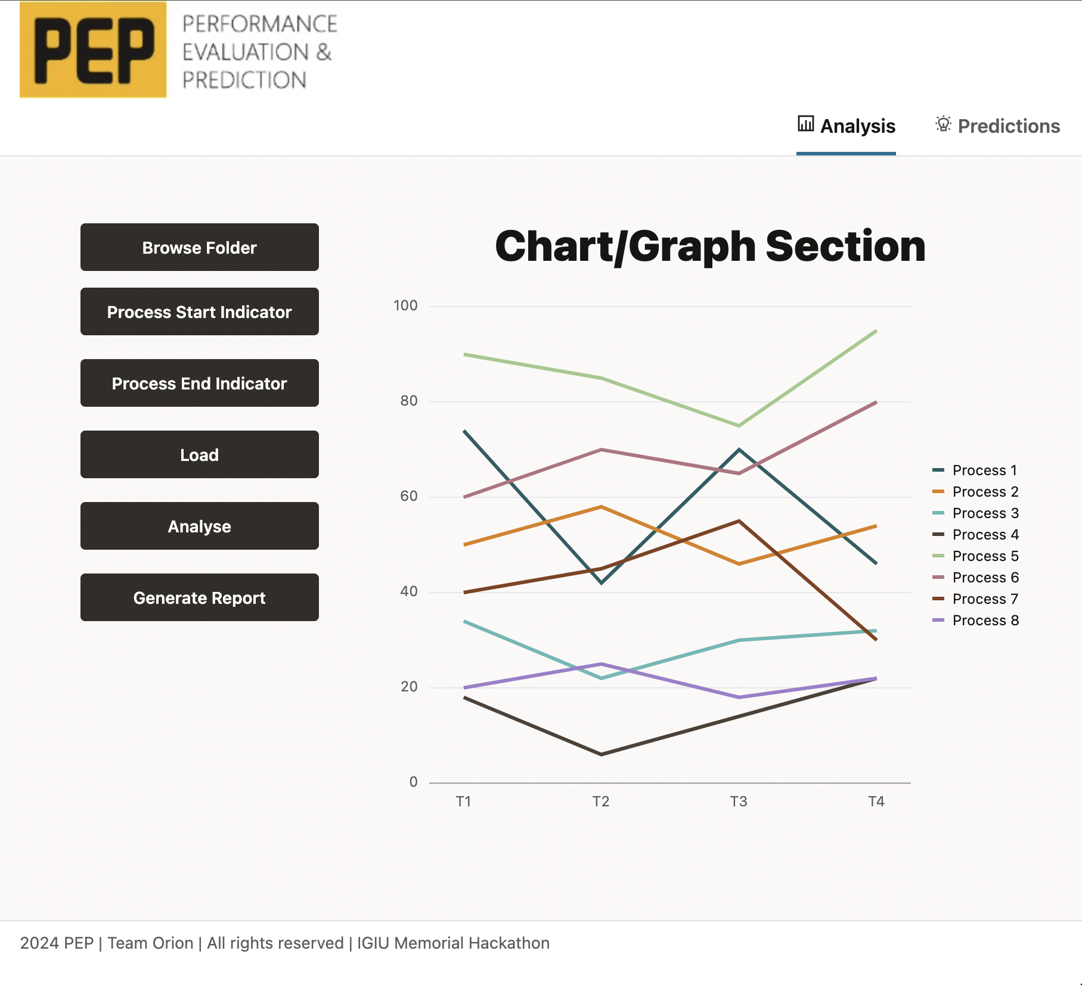
Demo

Slide 12
What’s Next?
What would it take to complete or take advantage of the value proposed by this project?
Development needs:
Extending the framework to process high volume data using parallel data processing pipelines.
Analyze the logs and send out automatic notifications when risks are identified.
Tapping the capability of Oracle Gen AI.
Add the report generation capability.

Slide 13
Summary
Key points of what the project will achieve
Time is the most expensive thing today. And data is the most impactful thing today. PEP aims to make use of time and data to the best.
Performance is a factor that is ignored on many occasions. But infecting it has a critical impact on everyone and everything related to the product.
Early investing in identifying the performance issues will drastically help the further enhancements applied to the product. It is like a rocket—the less weight it has, the faster it will fly!
In an era where data is fuel for decision-making, living, and pretty much everything, performance improvement can positively impact everything.
PEP gives us granular control over the way we want to get insights about data. This product can also be customized to suit any particular customer needs.
“Pep” literally means to energize and boost. That’s exactly what it does to the product!

