Slide 1
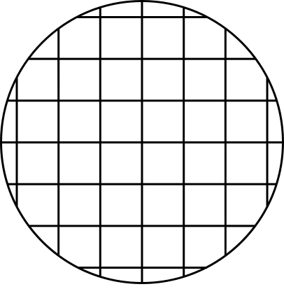


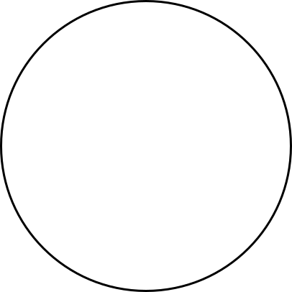

Application of AI/ML in concrete mix design
Done by,
Aadil M Moopan
Shijith S
Shravan G

Slide 2
Concrete mix design is a complex and multistage process in which we try to find the best composition of ingredients to create good performing concrete.
Machine learning has recently gained significant attention, and future predictions for this technology are even more promising.
Data mining on large sets of data attracts attention since machine learning algorithms have achieved a level in which they can recognise patterns which are difficult to recognise by human cognitive skills.
Introduction

Slide 3
Technology & Concepts Used
Machine Learning was used to learn the effectiveness of different ratios of components used in the concrete mix design.
Five ML methods are planned, of which three have been done this semester. The independent results will be compared.
Optimisation of various ratios for concrete mix design is the main aim of this project.

Slide 4
Importance of Concrete Mix Design
Concrete is one of the most important materials in Civil Engineering.
Knowing the compressive strength of concrete is very important when constructing a building or a bridge.
The Compressive Strength of Concrete is a highly nonlinear function of ingredients used in making it and its characteristics.
Thus, using Machine Learning to predict the Strength could be useful in generating a combination of ingredients which result in high Strength.

Slide 5
Machine Learning
Machine Learning aims to use various state-of-the-art achievements in computer science to build upon a system that will be able to learn from data sets and, thus, seek patterns and relationships between variables and groups of variables, which would be challenging to conduct with conventional methods.

Slide 6
Data Description
The number of Instances (Data) we used is 1030. We have used nine attributes, out of which 8 are independent variables, and one is an output or dependent variable.
The eight attributes or inputs we used are Cement (kg/m³), Blast Furnace (kg/m³), Fly Ash (Kg/m³), Water (Kg/m³), Superplasticizer (Kg/m³), Fine Aggregates (Kg/m³), Coarse Aggregates (Kg/m³) and Age (Days).
The output is Concrete Compressive Strength (MPa)

Slide 7
Exploring the Data
What we did?
We have explored the data and computed the mean, median, Mode, Percentiles, Min, Max and Standard Deviation.
After that, we checked the pairwise relation between features and graphs were plotted and found that there seems to be no high correlation between independent variables (features). This can be further confirmed by plotting the Pearson Correlation coefficients between the features.
Next, we have plotted the feature correlation heatmap among different attributes.

Slide 8
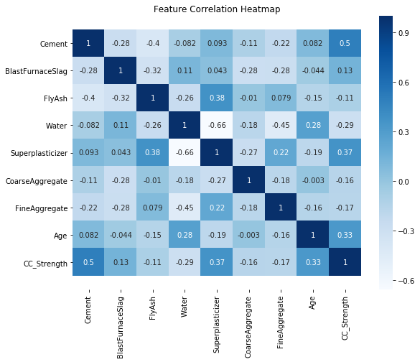
Exploring the Data
Observations
There aren't any high correlations between Compressive strength and other features except for Cement, which should be the case for more strength.
Age and Superplasticizer are the other two features which are strongly correlated with Compressive Strength.
Super Plasticizer seems to have a negative high correlation with Water, and positive correlations with Fly ash and Fine aggregate.

Slide 9
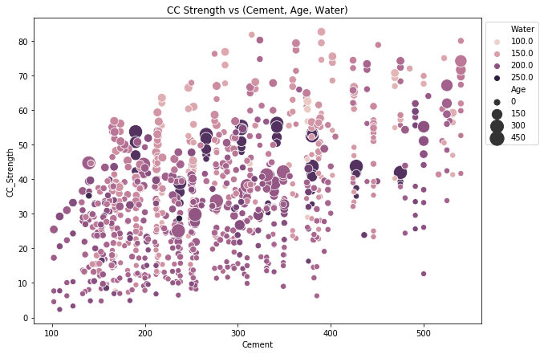
Exploring the Data
Observations from Strength vs (Cement, Age, Water)
Compressive strength increases with amount of cement
Compressive strength increases with age
Cement with low age requires more cement for higher strength
The older the cement is the more water it requires
Concrete strength increases when less water is used in preparing it.

Slide 10
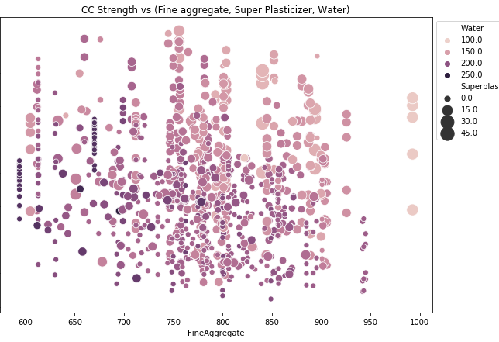
Exploring the Data
Observations from CC Strength vs
(Fine aggregate, Super Plasticizer, FlyAsh)
Strength decreases with an increase in water, strength increases with an increase in Superplasticizer.
More Fine aggregate is used when less water and more Superplasticizer are used.

Slide 11
Exploring the Data
Conclusions and Discussions
Although we are making conclusions by observing the scatter plots, there is an underlying non-linear interaction between features which we cannot visualize.
We can visually understand 2D, 3D and max up to 4D plots as shown, we can further use row-wise and column-wise plotting features by seaborn to do further analysis, but still, we lack the ability to track all these correlations by ourselves. For this reason, we can turn to Machine Learning to capture these relations and give better insights into the problem.

Slide 12
AI/ML Models

Slide 13
ML Models Used
Linear Regression (without regularisation)
Lasso Regression - L1 regularisation (Tries to push coefficients to zero)
Ridge Regression - L2 regularisation (Tries to keep coefficients as low as possible)
Decision Trees
Random forest Regressor

Slide 14
Data Preprocessing
Separated Input Features and Target Variable.
Split data into Training and Test splits.
Standardization the data i.e. to rescale the features to have a mean of zero and standard deviation of 1.
Linear Regression
The Go-to method for Regression problems.
The Algorithm assigns coefficients to each input feature to form a linear relation between input features and the target variable to minimize an objective function.
The objective function used in this case is Mean Squared Error.

Slide 15
Models Used
There are three versions of Linear Regression
Linear Regression - No regularisation
Lasso Regression - L1 regularisation (Tries to push coefficients to zero)
Ridge Regression - L2 regularisation (Tries to keep coefficients as low as possible)
We will compare these three algorithms.

Slide 16
Evaluation
Comparing the Root Mean Squared Error (RMSE), Mean Squared Error (MSE), Mean Absolute Error (MAE) and R2 Score.
Model RMSE MSE MAE R2
Linear Regression 10.29 105.78 8.23 0.57
Lasso Regression 10.68 114.13 8.66 0.54
Ridge Regression 10.29 105.86 8.24 0.57

Slide 17
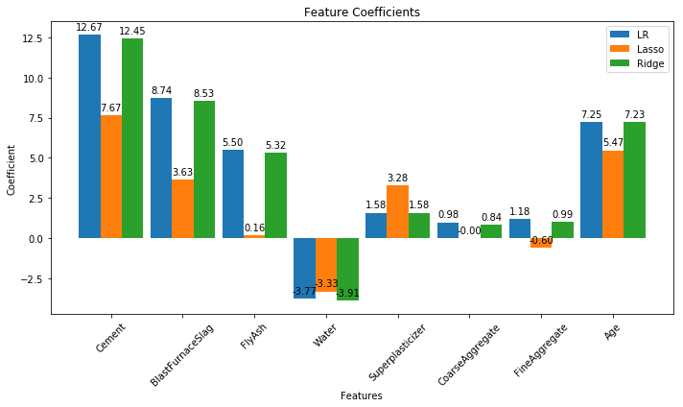
Plotting the coefficients
Lasso Regression reduces the complexity of the model by keeping the coefficients as low as possible. Also, coefficients with Linear and Ridge are almost same.

Slide 18
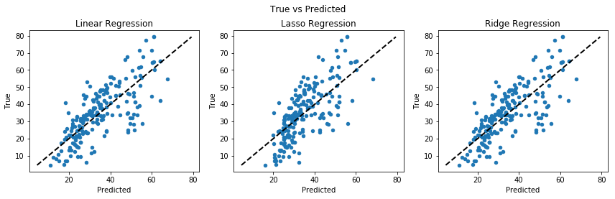
Plotting Predictions
Looking at the graphs between predicted and true values of the target variable, we can conclude that Linear and Ridge Regression perform well as the predictions are closer to the actual values. While Lasso Regression reduces the complexity at the cost of loosing performance in this case. (The closer the points are to the black line, the less the error is.)

Slide 19
Conclusion
Comparing the graphs, we find Linear and Ridge regression to be the better of the lot.

Slide 20
Thank you

