Slide 1
Data Modelling
Session 1: Database Design Re-cap

Slide 2
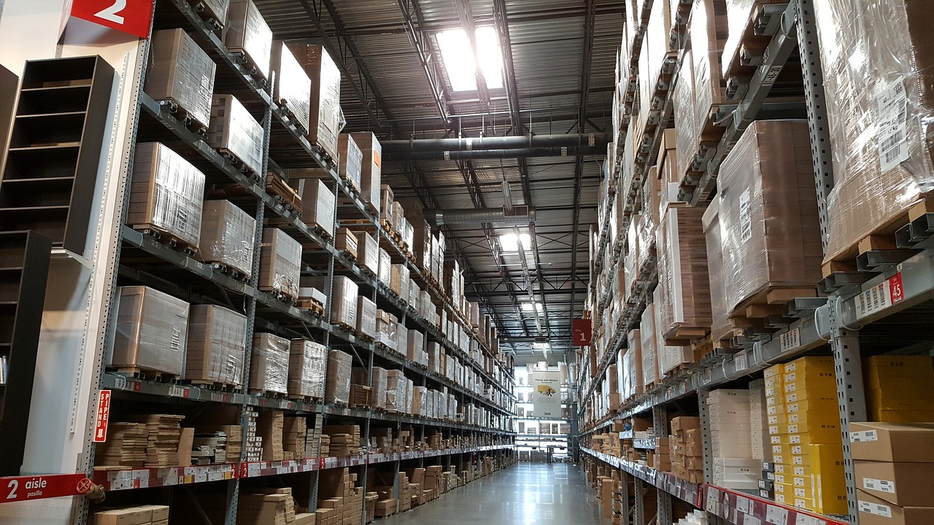
Data Warehouse
Data warehouse is
Subject-oriented
Integrated
Non-volatile
Time-variant
collection of data points

Slide 3
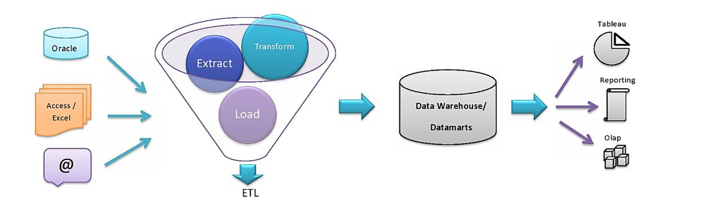
Journey of Data in an Organization

Slide 4
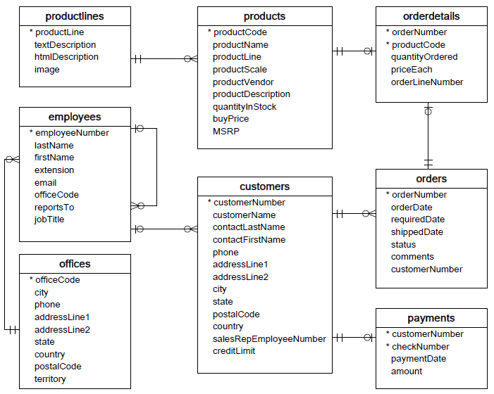
ER Diagram

Slide 5

Star Schema
Dimension Table
Dimension Table
Dimension Table
Fact Table
Dimension Table
Dimension Table

Slide 6

Snowflake Schema
Dim Table L2
Dim Table L2
Dim Table L1
Dim Table L2
Dim Table L2
Dim Table L1
Dim Table L1
Dim Table L2
Fact Table
Dim Table L2
Dim Table L2
Dim Table L1
Dim Table L1
Dim Table L2
Dim Table L2
Dim Table L1
Dim Table L2
Dim Table L2
Dim Table L2

Slide 7
DDL and DML
Data Definition Language
Data Manipulation Language
CREATE
Schema
Tables
Views
Constraints
ALTER
DROP
Operates on the structure of the Entity
INSERT
UPDATE
DELETE
Operates on the contents of the Entity

Slide 8
Data Modelling
Session 2: Building blocks of data modelling

Slide 9


Slide 10


Slide 11


Slide 12



Slide 13











Slide 14
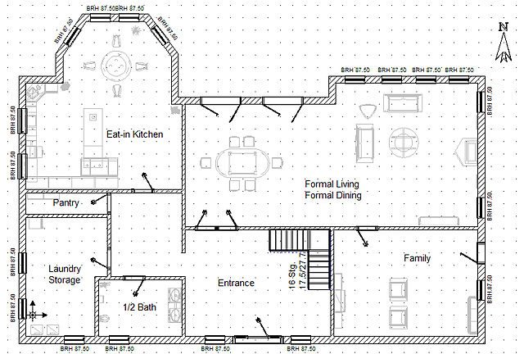
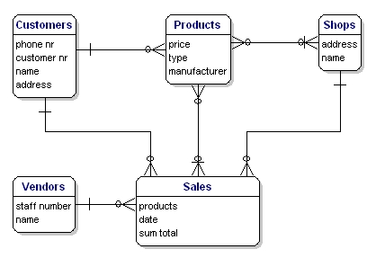
Introduction to Data Modelling

Slide 15
Database Design
Design
Development/Implementation
Manipulation
Revision
Production
Maintenance

Slide 16
Relational Schemas
Advantages
Disadvantages
Data structuring is easy
Efficient querying as optimizations like indexing is possible
Easy to navigate and explore the data
Relationships can be easily defined between data points
It’s very rigid, restricts flexibility
Relational Databases do not scale out horizontally very well, can’t keep adding more and more tables/columns
Very minimal/no support on semi-structured data

Slide 17
Relational vs Non-Relational Schemas
ACID
BASE
Atomic: Everything in a transaction succeeds or the entire transaction is reverted
Basic Availability: Supports basic needs for data capture
Consistent: A transaction is consistent across the database
Soft state: The state of the system could change over time
Isolated: Transactions are independent of each other
Eventual consistency: Rather than being consistent after each transaction, it attains that state of consistency eventually
Durable: Completed transactions are retained, even when the server restarts

Slide 18
Data Modelling
Session 3: Problem-solving using Data Modelling

Slide 19
Problem Statement: Create a data model for retail chain to understand its consumer behavior
Sales Transactions
Product Details
Customer Information
Employee Information
Product Inventory Inflow
Branches details
Campaigns/Discounting Information
Details of Customer Complaints

Slide 20
Database Design

Slide 21
Database Creation
CREATE DATABASE databasename;
CREATE SCHEMA schemaname;
USE databasename
DROP DATABASE databasename;
DROP SCHEMA schemaname;

Slide 22
Table Creation
CREATE TABLE table_name
(
column1 column_definition,
column2 column_definition,
...
CONSTRAINT [constraint_name]
PRIMARY KEY (column1, column2, ... column_n)
);
ALTER TABLE table_name
ADD CONSTRAINT [ constraint_name ]
PRIMARY KEY (column1, column2, ... column_n);
DROP TABLE table_name;
ALTER TABLE table_name
ADD CONSTRAINT [ constraint_name ]
FOREIGN KEY (column1) REFERENCES table2_name(reference_column);

Slide 23
Database/Table Manipulation
INSERT INTO table_name VALUES (value1, value2, value3, ...);
UPDATE table_name SET column1 = value1, column2 = value2, ... WHERE condition;
DELETE FROM table_name WHERE condition;
DELETE table_name;

Slide 24
Understanding Customer Behaviour
Number of Transactions by Gender
Transactions by Men
Transactions by Women
Number of customers who have placed an order from more than 1 store
City with highest number of orders
Area with highest sales (Sum of all sales prices)
State with highest customers

