Slide 1
BLUESTOCK FINTECH
Mutual Fund Analytics Platform
Capstone Project — Final Presentation
End-to-End Data Engineering · ETL Pipeline · Analytics · Interactive Dashboard
1 / 12

Slide 2
Problem & Objective
The Problem
The Objective
NAV, AUM and SIP data live in fragmented formats across AMFI
No unified analytics platform for risk-adjusted fund comparison
Retail investors can't easily see if their fund beats its benchmark
Monthly reports are static PDFs — no self-service dashboard
Build an automated ETL pipeline from raw AMFI data
Design a normalised SQL schema (6-table star schema)
Compute Sharpe, Sortino, Alpha/Beta, VaR/CVaR from scratch
Deliver an interactive, filterable analytics dashboard
2 / 12

Slide 3
Data Sources
40
46K+
32.7K
10
Real fund schemes
NAV rows, Jan'22–May'26
Investor transactions
Provided datasets
Sources: AMFI India (amfiindia.com) · mfapi.in REST API (no auth) · NSE/BSE public reports
Dataset | Rows | Used In
01_fund_master.csv | 40 | dim_fund, all notebooks
02_nav_history.csv | 46,000 | fact_nav, EDA, Performance
08_investor_transactions.csv | ~32,000 | Investor Analytics, Cohorts
10_benchmark_indices.csv | ~8,000 | Alpha/Beta, benchmark charts
3 / 12

Slide 4
System Architecture
EXTRACT
AMFI CSVs, mfapi.in API, NSE/BSE reports
TRANSFORM
Pandas cleaning: dates, dedup, forward-fill, validation
LOAD
SQLite 6-table star schema (dim_fund, dim_date, 4 fact tables)
ANALYSE
Jupyter notebooks: EDA, Performance, Advanced Analytics
VISUALISE
Interactive HTML/Plotly dashboard, 4 pages, live filters
4 / 12

Slide 5
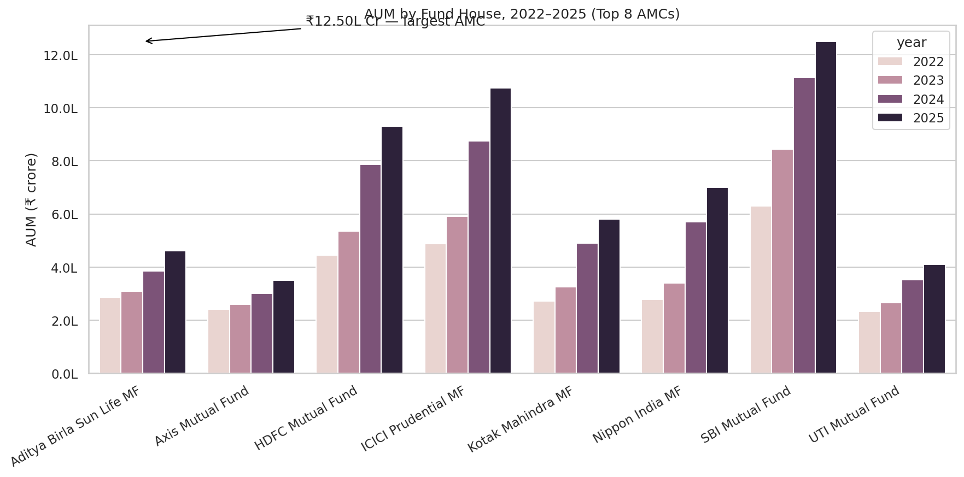
EDA Highlights — AUM & Folio Growth
SBI Mutual Fund is the clear AUM leader
...across every year 2022–2025 among the top 8 AMCs, not just the latest snapshot.
₹12.5L Cr
SBI MF AUM, Dec 2025 — largest AMC in India
5 / 12

Slide 6
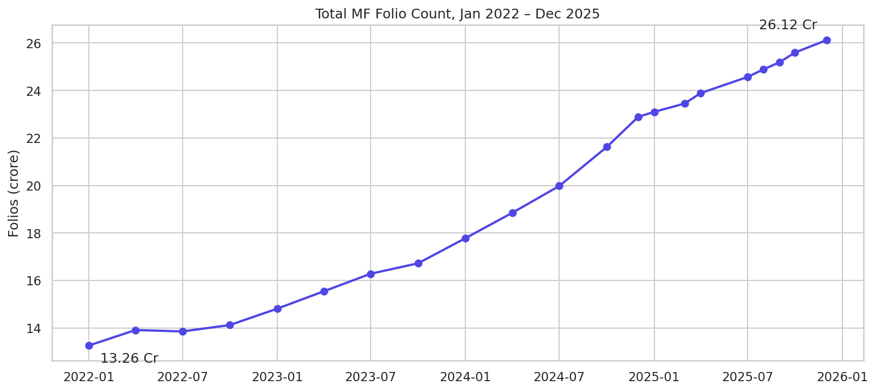
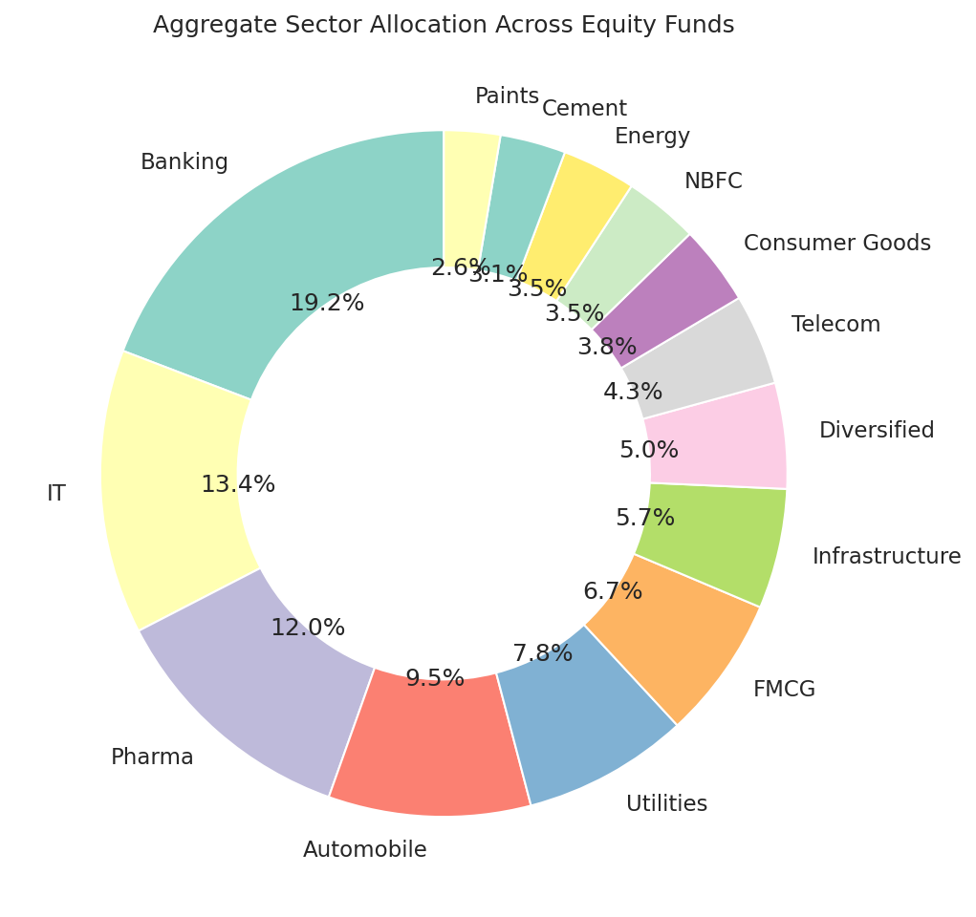
EDA Highlights — Folios & Sector Mix
Folios grew from 13.26 Cr → 26.12 Cr (2022–2025); Financial Services & IT dominate aggregate equity holdings.
6 / 12

Slide 7
Performance — Fund Scorecard
Rank | Scheme | Score | 3yr CAGR | Sharpe
1 | Mirae Asset Large Cap Fund — Regular — Growth | 86.25 | 33.99% | 1.45
2 | ICICI Pru Midcap Fund — Regular — Growth | 82.25 | 31.77% | 1.18
3 | Kotak Flexicap Fund — Regular — Growth | 82.00 | 29.58% | 1.31
4 | HDFC Mid-Cap Opportunities Fund — Regular — Growth | 80.75 | 32.43% | 1.09
5 | ICICI Pru Bluechip Fund — Direct — Growth | 80.00 | 32.48% | 1.03
Composite score = 30% × 3yr return rank + 25% × Sharpe rank + 20% × Alpha rank + 15% × expense ratio rank (inv.) + 10% × max drawdown rank (inv.)
Caveat: ranks across ALL categories on one scale — filter to one category before using this for fund selection.
7 / 12

Slide 8
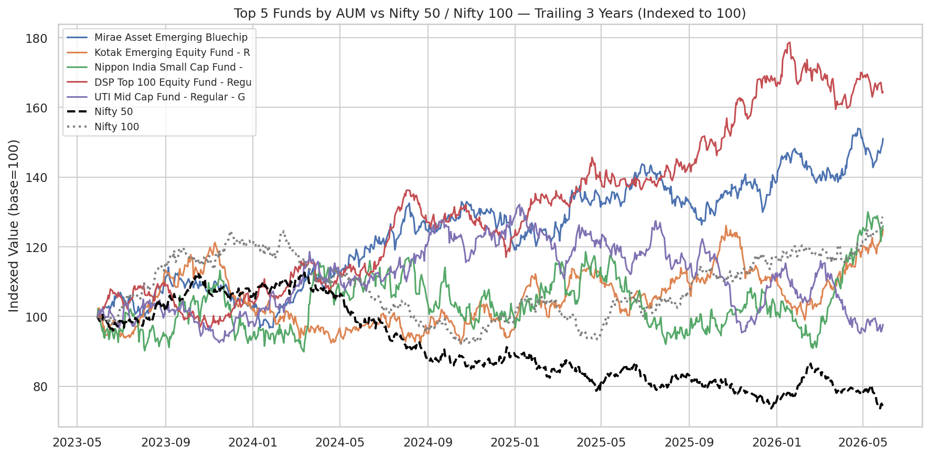
Performance — Benchmark Comparison & Risk
Top 5 funds by AUM vs Nifty 50 / Nifty 100
VaR (95%), riskiest fund:
SBI Small Cap Fund — Direct
-2.69% VaR / -3.24% CVaR
Sector HHI, mean across equity funds:
2,029 (moderately concentrated)
Benchmark comparison is relative to the supplied Nifty dataset, which does not track real market history — see report Section 8.
8 / 12

Slide 9
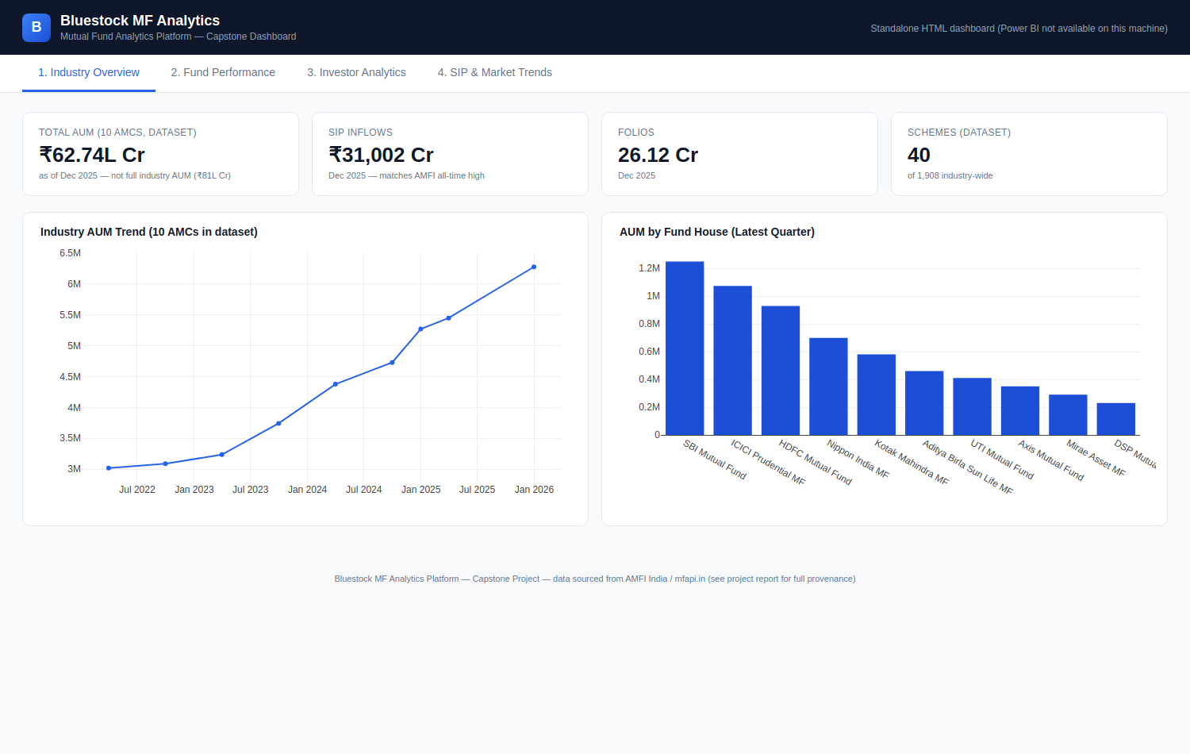
Interactive Dashboard — Industry Overview
Standalone HTML/Plotly dashboard (Power BI Desktop unavailable) — KPI cards match real AMFI figures for SIP inflow and folios.
9 / 12

Slide 10
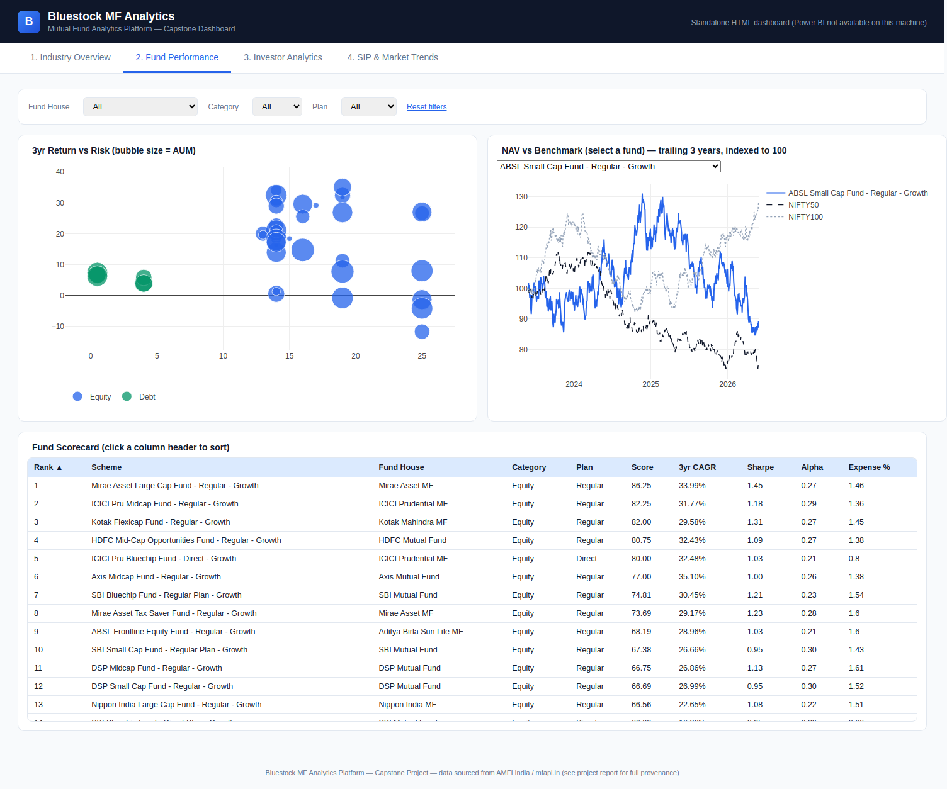
Interactive Dashboard — Fund Performance
Functional filters (fund house, category, plan), sortable scorecard, NAV-vs-benchmark selector — verified working via automated browser testing.
10 / 12

Slide 11
Key Findings
Top fund
Mirae Asset Large Cap Fund — score 86.25, 33.99% 3yr CAGR, Sharpe 1.45
Highest risk
SBI Small Cap Fund (Direct) — 95% VaR of -2.69%, CVaR -3.24%
Data limitation
Fund NAVs show ~zero correlation with Nifty 100 (R² ≈ 0.0006) — Alpha/Beta are methodologically correct but not real market signals
Investor retention
97.8% of long-tenure SIP investors flagged "at-risk" — median SIP gap is 65 days, not the ~30 expected
Sector risk
Equity fund sector HHI averages 2,029; one fund (Axis Bluechip) reaches 2,968 — "highly concentrated"
11 / 12

Slide 12
Thank You
Bluestock MF Analytics Platform — Capstone Project
github.com/Shradd7/Bluestock_MutualFundPlatform
12 / 12

