Slide 1


Multimodal Emotion Recognition
Research Paper Analysis, Key Takeaways, Gaps & Proposed Research Direction
Name: Shraddha Verma
Mentor: Dr. Venkatnareshbabu kuppilli
Institute: NIT GOA

Slide 2
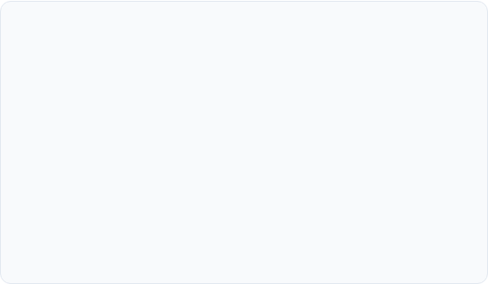

What is Multimodal Emotion Recognition?
The MER Concept
Unimodal vs. Multimodal
Detecting human emotions by integrating multiple data streams including text (natural language), audio (vocal tone), facial expressions (visual), and conversational context.
Unimodal: Uses one modality (e.g., just text). Highly prone to ambiguity and environmental noise.
Multimodal: Fuses cues to improve robustness. Resolves conflicts (e.g., identifying sarcasm where text is positive but voice is cynical).
Mimics human social perception by verifying emotional states across independent sensors.

Slide 3







Why MER is Important
Mental Health
Smart Education
Driver Safety
Social Robotics
Automated monitoring for depression, anxiety, and PTSD through subtle vocal and facial cues.
Adapting online content based on student frustration or engagement levels.
Monitoring fatigue, distraction, or road rage to prevent accidents.
Enabling robots to understand and respond to human emotions naturally.

Slide 4
Evolution of Emotion Recognition
Unimodal ER
Multimodal ER
Context-aware
Conversational
LLM-based
Single signals (Face or Voice)
Early Fusion of AVT channels
Environmental context inclusion
Dialogue history & interaction
Affective reasoning (2025+)

Slide 5
Core Research Papers Analyzed
Paper Title | Year | Core Focus Area
Emotion Recognition from Unimodal to Multimodal Analysis | 2023 | Evolution & Fusion foundations
State-of-the-Art MER: A Comprehensive Survey and Taxonomy | 2026 | Modern architectural classifications
A Comprehensive Review of MER: Techniques & Challenges | 2025 | Future directions & gaps
MER 2025: When Affective Computing Meets LLMs | 2025 | LLM-driven emotion reasoning
Emotion Recognition in Conversations: A Survey | 2025 | Contextual dialogue modeling

Slide 6
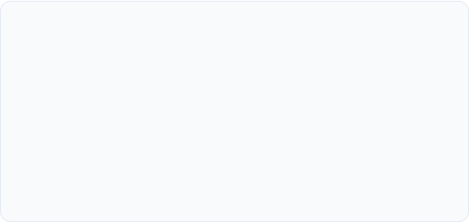
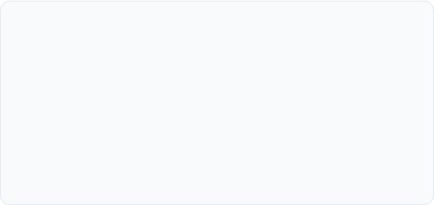
Paper-wise Analysis (1 & 2)
Unimodal to Multimodal (2023)
SOTA Survey & Taxonomy (2026)
Contribution: Highlights the shift from isolated signal processing to integrative systems.
Contribution: Categorizes modern DL architectures into hierarchical taxonomies.
Learning: Fusion is the "brain" of the system; simple concatenation often fails to capture cross-modal nuances.
Learning: Current focus is shifting toward "biomimetic" fusion that mimics human cross-sensory attention.

Slide 7


Paper-wise Analysis (4 & 5)
MER meets LLMs (2025)
Conversational ER (2025)
Takeaway: LLMs are being used for emotion reasoning, not just classification. They explain why someone is sad based on cultural/social knowledge.
Takeaway: Emotions in dialogue are dependent on "Speaker Influence" and "Dialogue History"—context is as important as the signal itself.

Slide 8
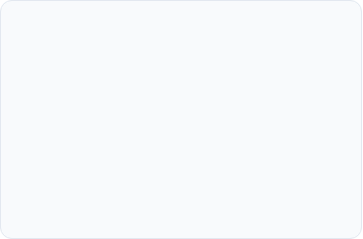

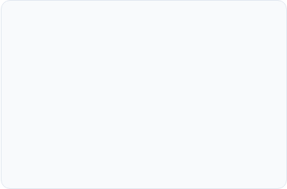
Synthesized Findings Across Papers
MER Dominance
The Fusion Heart
The Explainability Gap
Literature unanimously agrees: MER vastly outperforms unimodal ER by resolving ambiguities across modalities.
The success of any MER system depends 90% on how the fusion layer is designed (Early, Late, or Hybrid/Adaptive).
Deep Learning provides accuracy but fails to provide interpretability or psychological reasoning.

Slide 9

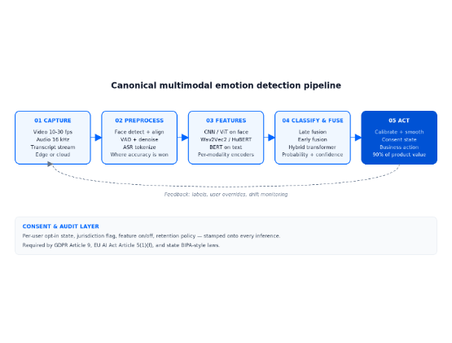
Identified MER Pipeline
1. Input: Multi-stream raw data (Vocal, Visual, Textual).
2. Feature Extraction: CNN/RNN/Transformers for modality-specific features.
3. Alignment: Synchronizing signals across time.
4. Fusion: Dynamic weighting and integration.
5. Prediction: Classification into emotional categories or intensity.

Slide 10
Identified Research Gaps
Gap / Loophole | The Problem | Research Opportunity
Fusion Conflict | Conflicting signals (e.g. happy face + sad voice). | Adaptive/Attention-based weighting.
Missing Modalities | Systems crash if one modality (video/audio) is noisy. | Robust fusion under data loss.
Explainability | Models are black boxes; can't explain "Why". | Explainable Adaptive Fusion.
Context/Speaker | Ignoring speaker dependency in conversations. | Dialogue history modeling.

Slide 11


Deep Dive: Fusion Conflict Problem
The Conflict Scenario
Proposed Solution
Text: "I am okay" (Neutral)
Dynamic Modality Weighting: Model learns to trust the 'Visual' modality more during crying, effectively ignoring the neutral text.
Voice: Shaky/Sad (Negative)
Face: Crying (Highly Negative)
Adaptive Fusion: Smart fusion layers that prioritize higher-intensity signals.
Problem: Current models often average these out, leading to incorrect neutral predictions.

Slide 12
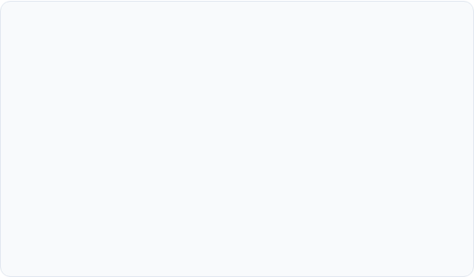
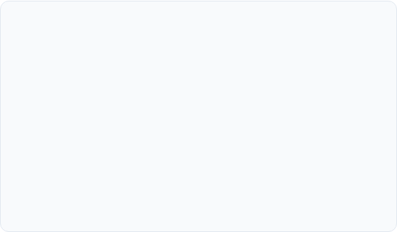
Deep Dive: Conversation Context
The Loophole
The Opportunity
Current systems treat utterances as isolated snapshots. They ignore that a person's current emotion is a product of:
Conversation-Aware MER: Using GNNs or Transformers to model the emotional influence between multiple speakers over time.
•
Dialogue History
•
Previous Speaker's influence
•
Current Speaker's baseline personality

Slide 13



Possible Research Directions
Option 1
Option 2
Option 3
Adaptive Context-Aware MER
Robust MER under Noise
Explainable Adaptive Fusion
Designing fusion mechanisms that survive missing modalities or high sensor noise.
Focusing on conversational history and speaker-modality relationships.
Creating models that not only predict but explain which modality influenced the choice.

Slide 14
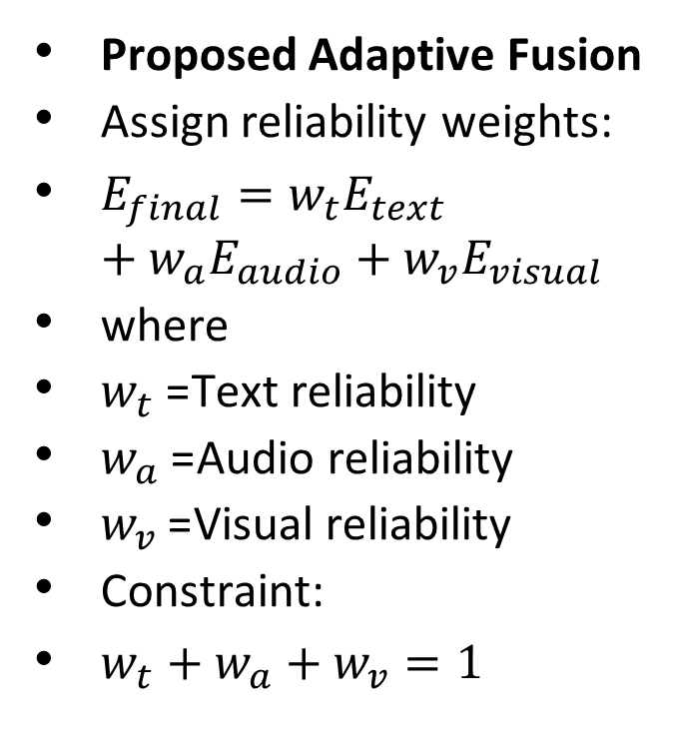
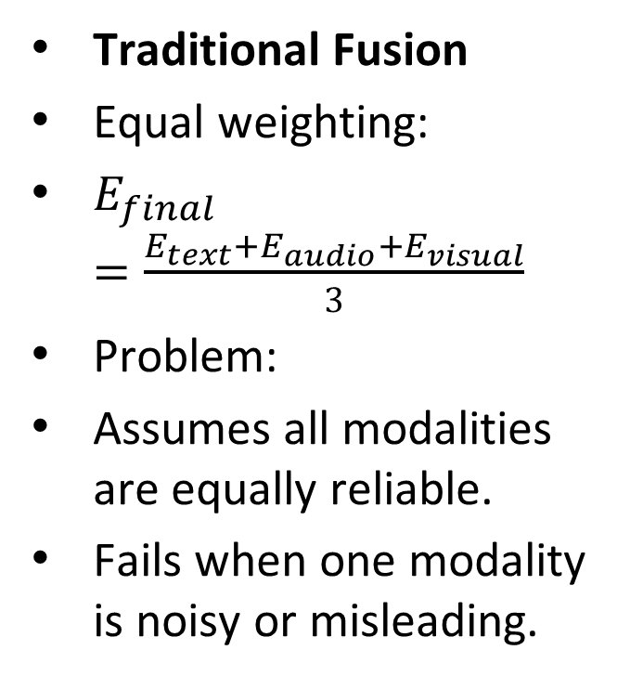
Mathematical Example: Adaptive Fusion
Traditional Fusion
Equal weighting:
$E_{final}=\frac{E_{text}+E_{audio}+E_{visual}}{3}$
Problem:
Assumes all modalities are equally reliable.
Fails when one modality is noisy or misleading.
Proposed Adaptive Fusion
Assign reliability weights:
$E_{final}=w_{t}E_{text}+w_{a}E_{audio}+w_{v}E_{visual}$
where
$w_{t}$= Text reliability
$w_{a}$= Audio reliability
$w_{v}$= Visual reliability
Constraint:
$w_{t}+w_{a}+w_{v}=1$

Slide 15
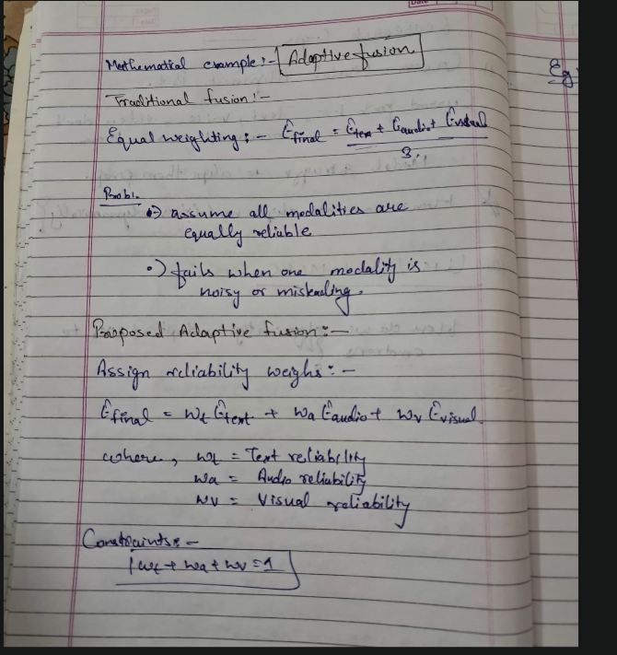
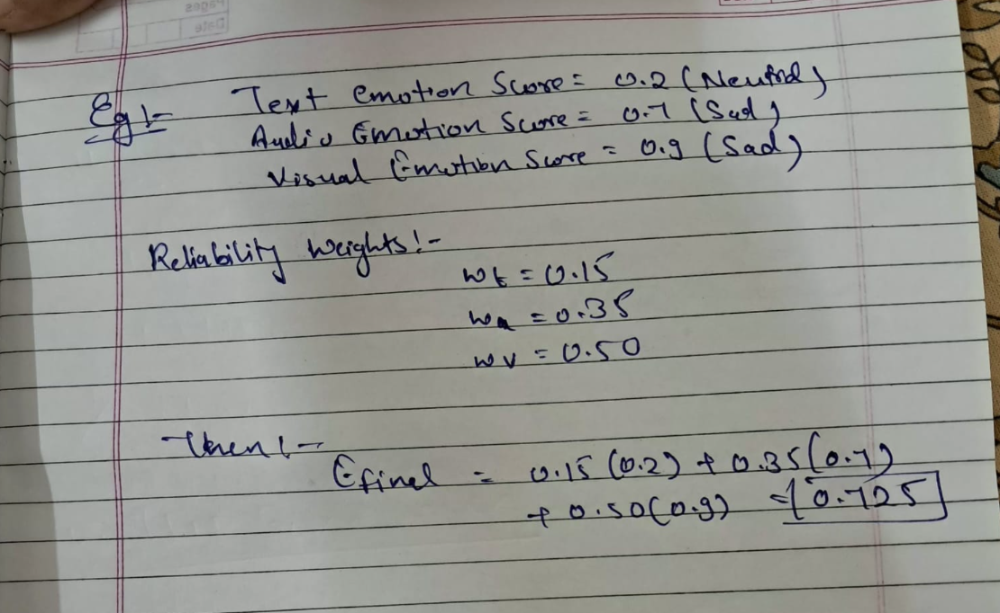
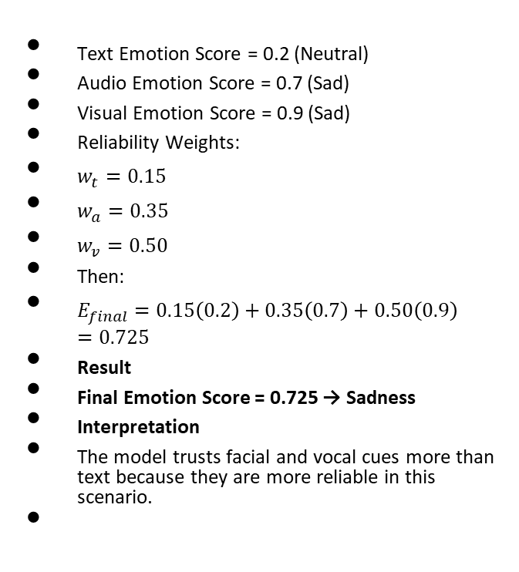
Example
Text Emotion Score = 0.2 (Neutral)
Audio Emotion Score = 0.7 (Sad)
Visual Emotion Score = 0.9 (Sad)
Reliability Weights:
$w_{t}=0.15$
$w_{a}=0.35$
$w_{v}=0.50$
Then:
$E_{final}=0.15\left(0.2\right)+0.35\left(0.7\right)+0.50\left(0.9\right)=0.725$
Result
Final Emotion Score = 0.725 → Sadness
Interpretation
The model trusts facial and vocal cues more than text because they are more reliable in this scenario.

Slide 16
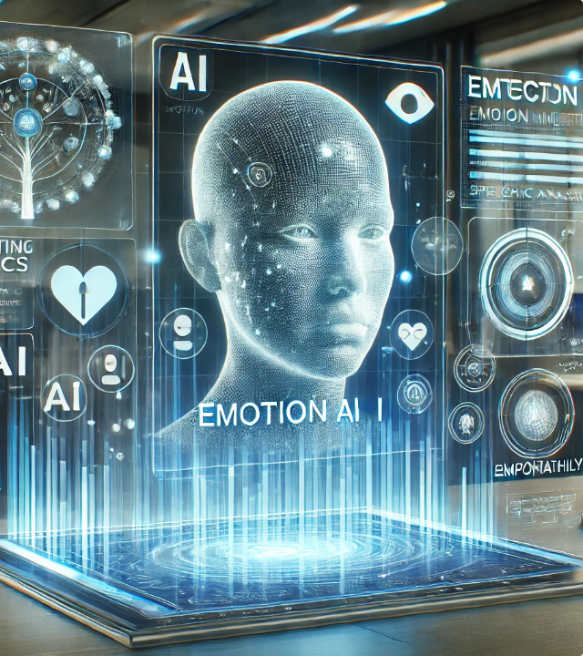
Final Proposed Direction
"Explainable Adaptive Fusion for MER under Missing or Noisy Modalities"
Why this is strong:
•
Solves the core Fusion Problem.
•
Handles real-world imperfect data (missing video/audio).
•
Improves trust via explainability.
•
Addresses gaps found in recent 2025/2026 papers.

Slide 17
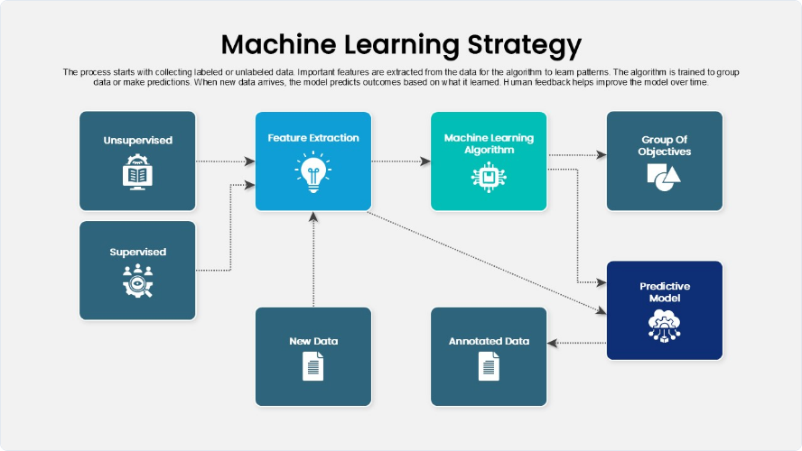
Proposed Methodology: Detailed Flow
Adaptive Pipeline: Modality Reliability Scoring → Dynamic Weight Assignment → Explainable Output Layer

Slide 18
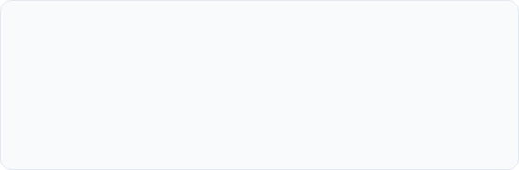
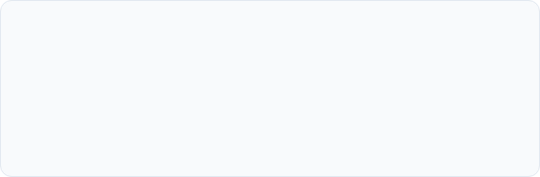
Expected Contributions
90%
Robustness Target: Maintain high accuracy even when one modality is completely missing or highly corrupted by Gaussian noise.
Technical Contribution
Impact Contribution
Dynamic Modality Importance Learning; Benchmark comparison across CNN, GRU, LSTM, and Transformers.
Real-world deployment readiness for mobile and edge devices where sensor data is often unreliable.

Slide 19

Conclusion
MER is shifting from simple classification to Context-Aware, Explainable, and Reasoning-based systems.
My analysis of these 5 SOTA papers has identified that Adaptive Fusion is the key to solving real-world challenges like modality conflict and noise.
My proposed research aims to build a framework that is both Robust to missing data and Explainable to human users.

Slide 20
References
# | Paper Title | Year
1 | Emotion Recognition from Unimodal to Multimodal Analysis: A Survey | 2023
2 | State-of-the-Art Multimodal Emotion Recognition: A Comprehensive Survey | 2026
3 | A Comprehensive Review of MER: Techniques, Challenges, and Future Direction | 2025
4 | MER 2025: When Affective Computing Meets Large Language Models | 2025
5 | Emotion Recognition in Conversations: A Survey | 2025

Slide 21
Real Dataset Example (MELD Dataset)
Modality | Input
Text | I am fine.
Audio | Low pitch, slow voice, low energy
Video | Sad facial expression
Actual Emotion Label | Sadness

Slide 22
Algorithms Used in Proposed Pipeline
Component | Algorithm | Purpose
Text Processing | BERT | Understands sentence meaning and context
Audio Processing | BiLSTM | Captures emotional speech patterns
Video Processing | CNN | Extracts facial expression features
Fusion Layer | Weighted Fusion | Combines modalities
Reliability Module | Reliability Scoring | Assigns trust scores

Slide 23
Existing Method (Equal Fusion)
Emotion | BERT | BiLSTM | CNN
Joy | 0.70 | 0.20 | 0.10
Sadness | 0.20 | 0.70 | 0.80
Anger | 0.10 | 0.10 | 0.10
Simple Average Fusion:
Joy=(0.70+0.20+0.10)/3=0.33
Sadness=(0.20+0.70+0.80)/3=0.56
Prediction: Sadness

Slide 24
Proposed Reliability-Based Fusion
Modality | Reliability
Text | 0.20
Audio | 0.40
Video | 0.40
Weighted Joy=(0.20×0.70)+(0.40×0.20)+(0.40×0.10)=0.26
Weighted Sadness=(0.20×0.20)+(0.40×0.70)+(0.40×0.80)=0.64
Final Prediction: Sadness
Benefit: Reliability-aware fusion gives more trust to audio/video when text is misleading.

Slide 25
What is MELD Dataset & How I Will Use It
MELD Dataset
• Contains Text, Audio and Video.
• Provides emotion labels.
• Used as training and testing dataset.
Flow:
MELD Input → BERT/BiLSTM/CNN → Fusion → Emotion Prediction

Slide 26
What is BERT & How I Will Use It
BERT (Bidirectional Encoder Representations from Transformers)
Purpose:
Understand sentence meaning.
Usage:
Text → BERT → Text Features → Fusion Layer

Slide 27
What is BiLSTM & How I Will Use It
BiLSTM (Bidirectional Long Short-Term Memory)
Purpose:
Capture emotional patterns from speech.
Usage:
Audio → BiLSTM → Audio Features → Fusion Layer

Slide 28
What is CNN & How I Will Use It
CNN (Convolutional Neural Network)
Purpose:
Extract facial expression features.
Usage:
Video Frames → CNN → Visual Features → Fusion Layer

Slide 29
What is Fusion & How I Will Use It
Purpose:
Combine Text, Audio and Video features.
Usage:
Text Features + Audio Features + Visual Features → Fusion Layer → Unified Representation

Slide 30
What is Reliability Scoring Module & How I Will Use It
Purpose:
Assign trust scores to modalities.
Example:
Text=0.20, Audio=0.40, Video=0.40
Usage:
Reliability Scores → Weighted Fusion → Final Emotion Prediction
Contribution:
More robust under noisy or misleading modalities.

Slide 31
Complete Proposed MER Architecture
MELD Dataset
Text
Audio
Video
BERT
BiLSTM
CNN
Audio Features
Text Features
Visual Features
Fusion Layer
Reliability Scoring Module
Happy / Sad / Angry
Neutral / Excited
Adaptive Weighted Fusion
Emotion Classifier

