Slide 1
Food Recipe Dataset Analysis
- Presented by Shraddha Sundaresan

Slide 2
Title and Content Layout with List
Data Cleaning –
Outlier Analysis
Checking for duplicates
Missing values
Removing inconsistencies
Re-structuring/Tidying data/Data transformations
Combining the data sets(Having relevance)
Create Visualization
Debunking the claims

Slide 3
About the Recipe Dataset
recipe_name​ | The name of the recipe. (String)​
prep_time​ | The amount of time required to prepare the recipe. (Integer)​
cook_time​ | The amount of time required to cook the recipe. (Integer)​
total_time​ | The total amount of time required to prepare and cook the recipe. (Integer)​
servings​ | The number of servings the recipe yields. (Integer)​
ingredients​ | A list of ingredients required to make the recipe. (List)​
directions​ | A list of directions for preparing and cooking the recipe. (List)​
rating​ | The recipe rating. (Float)​
url​ | The recipe URL. (String)​
cuisine_path​ | The recipe cuisine path. (String)​
nutrition​ | The recipe nutrition information. (Dictionary)​
timing​ | The recipe timing information. (Dictionary)​
Column name | Description
url | The recipe URL. (String)
Name | The recipe name. (String)
Prep Time | The recipe prep time. (String)
Cook Time | The recipe cook time. (String)
Total Time | The recipe total time. (String)
Servings | The recipe servings. (String)
Yield | The recipe yield. (String)
Ingredients | The recipe ingredients. (String)
Directions | The recipe directions. (String)

Slide 4
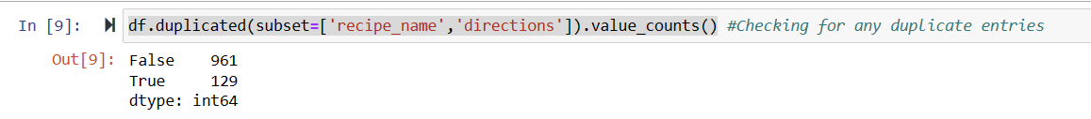
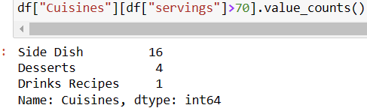
Approach towards data cleaning(Dataset 1)
To check if there are null fields in the dataset along the columns and check for duplicate recipe names.
Drop the duplicates.
From the basic description of our data we see that the serving size goes up to 1090. But are they really outliers?

Slide 5
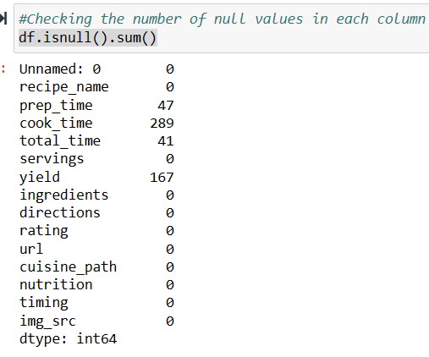
More into Data Cleaning
We can drop of the yield column, as it depicts the dimension and serving size of the recipe.(Serving size column is good enough for an analysis).
Is the total_time an aggregate of cook time and prep_time?
The answer is no, not always.
The timing column contains another field called additional time for some recipes.(Now we may add up these values to check if they are corresponding to the correct total time).
This condition was satisfied.

Slide 6
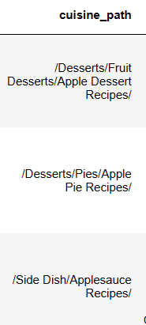
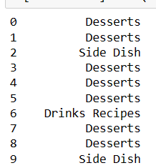
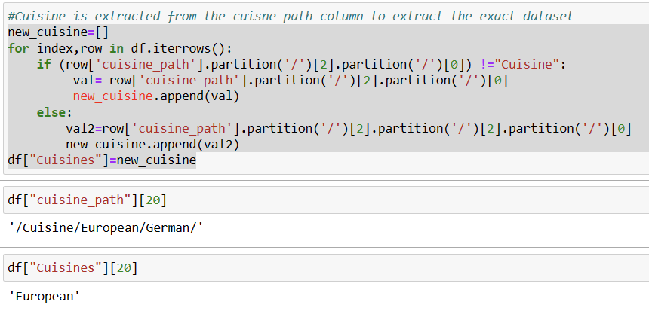
Formats of the data
The total time column is on a different format we can convert them all to the same format(minutes in our case).
We may also parse through the cuisine to understand the background of the recipe.
It is not always about returning the parent path, sometimes the cuisine is stored on the child path.

Slide 7
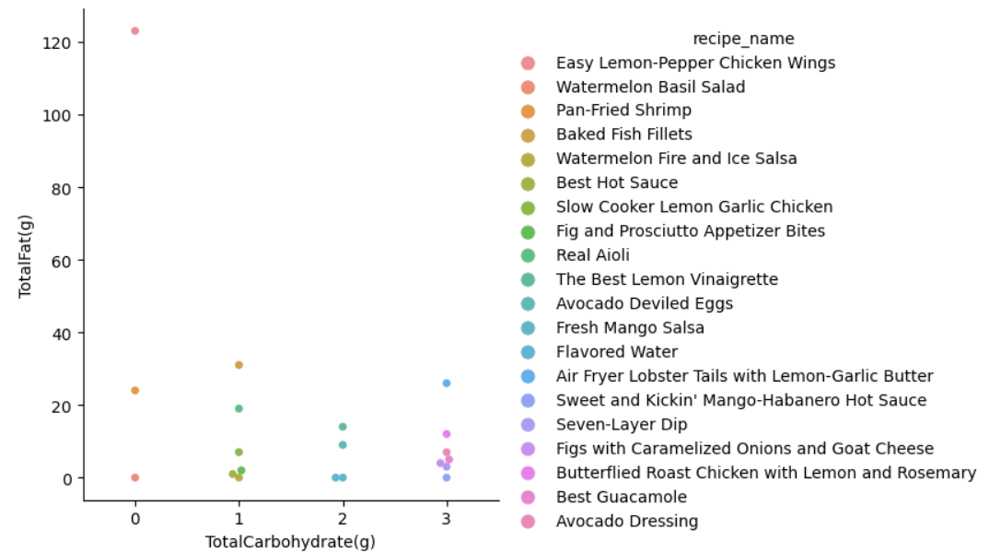
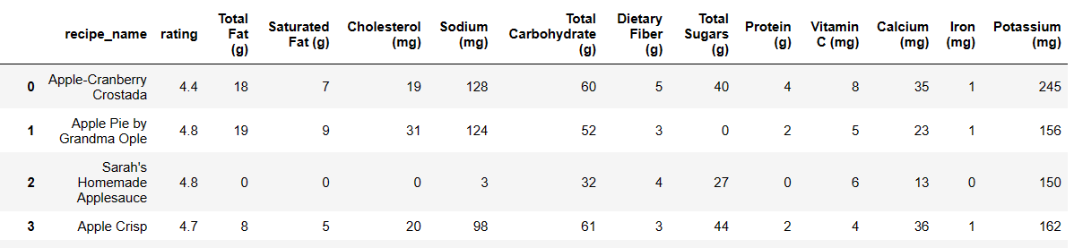
Looking into Nutrition(Keto diet)

Slide 8
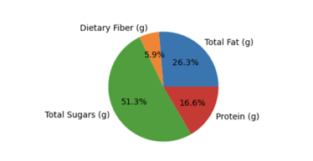
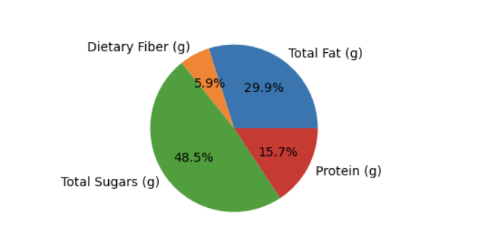
Ratings and nutritional value
Macro-nutrition distribution based on the first quartile rating.
Macro-nutrition distribution on the fourth quartile ratings.
A minute drop in sugar levels is observed amongst the highly rated dishes.

Slide 9
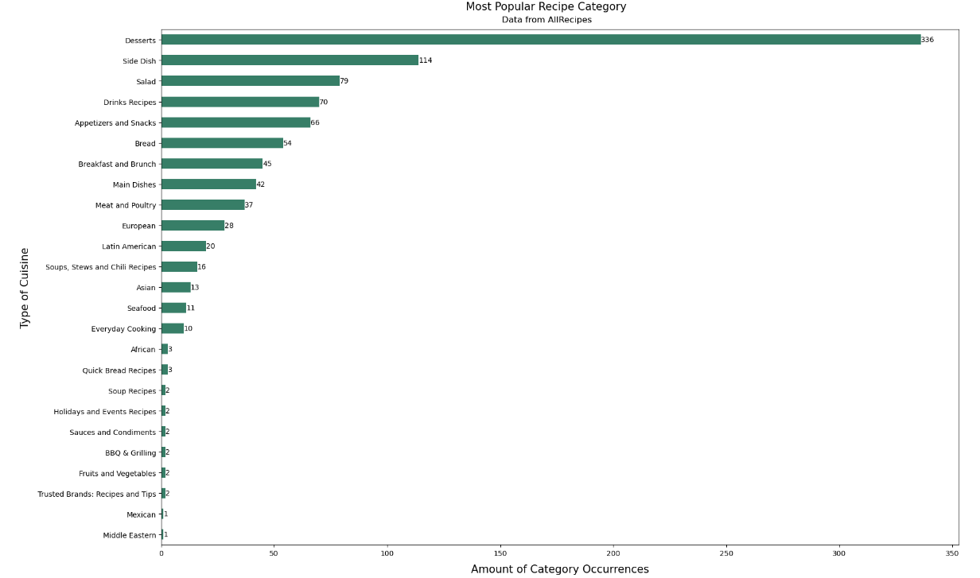
Popularity of Cuisines
The most popular type of Cuisine is Desserts and the least is Middle-eastern type.
We can further drill down to understand if there are particular foods with the least ratings.

Slide 10
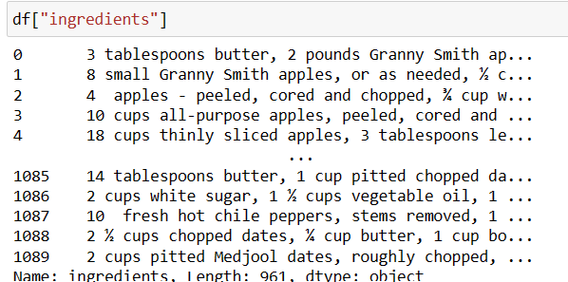
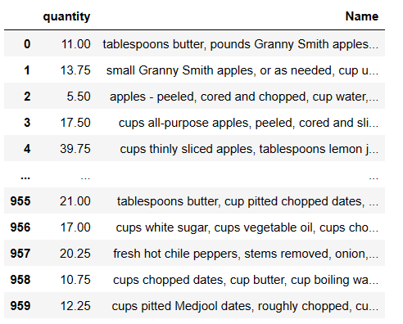
The ingredients column
The ingredients column consists of multiple items associated with the quantity and unit in a text format.
This needs to be segregated to separate columns.
So the first approach is to convert the unicode quantities into fraction values that associates against each sentences.

Slide 11
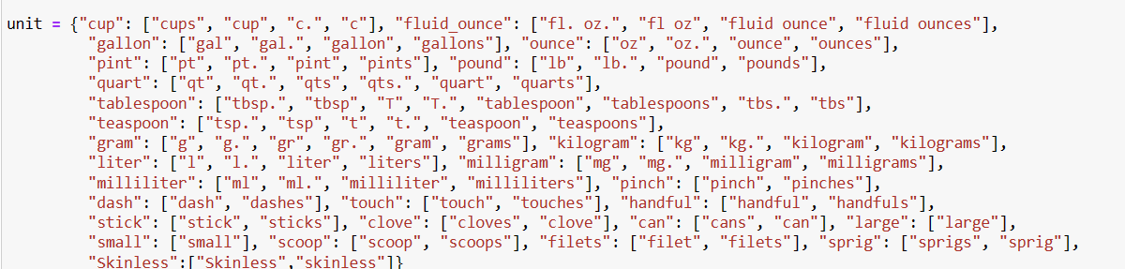
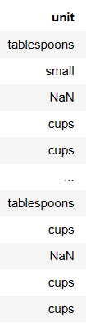
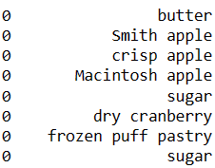
Extraction of Units
The units are extracted by an externally created set of unit values.
This allows us to create a unit,quantity and item column.
This done by loading the existing small model from spacy, to get the meaningful ingredients list out of the entire ingredients description.
Stemming/lemmatization to get to the root words.
This is to make sure that we do not have re-occurring words such as egg and eggs.(Our purpose from the hypothesis is to understand the type of item that occurs maximum time).

Slide 12
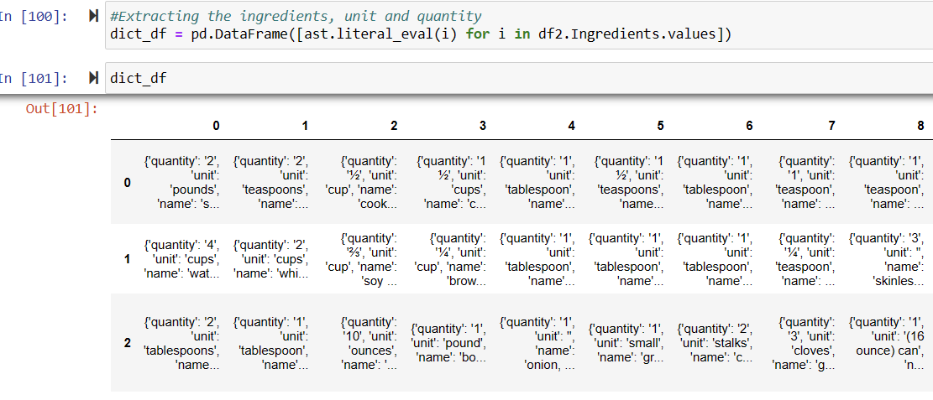
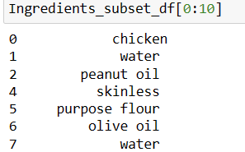
Extracting Ingredients from the second dataset
Since the Ingredients column is a list of dictionary values, where the dictionary keys are string values. We need to split the list into individual columns and rows before iterating through the dictionary key value pair.

Slide 13
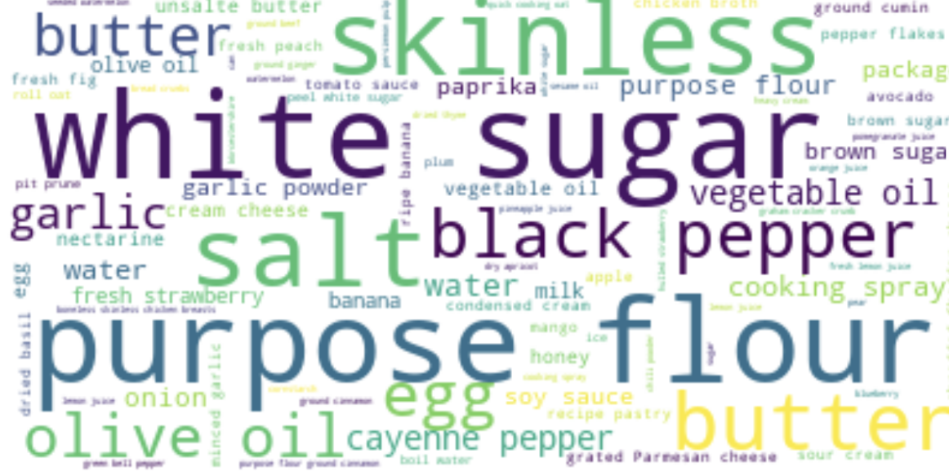
Combining the two datasets,based on items
Once we combine the dataset based on the extracted items list.
A word cloud is formed to understand the most prominent ingredient in most of the recipes.
Our hypothesis that ,The highest contributing ingredients are Sugar,salt,purpose flour is hence true

Slide 14
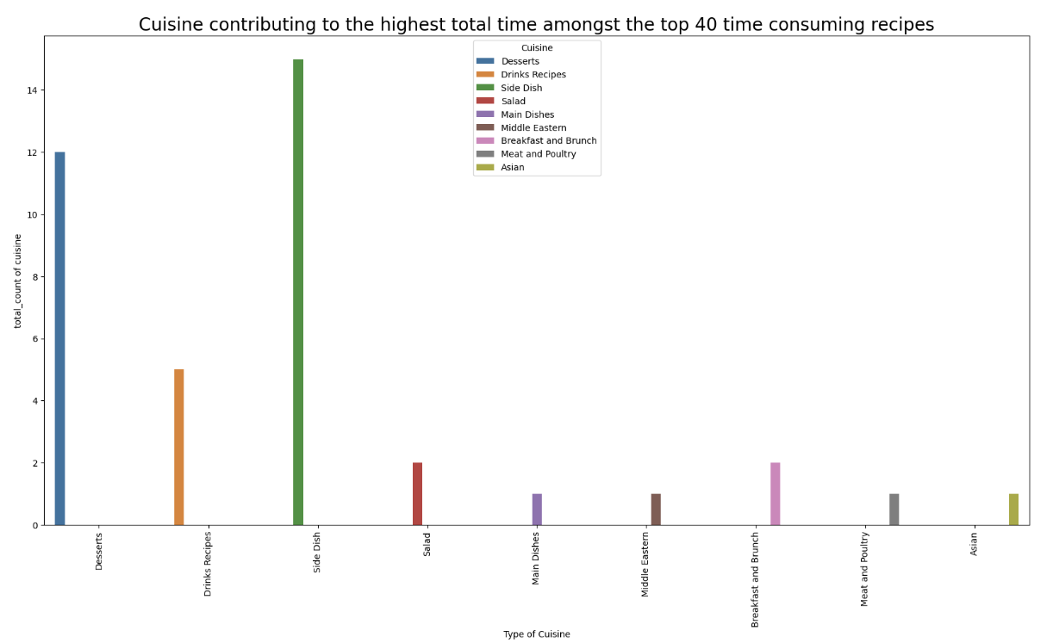
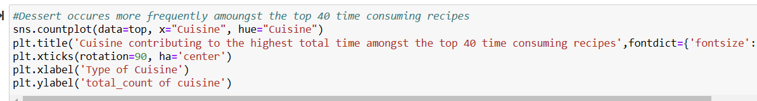
Hypothesis 2-Dessert occures more frequently amoungst the top 40 time consuming recipes
From the bar chart it is evident that the Side dishes contribute to more overall timing amongst the top 40 time consuming dishes.

Slide 15
Further Enhancements
Building recipe recommendation engines based on the nutritional requirement.
To find the type of ingredients that is mostly used in each kind of Cuisine
To find easy to prepare recipes of recipes having the least number of ingredients.
Find particular cuisine recipes with the highest rating and retrieve the ingredients associated with it.

Slide 16
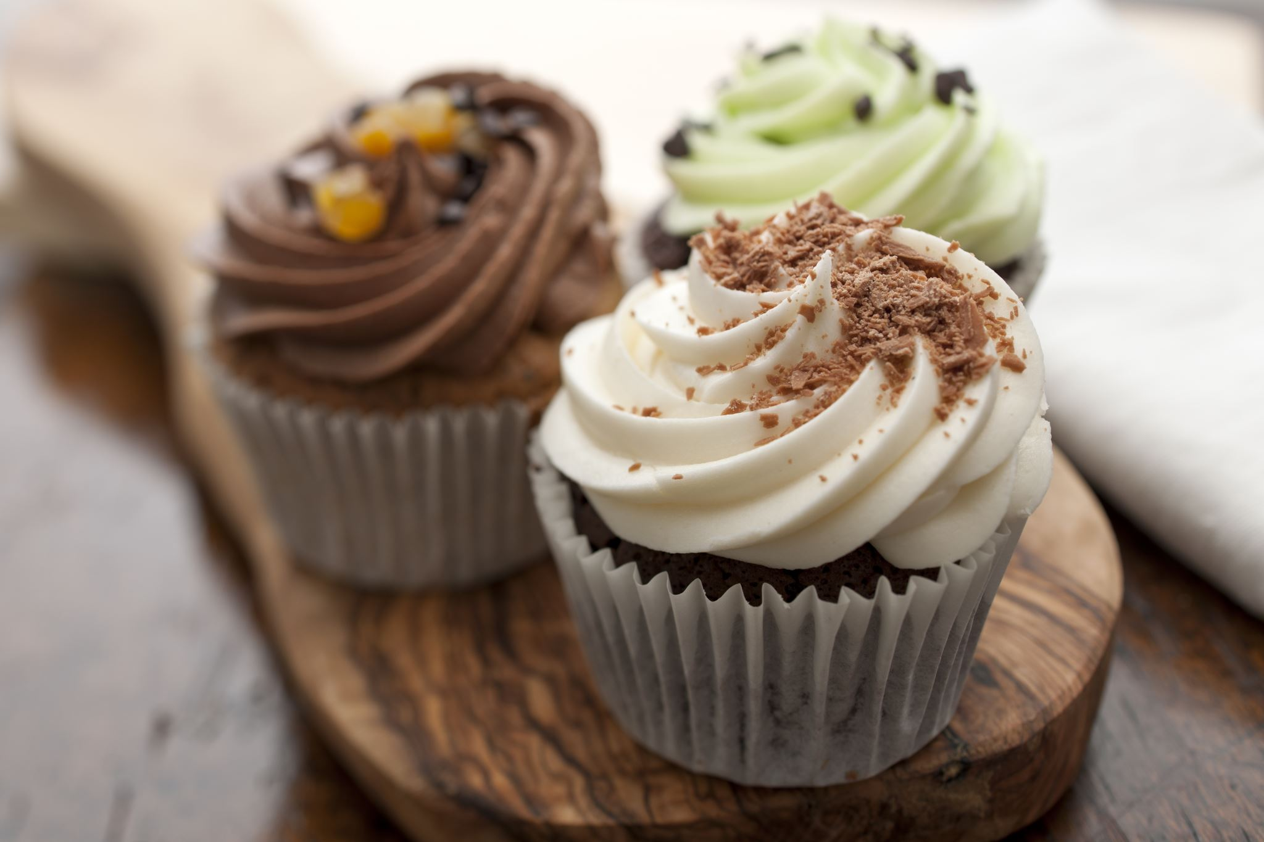
Thank You

