Slide 1



Weather Management and Prediction
-By
Shraddha Chaudhari
Tripta Gaidu
Kaveri Narawade

Slide 2

Learning Objectives
Understanding and exploring the datasets using libraries such as pandas
Gain foundational understanding of weather data type and their implications on sustainability
Learn how to apply machine learning techniques and Linear Regression
Familiarize with kaggle as platform for finding datasets and apply learned skills in real world application
GOAL
Source :
www.freepik.com/

Slide 3
Kaggle for Datasets
Tools and Technology used
Google colab as a platform
Python programming language
Green Skilling technology

Slide 4
Methodology
(1)Data Collection and Upload :- A weather dataset was collected from kaggle and uploaded to Google colab.
(2)Data Processing and cleaning :- Handled missing values and removed the duplicates and ensured uniform measurement units.
(3)Exploratory Data Analysis(EDA) :- Visualized trends using matplotlib, klearn and seaborn.
(4)Weather Analysis and Prediction :- Applied Linear Regression for temperature prediction and used Time Series Analysis for forecasting.
(5)Green Skilling and Sustainability :- Analyzed long term weather patterns to understand climate change impacts on the environment.

Slide 5
Problem Statement
Climate change and unpredictable weather patterns have significant impact on daily life, agriculture and energy consumption. Accurate analysis in temperature trends can help in better forecasting and sustainable planning. This project aims to analyze Seattle's weather dataset, sourced from kaggle, focusing on minimum and maximum temperature variation over time.
To achieve this, Linear Regression will be applied to predict future temperature based on historical data. By identifying seasonal patterns and temperatures fluctuation, the model can help in weather forecasting, energy management and climate resilience planning. Additionally, insights from this study can contribute to Green Skilling initiatives, enabling individuals and organizations to adopt sustainable practices based on temperature trends, such as optimizing energy usage and improving climate adaptation strategies.

Slide 6
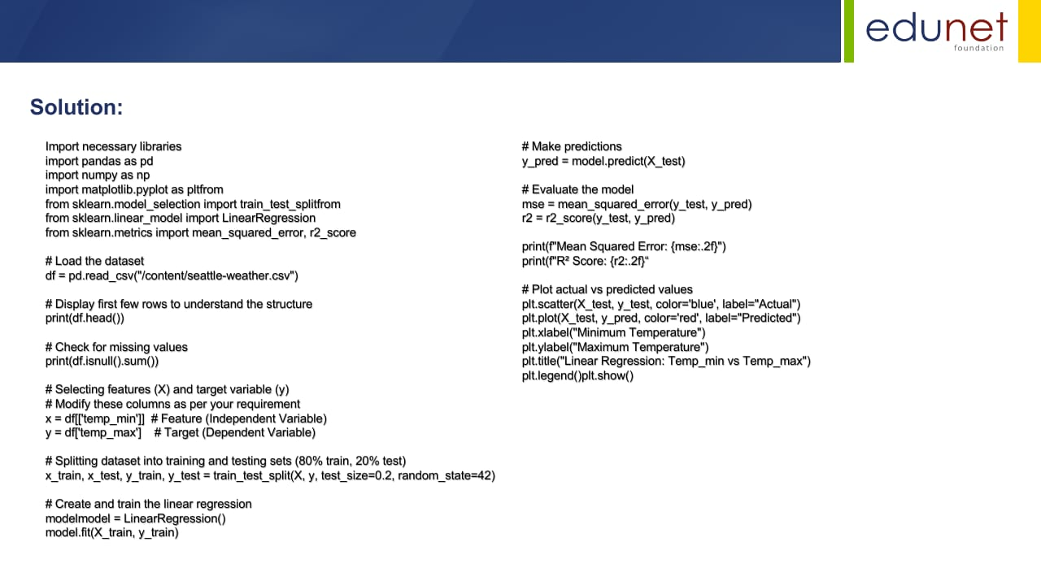
Solution:

Slide 7
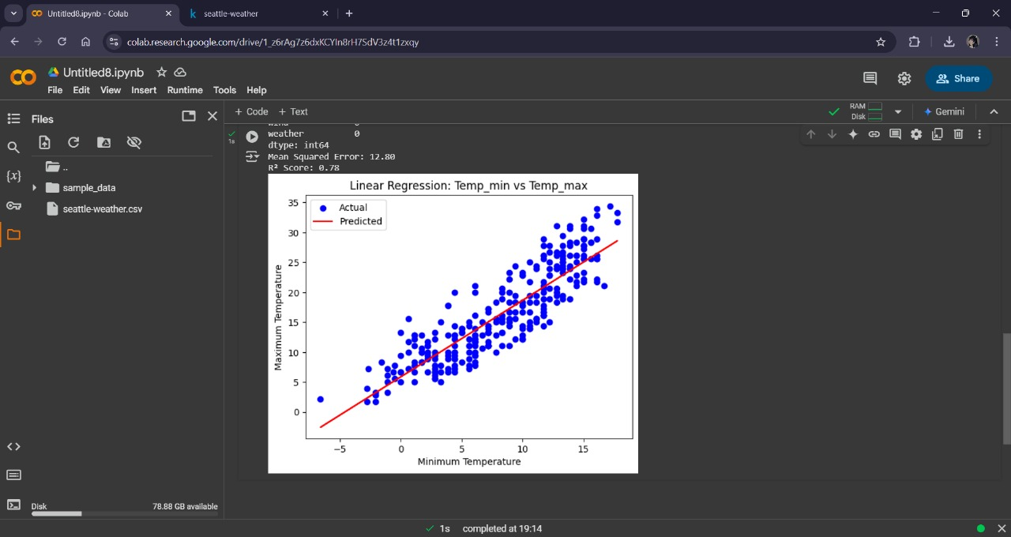
Screenshot of Output:

Slide 8
Conclusion:
In the analysis of Seattle’s weather data, focusing on minimum and maximum temperature variations, the project successfully identified key seasonal trends and fluctuations. By applying Linear Regression using python, we were able to model and predict future temperature patterns, which can significantly aid weather forecasting and management. Utilizing kaggle as a resource for acquiring the dataset and performing the analysis on Google Colab, allowed efficient workflow in a cloud-based environment.

