Slide 1

Customer Activation and Retention
Submitted by,
Shraddha Waghmare
Internship 18

Slide 2
Introduction
Customer satisfaction has emerged as one of the most important factors that guarantee the success of online store; it has been posited as a key stimulant of purchase, repurchase intentions and customer loyalty. A comprehensive review of the literature, theories and models have been carried out to propose the models for customer activation and customer retention. Five major factors that contributed to the success of an e-commerce store have been identified as: service quality, system quality, information quality, trust and net benefit. The research furthermore investigated the factors that influence the online customers repeat purchase intention. The combination of both utilitarian value and hedonistic values are needed to affect the repeat purchase intention (loyalty) positively. The data is collected from the Indian online shoppers. Results indicate the e-retail success factors, which are very much critical for customer satisfaction

Slide 3
Analysis
There are 269 rows and 71 columns in the given dataset. The data does not contain any null value. Columns are as follows
1Gender of respondent | 2 How old are you? | 3 Which city do you shop online from? | 4 What is the Pin Code of where you shop online from? | 5 Since How Long You are Shopping Online ? | 6 How many times you have made an online purchase in the past 1 year? | 7 How do you access the internet while shopping on-line? | 8 Which device do you use to access the online shopping? | 9 What is the screen size of your mobile device?\t\t\t\t\t\t | 10 What is the operating system (OS) of your device?\t\t\t\t | 11 What browser do you run on your device to access the website?\t\t\t | 12 Which channel did you follow to arrive at your favorite online store for the first time? | 13 After first visit, how do you reach the online retail store?\t\t\t\t | 14 How much time do you explore the e- retail store before making a purchase decision? | 15 What is your preferred payment Option?\t\t\t\t\t

Slide 4
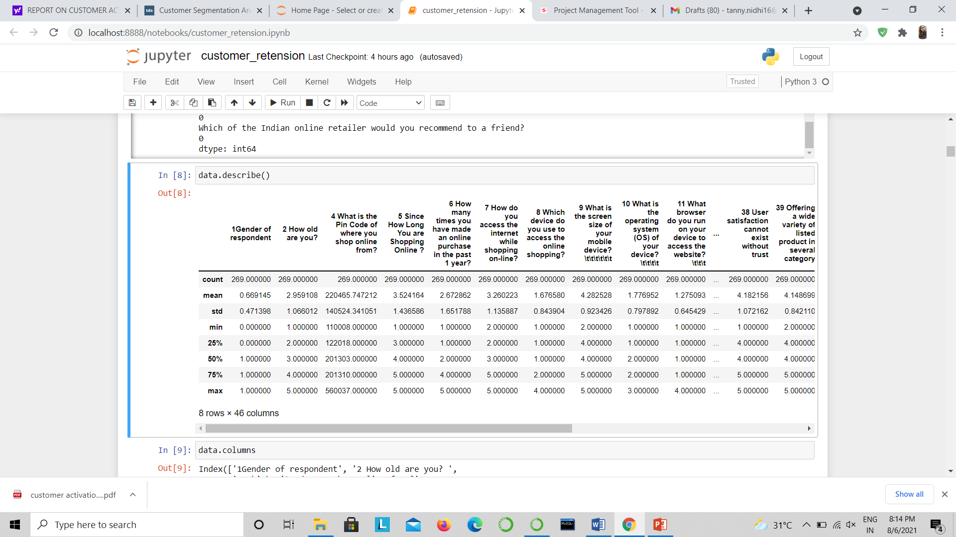
Data Describe

Slide 5
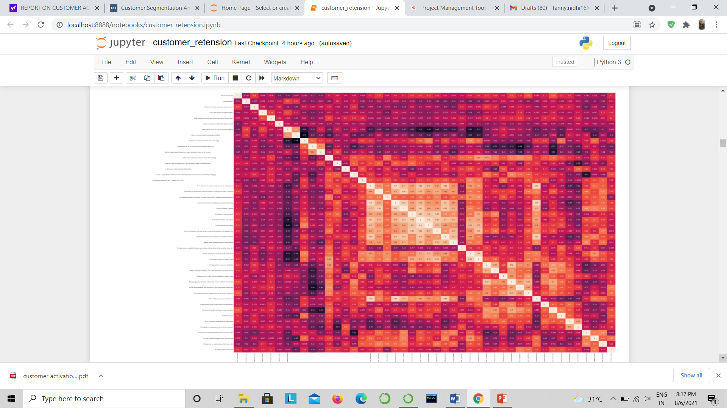
Heatmap

Slide 6
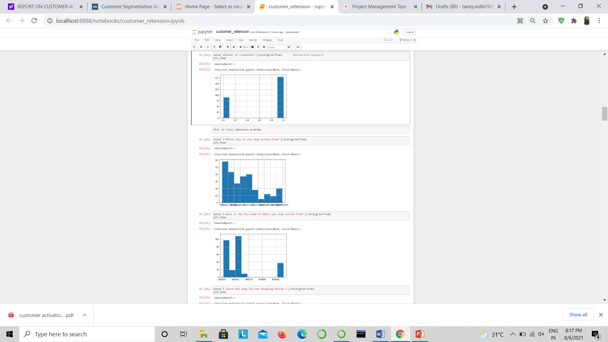
Uni-Variate Analysis

Slide 7
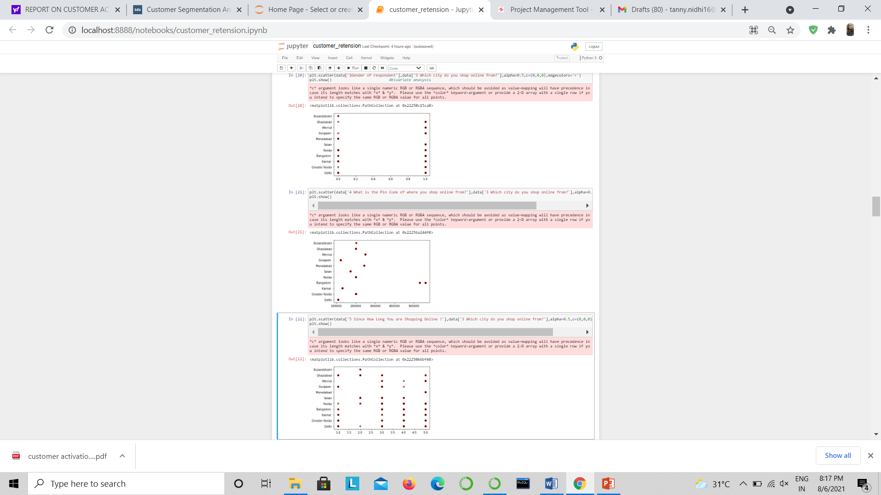
Bivariate analysis

Slide 8
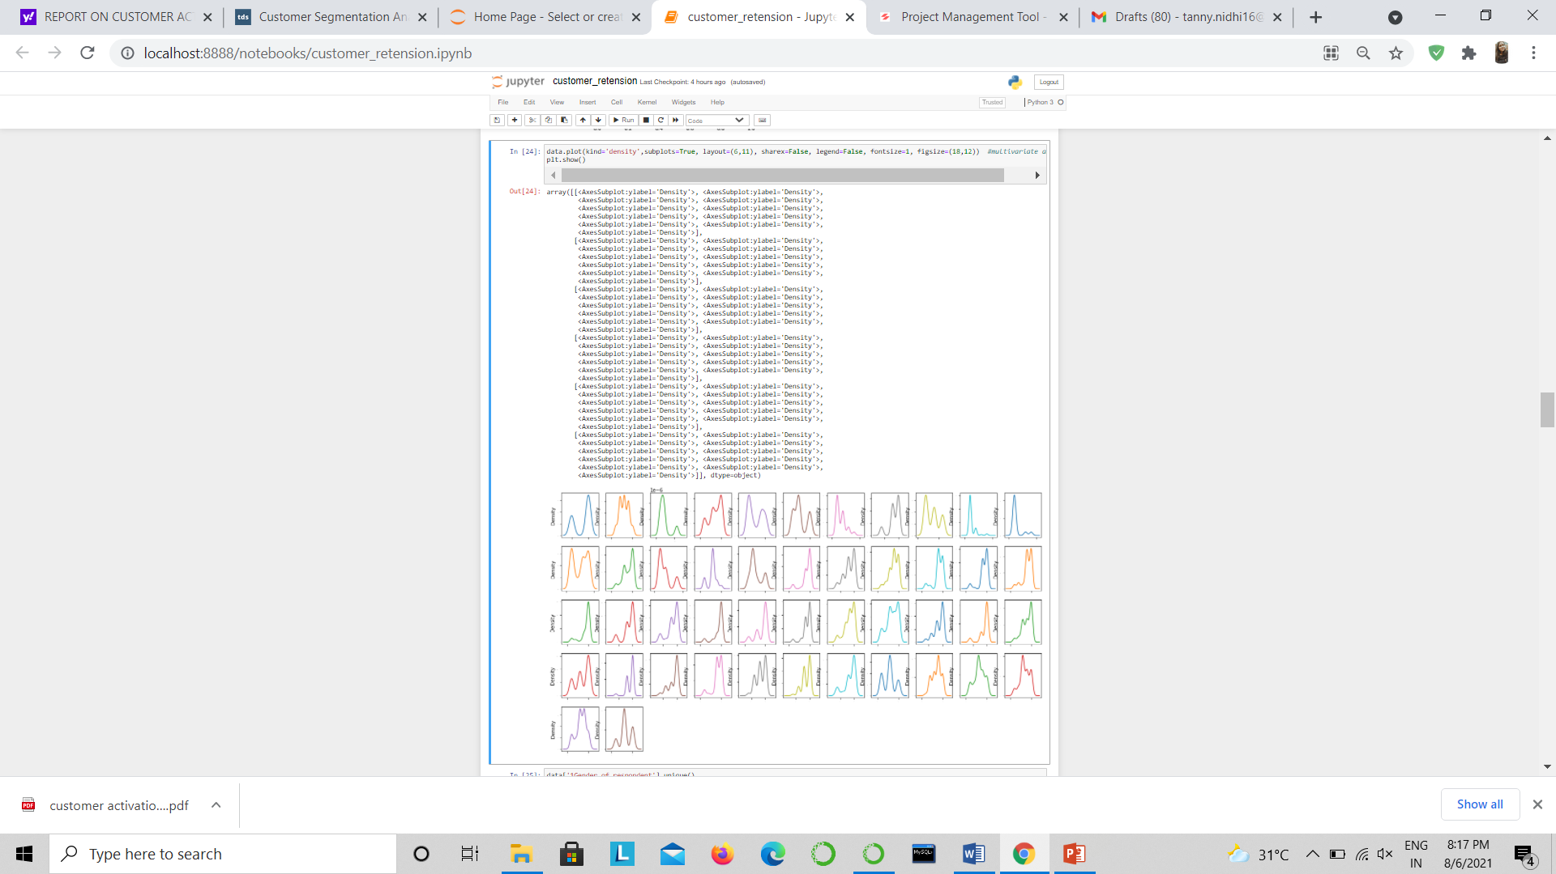
Multivariate analysis

