Slide 1
ENGRAPHO
WEB Application
Shraddha Kulkarni (6117-9554-57)
Bharath Chandra Thota (7232-8071-34)

Slide 2

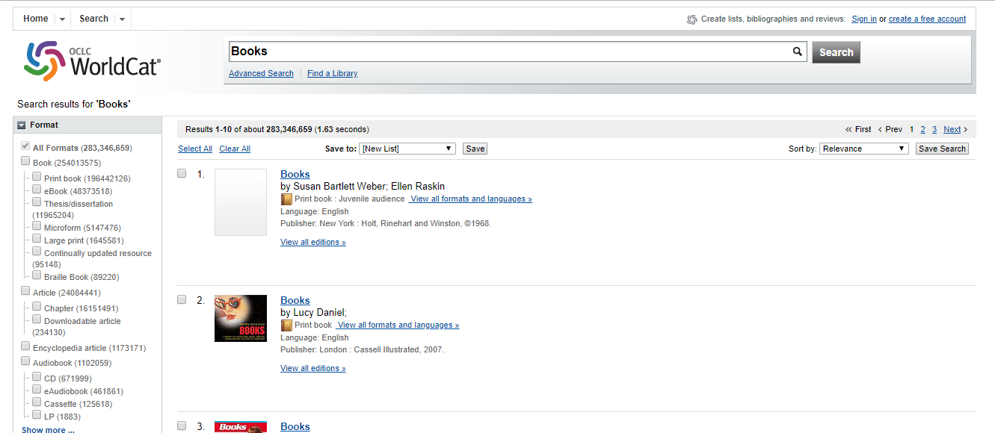




TECHNOLOGIES
Python, Flask,
AWS S3
HTML5, CSS3,
Javascript,
jQuery,
Bootstrap
MongoDB

Slide 3
META DATA
FILE TYPE | META DATA
MP3 Files | Song Name, Artist, Album, Year, Comment, Track, Genre, Band, Supports both ID3TagV1 and ID3TagV2
Word Files | File Name, Author, Subject, Keywords, Comments, File size, References, No. of Pages, Paragraphs, Lines, Words, Table of Contents
PPT Files | File Name, Author, Subject, Keywords, Comments, File size, References, No. of Slides
PDF Files | File Name, Author, Creator, Creation Date, Modified Date, Producer, File size

Slide 4
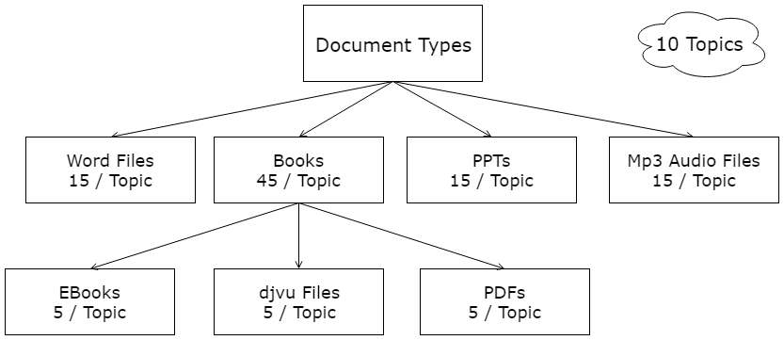
METADATA
Title
Author
Subject
Keywords
Comments
File size
References
No. of pages
Paragraphs
Lines
words
Table of Content
15

Slide 5
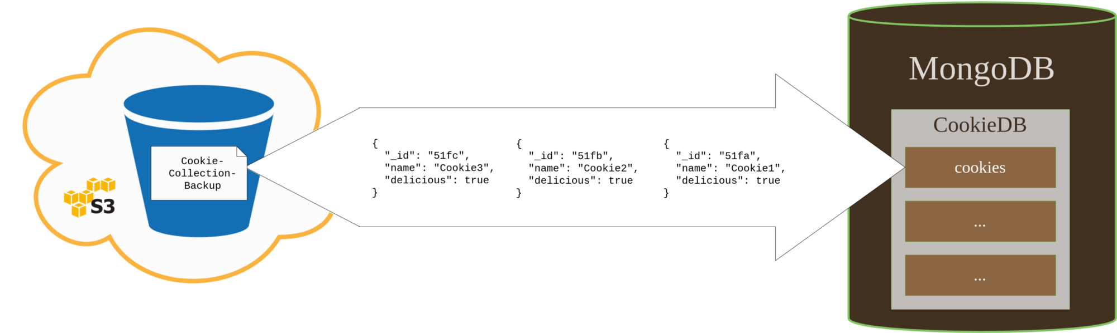
All Documents and Metadata stored in EC2 Instance on AWS
Sources: Google Scholar, SlideShare, Springer, LinkedIn, Elsevier

Slide 6
THIRD PARTY PYTHON LIBRARIES
LIBRARY | DESCRIPTION
EYED3 | This library extracts metadata from mp3 files those have metadata of type ID3.
PYPDF2 | This library extracts metadata from pdf files those have metadata of type XMP.
DOCX | This library extracts metadata from the Microsoft Word documents.
PPTX | This library extracts metadata from the Microsoft PPT documents.
REQUESTS | This module is used to upload and query the metadata.

Slide 7
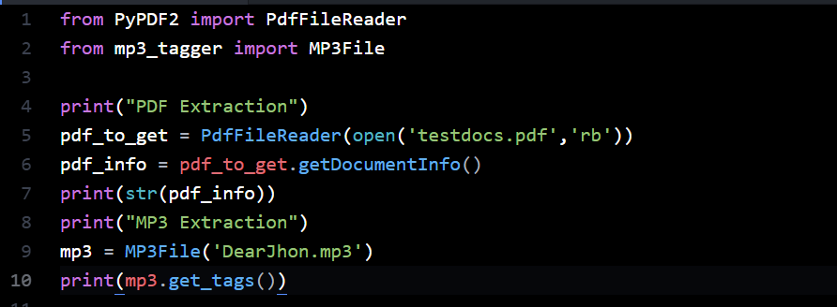
SAMPLE CODE

Slide 8
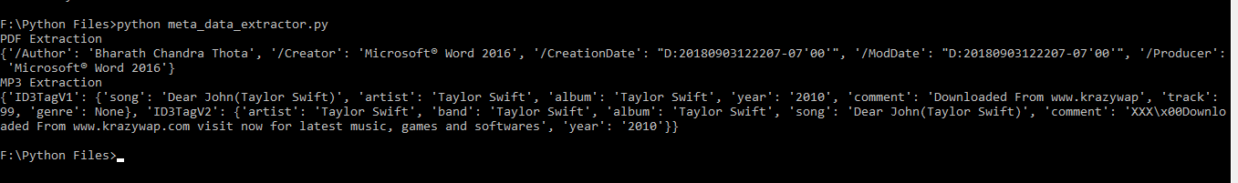
SAMPLE EXECUTION

Slide 9
TIMELINE
TIME | ACTIVITY | DESCRIPTION
September 9, 2018 | Submit Proposal | Submission of project proposal.
September 9, 2018 – October 5, 2018 | Dataset Development | Collecting the data (Pdfs, Word, Excel, ppts, Images, Mp3) from which metadata is to be extracted.
October 6, 2018 | Submit the Status | Report the work done till date
October 7, 2018 – November 17, 2018 | Development | Developing backend, web pages and metadata extraction.
November 18, 2018 – November 27, 2018 | Testing | Testing the Application.
November 30, 2018 | Submit Final Report | Submission of final report.

Slide 10
THANK YOU.

