Slide 1

razorpay
Product Teardown
From payment gateway to India's financial OS — and the PM questions behind every product bet
Shraddha Singh
Product Manager · Fintech & Enterprise SaaS
June 2026

Slide 2
AGENDA
What this teardown covers
Agenda
01
02
03
Context
The Product
The Business
What is Razorpay · The B2B user · Core problems solved
Platform evolution · Product suite · Feature analysis
3-layer business model · Revenue data · Market opportunity
04
05
The Competition
Product Thinking
Razorpay vs Stripe · PayU · Cashfree · PhonePe for Business
3 product opportunities · PM Takeaways

Slide 3
WHAT IS RAZORPAY
Overview
What is Razorpay?
"They won because their API documentation was better — and in a developer-bought product, documentation is the product."
• Founded 2014 by Harshil Mathur & Shashvat Nakrani — IIT Roorkee → YCombinator
• Started as a payment gateway API; now: payments, banking, payroll, and lending
• Won the market not on price but on developer experience — best API docs in the industry
• Platform expansion: each new product uses data from the previous one
• Positioning: India's financial operating system for SMEs and enterprises
8M+
$90B+
$7.5B
100+
Businesses on platform
Annual payments processed
Valuation (Series F 2021)
Payment methods
The simplest version: won the gateway market on developer experience, then used that distribution to expand into every financial product an SME needs.

Slide 4
THE B2B USER
Three distinct user types — very different needs
The B2B User — Why Complexity Matters
Developer / Tech Lead
Finance / Operations
Business Owner / Founder
Builds checkout & payment flows; evaluates APIs
Owns reconciliation, settlements, compliance
Cares about conversion, revenue, growth
Clean docs, reliable uptime, instant sandbox, fast integration. Will internally advocate for the tool that makes them look good.
Accurate reporting, predictable settlement times, audit trail, GST handling. Will block adoption if reporting doesn't work.
Higher checkout success rate, lower payment failure rate, access to credit when needed. Buys on outcomes, not features.
Initiates adoption
Veto power
Writes the cheque
PM insight: Design first for the developer (initiates) while ensuring the finance team can't block. The developer self-serves; the finance team has veto power. You need both.

Slide 5
CORE PROBLEMS SOLVED
What India's payment landscape looked like before Razorpay
The Problems Razorpay Solved
01
02
Gateway integration took weeks
API documentation was unusable
Banks and CCAvenue required manual forms, verification, enterprise sales cycles. A startup couldn't go live in a day.
Competitors had PDFs, SOAP APIs, guides written by lawyers. Developers copied Stack Overflow to understand basic auth flows.
→ Self-serve in 15 min
→ Developer-first docs
03
04
Payment failure rates: 65–70%
SMEs had no real banking product
Industry average success rate was ~65–70%. Lost transactions = lost revenue. Nobody treated this as a PM metric.
Traditional SME accounts were enterprise accounts stripped down. No API access, no automation, no real-time visibility.
→ 85%+ success rate
→ RazorpayX banking API

Slide 6
The Product
Platform Evolution · Suite · Feature Analysis
Razorpay · Product Teardown · Shraddha Singh · June 2026

Slide 7
PRODUCT EVOLUTION
From API to full financial OS — 10 years of platform expansion
How the Platform Evolved
2014
2016–17
2018–19
2020
2021
2022–24
Gateway
Distribution
Product Depth
Adjacency
Full Stack
Enterprise
Payments API + sandbox
PCI-DSS int'l cards
Links · Pages Subscriptions
RazorpayX Smart Collect
Capital + Opfin
Int'l payments AI fraud layer
THE SEQUENCING LOGIC:
Payment collection → Banking → Payroll → Lending. Each step used data from the previous one. Banking gave cash flow visibility. Payroll gave employee/burn data. Both made Razorpay Capital's underwriting structurally better than any traditional lender could achieve.
2014
YC batch — gateway launch
2020
RazorpayX — banking API
2021
Capital launched — lending enters

Slide 8
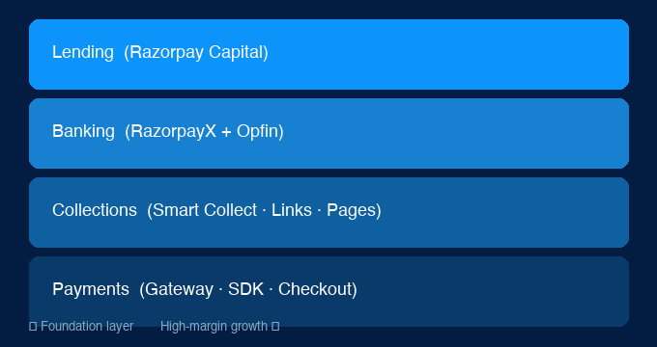
PRODUCT SUITE
The 4-layer platform stack
The Razorpay Product Stack
Product · Revenue Model · PM Insight
Payment Gateway
MDR per transaction
Foundation; self-serve in 15 min; 85%+ success rate
RazorpayX
Float income + SaaS
Current accounts with API; corporate cards; vendor payments
Opfin (Payroll)
Per-employee SaaS
Payroll, PF, ESI, TDS — acquired ₹125 Cr (2021)
Razorpay Capital
Interest + processing fee
SME loans underwritten via transaction history — no bureau
Smart Collect
Per-transaction fee
UPI QR, virtual accounts, B2B collections
Links & Pages
MDR per transaction
No-code payment collection for non-technical merchants
Lending (Razorpay Capital) sits at the top of the stack and generates the highest margin. Transactions at the bottom are a customer acquisition cost — not the core business.

Slide 9
FEATURE ANALYSIS
What's working, what's not, and why
Feature Analysis
Feature
Signal
What Works
Risk / Gap
Payment Gateway
✅ Strong
85%+ success rate; best-in-class DX; 8M+ merchants
Commoditizing — PayU and Cashfree have closed the API gap
RazorpayX
✅ Strategic
API banking fills a genuine SME gap; 360° merchant view
No banking licence — ceiling set by RBI's partner-bank model
Razorpay Capital
✅ High potential
Transaction-history underwriting beats bureau for SMEs
Credit risk in an economic downturn; needs NPAs below 2%
Opfin (Payroll)
⚠️ Execution risk
Payroll data = best underwriting signal for Capital
Compliance payroll (PF, ESI, TDS) is brutally hard to get right at scale
Payment Links/Pages
✅ Strong
Democratized collection for non-dev merchants; Tier 2/3 reach
No clear data pipeline from no-code users to Capital underwriting yet
International
⚠️ Early
Addresses real pain for SaaS & exporters
Established players (Wise, Payoneer); RBI cross-border rules are complex
Revenue driver:
Biggest moat:
Execution risk:
Gateway MDR + Capital interest income
Transaction data → SME credit underwriting
Opfin compliance accuracy at scale

Slide 10
The Business
Model · Revenue · Market Opportunity
Razorpay · Product Teardown · Shraddha Singh · June 2026

Slide 11
BUSINESS MODEL
The 3-layer stack — and why transactions are a CAC, not a business
Business Model — 3 Layers
01
02
03
Transactions
Banking
Lending
Payment gateway, Links, Pages, Smart Collect. Revenue: MDR ~1.8–3% per transaction. Strategic role: Customer acquisition cost. Thin margin; volume-dependent. The entry point into the relationship, not the revenue goal.
RazorpayX, corporate cards, Opfin payroll. Revenue: Interchange, float income, SaaS fees. Strategic role: Deepens merchant lock-in; provides 360° cash flow view that enables Capital underwriting. Improves with AUM.
Razorpay Capital — business loans & credit lines. Revenue: Interest income + processing fees. Strategic role: Highest-margin business. Transaction-history underwriting = structurally better than bureau-based lending for SMEs. Credit risk is the constraint.
Low–medium margin · Volume play
Medium margin · Improves with AUM
High margin · Data flywheel advantage
The long-term bet: gateway processing fees are a CAC. The real business is lending and banking — which require the transaction data that the gateway generates.

Slide 12
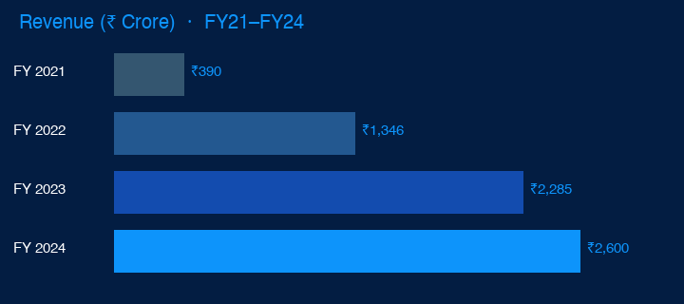
BY THE NUMBERS
Financial data FY21–FY24 · Sources: Inc42, Entrackr, public filings
By the Numbers
8M+
$90B+
85%+
Merchants on platform
Annual payments processed
Checkout success rate
As of FY24
GMV FY24
vs 65–70% industry avg
$7.5B
100+
<2%
~6.7× revenue growth
₹390 Cr (FY21) → ₹2,600 Cr+ (FY24)
Valuation — Series F
Payment methods
Capital NPA target
Net loss narrowing
October 2021
UPI, cards, netbanking, wallets
Transaction-history underwriting advantage
Path to profitability via Capital margin expansion
Data flywheel effect
More merchants → more transaction data → better underwriting → more Capital disbursals

Slide 13
HONEST ASSESSMENT
What's working and what isn't
Honest Assessment
✓ What's Working
✗ What's Not Working
✓ Developer experience moat — 8 years of compound advantage in API quality & docs
✓ Data flywheel — more transactions → better fraud detection → higher success rate → more merchants
✓ SME trust — 8M+ businesses rely on Razorpay for revenue collection; high switching cost
✓ Capital's underwriting advantage — transaction-history beats bureau for new-to-credit SMEs
✓ Enterprise expansion — moving upmarket without losing the SME base
✗ Regulatory ceiling — no banking licence; one RBI circular away from a product constraint
✗ Commoditization in the gateway — PayU and Cashfree have closed the API gap
✗ Enterprise sales motion — self-serve breaks down above ₹10Cr transaction volume
✗ Opfin execution risk — payroll compliance errors at scale = reputational crisis
✗ Valuation overhang — $7.5B Series F set at 2021 peak; secondary market is difficult

Slide 14
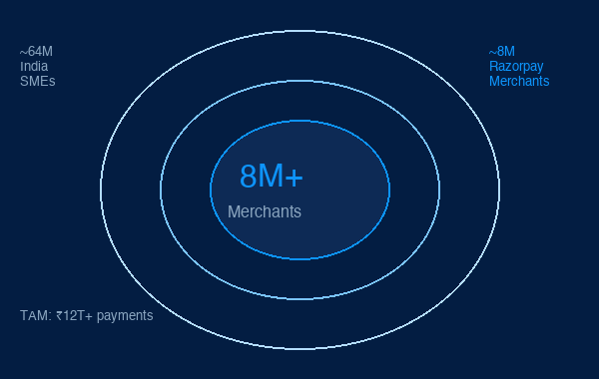
MARKET OPPORTUNITY
India's digital payments and SME finance landscape
India Market Opportunity
Key Market Numbers
64M+
SMEs in India — Razorpay's addressable market
8M+
Merchants on platform — ~12.5% TAM penetration
₹12T+
Annual digital payments TAM (FY24)
$90B+
Razorpay GMV — growing at ~30% YoY
90%+
SMEs underserved by traditional finance → Capital TAM
10×
Revenue/merchant headroom vs global benchmarks
Razorpay's opportunity is not user growth — it's revenue depth per merchant. At current penetration levels, Capital alone has a multi-billion dollar runway within the existing merchant base.

Slide 15
The Competition
Razorpay vs Stripe · PayU · Cashfree · PhonePe Business
Razorpay · Product Teardown · Shraddha Singh · June 2026

Slide 16
RAZORPAY vs STRIPE
Why the 'Indian Stripe' framing misses the point
Razorpay vs Stripe — Key Differences
Dimension
Razorpay
Stripe
Core user
Indian developer + SME finance
Global developer, internet businesses
Market context
UPI-first; large unbanked SME
Card-first; established banking infra
Revenue emphasis
Transactions + banking + lending
Transactions + Stripe Capital
Data advantage
Deep India SME cash flow data
Global transaction patterns
Regulatory posture
Navigates RBI, SEBI, IRDAI
Works within established frameworks
Key moat
India-specific data + compliance
Global developer network effects
Expansion limit
India-specific advantages don't travel well
Global — but India requires local regulatory relationships
Key insight: Razorpay can build products Stripe cannot — India-specific data, regulatory relationships, and SME distribution. The moat protects them in India; expansion carries none of these advantages.

Slide 17






COMPETITIVE LANDSCAPE 2025–26
The real challengers to Razorpay's gateway moat
Indian Fintech Competitive Landscape
Player
Target
Edge
Differentiator
Threat
PM Note
PayU India
Enterprises, mid-market
Prosus-backed, long-standing PG
International, emi options
HIGH
Direct gateway competitor; comparable API now
Cashfree
Startups, fintechs
Strong payouts & disbursals
Faster payouts than Razorpay
HIGH
Developer trust; strong in payout use-cases
Juspay
Large enterprises (Swiggy, CRED)
Hyperswitch multi-PSP router
Checkout orthestration
MED-HIGH
Addresses checkout failure at scale — PM layer
PhonePe Biz
SMBs, offline merchants
UPI + SmartSpeaker edge
Zero MDR UPI, kirana reach
MEDIUM
Bharat segment; different buyer persona
Stripe
Global SaaS, startups
Global infra, radar fraud
Best-in-class DX for global cos
LOW
No Indian-specific compliance depth
CCAvenue
SMEs, legacy enterprises
20+ years, bank relationships
High-value enterprise legacy
LOW
API quality gap; losing developer mindshare

Slide 18
Product Thinking
3 Opportunities I'd Build Next · PM Takeaways
Razorpay · Product Teardown · Shraddha Singh · June 2026

Slide 19
PRODUCT OPPORTUNITIES
What I would build next — and why now
Three Product Opportunities
01
02
03
AI Cash Flow Intelligence
Razorpay for Bharat
Embedded Compliance
Problem: Razorpay Capital is reactive — merchants apply when they need money. Build: Forward-looking cash flow forecast using transaction time-series. 'You have 23 days of runway. Your August dip is coming — here's a pre-approved offer.' Why: Proactive credit offer → 3–5× conversion vs. cold pitch. The data already exists.
Problem: 8M merchants ≠ 64M SMEs. The remaining 56M are Tier 2/3 businesses on WhatsApp, in Hindi/Marathi/Tamil, with unreliable internet. Build: Simplified vernacular-first, low-bandwidth payment collection. Offline-first. Feature phone compatible. Why: UPI solved the consumer side. Merchant-side collection infrastructure for Bharat is unbuilt.
Problem: SMEs spend 10–15 hrs/month on GST filings, TDS, PF — or pay ₹3,000+/month to CAs. Build: Pre-populate GST/TDS filings from transaction data. Review + file in one click. Why: Makes switching from Razorpay almost impossible. Compliance history lives in the platform. A local moat Stripe cannot replicate.
RICE ~580 · HIGH
RICE ~430 · HIGH
RICE ~350 · HIGH
Recommended sequence: AI Cash Flow → Embedded Compliance → Razorpay for Bharat

Slide 20
PM TAKEAWAYS
What this teardown taught me
PM Takeaways
01
Developer experience is a product, not a feature.
Razorpay won its first market because documentation and API ergonomics were better — not because success rates were higher. In developer-bought products, the integration experience is the first product the buyer evaluates.
02
Platform expansions should use each other's data.
Every Razorpay product addition was justified partly because it generated data that improved an existing product. Adjacency without data leverage is just scope creep.
03
In regulated fintech, compliance is both constraint and moat.
Embedded compliance exists only because Razorpay has the regulatory relationships to file on behalf of merchants. Competitors can't copy the feature without copying the regulatory foundation. Build compliance in — don't bolt it on.
04
Transaction revenue is a customer acquisition cost in disguise.
The long-term bet is that payment processing margins pay for merchant acquisition, and the real business is lending and banking. Understanding multi-product LTV changes which merchants are worth acquiring at what cost.
05
Design for the skeptic, not the enthusiast.
Razorpay's finance-team-friendly dashboard wasn't technically necessary — developers could read API logs. But the finance team has veto power. Designing for the person who can say no is as important as designing for the one who wants to use it.

Slide 21
Shraddha Singh
Product Manager
6 years · Fintech · Insurtech · Enterprise GenAI KYC onboarding · Healthcare AI · Insurance platform
Open to PM · TPM · AI PM roles
Product Teardown · June 2026
shraddhasingh8968@gmail.com
Razorpay — From Payment Gateway to Financial OS
linkedin.com/in/shraddha-singh-9149a4172
shraddhasingh.dev

