Slide 1

CRED
Product Teardown
An inside-out analysis of India's most opinionated fintech product
Shraddha Singh
Product Manager
Feb 2026

Slide 2
AGENDA
What this teardown covers
Agenda
01
02
03
Context
The Product
The Business
What is CRED · Target user · Core problem
Product evolution · Feature analysis · App UI showcase
Business model · Revenue data · Market opportunity
04
05
The Competition
Product Thinking
4-player landscape · 6-way fintech threat analysis
Opportunities · User pain points · Onboarding · NSM

Slide 3

WHAT IS CRED
Overview
What is CRED?
Pay your credit card bills. Get rewarded. Be part of an exclusive club.
• Founded 2018 by Kunal Shah (FreeCharge)
• Invite-only: only users with CIBIL 750+ can join
• Core utility: aggregate all credit cards, pay bills in one tap
• Reward layer: earn CRED coins for every rupee paid on time
• Now expanding into lending, travel, investments, UPI & vehicle management
13M
₹2,473 Cr
750+
₹19K Cr
Monthly Active Users
FY24 Revenue
Min. CIBIL to Join
Lending AUM
"The credit card bill was never the product. The user was."

Slide 4

THE USER
Who CRED is built for
The Target User
Persona — Aspirational Aryan
Why this user = CRED's product asset
• Age: 26–40, urban professional
• Income: ₹10L+ per annum
• Owns 2–4 credit cards
• Values exclusivity, design, and his time
• Pays bills but gets zero back from his bank
• Trusts brands that treat him as premium
Low credit risk
→ Safe to build a lending book
High purchasing power
→ Valuable to brands & advertisers
Multi-card holder
→ Rich spend data across categories
Aspirational mindset
→ Responds to status-driven design
Result: CRED can underwrite, advertise to, and retain this cohort at a fraction of normal CAC. The 750+ filter is not a constraint — it is a product decision.
CRED didn't just pick a demographic. It picked a data asset.

Slide 5
CORE PROBLEM
The insight behind CRED
The Problem CRED Solves
01
02
03
Bill payment is boring & unrewarded
Premium buyers are expensive to reach
Good credit behaviour is unrecognised
Banks give nothing back for on-time payments — a 2/10 experience
Brands can't efficiently target creditworthy, high-income users at scale
No social or economic reward for financial discipline in India
→ Bill-pay disruption
→ Premium ad market ($B+ TAM)
→ Credit culture reform
Delta 4 Theory (Kunal Shah): users switch only when new experience is 4× better. Bank netbanking = 2/10. CRED = 6/10. The switch happens.

Slide 6
The Product
Evolution · Features · App UI
CRED · Product Teardown · Shraddha Singh · Feb 2026

Slide 7







PRODUCT EVOLUTION
From bill payment to financial super-app
How the Product Evolved
2018
2019
2020
2021
2022
2023–24
Launch
Rewards
Lending
Expansion
Payments
Super-app
Credit card bill payment + CRED Coins
CRED Store: coins → brand offers
CRED Cash (credit line) + CRED Stash
Travel · RentPay Mint (FD)
CRED Pay (UPI) + Flash (BNPL)
Garage · Money (vehicles, unified finance)
THE PATTERN:
Each feature either (a) deepens engagement with the existing user base, or (b) monetises their trust in a new category. CRED is not chasing new users — it is extracting more value from the same premium cohort.
2018
Entry barrier established
2020
Lending arm launched
2024
First EBITDA-positive quarter

Slide 8
FEATURE ANALYSIS
What each feature does and where it struggles
Feature Analysis
Feature
Signal
What Works
Risk / Gap
Bill Payment
✅ Strong
Solves real pain. Builds monthly habit. Gateway product.
Now commoditised — GPay/PhonePe offer the same utility.
CRED Coins
✅⚠️ Mixed
Creates Pavlovian loop; drives retention and repeat opens.
Coin devaluation erodes trust with power users.
CRED Store
✅ Strong
Brands pay premium CPMs to reach high-converting users.
Store has become noisy; curation quality has dropped.
CRED Cash
✅ Strong
Low-risk lending (750+ CIBIL), high margins, zero extra CAC.
RBI BNPL crackdown forced product restructuring 2022.
CRED Garage
✅ Underrated
Vehicle data → insurance upsell → recurring revenue.
Low awareness; undermarketed relative to its potential.
CRED Travel
⚠️ Weak
Coin redemption play keeps users on platform.
No sustainable edge vs MMT/Ixigo/Goibibo.
Core revenue drivers:
Biggest risk:
Hidden gem:
Bill Pay + Lending + Store
Coins devaluation → trust erosion
CRED Garage — insurance upsell flywheel

Slide 9
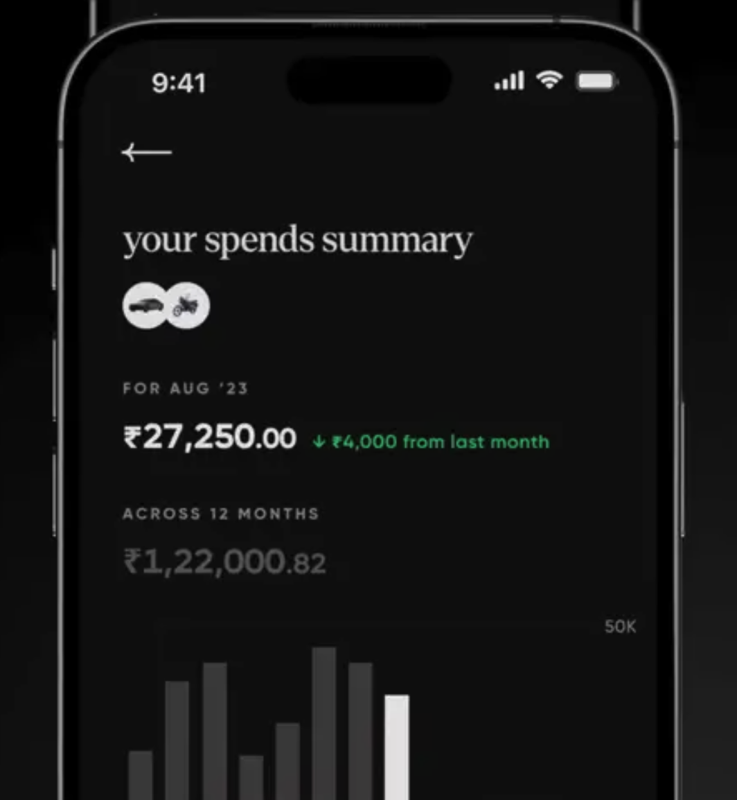
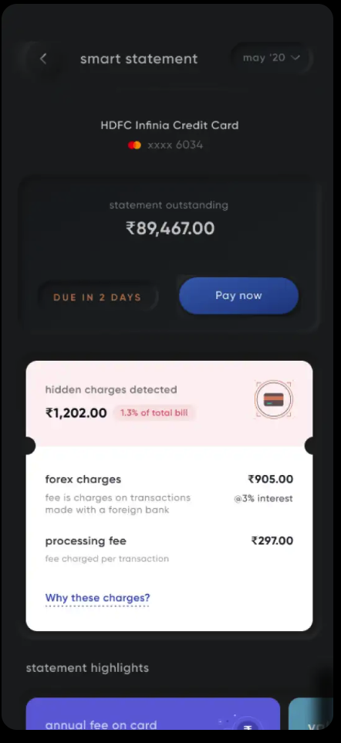
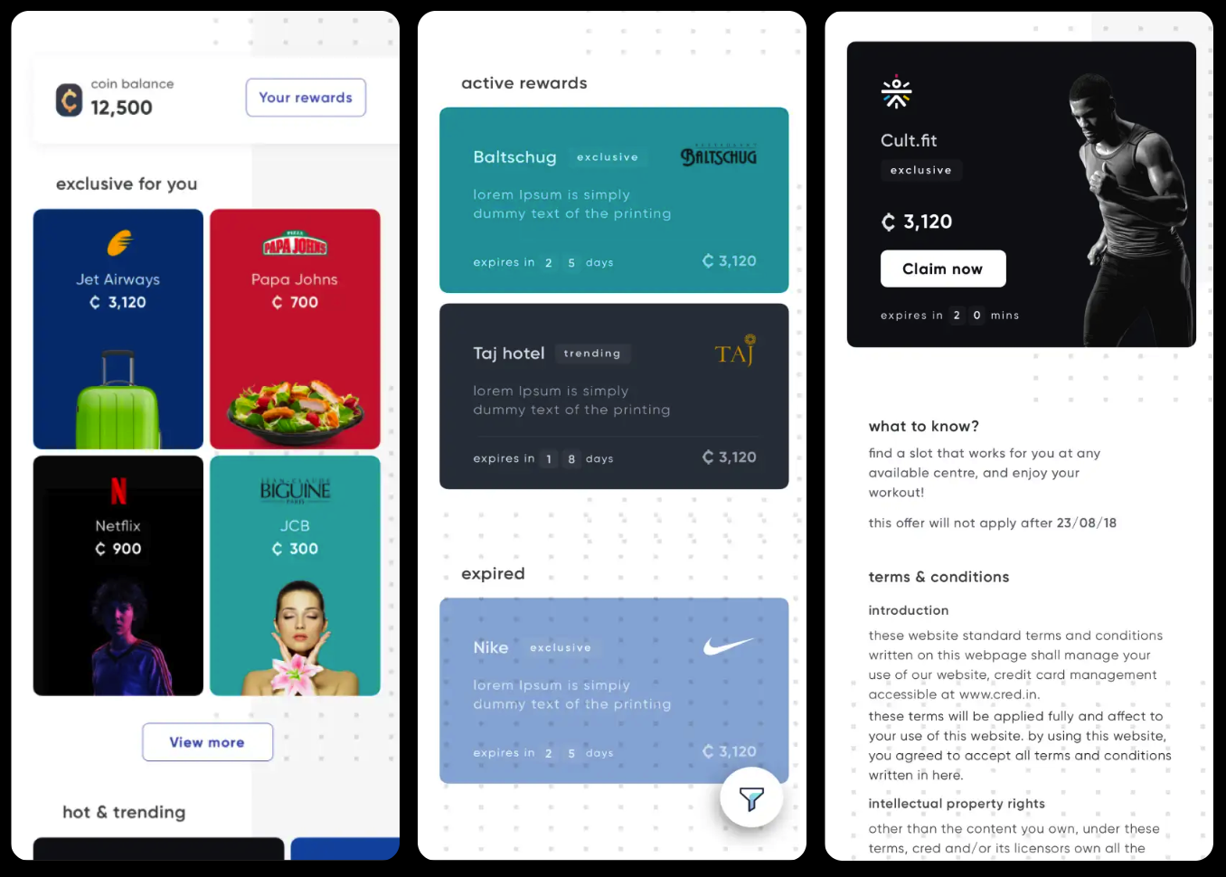
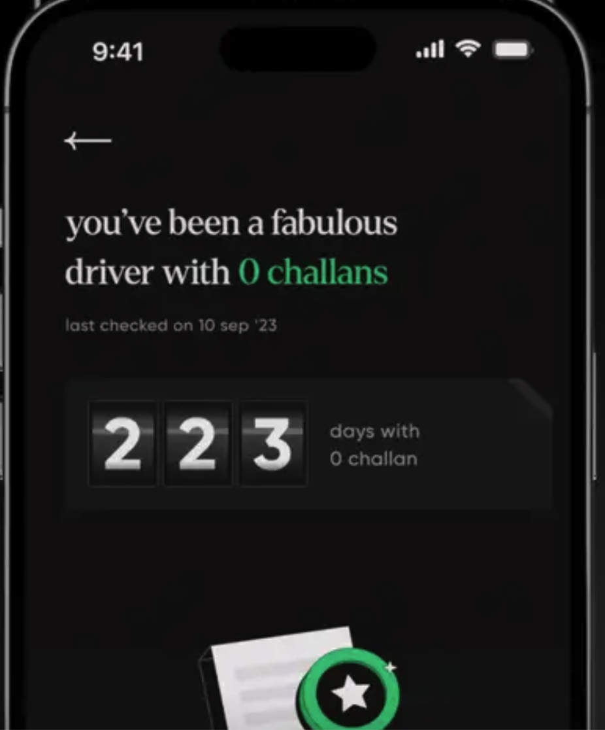
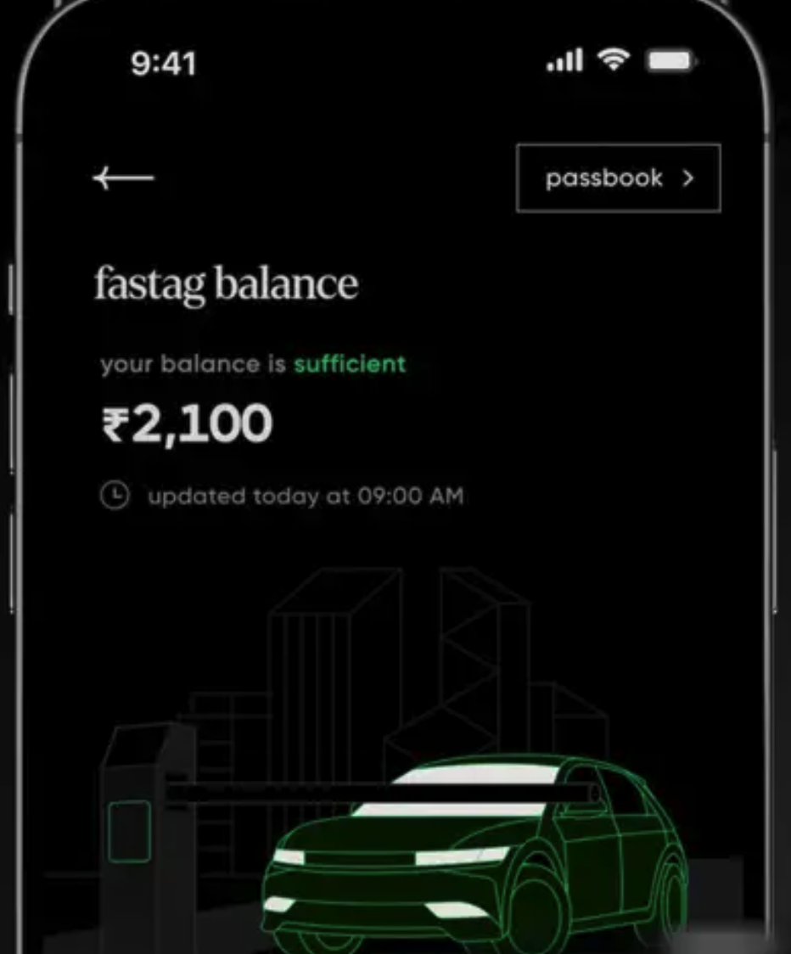
APP UI SHOWCASE
Key screens — Bills · Lending · Garage
App UI — Key Screens
My Bills
CRED Rewards
CRED Garage
Monthly bill aggregation and one-tap payment
Rewards timely credit card bill payments with "CRED coins," cashback, and exclusive brand offers.
Vehicle management, FASTag & insurance
PM note: Bills screen is clean and high-trust — solves real pain in one tap. CRED Cash converts well because the pre-approved limit is shown upfront (no application anxiety). Garage is the most undervalued screen — vehicle data compounds into insurance upsell.

Slide 10
The Business
Model · Revenue · Market
CRED · Product Teardown · Shraddha Singh · Feb 2026

Slide 11
BUSINESS MODEL
How CRED actually makes money
Business Model
01
02
03
Advertising & Commerce
Lending
Transactional Commissions
Brands pay premium CPMs for placement in CRED Store and targeted campaigns. Higher conversion than generic digital ads due to verified CIBIL-filtered audience.
CRED Cash, Flash, Stash — instant credit lines and BNPL. Low NPA risk (750+ CIBIL). Interest income + processing fees. ₹19,000 Cr AUM as of Dec 2024.
Travel bookings, RentPay, Garage services — CRED earns a commission on every transaction completed through the platform.
High margin
Very High margin
Medium margin
~₹500 Cr est. FY24
₹19,000 Cr AUM · NPA 1.1%
~₹200 Cr commissions est.
Master play: Bill payment is a FREE acquisition tool → build trust + data → monetise through lending and commerce. Contribution margin positive for 9 consecutive quarters by FY24.

Slide 12
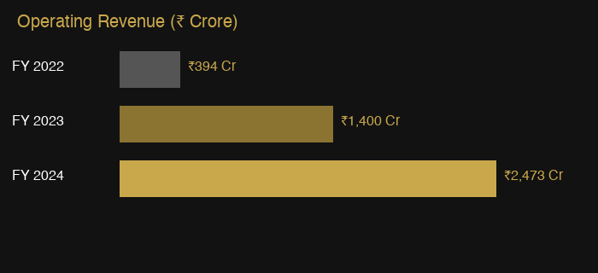
BY THE NUMBERS
Public financial data FY22–FY24 · Sources: Inc42, Entrackr, TechCrunch
By the Numbers
13M
1.1%
₹19,000 Cr
Monthly Active Users
NPA on CRED Cash
Lending AUM
Flat since Nov 2022 — intentional
vs 2.7% banking industry avg
As of Dec 2024
9 Qtrs
-41%
$942M
6.3× revenue growth
from ₹394 Cr (FY22) to ₹2,473 Cr (FY24)
Contribution Margin +ve
Operating Loss Drop
Total Raised
Operating loss narrowing
Path to EBITDA break-even
FY23→FY24: ₹1,024Cr → ₹609Cr
11 rounds · $6.4B peak val.
₹1,024 Cr (FY23) → ₹609 Cr (FY24) → targeting EBITDA+
Lending is the margin engine
9 consecutive quarters of positive contribution margin

Slide 13


HONEST ASSESSMENT
What's working and what isn't
Honest Assessment
✓ What's Working
✗ What's Not Working
✓ Trust moat — 750+ CIBIL filter creates self-selecting quality users
✓ Lending business — low NPAs, high margins, zero extra CAC
✓ Design & brand — one of India's best-designed consumer apps
✓ CRED Garage — quietly strong; vehicle data = insurance goldmine
✓ Core retention — bill reminders create reliable monthly re-engagement
✗ CRED Coins devaluation — heavy users feel cheated
✗ Feature sprawl — too many tabs, weak discoverability
✗ Travel & Commerce — no edge vs dedicated players
✗ High CAC — brand campaigns expensive to sustain at scale
✗ RBI regulatory risk — lending & BNPL under ongoing scrutiny

Slide 14
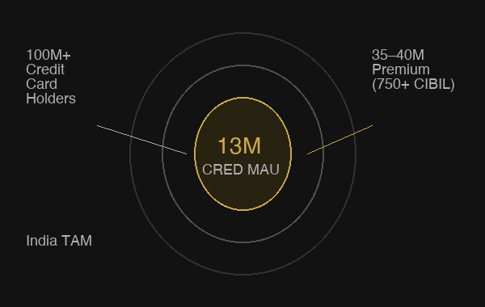
MARKET OPPORTUNITY
India's premium credit card market
India Market Opportunity
Key Market Numbers
100M+
Credit card holders in India (growing at ~20% YoY)
35–40M
Premium holders (750+ CIBIL) — CRED's actual TAM
13M
CRED MAU — ~33% TAM penetration
₹8–10T
Annual credit card spend in India (FY24)
₹2,473 Cr
CRED revenue FY24 on 13M users = ₹190/user/yr
10×
Revenue/user headroom vs global fintech benchmarks
CRED's opportunity isn't user growth — it's revenue depth per user. At ₹190/user/yr it is massively undermonetised vs international benchmarks (Amex: ₹8,000+/user/yr). Lending at scale is the unlock.

Slide 15
The Competition
Who's threatening CRED's moat in 2025–26
CRED · Product Teardown · Shraddha Singh · Feb 2026

Slide 16



COMPETITION
Mass-market players vs CRED
CRED vs Mass Market
Dimension
CRED
PhonePe
Paytm
GPay
Primary Utility
CC Bills + Rewards
UPI Payments
Payments + Lend.
UPI Payments
Target User
Premium 750+ CIBIL
Mass market
Mass market
Mass market
Rewards
Strong (coins)
Cashback
Cashback
Minimal
Lending
Yes (premium)
Yes
Yes (aggressive)
No
Brand
Premium/exclusive
Utility
Declining
Google-backed
Design
Best-in-class
Good
Average
Clean
UPI Market Share 2025:
PhonePe 47%
GPay 37%
Paytm 10%
CRED Pay ~3%
CRED's defensible position: only platform that has earned trust of India's creditworthy, high-income segment at scale.

Slide 17






COMPETITIVE THREAT LANDSCAPE 2025–26
The real challengers to CRED's moat
Fintech Threat Landscape
Company
Target User
Card Model
Rewards
Threat
Why
OneCard
Urban prof. 21–35
Own issuer (SBM/BoB)
5× pts on top 2 categories
HIGH
Same demo, owns the card relationship
Slice SFB
18–30, credit newcomers
Full bank post NESFB merger
Cashback + savings account bundle
MEDIUM
Captures users before CRED-eligibility
Uni Cards
Premium prof, high spenders
Co-branded partner banks
Pay 1/3 monthly (split payments)
LOW
₹95 Cr revenue — struggling to scale
Jupiter
Digital-first millennials
Neobank, Federal Bank
Smart pots + RuPay UPI card
HIGH
Full financial OS for the same user
Fi Money
Tech professionals high income
Neobank, Federal Bank
Smart deposits + premium credit line
HIGH
Lifestyle + credit competitor
Scapia
Travel lovers, frequent flyers
Co-branded Federal Bank
20% coins travel, zero forex, zero fee
MED-HIGH
Steals CRED Travel segment users

Slide 18
Product Thinking
Opportunities · Pain Points · Onboarding · North Star
CRED · Product Teardown · Shraddha Singh · Feb 2026

Slide 19
PRODUCT OPPORTUNITIES
What I would build next
What I Would Build Next
01
02
03
CRED Score Dashboard
CRED for Business
Proactive Spend Intelligence
Problem: Users open CRED once/month and leave. No daily reason to return. Build: Proprietary health index — bill behaviour, credit utilisation, spend patterns, debt-to-income. Why: Daily open reason, new data asset, natural CRED Cash upsell.
Problem: Self-employed & founder users (large CRED cohort) can't separate personal vs business card spend. Build: 'Business Mode' — tag transactions, generate spend reports, export to accounting. Why: Low build cost, high perceived value, opens B2B lane.
Problem: Users know their balance, not their behaviour. Build: Monthly AI 'Spend Story' — anomalies + one recommended action (e.g. 'Switch this sub to Card B for 2× rewards'). Why: Increases DAU, deepens trust, upsells CRED Cash or Mint.
RICE ~520 · HIGH
RICE ~390 · MED
RICE ~280 · MED
Recommended sequence: CRED Score Dashboard → Spend Intelligence → Business Mode

Slide 20
PRODUCT OPPORTUNITY BRIEF
CRED Score Dashboard — Full Brief
Product Brief: CRED Score Dashboard
Problem Statement
Success Metrics
Users open CRED once/month to pay bills then leave. CIBIL is a lagging indicator — tells users what happened, not what to do. No competitor offers a proactive financial health OS for premium users.
PRIMARY
• DAU/MAU ratio (target: +8pp in 90 days)
• CRED Cash activation rate among dashboard users
GUARDRAIL
• Session length ≤ 10% increase (avoid fatigue)
• CIBIL pull consent rate ≥ 80%
Target User
Existing CRED members who pay bills regularly but haven't activated CRED Cash — the pre-lending conversion cohort.
RICE Score
MVP Features (MoSCoW)
Reach: 13M MAU (100% eligible)
Impact: HIGH — lending funnel entry
Confidence: 80% · Effort: M (8–12 wks)
→ RICE ~520 · HIGH PRIORITY
M CRED Health Score (proprietary index)
M Credit utilisation trend (30/60/90 days)
S Spend category breakdown + benchmarks
S Bill payment streak & on-time history
C 'Improve your score' action cards
W Competitor card comparison engine
Top 3 Risks
1. RBI data localisation rules may restrict real-time CIBIL pulls
2. Users may distrust a proprietary score vs official CIBIL
3. Score gamification may incentivise wrong financial behaviours

Slide 21
USER PAIN POINTS
Synthesised from 1★ & 2★ app reviews — Play Store, Trustpilot, MouthShut
Top 5 User Pain Points
01
CRED Coins Devaluation
HIGH
"50,000 coins and nothing redeemable for more than ₹50"
Fix: Transparent tier system with locked-in redemption rates
Coins worth less each cycle. Power users with large balances feel cheated.
02
No Phone Support / Slow Resolution
HIGH
"Multiple emails sent, no response. Money stuck for 3 weeks"
Fix: Live chat for payment issues; 4-hr SLA on transaction failures
No care number. Bot fails on complex issues. Email takes 5–10 days.
03
Payment Failures & Refund Delays
HIGH
"Refund initiated after 45 days of follow-up — unacceptable"
Fix: Real-time bank confirmation + auto-refund SLA of 3 days
Transactions marked 'successful' but not credited. Refunds take 7–21 days.
04
Notification Spam & App Clutter
MEDIUM
"I get 5 notifications a day about Store deals I never asked for"
Fix: Opt-in notifications by category; surface bill CTA prominently
5+ daily promo notifications. Bill payment (core) is buried in tabs.
05
Store Product Quality & MRP Mismatch
MEDIUM
"MRP on product was higher — doesn't feel like a discount at all"
Fix: Verified MRP display; buyer protection policy for Store orders
Products delivered with MRP higher than advertised price. Mystery box issues.

Slide 22
ONBOARDING FLOW
From app download to first bill payment
Onboarding Flow Analysis
ENTRY CONTEXT:
~35–40M Indians qualify (750+ CIBIL). CRED's onboarding must preserve exclusivity while minimising drop-off in this pre-qualified cohort.
App Discovery
Download & Open
OTP Verify
CIBIL Check
Card Linking
First Payment
Invite from friend or IPL ad
Play Store install; CRED brand splash
Mobile → OTP; < 30 sec
PAN + DOB; score auto-fetched
Manual entry or auto-detect
Dashboard shows due; one-tap pay
✅ Exclusivity creates aspirations pre-install
✅ Premium first impression on open
✅ Frictionless; well-designed
✅ Instant; user sees score for free
✅ Supports all major networks
✅ Clean UI; instant coins earned
⚠️ Invite gate blocks organic growth
⚠️ No value preview before sign-up
⚠️ None — step is clean
🔴 HIGH DROP-OFF Fear of hard inquiry
⚠️ Manual entry tedious; auto fails
⚠️ Coin value opaque before first pay
CRITICAL DROP-OFF:
CIBIL check step — fear of hard inquiry causes an estimated 15–25% of qualified users to abandon. Fix: display 'soft check only — your score won't change' badge prominently before PAN entry. Reduce form from 4 fields to 2 (PAN + consent).
PM Fixes: (1) 'Soft check' badge at CIBIL step · (2) CAMS/CVL one-click card import · (3) Show coin value before first payment to anchor expectations

Slide 23
NORTH STAR METRIC
What CRED should optimise for
North Star Metric
Candidate 1
Candidate 2
Candidate 3
Monthly Bill Payment GMV
Revenue Per Active User (RPAU)
Lending AUM Per Eligible User
Why it works:
Why it works:
Why it works:
Measures core utility. Easy to track. Grows with card adoption in India.
Captures monetisation efficiency. Aligns with lending + commerce strategy. Forces product to deepen value for existing fixed user base.
Directly tracks the highest-margin business. Metric CRED's investors care most about.
Trade-off:
Trade-off:
Trade-off:
Doesn't capture monetisation. GMV can grow while business stagnates. No signal on lending or commerce revenue.
Could incentivise short-term squeezing. Needs guardrails on NPA and churn rate.
Too narrow — ignores 80%+ of users not using CRED Cash. Neglects the trust layer that makes lending work.
✗ Reject
✓ RECOMMENDED
✗ Reject
Supporting metrics laddering up to RPAU: ① Monthly Bill GMV (core health) ② Lending AUM Growth (monetisation depth) ③ CRED Store GMV per Active User (commerce engagement)

Slide 24
PM TAKEAWAYS
Lessons for product builders
PM Takeaways
Constraint as strategy
Nail the core loop first
The 750+ CIBIL rule is a product decision, not just marketing. It sets the quality of every downstream feature — NPA rates, brand perception, ad CPMs. Constraints can be moats.
Bill payment → coins → store is a tight, validated loop. CRED earned the right to expand into lending and travel only after this worked. Premature expansion dilutes trust.
Monetisation follows trust
Design is a product feature
CRED didn't launch lending on day one. It waited until users trusted the brand enough to borrow from it. The sequencing of trust-building before monetisation is deliberate strategy.
In a world of functional parity (everyone does bill payments), CRED's UI and brand voice are genuine retention drivers — not a vanity metric.

Slide 25

Shraddha Singh
Product Manager
shraddhasingh8968@gmail.com
linkedin.com/in/shraddha-singh-9149a4172
PM Portfolio · CRED Product Teardown · Feb 2026

