Slide 1
Population Versus Samples
STATISTICS FOR MACHINE LEARNING - IE 551
By
Sammed Sunil Admuthe (ssa180)
Shraddha Sanjeev Pattanshetti (ssp2304)

Slide 2
Objective
Develop methods, models, algorithms, etc., to generalize findings from a sample to the entire population data
Minimize or keep the results of the sampling error very low

Slide 3
Dataset
Sample data set contains 50 observations - 69.7, 60.3, 61.2, 56.4, 52.8, 46.2, 44.7, 44.0, 76.3, 73.4, 94.7, 40.7, 81.1, 65.0, 64.4, 67.9, 43.9, 35.8, 87.9, 68.5, 64.2, 46.0, 77.0, 53.3, 67.5, 73.0, 167.6, 76.2, 65.2, 80.2, 47.9, 54.0, 45.4, 96.5, 78.8, 58.4, 56.0, 75.5, 96.3, 54.7, 43.7, 46.4, 56.8, 50.0, 65.2, 77.0, 83.5, 66.4, 55.0, 43.7

Slide 4
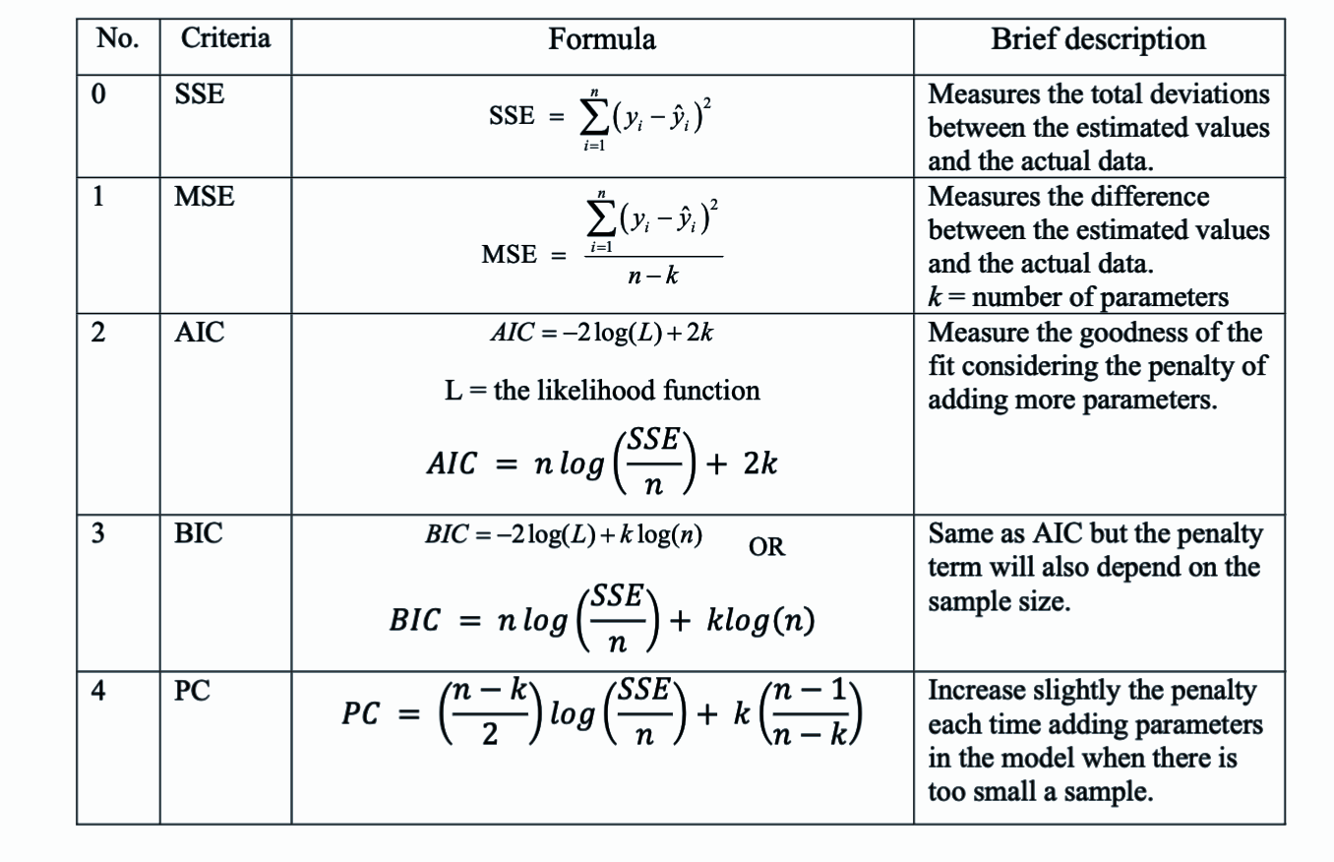
Criteria Used
SSE
MSE
AIC
BIC
PC

Slide 5
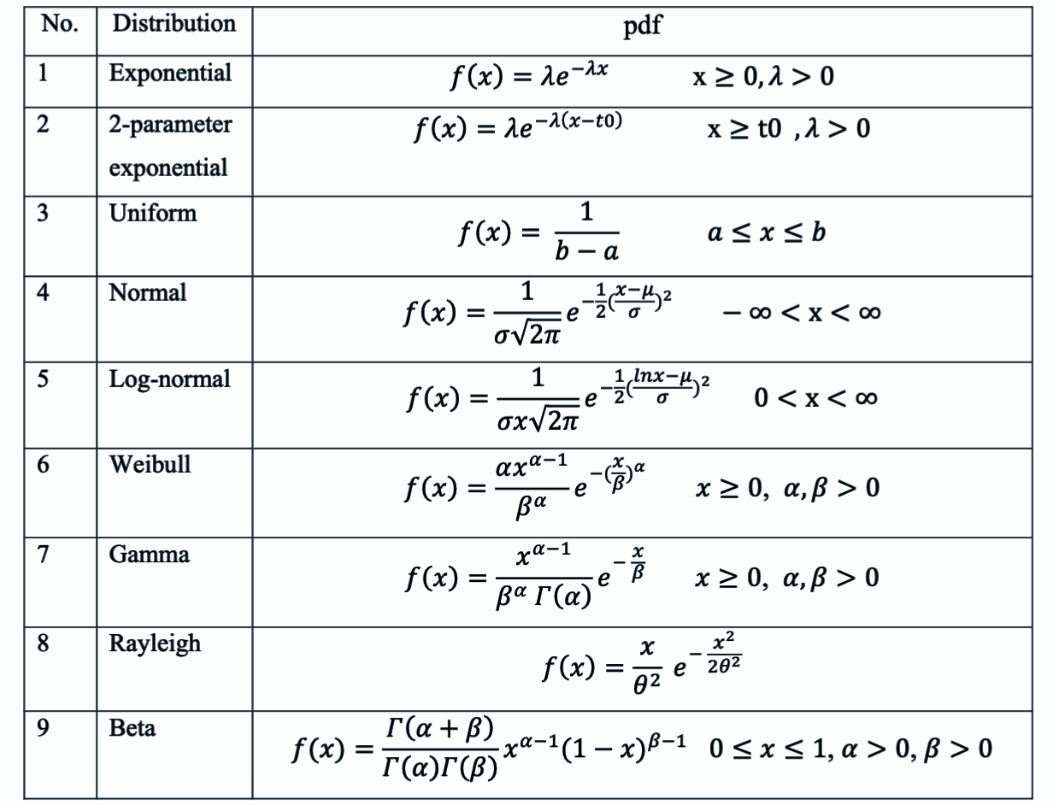
Distribution Functions
Exponential
Two Parameter Exponential
Uniform
Normal
Log-Normal
Weibull
Gamma
Rayleigh
Beta

Slide 6
Methodological Approach
Data Preparation
Sort the Data
Calculate Empirical Distribution Function - ECDF(x) = i / n
Where i is the rank of the data point in the sorted dataset (starting from 1) and n is total number of data points
Distribution Fitting
Criteria Calculation Functions

Slide 7
Methodological Approach
Criteria Matrix Assembly
9 (distribution function) by 5 (criteria) matrix is being created.
Calculating Ranking matrix
The calculated criteria for each distribution are assembled into a matrix for comparison, aiding in the selection of the best-fitting distribution
Calculating Mean (Expected Value) for best Distribution Function

Slide 8
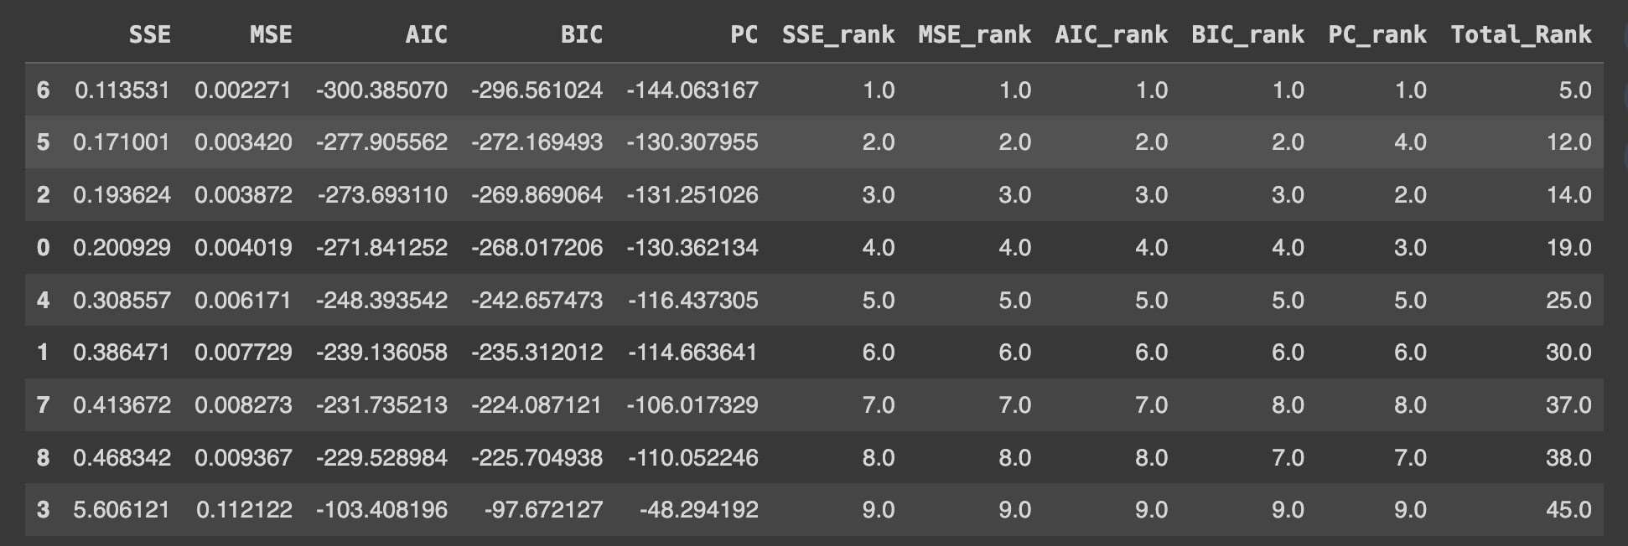
Ranking Matrix
Mapping: 1-expon, 2-uniform, 3-norm, 4-lognorm, 5-weibull_min, 6-gamma, 7-rayleigh, 8-beta, 9-2expon

Slide 9
Parameter Estimation for distribution function
To estimate the parameters for given distributions we use 1. MLE - Seeks the parameter values that maximize the likelihood function, which measures the probability of observing the given sample data under different parameter values of the model.(Maximized Likelihood function)
2. MM - The Method of Moments estimates the parameters by equating the population moments (like mean, variance, skewness, etc.) to the sample moments and solving these equations for the parameters.
params = dist.fit(sorted_data, method = “MM”) #Method of Moments

Slide 10
Expected Value Calculation
1 - Integrating PDF Normal = μ
Exponential = 1/λ (scale) Uniform = (a+b)/2
2-Parameter Exponential = μ+β (β is scale parameter)
Log Normal = e**(μ+(s**2)/2) (** Python syntax for power) Weibull = λΓ(1+1/c) (Γ is gamma function, c is shape parameter, λ is scale)
Gamma = kθ
Rayleigh = σ√(π/2​) Beta = α/(α+β) (α and β are shape parameters)
2 - Monte Carlo Simulation

Slide 11
Monte Carlo Simulation
The Monte Carlo method involves generating a large number of random samples from the distribution that the data is assumed to follow and then calculating the mean of these samples.
Samples are generated based on parameters for a particular distribution.
Compute the mean of generated random samples The code snippet below show randomly generated 4000 sample data to estimate the mean of hypothetical population
np.mean(dist.rvs(*params[:-2], loc=params[-2], scale=params[-1], size=4000)) #4000 data points

Slide 12
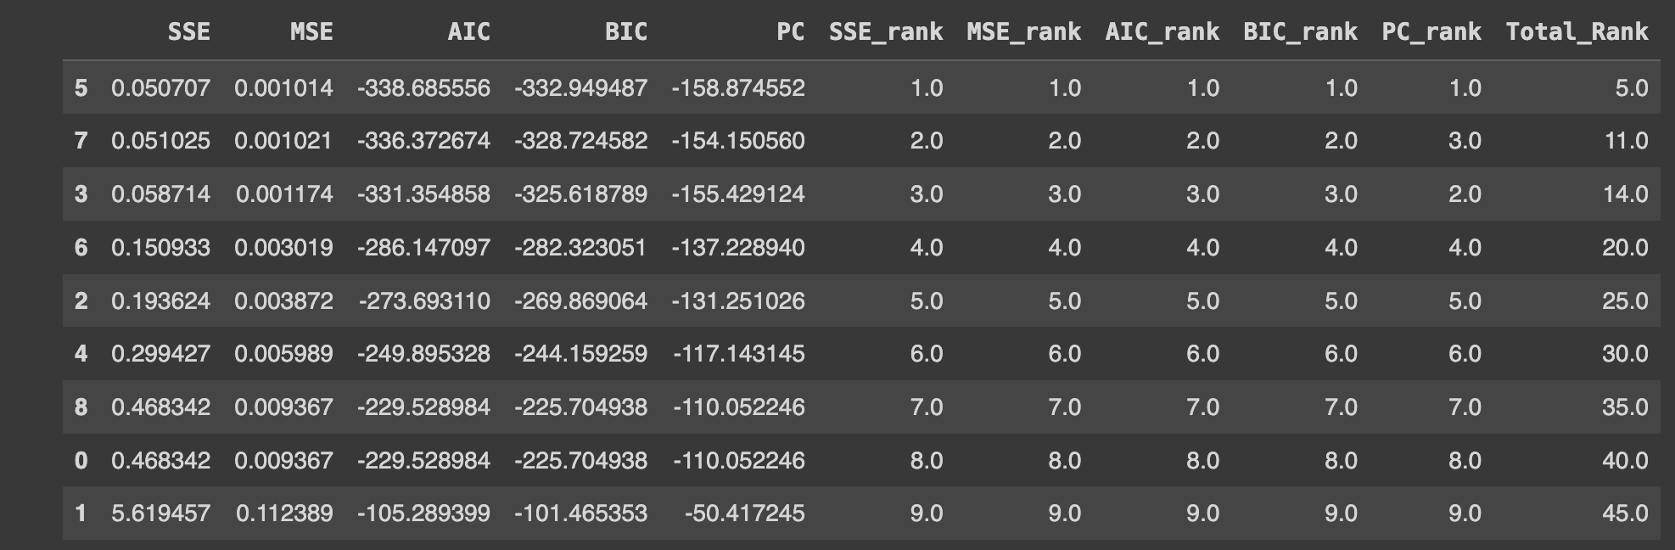
Ranking Matrix using Maximum Likelihood
Mapping: 1-expon, 2-uniform, 3-norm, 4-lognorm, 5-weibull_min, 6-gamma, 7-rayleigh, 8-beta, 9-2expon

Slide 13
Ranking Matrix using Method of Moments
Mapping: 1-expon, 2-uniform, 3-norm, 4-lognorm, 5-weibull_min, 6-gamma, 7-rayleigh, 8-beta, 9-2expon

Slide 14
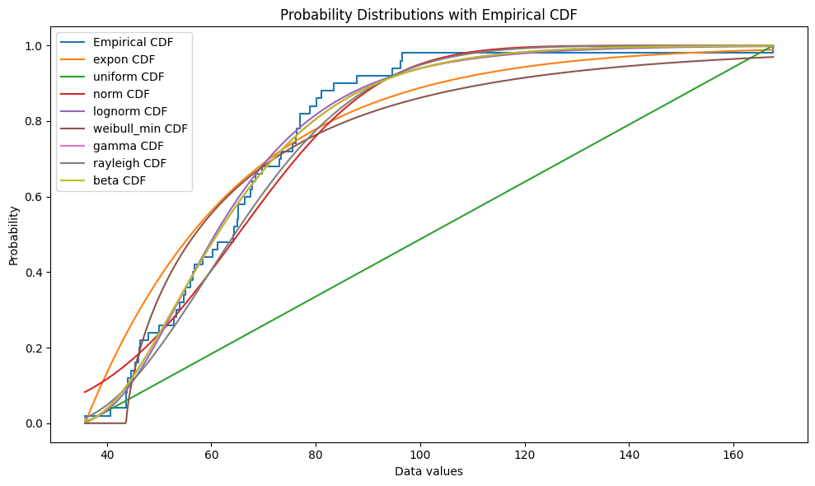
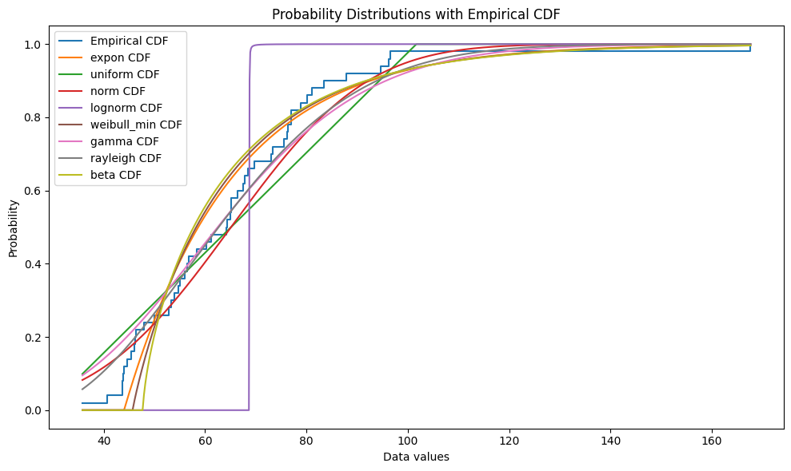
Graphs
CDF Plot for MLE
CDF Plot for MM

Slide 15
Conclusion
We draw out following conclusions about the distribution fit -
Using MLE Best fit distribution weibull_min
Expected Value Using Monte Carlo 70.40
Expected Value by integrating PDF 70.62
Using MM Best fit distribution gamma
Expected Value using Monte Carlo 64.53
Expected Value by integrating PDF 64.62

