Slide 1
Insights and Recommendations for Stakeholders
Advanced Analytics for Organisational Impact

Slide 2
Background Context

Slide 3
Business Context
Turtle Games -- a toy manufacturer and retailer with a global customer base wants to Apply predictive models, advanced data visualisations to understand and predict customer buying patterns, customer background, customer views about products / discounts etc.
They have an objective of employing data driven business strategies so that they can improve overall sales and profit.

Slide 4
Questions to support business objectives
How customers accumulate loyalty points?
How groups within the customer base can be used to target specific market segments?
How social data (e.g. customer reviews) can be used to inform marketing campaigns?
The impact that each product has on sales
How reliable the data is (e.g., normal distribution, skewness, or kurtosis)
What the relationship(s) is/are (if any) between North American, European, and global sales?
Additional Questions for client or exploration
Does high salary and high spending score together result in more loyalty points?
Customer classification by educational background can bring some benefits?
How we can improve customer review and summary capturing so that we get correct inputs and sentiments

Slide 5
Data Import, exploration and cleaning

Slide 6
Data ingestion and wrangling
Imported the necessary libraries (e.g. Pandas and Numpy) for functions and seaborn, matplotlib for visualisation etc.
Imported csv file into data frame with proper naming conventions
Explored summary of data frame like columns, rows, null values, datatypes etc. Also Descriptive statistics are explored using describe method.
Missing values are checked for each column using isna().sum(), there are no missing values
Cleaned up the dataframe by removing unnecessary columns like language and renamed column with suitable titles

Slide 7
Data Insights, Observations and Trends

Slide 8
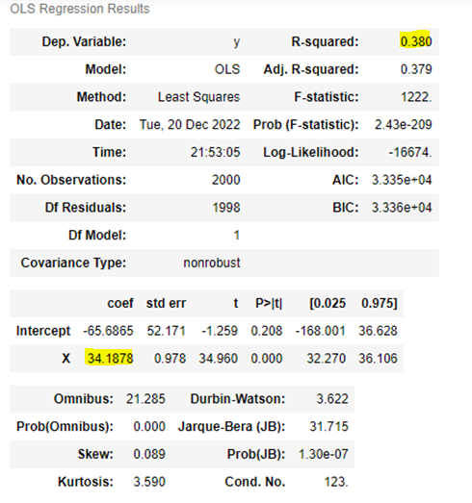
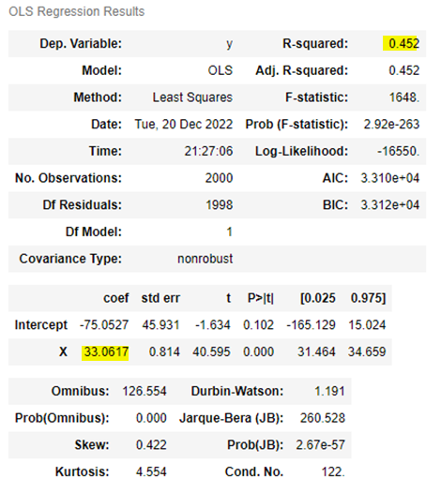
Question Answered/Explored
How customers accumulate loyalty points
Trends and insights:
45% of the total variability of loyalty points, is explained by the variability of spending which is not highly accurate
Here, if the spending changes by 1 unit the loyalty will change by 33.0617 units.
Around 38% of the total variability of loyalty points, is explained by the variability of Renumeration

Slide 9
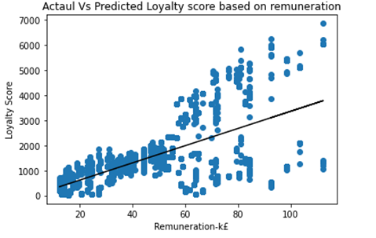
Linear Regression Results
Squared distance of observations from line of best fit increases for higher spending score and renumeration on both sides of line of fit. Good prediction results for lower or middle level income or spending

Slide 10
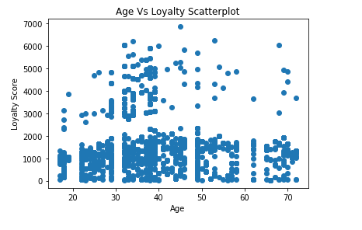
Age vs Loyalty are not quite co-related hence not considered for analysis

Slide 11

Questions answered / Explored
Can salary and spending score together help to predict loyalty points better?
Trends and insights:
R square is close to 1 explanatory power is strong → 82 percent of variation of loyalty score explained by model
1unit increase in re-numeration then loyalty score will increase by 33.98 and 1 unit increase in spending score then loyalty score will increase by 32.89
Big absolute error

Slide 12
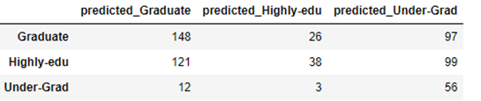
As per available data customer can be classified into three educational groups Graduate','Highly-edu','Under-Grad'. If we can build a model to predict customer educational background based on numeric independent variables like spending score, age etc. then this data can be used for promotional strategy
Questions answered / Explored
Whether classification can help to improve sales trend or give some insights ?
Trends and insights:
The accuracy of the model is 40%, which is not very accurate and therefore not useful as a predictive model. It seems that there is a 40% chance of success.
Graduate or highly graduate classification has more than 50% of precision. It predicts that 148 of the 271 (sum of the graduate row is 148+26+97), or 54%, were correctly predicted as Graduate.

Slide 13
The marketing department wants to better understand the usefulness of renumeration and spending scores to identify groups within the customer base that can be used to target specific market segments.
Questions answered 4
How groups within the customer base can be used to target specific market segments?
Trends and insights:
5 marketing segments can be determined as The number of predicted values per class indicates a better distribution for k=5 than k=6.
Possible marketing segments:
High spending-high salary
Low spending –low income
Low spending high salary
Low salary high spending
Medium spending and earning

Slide 14
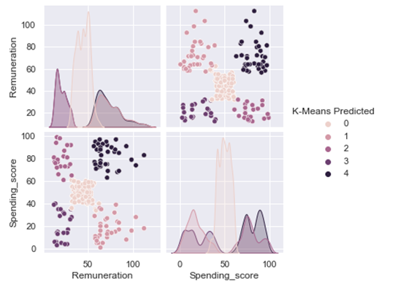
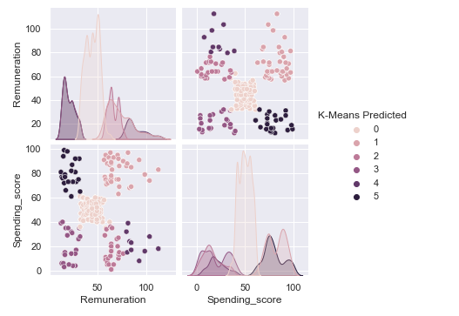
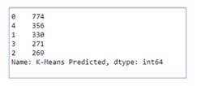

Clustering Diagrams
K = 5
K = 6

Slide 15
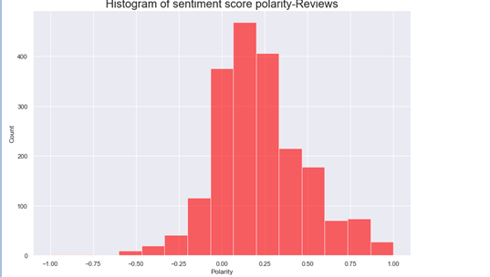
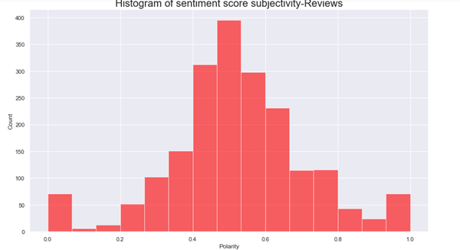
Customer reviews were downloaded from the website of Turtle Games. This data will used to steer the marketing department on how to approach future campaigns.
Questions answered / Explored
How social data (e.g. customer reviews) can be used to inform marketing campaigns?
Trends and insights:
Book, fun, time, new, card, tiles, one are frequently used words
Reviews are more fact based and objective and polarity are more positive
Most of the negative comments are related to disappointments where expectation or commitments are not met.

Slide 16
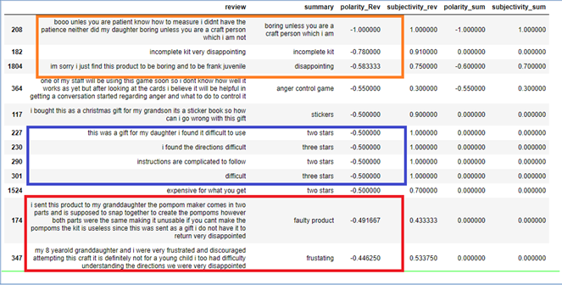
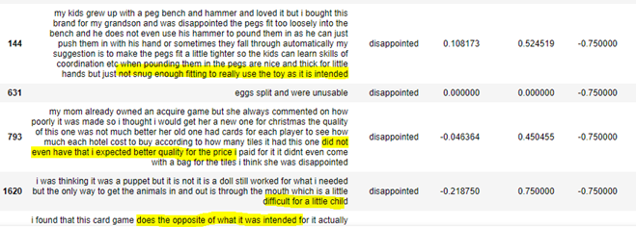
Negative reviews

Slide 17
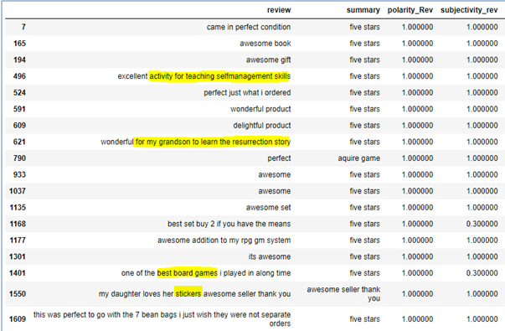
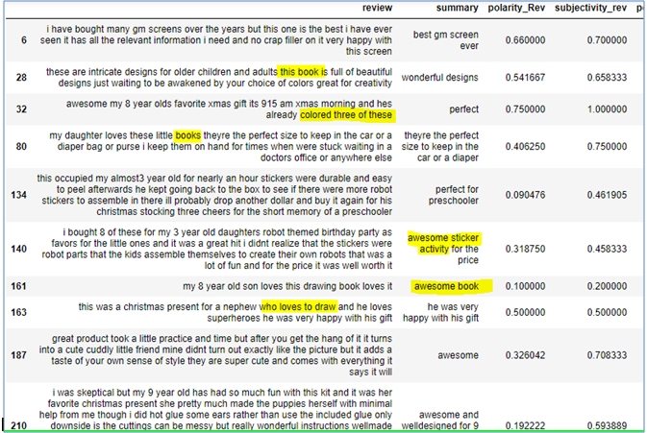
Positive Reviews

Slide 18
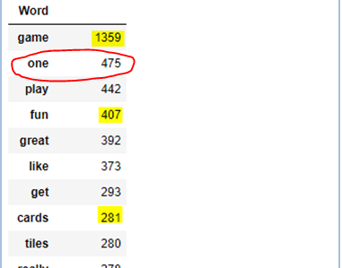
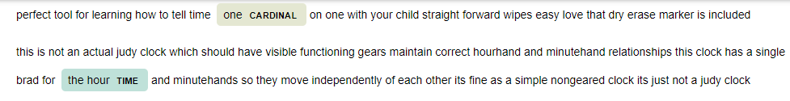
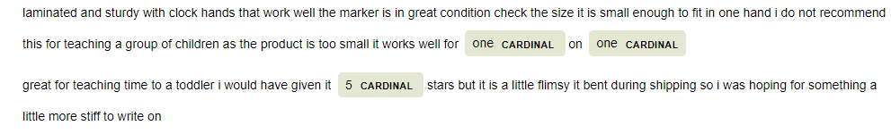
Named entities

Slide 19
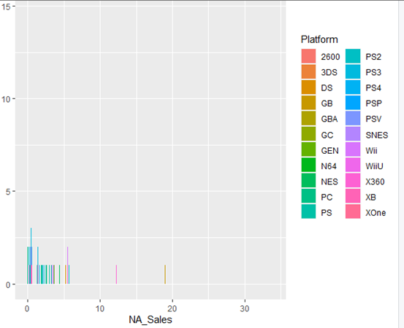

Questions answered
What is the impact on sales per product ?
Trends and insights:
Most of the products have global sale below 10 million
Product 107 has highest global sale.
Most of the game platform has NA sale below 10 million pound and maximum NA sale is through PS games

Slide 20
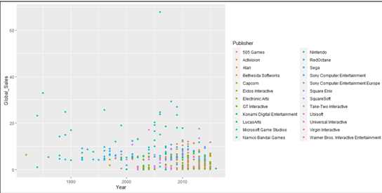
Indicating NA region sale has more contribution in global sale
Every year global sales are higher for these publishers:

Slide 21

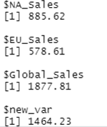
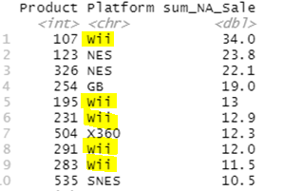
Further Trends and insights:
107 has maximum EU sale and Wii platform has more sale
Total sale contributions
Major NA sale is from wii platform

Slide 22
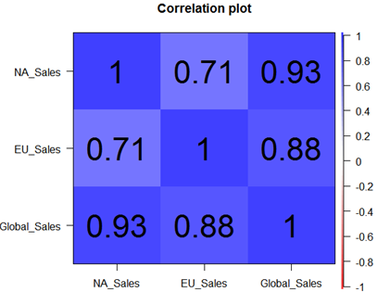

Co-relation between sale values
The correlation between NA and Global sale is 0.93. A positive correlation coefficient suggests that the two variables vary in the same direction. That means as the one increases, so does the other; and if one decreases, the other does too. Again the coefficient is closer to 1, meaning there is a strong positive correlation. This means that NA sale strongly correlates with Global sale
Predict global sales based on provided values as MLR model is 96%---very accurate

Slide 23
Recommendations

Slide 24
Multiple linear regression model with around 82% accuracy should be utilised to predict customer loyalty score this can help to explain customer based on their income and spending history how much loyalty points they can gain and can help to attract more customers
Even though classification model to classify customers with educational background is just 40% accurate But if there are no extra budget required then it could be worth exploring promotional strategies as graduate or highly graduate classification has more than 50% of precision. promotional strategy like graduate or highly educated group of customers are offered discount on books or video game promotions targeted for under graduates etc.
Correct clustering of 5 can help with targeted marketing Example high earning high spending customers are premium customers, and low income , low spending customers can be least prioritised. High income low spending customer base can be targeted
Most of the negative reviews are related to difficulty in following instructions or not suitable for age, work on this. Also most negative reviews are related to disappointments where expectations or claims are not met
Positive reviews are related to activity books games, these games should be focused

Slide 25
Negative reviews

Slide 26
More Recommendations
Nort America Region has more sale mostly for 107 product Wii and PS* platforms so this should be maintained or further explored
There is potential to increase EU sale
Yearly Sale is increasing for Action and simulation and decreasing for sports this should be part of sale increase strategy.

Slide 27
Conclusion

Slide 28
Conclusions
There are some highly accurate models which should be further explored to get right predictions on global sale or customer loyalty points. This can help to outline future strategy.
Proper clustering and classification should be explored for tragetted marketing and this should be weighed based on accuracy plus benefits plus expenses to implement marketing strategy
Customer reviews, word clouds , frequency and named entities these NLP techniques when effectively used can help to increase sale
Detailed exploration on which products, generes, platforms and region can bring more profit or have potential to increase sale should help

