Slide 1
Background Context

Slide 2
Business Context
The reasons for missed appointments need to be better understood
The government needs a data-informed approach to deciding how best to handle this problem. At this stage of the project the two main questions posed by the NHS are:
Has there been adequate staff and capacity in the networks?
What was the actual utilisation of resources?

Slide 3
Prepare your GitHub repository.
value and impact of GitHub in the context of the scenario.
As the projects grow in size and complexity there is benefit from maintaining well-organised files
A good organisational system for code, working files, source files, and final documents
Result in more efficient workflows, clarity in the work, and prevent accidental deletions or duplications.
Sharing and updates are made easy
Undo or roll back the change without causing further issues---version control
GitHub is the ideal space for:
storing code
controlling changes over time
learning from and with others
building a portfolio of work.
It serves as sandbox, knowledge bank and portfolio.

Slide 4
Patterns, trends, and insights

Slide 5
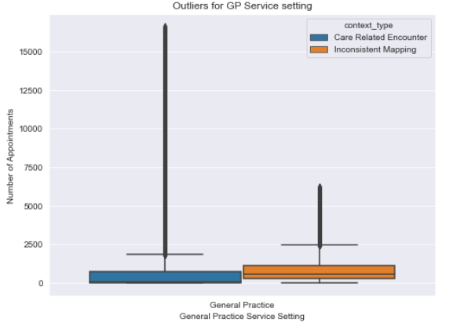
Import and explore data
There are no Missing or null values
But there are some unknown , unmapped values
How business will like to handle?
My functional approach is to remove unmapped values while drawing visualisation
Outlier observations:
There are more outliers for care related encounter
Records with inconsistent mapping has higher mean tan that for for care related encounter

Slide 6
Import and explore data ( Questions)
What is the number of locations, service settings, context types, national categories, and appointment statuses in the data sets?
What is the date range of the provided data sets, and which service settings reported the most appointments for a specific period?
What is the number of appointments and records per month?
What monthly and seasonal trends are evident based on the number of appointments for service settings, context types, and national categories?
What are the top trending hashtags (#) on Twitter related to healthcare in the UK?
Questions for Client
There are some unmapped and unknown values, can that data be made available, it should be ignored or can be replaced by other values
Impact on various factors based on whether or not visits are attended?

Slide 7
Import and explore data ( Observations with pictures )
Number of location = 106
Number of service settings = 4
Number of context types = 2
Number of national categories = 17
Total appointment statuses = 2
Five locations with highest records
NHS North West London ICB - W2U3Z 13007
NHS Kent and Medway ICB - 91Q 12637
NHS Devon ICB - 15N 12526
NHS Hampshire and Isle Of Wight ICB - D9Y0V 12171
NHS North East London ICB - A3A8R 11837
All appointments were scheduled between 08/2021 to 06/2022

Slide 8
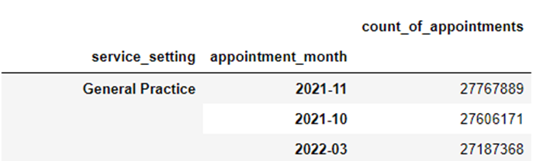
Which service settings reported the most appointments for a specific period?

Slide 9
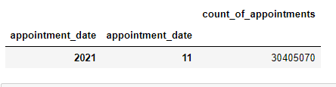
Other insights
What is the number of appointments and records per month?
Other Observations
GP Service settings have more appointments
Those appointments are for care related encounter
General consultation related routine appointments are more in count

Slide 10
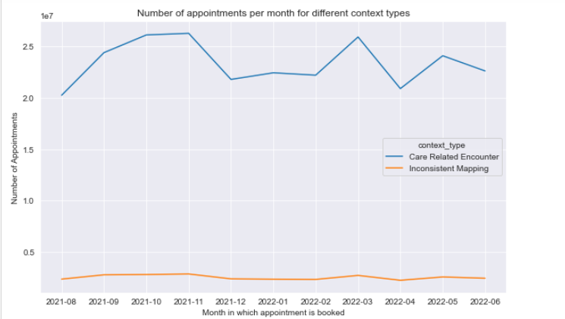
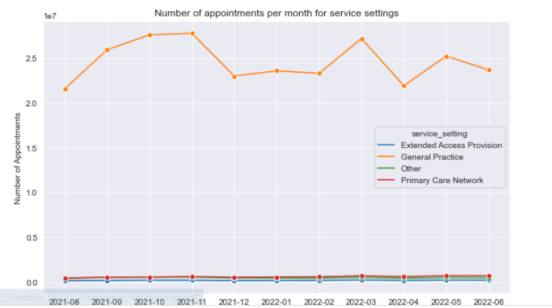

Slide 11
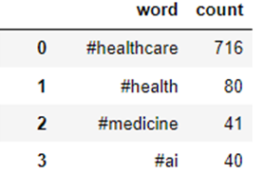
Overall Conclusion related twitter data exploration
Count of zero re-tweets is maximum , more number of people don’t prefer re-tweeting
Same pattern for tweet_favorite_count
Most of the hashtags are for healthcare, top3 as below

Slide 12
Recommendations

Slide 13
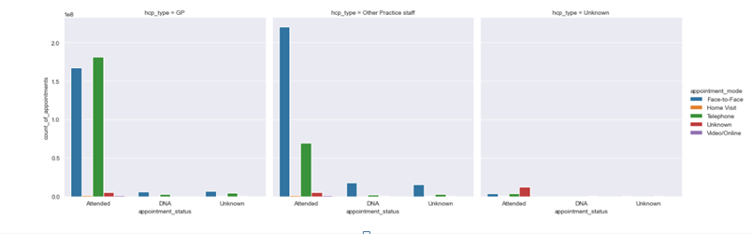
Since GP appointments are more, increase GP staff
NHS staff is not fully utilised as their percentage utilisation is less than 100%, effectively distribute use staff to cover all locations at least to avoid any appointment non attendance due to staffing issues
People attend more telephonic appointments for GP and face to face for other staff hence effectively utilise this combination
Also face to face appointments are more during busiest month hence increase corresponding staff during busy months

Slide 14
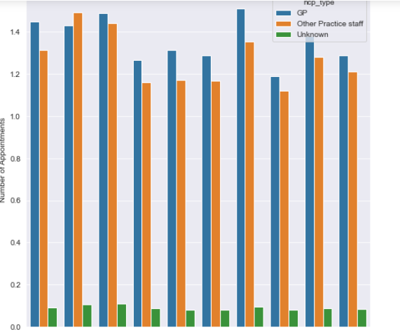
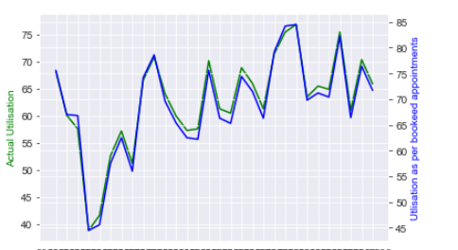

Slide 15
Conclusion

Slide 16
Conclusions
Has there been adequate staff and capacity in the networks?
Yes there has been adequate staff and capacity in the networks just GP –telephonic appointments and other face to face appointments are mostly attended by people hence staff should be set up accordingly
What was the actual utilisation of resources?
Staff is not fully utilised, utilisation is below 100% for all months also percentage utilisation by booked appointments when compared with attended % then attended utilisation is always less than need to work on this
Additional conclusions
When appointment duration is less there are more count of appointments
When Time from booking to appointment is less count of appointments is more in most cases

Slide 17
