Slide 1
CalWORKs
California Work Opportunity and Responsibility to Kids
Group 11: Data Mining and Business Intelligence
Mohan Wang, Robert Dube, Shraddha Sharma, Shreshta Balerao

Slide 2
What is CalWORKs?
Welfare program that gives cash aid and services to eligible needy California families
Provides support through cash aid, housing, food, utilities, clothing or medical care
California's version of the Federal Temporary Assistance to Needy Families
Must be a citizen of California State.
Families need to apply and qualify for the CalWORKs benefits.

Slide 3
Income of the family
Age of Applicant
Eligibility for CalWORKs AID
Applicant’s citizenship
Resources and Assets
Children must be deprived of parental support and care due to incapacity, death, absence of a parent or unemployment of principal wage earner.
Time limit:
For Adults: Cash aid is provided monthly up till a limit of 48 months
For Children: Children may still be eligible for the cash aid after 48 months to the age of 18.

Slide 4
Introduction of the Data Set
The data set explores the number of applicants to the Calworks Program
The data set has the numbers of applicants for each county in California from January 2010 – September 2015
The data set was interesting because of its size and the proximity of time with the “Great Recession” of 2008
California has the 8th largest economy in the world* and it is diverse and unique
California has also been struggling with deficits and recovering from the recession until 2013 when the state showed a surplus
The team was interested to see the affects of the forecast on four diverse counties in regard to population and economic forces of the counties
*Source: http://www.latimes.com/business/la-fi-california-world-economy-20150702-story.html
**Source: http://www.nationalmemo.com/the-5-best-ideas-from-californias-progressive-resurgence/

Slide 5
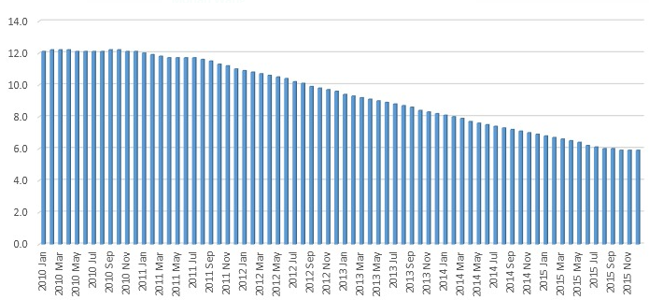
Correlations With External Factors
Poverty Rate of the particular county
Unemployment rate
Awareness about the CalWORKs program among the population
Population of the County

Slide 6
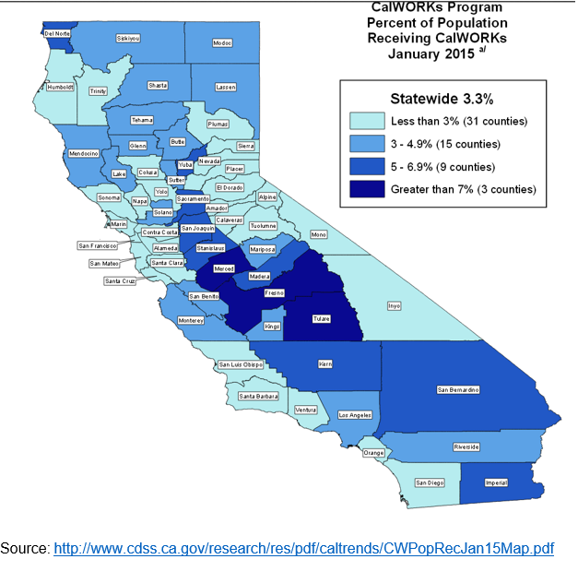
Team Selection Process
Team focused on four counties split out by geography and by percent population category.
Model is based on the percent of Population receiving CalWORKs aid.
Combination of all four factors discussed in previous slide

Slide 7

Selected Counties
Siskiyou County-
Northern California, rural and an agriculture based economy – one of California’s least populated counties
Los Angeles County –
Located in Southern California, home to the rich and famous and the capital of the entertainment industry – most populated county in US
01
02
04
Fresno County –
Located in Central California, knows to be one of the less affluent parts of the state
San Francisco County-
One of the wealthiest counties in the state near Silicon Valley and Wine Country
03

Slide 8
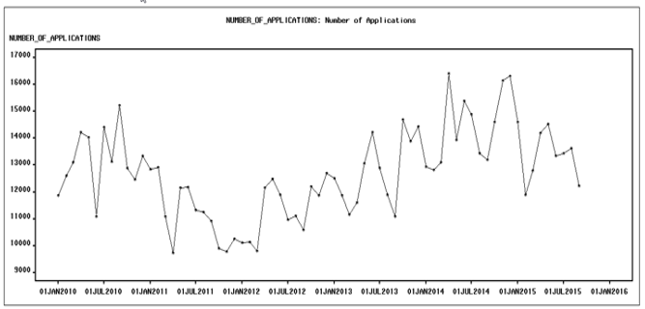
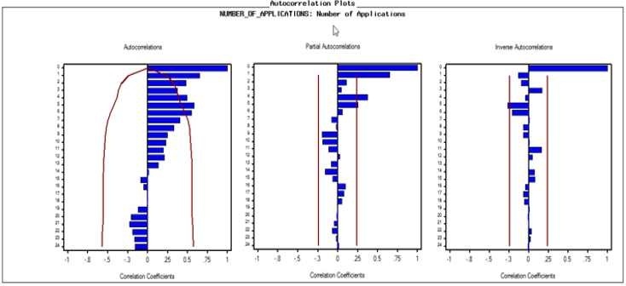
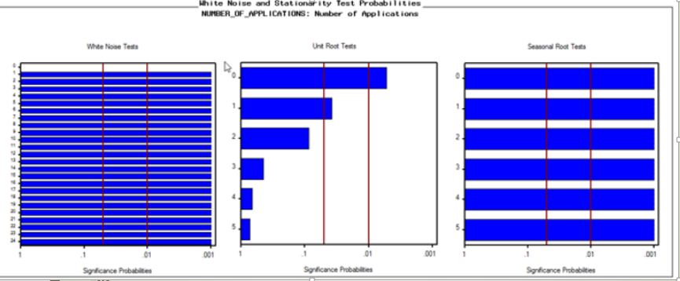
Los Angeles County Data
Some small signs of seasonality and AR
Raw Data graphed, anomaly noticed in data set in middle of 2012, slightly increase trend to the data
White noise fails due to the non randomness of the errors, unit root test is also not significant enough yet, but seasonal root test looks strong

Slide 9
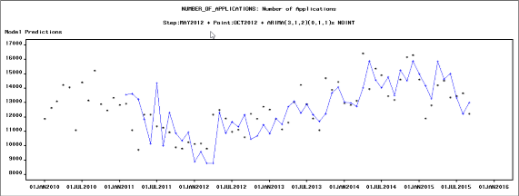
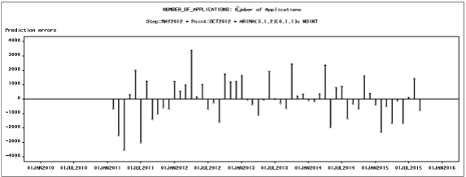
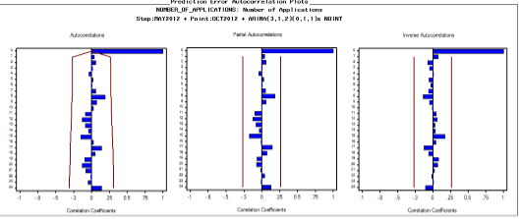
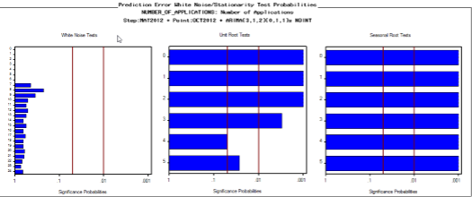
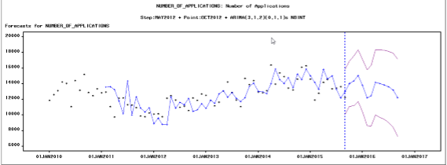
Model Selection
We chose the ARIMA (3,1,2)(0,1,1) with a step intervention at May 2012 and Point in October 2012
Time limit:
This model ran the best out of all the models we ran
Model had 92% accuracy and an RSME of 1186.9
Our forecast gradient also was the best our of all the models and captured the trend of the data well

Slide 10
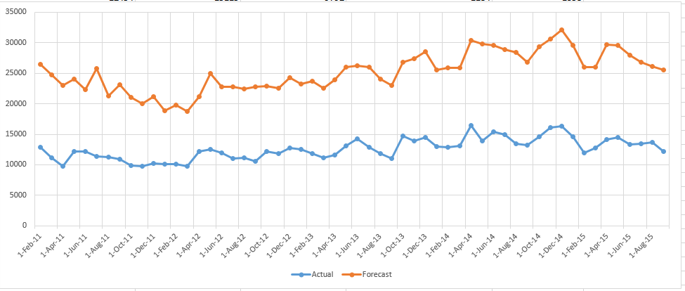
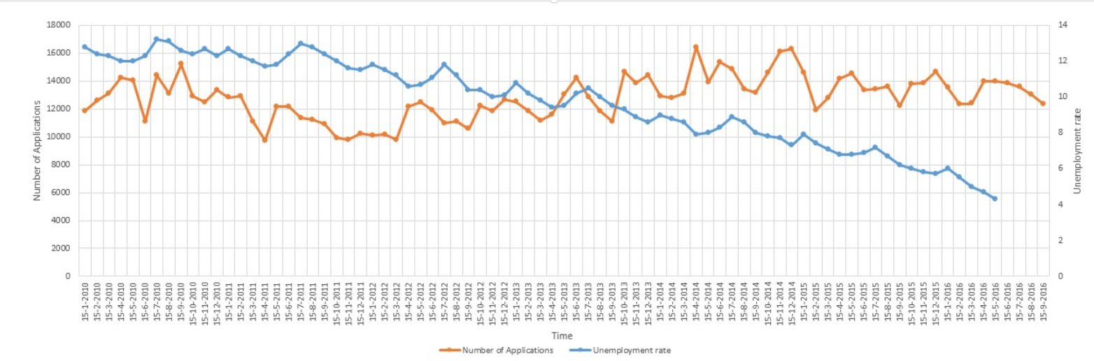
Model Performance
Model Forecast vs. Actual Data Observations
Our model performed very well against the actual data observations, mirroring the trends and following the actual data points
It was also interesting to see how the number of applicants over time remains steady, despite unemployment rates
Number of Applicants vs. Unemployment Rate

Slide 11
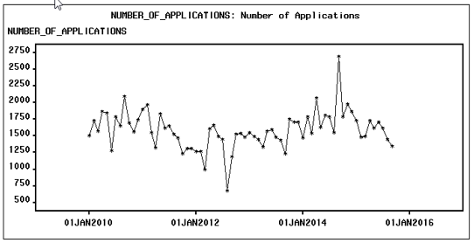
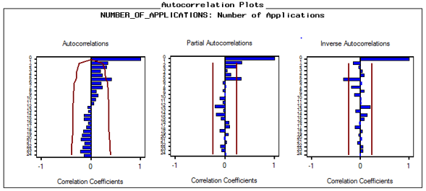
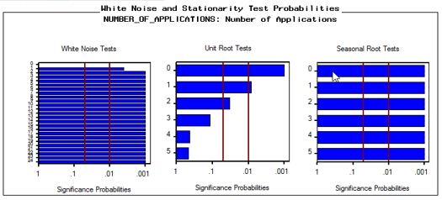
Fresno County Data
Some trend and seasonality existed, along with interventions
Signs of AR2 and MA2
Both the white noise tests and united root tests are far away from good

Slide 12
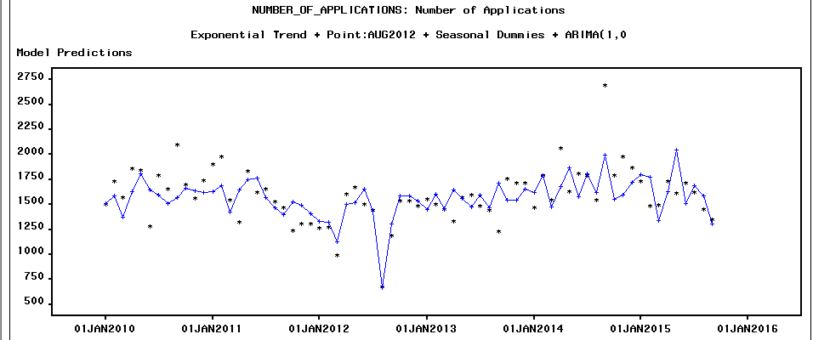
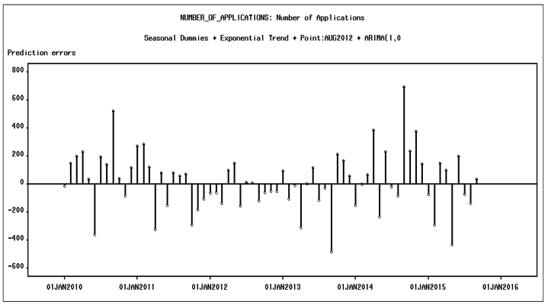
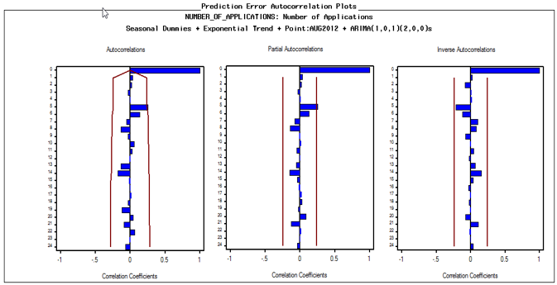
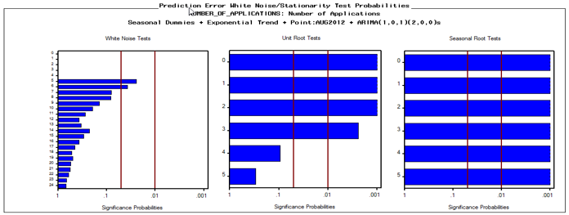
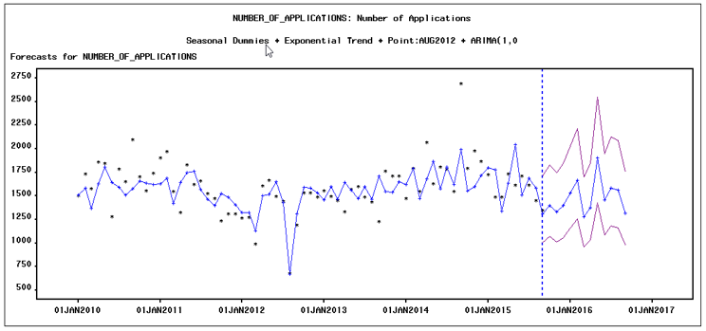
Model Selection
We chose ARIMA (1, 0, 1) (2,0,0) model with seasonal dummies and exponential trend, also intervention in point AUG2012.
ACF, PACF, IACF is fine, only a spike at Lag 5 is suspected.
White noise tests got only two spikes at 5% significant level.
Unit root tests results are quite the same for most models, so we have to accept it.
The forecast this model gives out seems reasonable based on previous data.

Slide 13
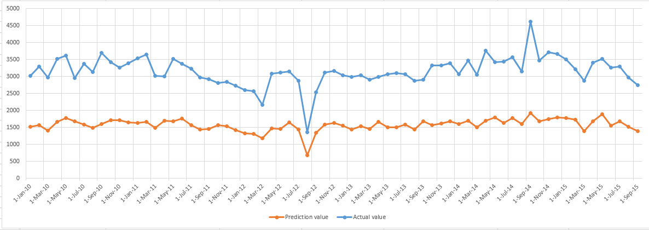
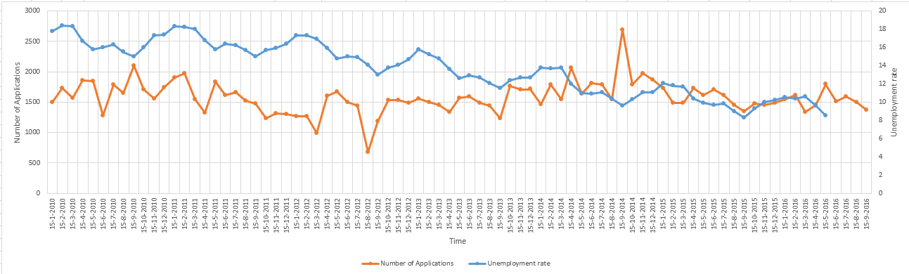
Model Performance
Model Forecast vs. Actual Data Observations
Although there is still some difference between actual and forecast numbers. Forecast and actual value got some pretty similar trend in variation.
We can see there are some synchronized changes between number of applications and unemployment rate.
Number of Applicants vs. Unemployment Rate

Slide 14
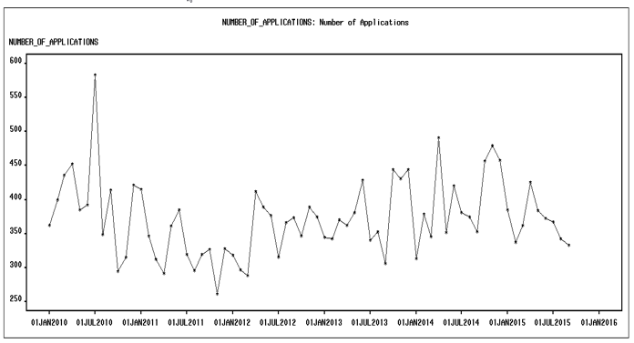
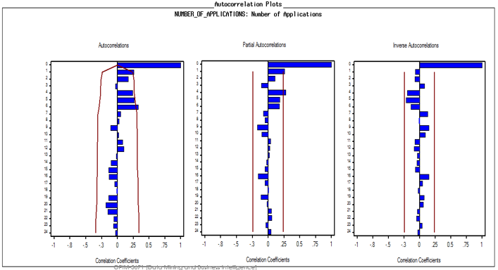
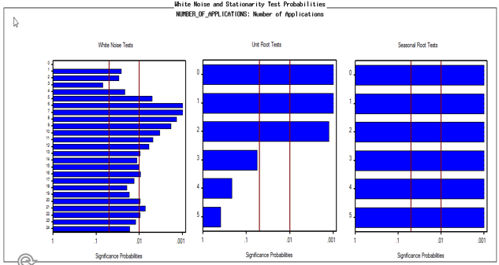
San Francisco County
White noise test failed and
Unit root test also failed partially at lag 4,5 and 6 and the model is not stationary
Seasonal root test is pretty good
The raw data captures no clear trend and seasonality.

Slide 15
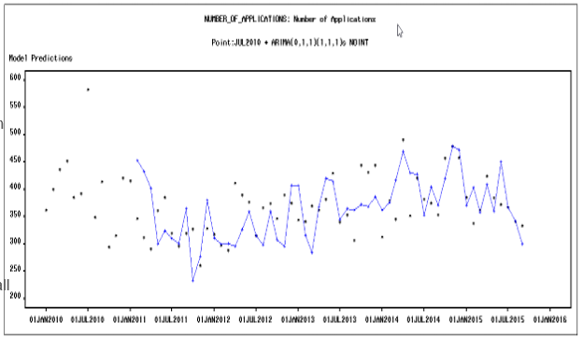
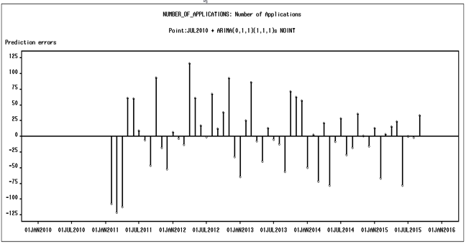
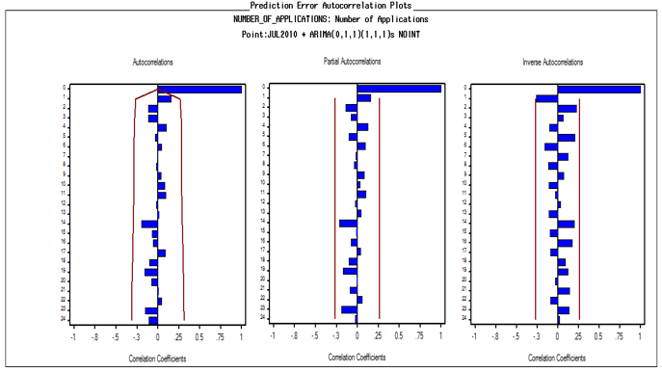
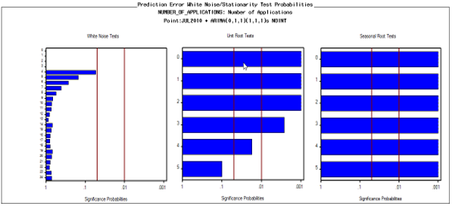
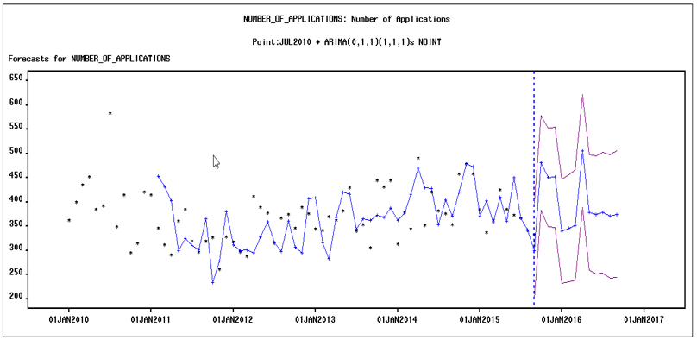
Model Selection
We chose ARIMA(0,1,1)(1,1,1) with a point intervention at July 2010.
ACF, PACF and IACF seems fine.
The model passes the White noise test, Dickey–Fuller Unit Root test and the Seasonal Root test.
The RMSE of the chosen model is 52.3, which is better compared to all other models.
The forecast is strong and the accuracy of the model is high.

Slide 16
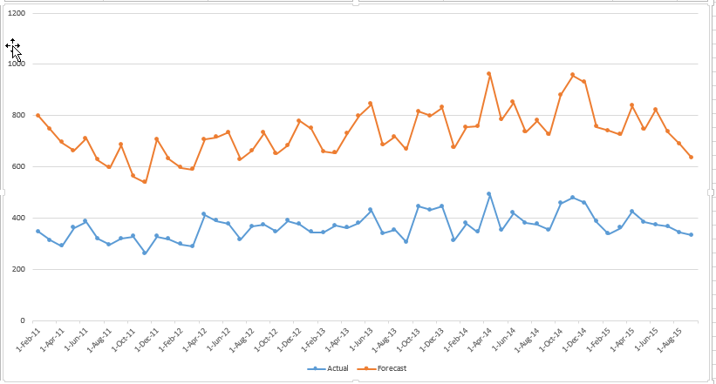
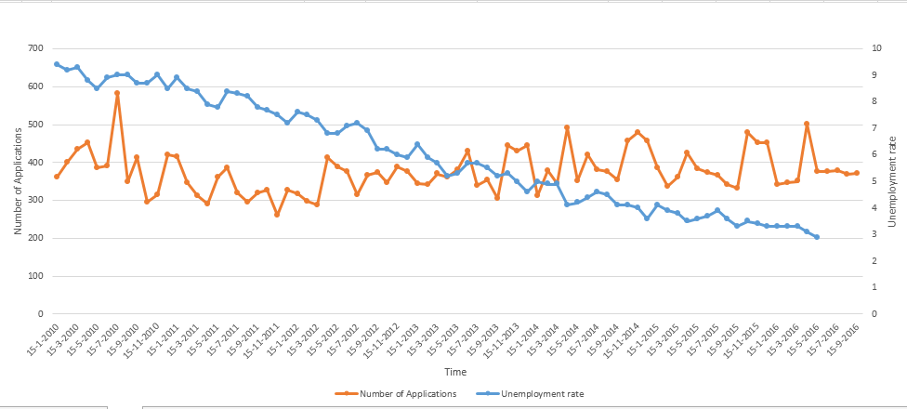
Model Performance
Model Forecast vs. Actual Data Observations
The trends of the predicted and actual show a strong correlation and are pretty much similar.
Although with a decreased unemployment rate, we see that there are slight fluctuations in the number of applications received.
This might be due to high cost of living in San Francisco county.
Number of Applicants vs. Unemployment Rate

Slide 17
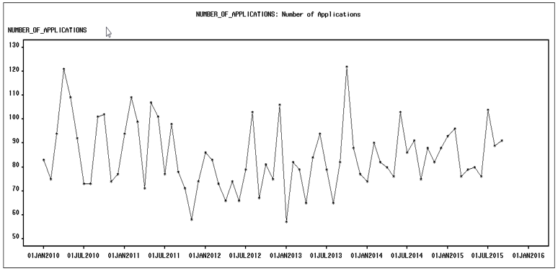
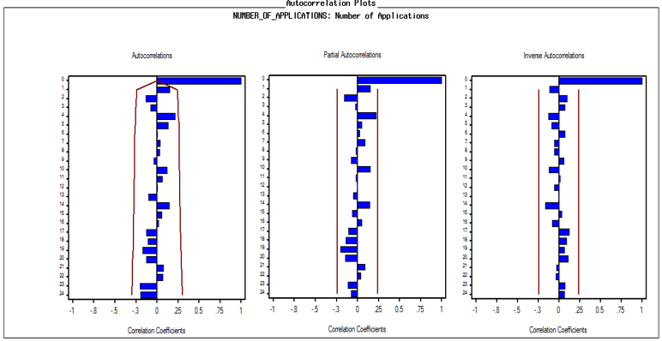
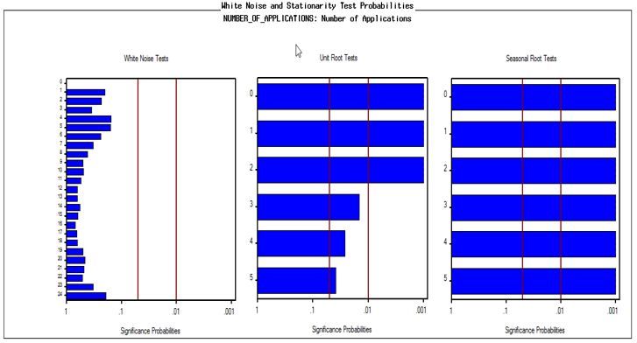
Siskiyou County
No significant trend and model. Let’s check further
Signs of MA1
White noise test shows pretty good result.
Unit root test failed and model is not stationary

Slide 18
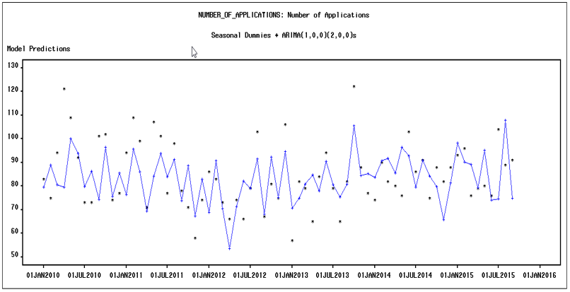
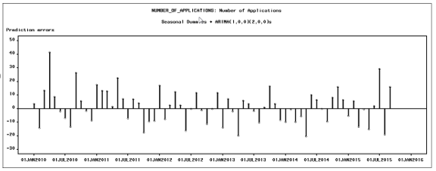
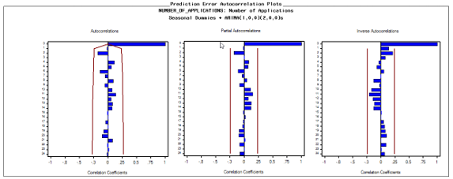
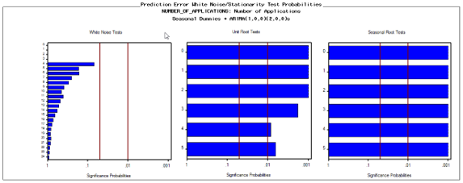
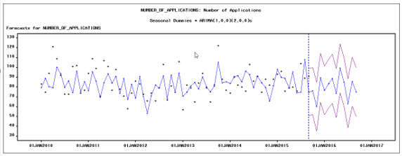
Model Selection
Chose Seasonal dummies+ ARIMA(1,0,0,)(2,,0,0)
Residuals are randomly distributed for this model.
Model passes the White noise test, Unit Root test and the Seasonal Root test.
RMSE of the chosen model is 255.84, which is better compared to all other models.
Forecast is strong and the accuracy of the model is high.

Slide 19
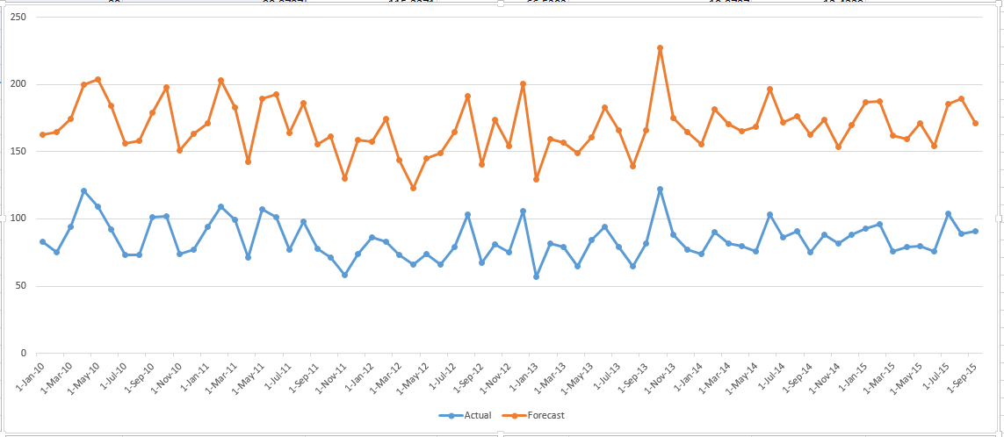
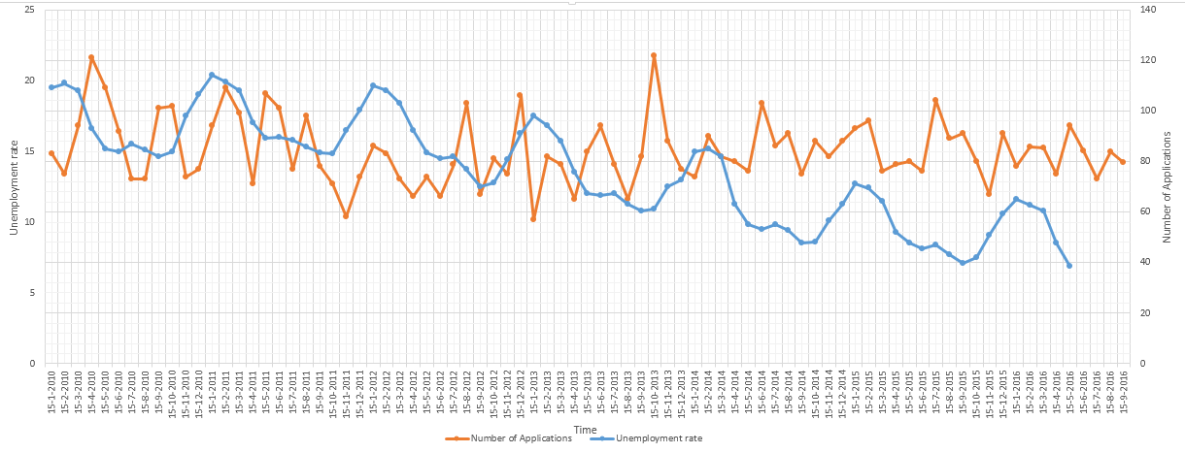
Model Performance
Model Forecast vs. Actual Data Observations
The trends of the predicted and actual show a strong correlation and are pretty much similar.
With a decrease in unemployment rate, we see that there are no difference in the number of applications received.
This might be because Siskiyou county is one of the least populated county without significant impact of external factors.
Number of Applicants vs. Unemployment Rate

Slide 20
Business Insight
Budget allocation :
Forecasting the application count would help in allocating budget for particular counties
Child leaving there family:
The trend line of forecast can give us information about children who can possibly leave their family, as major portion of the application request is from zero-parent family.
Education measures:
From the data , almost 2/3rd of the cases receiving cash grants are children. This gives an indication for government to initiate education measures in countries with increasing trend.
Unemployment trend :
Knowing the trend of unemployment may help the government in creating more employment opportunities.

Slide 21
Questions?

