Slide 1

Project Title - Seasonal Agriculture Performance Analysis
[Shraddha Singh
College Name- University of Allahabad ]
AICTE STU ID : ( STU69bce6062f1401773987334 )

Slide 2

PROBLEM STATEMENT
Agricultural activities are influenced by seasonal variations in environmental conditions, farming practices, resource availability and market conditions. As a result, agricultural performance may differ from one season to another. However, raw agricultural data does not clearly explain how agricultural performance changes across seasons or what patterns can be observed in different seasonal conditions. The problem is to analyze the given agricultural dataset and investigate seasonal differences in agricultural performance by identifying meaningful patterns, trends, relationships and variations within the available data.

Slide 3
Project Description Project Overview: A comprehensive Data Analytics project focusing on seasonal variations across Kharif, Rabi, and Zaid seasons. Data Processing Pipeline: Implemented data cleaning, median-based imputation for environmental variables (Rainfall, Soil Moisture, Yield), and generated key performance metrics (ROI %, Profit Margin %, Cost per Hectare). Analytical Scope: Conducted univariate, bivariate, and multivariate analysis to identify profit drivers and weather dependencies across crop varieties.

Slide 4

WHO ARE THE END USERS?
Farmers & Agricultural Producers: To select optimal crop varieties and align planting schedules with seasonal rainfall/moisture patterns.
Agricultural Policy Makers & Government Bodies: To allocate resource subsidies, plan irrigation support, and manage seasonal risk.
Agri-Business Analysts & Investors: To evaluate crop profitability profiles, cost per hectare, and expected returns on investment (ROI).

Slide 5

Technology Used
Programming Language: Python 3.x
Data Manipulation Libraries: Pandas, NumPy
Data Visualization Libraries: Matplotlib, Seaborn
Development Environment: Google Colab / Jupyter Notebook

Slide 6
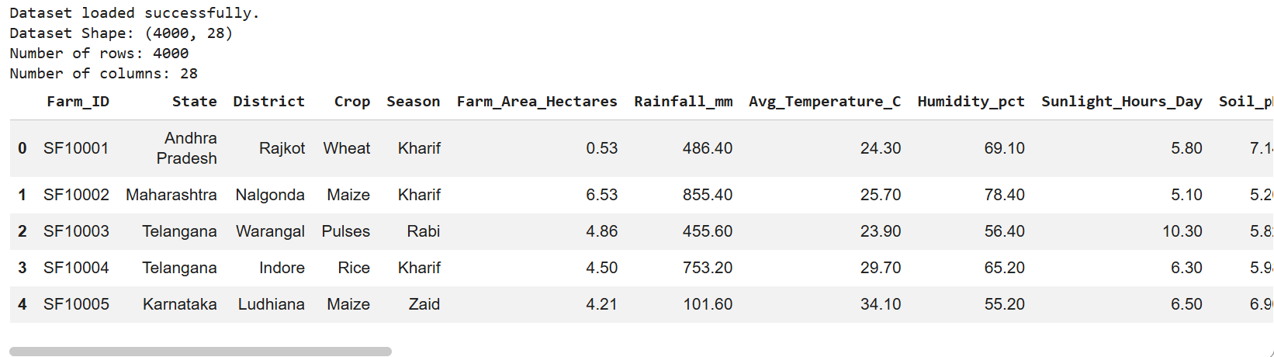
RESULTS

Slide 7
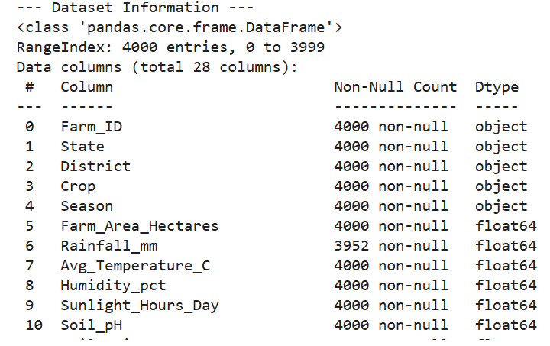
RESULTS

Slide 8
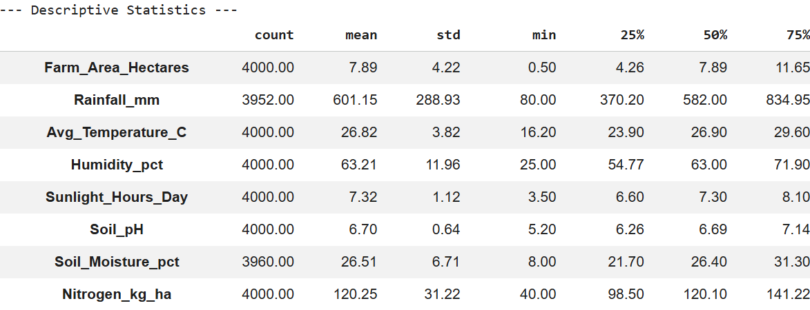
RESULTS

Slide 9
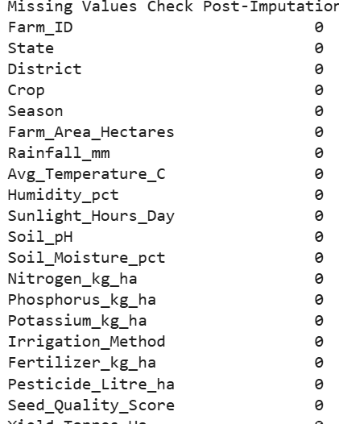
RESULTS

Slide 10
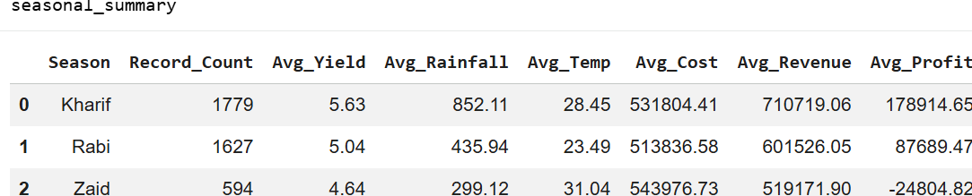
RESULTS

Slide 11
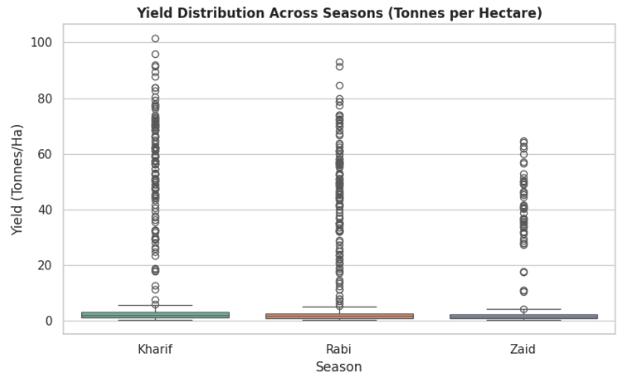
RESULTS

Slide 12
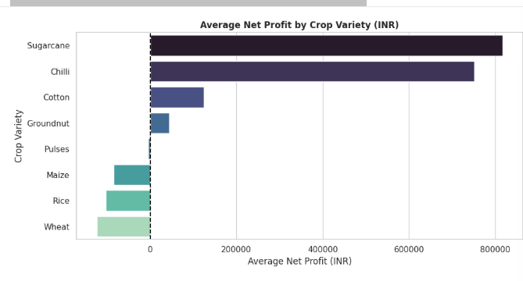
RESULTS

Slide 13
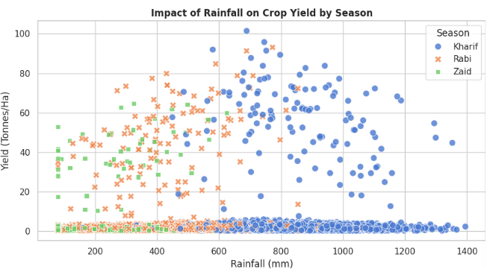
RESULTS

Slide 14
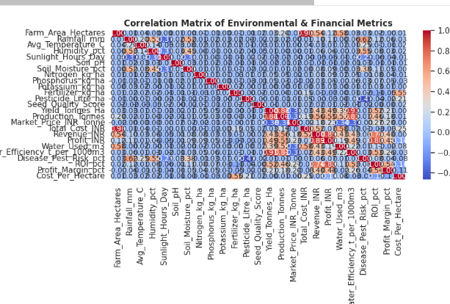
RESULTS

Slide 15
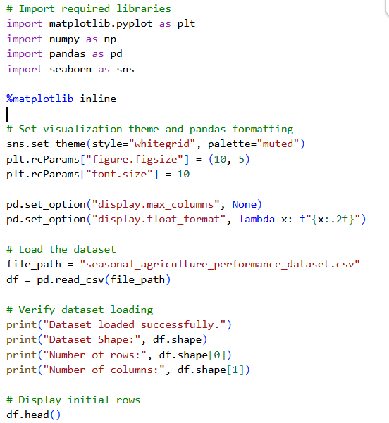
RESULTS Code Screenshot

Slide 16
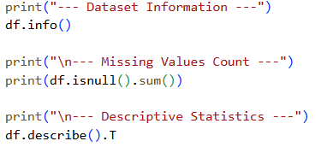
RESULTS

Slide 17
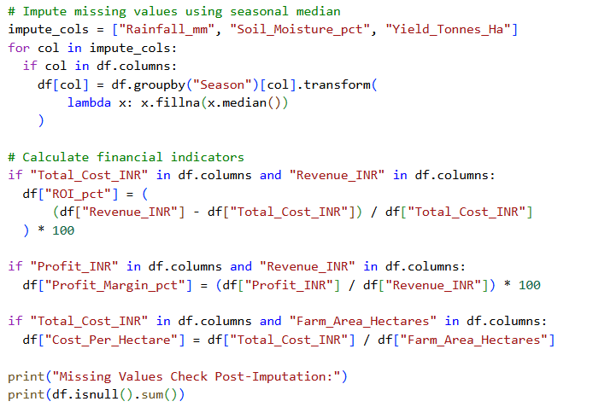
RESULTS

Slide 18
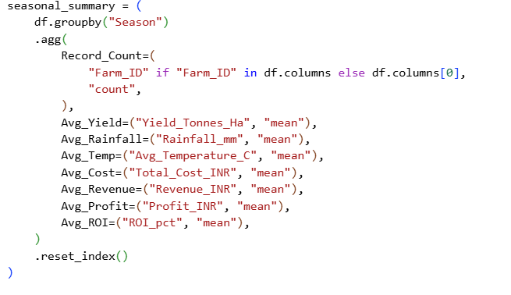
RESULTS

Slide 19
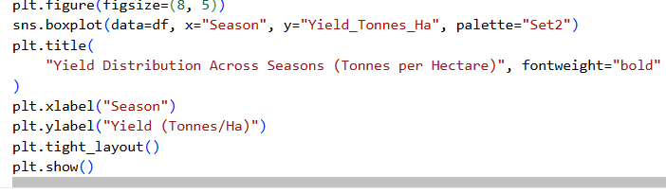
RESULTS

Slide 20
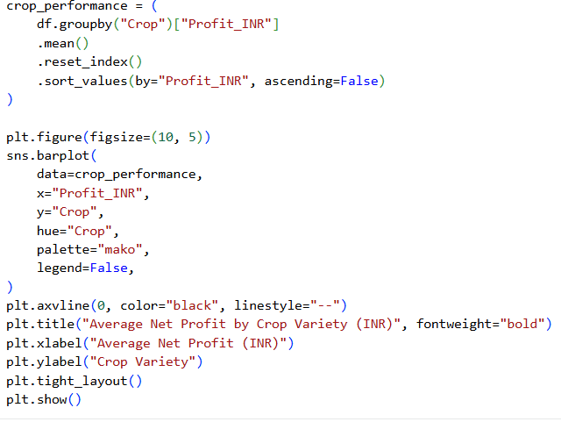
RESULTS

Slide 21
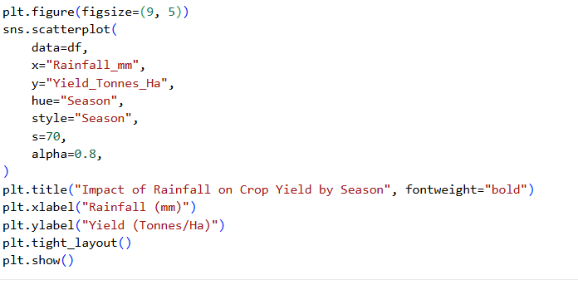
RESULTS

Slide 22
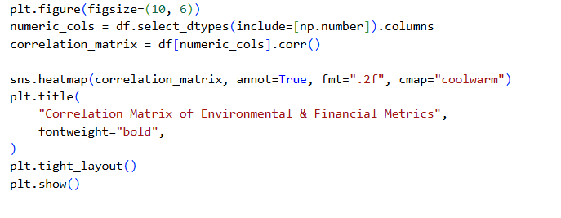
RESULTS

Slide 23
Future scope Predictive ML Models: Implement regression models (such as Random Forest or XGBoost) to predict yield outputs and optimal crop selection based on historical climate data. Interactive Web Dashboards: Transition static plots into dynamic visual applications using Streamlit or Power BI for real-time scenario modeling. GIS & Satellite Data: Incorporate spatial satellite imagery and soil mapping to account for micro-climatic and geographical variations. Live Weather Integration: Connect automated weather forecasting APIs to issue proactive seasonal advisory alerts to farmers.

Slide 24
GitHub Link
https://github.com/ShraddhaSingh1908/Seasonal_Agriculture_Performance_Analysis

Slide 25
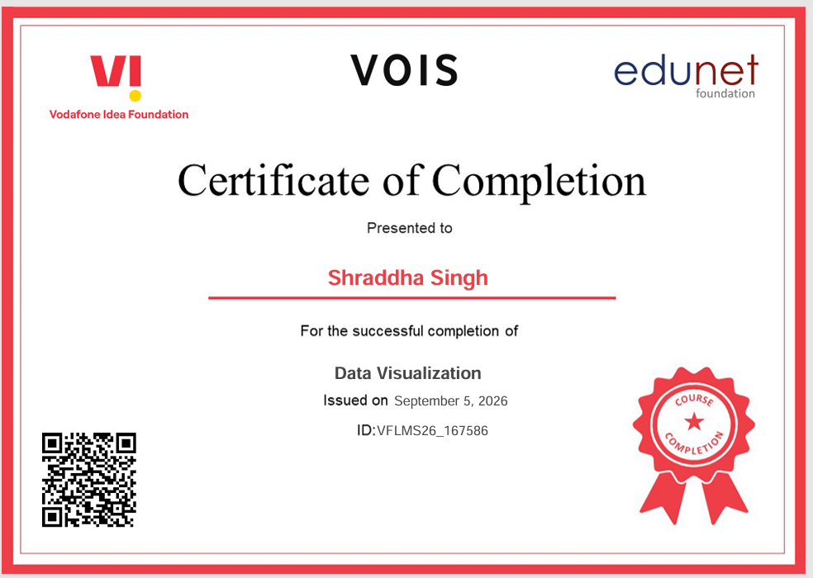
VOIS Course completion certificate - Course name- Data Visualization

Slide 26
Thank you
.
.

