Slide 1
Peer to Peer Networks
Chord Algorithm
Shraddha Jamadade
110287963

Slide 2
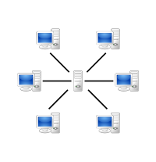
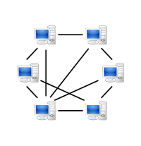
Introduction
Classification of Network Based on Architectures:
Client-Server Network Architecture
Peer to Peer Architecture
Client-server model
peer to peer model

Slide 3
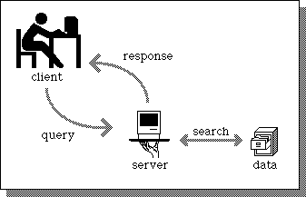
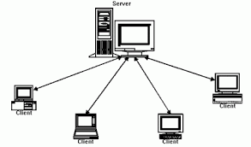
Client Server Model
Two processes:
client side and server side.
First the client sends a request over the network to the server, the client then waits for a reply.
When the server receives the request it performs the requested work and sends back a reply.

Slide 4
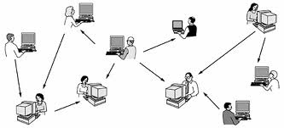
Peer-to-peer model
The p2p network differs form the client-server network as it does not distinguish clients and servers.
In the peer-to-peer architecture individuals form a loose group and can communicate with others in the group.

Slide 5
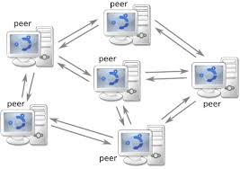
What is peer to peer network?
Group of interconnected nodes that share resources with each other without the use of a centralized administrative system.
The nodes are called ‘PEERS’.
All the peers have equal capabilities and responsibilities.

Slide 6
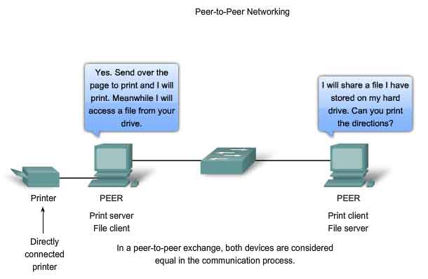

Slide 7
Literature Survey
In recent years this new innovative network architecture is widely used.
P2P systems attract increasing attention from researchers.
File sharing is the dominant P2P application on the Internet, allowing users to easily contribute, search and obtain content.

Slide 8
Architecture
A peer-to-peer network’s architecture is formed dynamically by an ad-hoc type of addition of nodes.
The loss of a certain node does not have a significant impact on the rest of the network.
There are generally two major types
Structured
Unstructured.

Slide 9
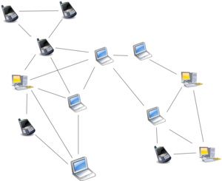
Unstructured
Unstructured peer-to-peer networks do not impose a particular structure on the network
formed by nodes that randomly form connections to each other.
Gnutella, Gossip, and KaZaA are examples of unstructured P2P protocols

Slide 10
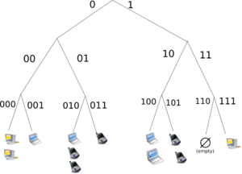
Structured
In structured peer-to-peer networks the overlay is organized into a specific topology
Any node can efficiently search the network for a file/resource, even if the resource is extremely rare.
The most common type of structured P2P networks implement a distributed hash table (DHT).

Slide 11
Structured P2P overlay network protocols and algorithms:
Content Addressable Network (CAN)
Tapestry
Chord
Pastry

Slide 12
Chord Algorithm : Properties
Emphasizes efficiency and simplicity
Efficient: less time per lookup
Scalable
Robust

Slide 13
Motivation
Addressed Difficult Problems
Load balance
Decentralization
Scalability
Availability
Flexible naming

Slide 14
Chord algorithm
The Chord protocol speciﬁes
- how to ﬁnd the locations of keys
- how new nodes join the system
- how to recover from the failure of existing nodes.
Chord uses consistent hashing.
A Chord node needs only a small amount of “routing” information about other nodes.

Slide 15
The Chord algorithm –
Construction of the Chord ring
How are nodes arranged in the network?
There is a pool of NodeID or Identifiers
Every node in the network is assigned a NodeID
Nodes arranged in identifier circle also called chord ring
Every node maintains a finger table consisting of its NodeID, information about its neighbouring nodes, successor

Slide 16
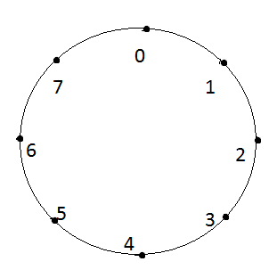
A
Node
Identifier
Circle
Arrangement of nodes in the network

Slide 17
How are keys assigned to nodes?
A
Nodes
Identifier circle
B
1
2
Keys
C
3
3

Slide 18
Node Joins
Stabilization protocol:
Stabilize(): n asks its successor for its predecessor p and decides whether p should be n‘s successor instead (this is the case if p recently joined the system).
Notify(): notifies n‘s successor of its existence, so it can change its predecessor to n
Fix_finger(): updates data in finger table

Slide 19
Addition of nodes
N1
N1
N1
N3
N3
N5
N5
N5

Slide 20
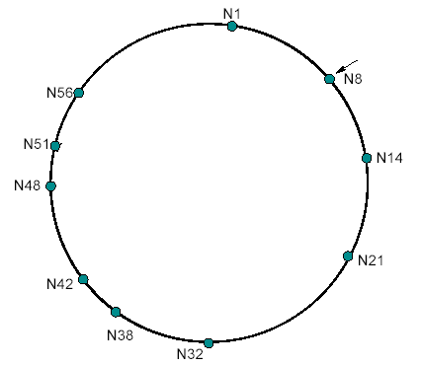
Failure of nodes
What happens, if N14, N21, N32 fail simultaneously?
Then N8 aquires N38 as successor

Slide 21
Future Scope
Chord-based DNS
DNS provides a lookup service
DNS provides a host name to IP address, Chord
can provide the same service.
Chord requires no special servers, while DNS relies on a set of special root
Chord-based DNS:
  no special root servers
  no manual management of routing information
  no naming structure
  can find objects not tied to particular machines

Slide 22
P2P Applications
Communication
Sharing resources and services
Sharing data,files
Some file sharing softwares are:
Napster
Gnutella
KaZaA
Bittorrent
Some other p2p Applications:
Skype (P2P telephony)
ICQ (P2P instant messaging)
SETI@home (P2P resource sharing)

Slide 23
Conclusion
Huge popularity of p2p networks prove that there is place for it in future.
Attractive features of Chord include its simplicity, provable correctness,and provable performance even in the face of concurrent node arrivals and departures.

Slide 24
References
1. http://en.wikipedia.org/wiki/Peer-to-peer
2. http://en.wikibooks.org/wiki/The_World_of_Peer-to-Peer_%28P2P%29/Building_a_P2P_System
3. http://en.wikipedia.org/wiki/Chord_%28peer-to-peer%29
4. http://pdos.csail.mit.edu/papers/chord:sigcomm01/chord_sigcomm.pdf
5. https://www.msu.edu/~liyang5/docs/Chordprotocolreport.pdf
6. http://www.cs.rit.edu/~kkm6815/ds/ppt2.pdf
7. IEEE “An Improvement to the Chord-Based P2P Routing Algorithm” by Dong Chen , Zhenhua Tan,
Guiran Chang, Xingwei Wang
8. Chord: A Scalable Peer-to-peer Lookup Service for Internet Applications Ion Stoica, Robert Morris,
David Karger, M. Frans Kaashoek, Hari Balakrishnan. MIT Laboratory for Computer Science
chord@lcs.mit.edu , http://pdos.lcs.mit.edu/chord/
9. “Veriﬁcation of Peer-to-peer Algorithm:A Case Study”Rana Bakhshi

Slide 25
THANKYOU!!

