Slide 1

SafeCity Team BitsPlease

Slide 2

The Problem of Unsafe Roads

Slide 3

Travel past sundown has always posed a problem for citizens owing to the lack of safety in different roads

Slide 4

Travellers in a new city
People working late into the night
Families looking for the safest possible routes
There is always reason to worry about one’s safety in quiet, dark roads with little to no life.

Slide 5

SafeCity
Aims to solve this very problem with a unique solution

Slide 6

Parameters
The amount of light
The amount of movement/human life
The crime rate of the area
The rate of accidents in the area

Slide 7

Scope of our product
SafeCity’s primary emphasis is a focus on women’s safety.
As one of the most prominent issues the world is combating today, SafeCity will be a step in the direction towards a safer world for women everywhere

Slide 8

Productizing the Project

Slide 9

According to the parameters of judging the safety the project was divided into four parts:
Light
Motion
Accidents
Crime

Slide 10

Using sensors to record the parameters and estimate safety
Working of Streetlights
SENSORS
Last movement in the area

Slide 11
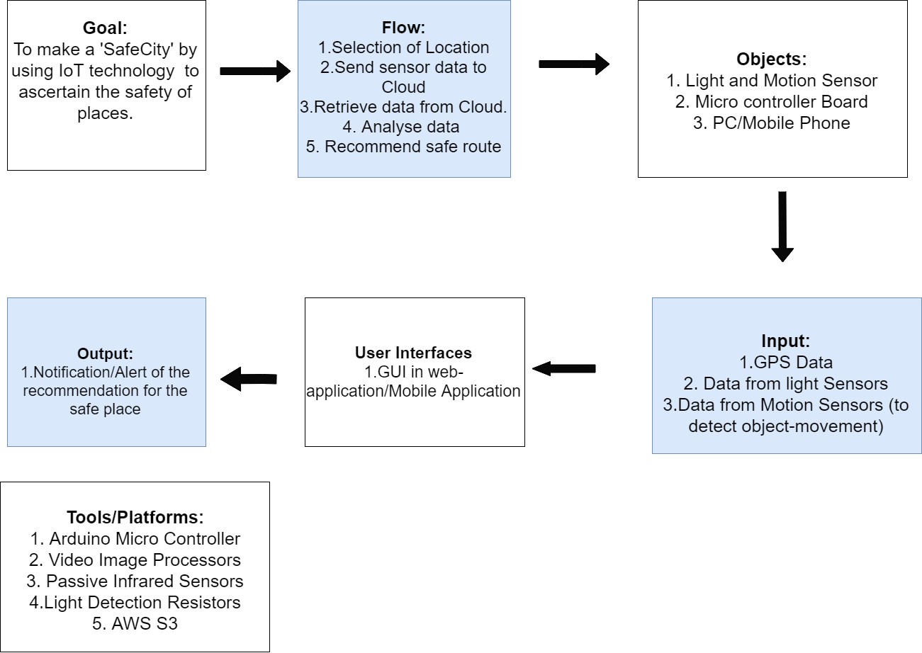

Slide 12

Our Process Is Easy
The user will be given the safest possible route to take
User will select their desired location from the app
Data will be used to estimate the safety of a given area
Store it into the
database
The sensors will collect the data
Diagram featured by http://slidemodel.com

Slide 13
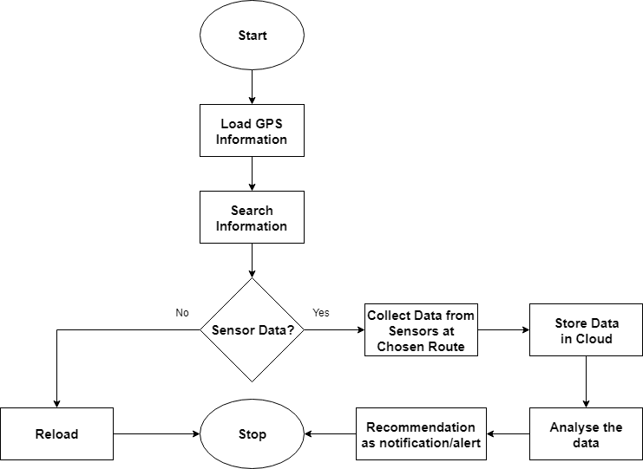

Slide 14
The crime rates of an area will be collected in collaboration with local law enforcement body

Slide 15
The rate of accidents will also be estimated from previous records and stored in the database

Slide 16
SafeCity will be available as a website

Slide 17
As well as a mobile application
Ensuring your safety on the go!

Slide 18

Demonstration

Slide 19

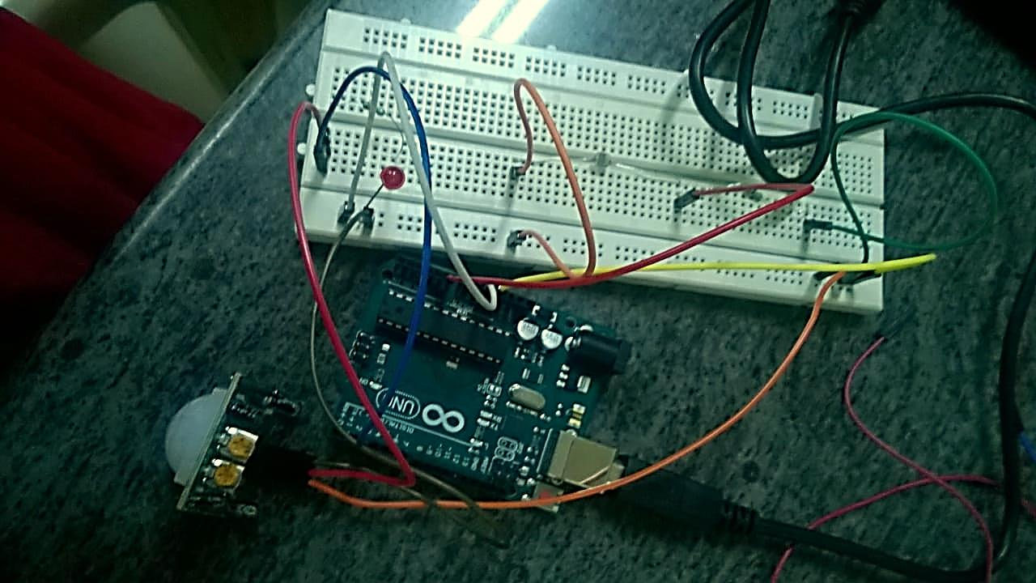

Slide 20
Future possibilities for the project

Slide 21

Thank You!
Team BitsPlease
Shraddha Gulati
CHRIST(Deemed to be University), Bangalore

