Slide 1

Title: Real-Time Process Monitoring System
Team Members:
Roll No.
Name
Reg. No.
04
Shraddha Gupta
12304195
23
Shreyansh Tripathi
12324670
48
Khushi Gupta
12303449

Slide 2

Project Overview
A desktop-based real-time process monitoring system that tracks system resource usage, providing insights into CPU and memory consumption.
🎯 Objectives:
Helps users monitor and manage system performance.
Detects high-resource-consuming processes.
Provides tools to kill, start, and filter processes.
Useful for system administrators and developers.
⚙ How does it work?
Continuously fetches CPU & Memory stats using psutil.
Displays graphical real-time usage trends using Matplotlib.
Allows process control (start/kill/export) via a user-friendly Tkinter GUI.

Slide 3
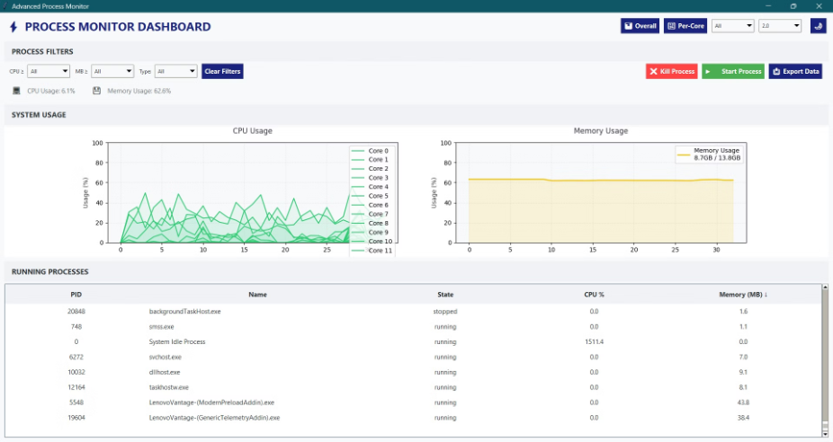
Key Features
Real-time CPU & Memory Usage Graphs
Color-coded (red: high, yellow: medium, green: low) graphs for resource monitoring
Per-Core & Overall CPU Monitoring
Process Filtering & Sorting (CPU, Memory, Type)
Kill & Start Process Controls
Export Process Data (for logging & analysis)
Adjustable Refresh Frequency
Theme Toggle for UI Customization

Slide 4


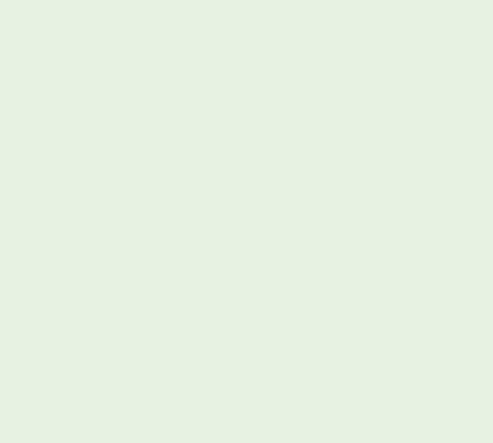
Module-wise Breakdown
System Usage Module (Real-time Monitoring)
Process Management Module (Process Control)
UI & Filtering Module (User Interaction & Customization)
Collects CPU usage per core & overall memory stats.
Displays a sortable list of running processes.
Built with Tkinter for a responsive desktop UI.
Uses Matplotlib to display graphs dynamically.
Provides options to Kill or Start processes.
Includes filters for CPU %, Memory, and Process Type.
Updates values based on a configurable refresh rate.
Allows exporting process details for analysis.
Offers a theme toggle (light/dark mode).
Supports custom refresh frequency selection.

Slide 5
Team Member Contributions
Team Member 1: (Backend & Data Handling)
Implemented process monitoring (psutil).
Developed CPU & Memory tracking functions.
Optimized data collection for real-time efficiency.
Team Member 2: (Graphing & UI Development)
Designed Tkinter-based UI.
Integrated Matplotlib for live graph plotting.
Added theme toggle & UI customization features.
Team Member 3: (Process Management & Controls)
Developed process kill/start functionality.
Implemented sorting, filtering, and exporting.
Optimized refresh rate & process updates.

Slide 6
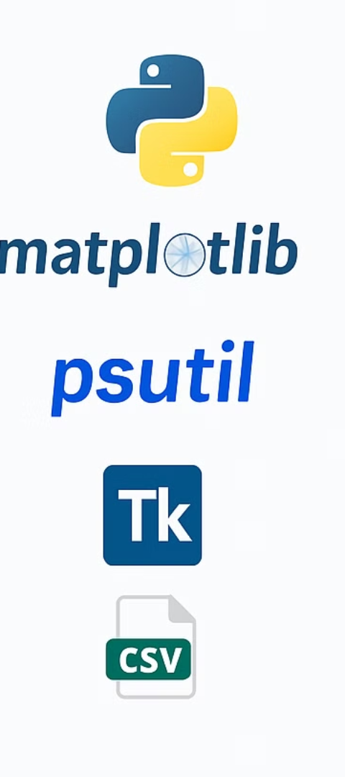

Tools & Technologies
Used
Programming Language: Python
Graphing Library: Matplotlib
System Monitoring: psutil
Graphical UI: Tkinter
Data Handling & Exporting: CSV

Slide 7
Conclusion & Future Scope
🎯 Key Achievements:
Successfully developed a real-time monitoring system.
Integrated process management features.
Created a user-friendly, efficient, and lightweight tool.
🚀 Future Enhancements:
Add historical data tracking & logs.
Implement network usage monitoring.
Introduce AI-based anomaly detection for processes.
Support multi-device monitoring via a web interface.

Slide 8
Thank You!

