Slide 1
ATOP (Assess the one who profess)
Shraddha
Shruti

Slide 2
PROBLEM STATEMENT
Student Evaluation at UML is a paper pen job. At the end of semester, students evaluate the professors by filling out a form which is later submitted to the Assistant of the Chair of the department. Is this process feasible? What’s next?
USER PERSONA
Chair of the Department/ Assistant to Chair
Faculty Members
Students

Slide 3
TECHNOLOGY APPROACH
Mobile application
(QR Code Scanning)
Technologies
Client : Flutter Database: MongoDB Server: Dart
CASE STUDIES
Shraddha: Flutter v/s React Native
Shruti: Mobile App Case Study
Cumulative Studies: How and where to host the results from the analytics? The existing assessing platforms.

Slide 4
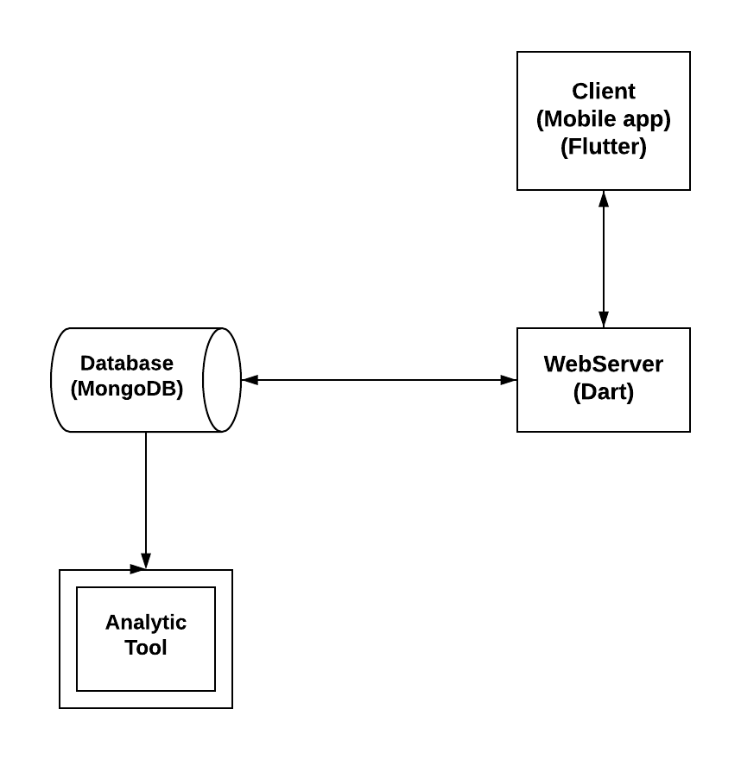
ARCHITECTURE

Slide 5
Questions?

Slide 6
THANK YOU!

