Slide 1
DOMAIN 3: GenAI
HACK ON TRACK
VASTAV वास्तव
Know what's real before you forward.
⚡ PS 3: IS THIS FORWARD TRUE ⚡
An AI-powered fact-checking system that verifies claims from WhatsApp forwards — text, screenshots, voice notes, PDFs, and URLs — in 6 Indian languages.
SDG Mapped:
🎓 SDG 4 – Quality Education
🏗️ SDG 9 – Industry, Innovation & Infrastructure
🕊️ SDG 16 – Peace, Justice & Strong Institutions
Team Name: _________________
Team Members: _________________

Slide 2
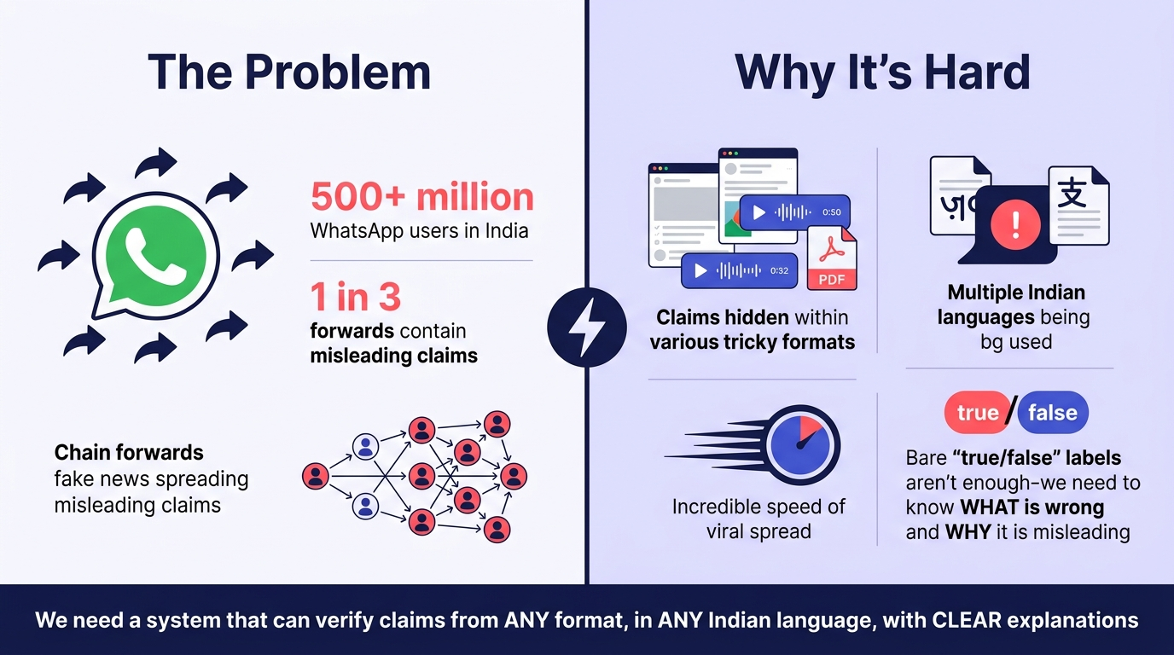


THE PROBLEM — Why We Built Vastav
Forwarded messages spread fast. Checking them is hard. A bare "true" or "false" doesn't help. People need to know what exactly is wrong, and why.

Slide 3
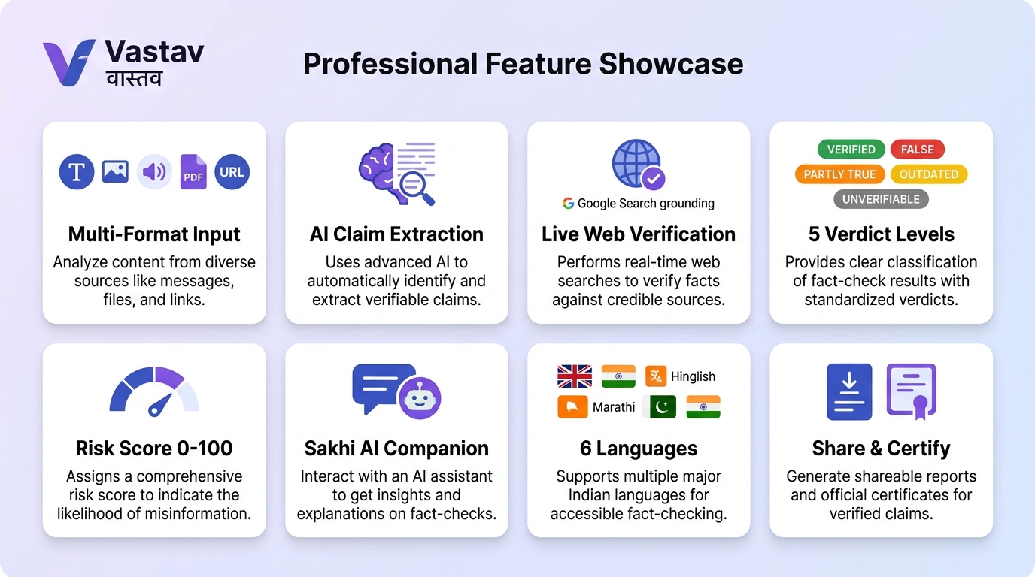
OUR SOLUTION — Vastav वास्तव
A comprehensive AI fact-checking desk with 8 core capabilities

Slide 4
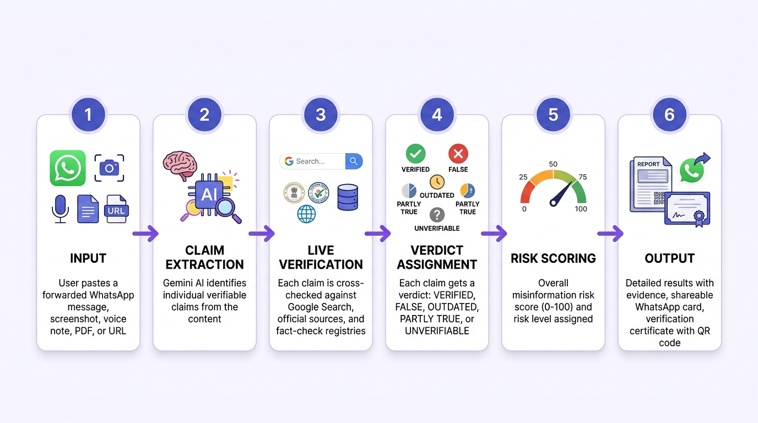
HOW IT WORKS — Verification Pipeline
From pasted forward to evidence-backed verdict in 6 steps

Slide 5
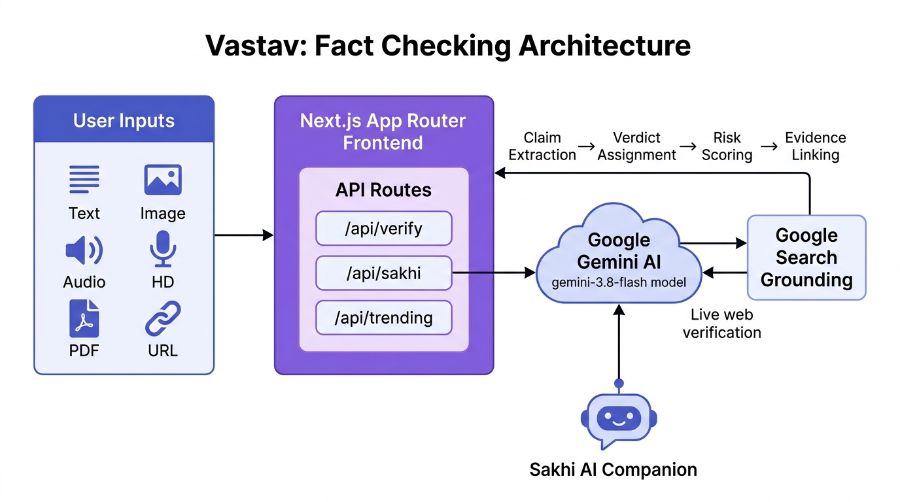
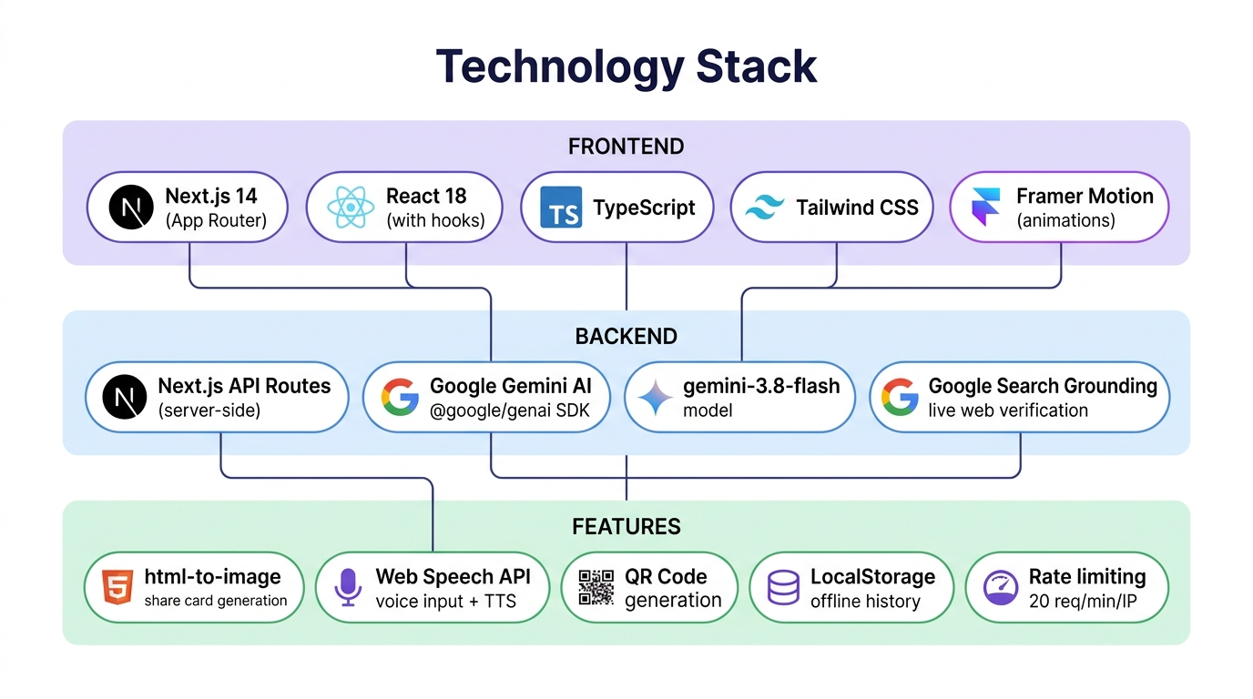
ARCHITECTURE & TECH STACK
🔒 Security
Server-side API keys only • In-memory rate limiter (20 req/min/IP) • No message content logging
🤖 AI Pipeline
Gemini 3.8 Flash primary → Gemini 3.5 Flash fallback • Google Search Grounding for live verification
🌐 Multimodal
Text, Image (8MB), Audio (10MB), PDF (10MB), URL → all processed with inline base64 data
💬 Sakhi Companion
Conversational AI with voice input (SpeechRecognition + MediaRecorder), TTS, language mirroring, fact-check handoff

Slide 6
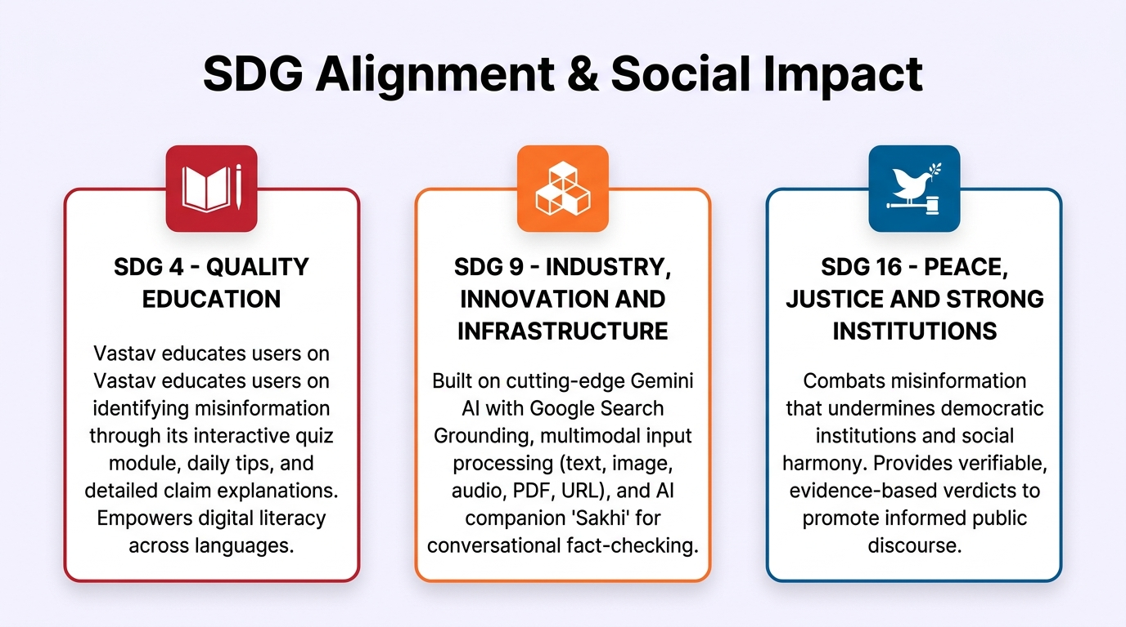
SDG ALIGNMENT & SOCIAL IMPACT
Vastav directly contributes to 3 United Nations Sustainable Development Goals
🚀 Future Scope: WhatsApp Bot integration • Browser extension • Regional language expansion • Community fact-checker network • API for third-party integration

Slide 7
VASTAV वास्तव
Know what's real before you forward.
🌐 LIVE DEMO
http://localhost:3000
THANK YOU
Team Name: _________________ • Members: _________________
Hack on Track • Domain 3: GenAI • PS 3: Is This Forward True

