Slide 1
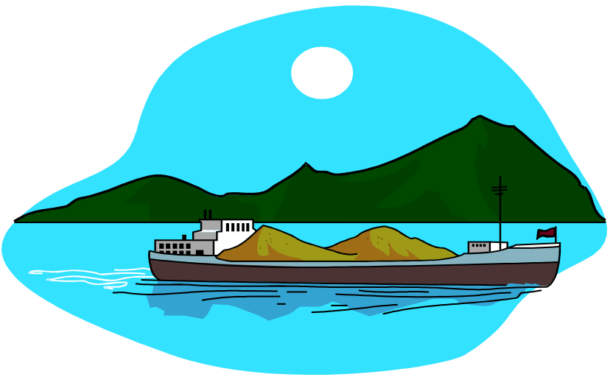

Buoyancy is the ability of an object to float.
It is related to the object’s density.

Slide 2

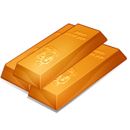


Density is the amount of matter in a given volume or space
Gasses are the least dense form of matter
Liquids are more dense than gasses, but less dense than solids
Solids are the most dense form of matter

Slide 3
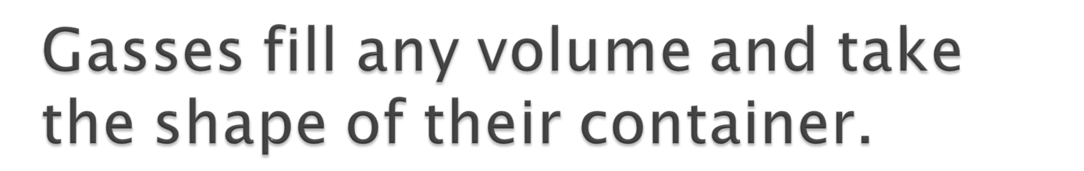
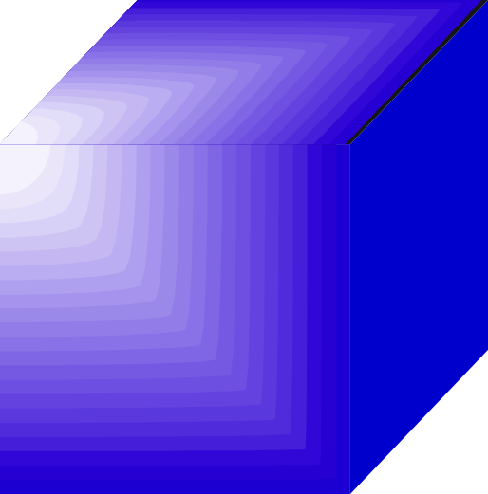

If the balloon pops, the gas will spread out evenly in the cube.

Slide 4
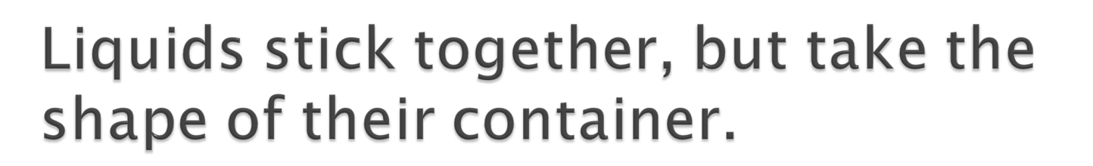

The water will take the shape of the cube.

Slide 5
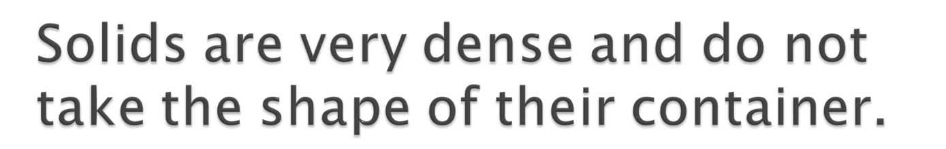
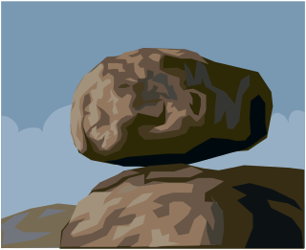
The rock will keep its own shape.

Slide 6
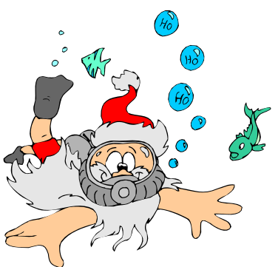



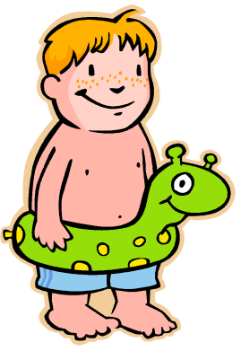





Slide 7


Buoyancy and density are called PROPERTIES of matter
Another property of matter is displacement, or how much matter (we use water) it pushes out of the way
A buoyant object will only displace its mass unless its surface area is large compared to its mass
What would happen if you used sand instead of water?

Slide 8
This powerpoint was kindly donated to
www.worldofteaching.com
http://www.worldofteaching.com
Is home to well over a thousand powerpoints submitted by teachers. This a free site. Please visit and I hope it will help in your teaching

