Slide 1
Heat
1st year

Slide 2
By the end of this chapter you will be able to:
Describe heat energy, its’ units and explain how it converts to other forms
Explain how heat affects expansion and contraction of materials
Explain conduction, convection and radiation
Identify good and bad conductors of heat (insulators V conductors)
Differentiate between heat energy and temperature

Slide 3
What is Heat?
Form of energy because it can move things
- E.g: Makes a hot air balloon rise.
- Steam engines
Measured in JOULES (J)

Slide 4
Heat can be converted to other forms of energy
Sunlight (heat) is used by plants for Photosynthesis (to make food), it is converted to chemical energy.
Oil and gas are burned in power stations to produce heat energy, this is used to turn turbines which produce electricity (electrical energy)

Slide 5
How is heat produced?
The movement of particles/molecules produces heat
Particles move about more and take
up more room if heated – this is why
things expand if heated
It is also why substances change form when heated
solids liquids gases

Slide 6
Heat Transfer
Heat always moves from a warmer place to a cooler place.
Hot objects in a cooler room will cool to room temperature.e.g: tea, coffee
Cold objects in a warmer room will heat up to room temperature.e.g: butter, ice

Slide 7
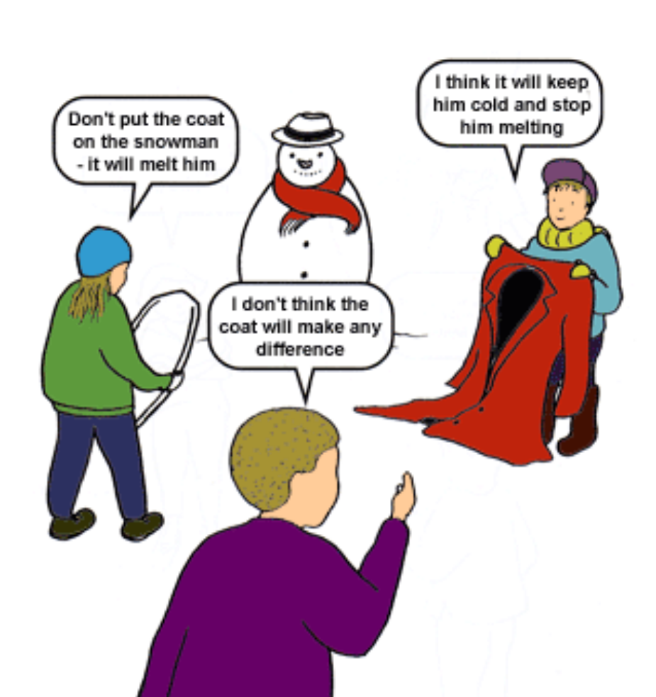
What do you think?

Slide 8
Forms of Heat Transfer
3 types;
Conduction
Convection
Radiation

Slide 9
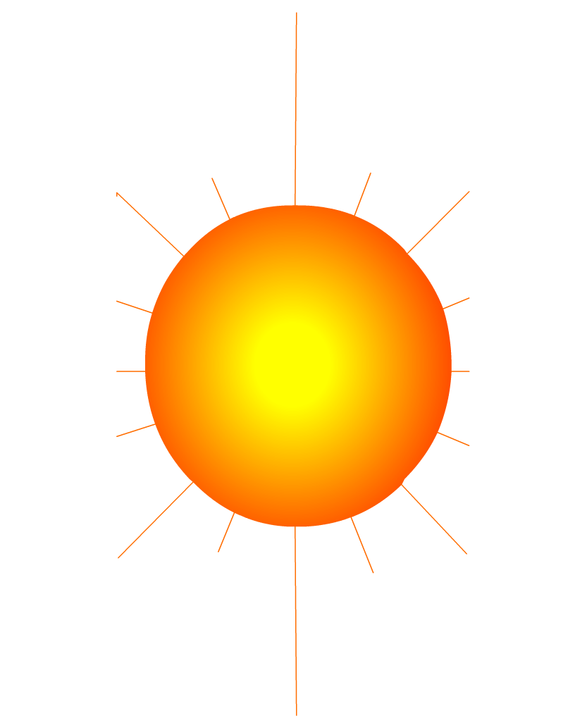
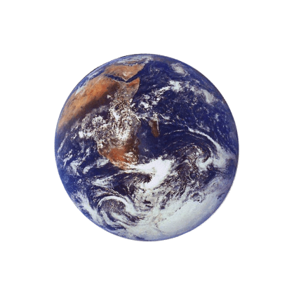
Radiation
How does heat energy get from the Sun to the Earth?
There are no particles between the Sun and the Earth so it MUST travel by radiation
RADIATION
?

Slide 10
Radiation
The transfer of heat in rays, from a hot object, without needing a medium to pass through
It travels in all directions from a hot object
The hotter an object is, the more heat it will radiate out
Does the surface affect the way heat is radiated?

Slide 11
What colour should we paint radiators?
Which colour is better to wear on a sunny day? black or white?
A dull black surface will radiate and absorb heat better than a bright shiny surface.

Slide 12
Four containers were filled with warm water. Which container would have the warmest water after ten minutes?
Dull metal
Shiny black
Shiny metal
Dull black
shiny metal
The __________ container would be the warmest after ten minutes because its shiny surface reflects heat _______ back into the container so less is lost. The ________ container would be the coolest because it is the best at _______ heat radiation.
radiation
dull black
emitting

Slide 13
Radiation – Think Pair-Share
Radiation travels in straight lines
True/False
Radiation can travel through a vacuum
True/False
Radiation requires particles to travel
True/False
Radiation travels at the speed of light
True/False

Slide 14
Radiation questions
Why are houses painted white in hot countries?
White reflects heat radiation and keeps the house cooler.
Why are shiny foil blankets wrapped around marathon runners at the end of a race?
The shiny metal reflects the heat radiation from the runner back in, this stops the runner getting cold.

Slide 15

Conduction
Transfer of heat is through a SOLID by being passed from one particle to the next
Particles at the warm end move faster and this then causes the next particles to move faster and so on. e.g: poker in fire
spoon in tea
In this way heat in an object travels from:
the HOT end the cold end

Slide 16
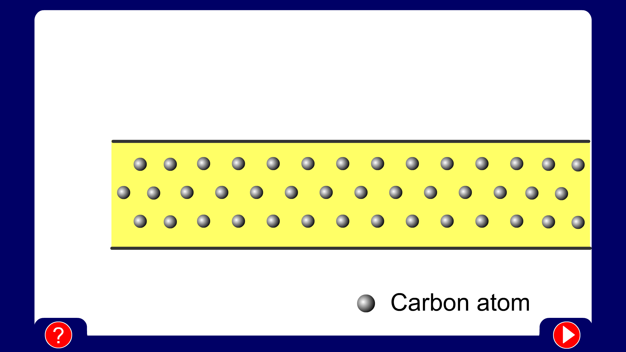
Conduction
When you heat a metal strip at one end, the heat travels to the other end.
As you heat the metal, the particles vibrate, these vibrations make the adjacent particles vibrate, and so on and so on, the vibrations are passed along the metal and so is the heat. We call this? Conduction

Slide 17
Conductors/Insulators
If a substance easily allows heat to move through it, we can say it is a good conductor of heat. e.g: most metals
If a substance does not allow heat to pass through it easily we can say it is an Insulator. E.g: wood, plastic, glass
Why do many sauce pans have plastic handles?

Slide 18
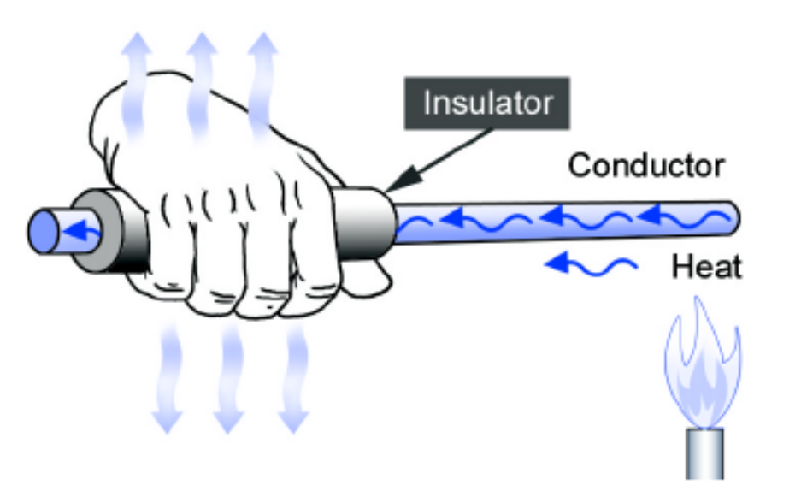
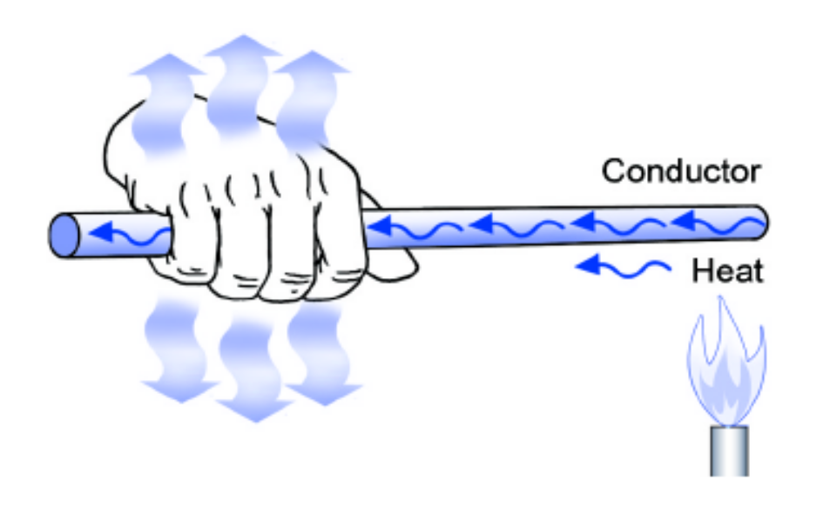
Conduction V Insulation

Slide 19
Conductor or Insulator?
Wood?
Aluminium?
Plastic?
Glass?
Iron?
Polystyrene?
Copper?
Cardboard?

Slide 20
Convection
What happens to the particles in a liquid or a gas when you heat them?
The particles spread out and become less dense.
A liquid or gas.

Slide 21
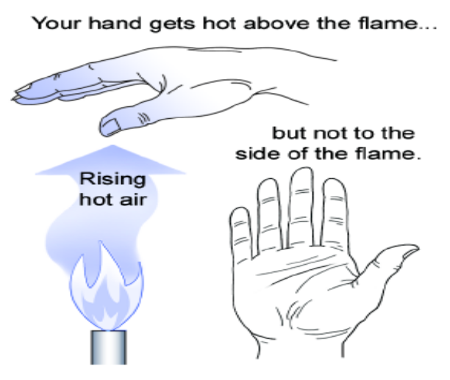
Convection
It is the way in which particles in a GAS or LIQUID move upwards, carrying heat with them
Think about when you boil water, the bubbles move upwards
Or think of a gas heater in the room, the heat rises around the room

Slide 22
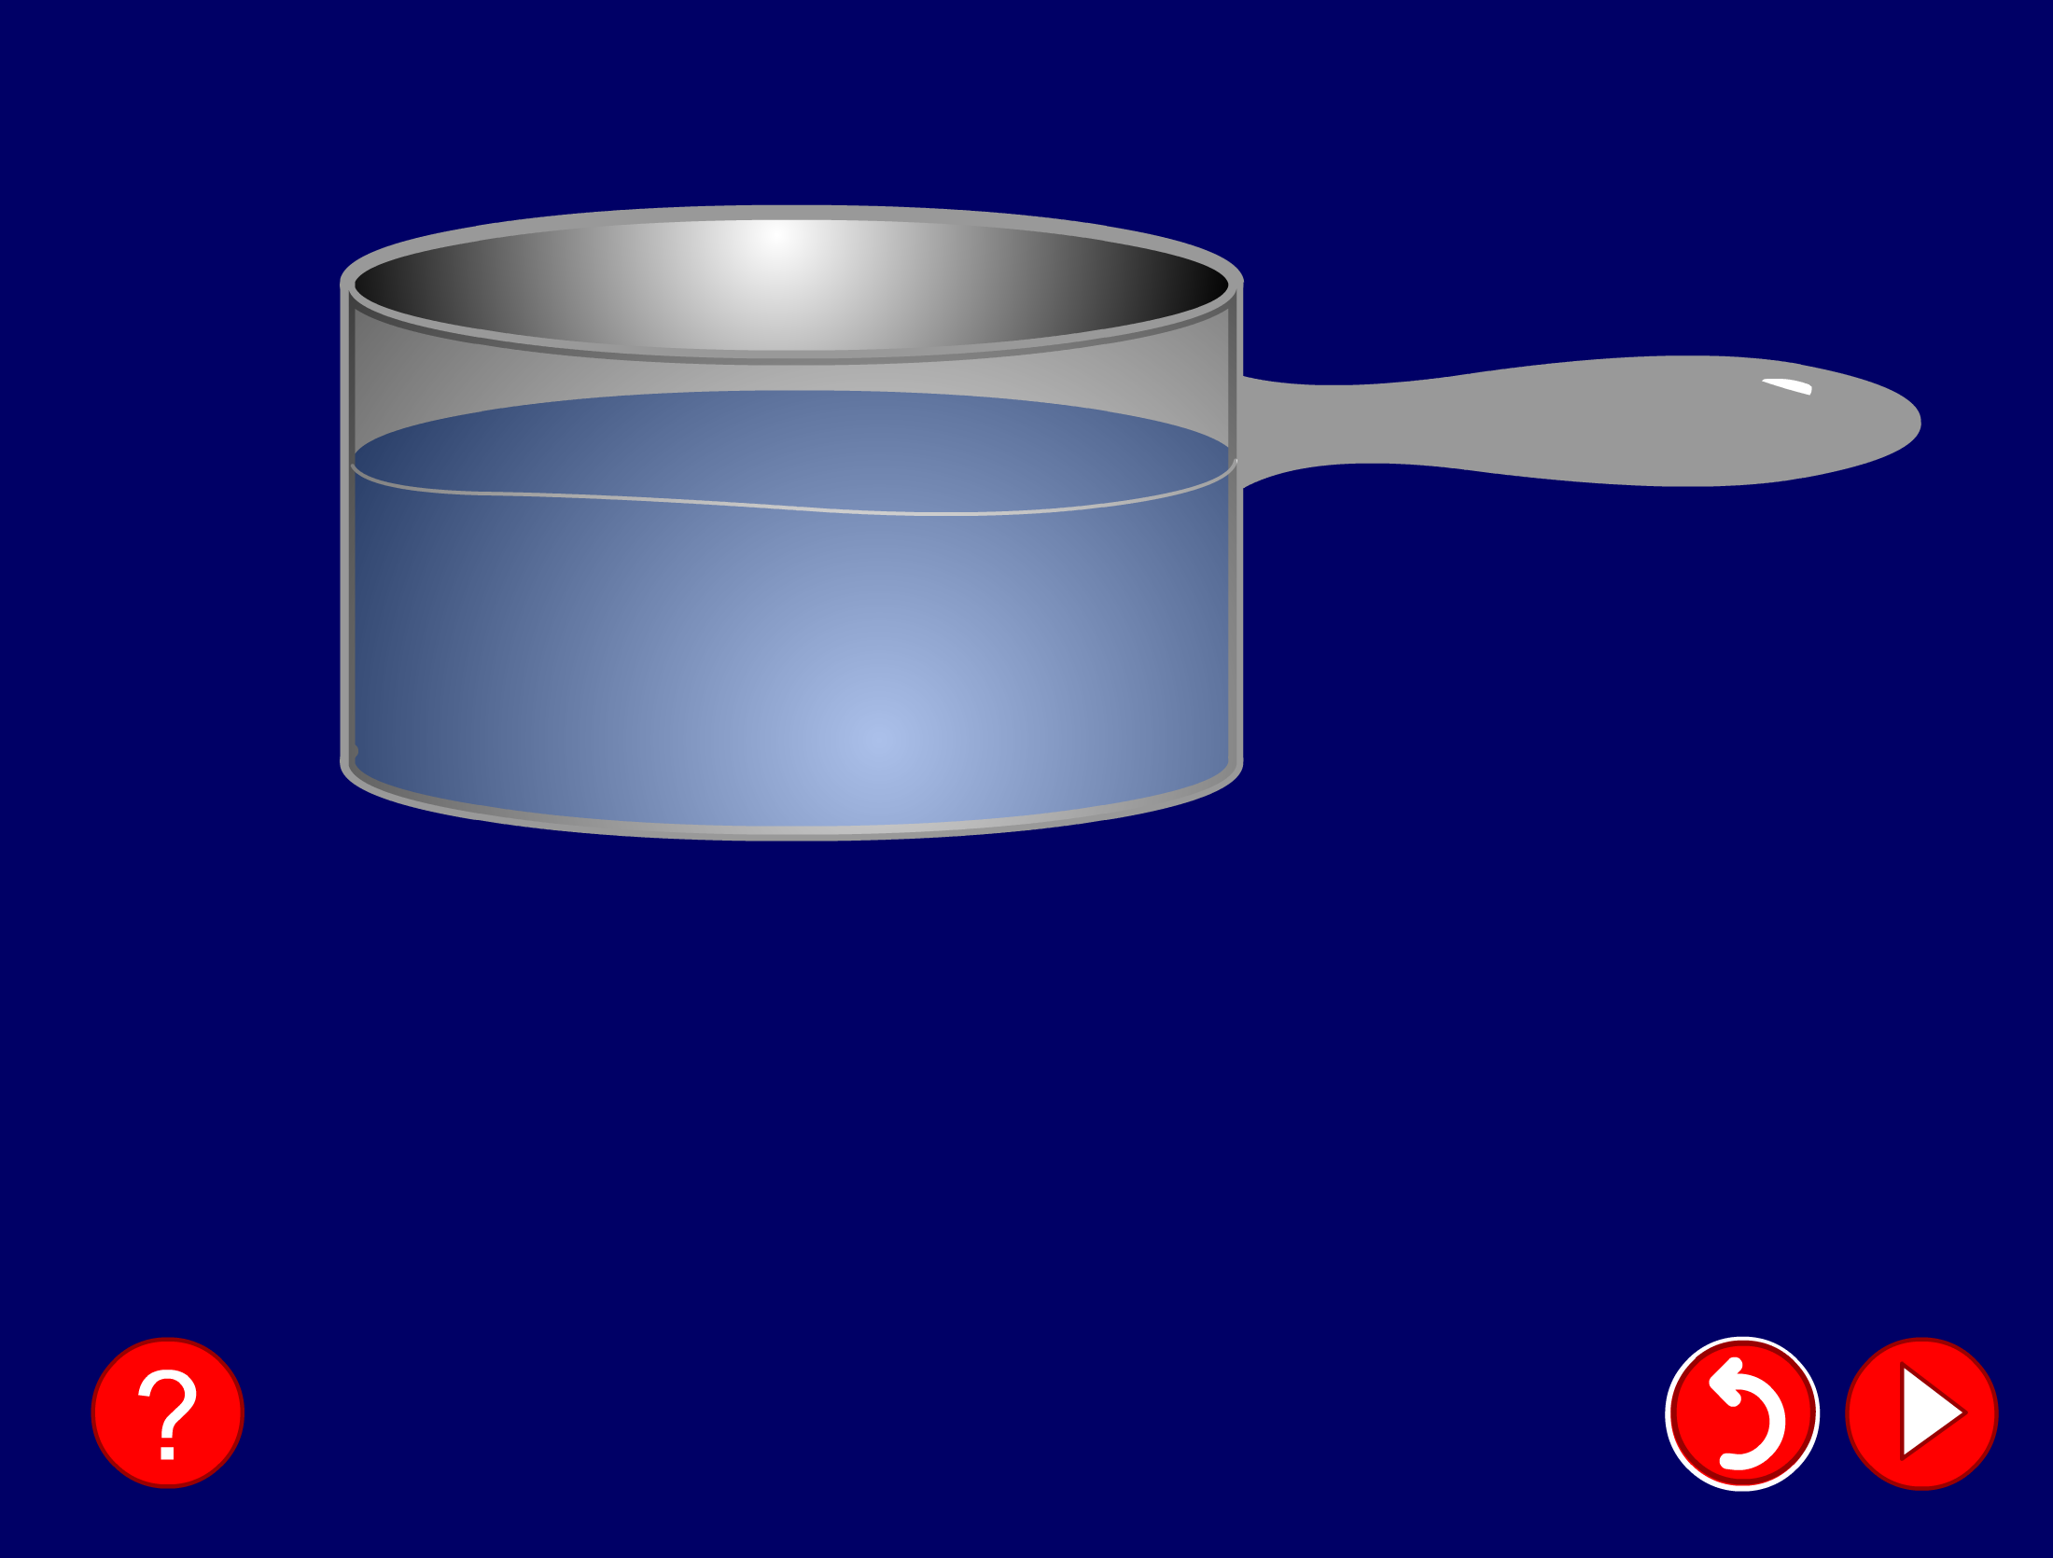
Convection
Cools at the surface
Convection current
Cooler water sinks
Hot water rises

Slide 23

Convection
Where is the cooling compartment put in a fridge?
Cooling compartment
It is warmer at the bottom, so this warmer air rises and a convection current is set up.
It is put at the top, because cool air sinks, so it cools the food on the way down.

Slide 24
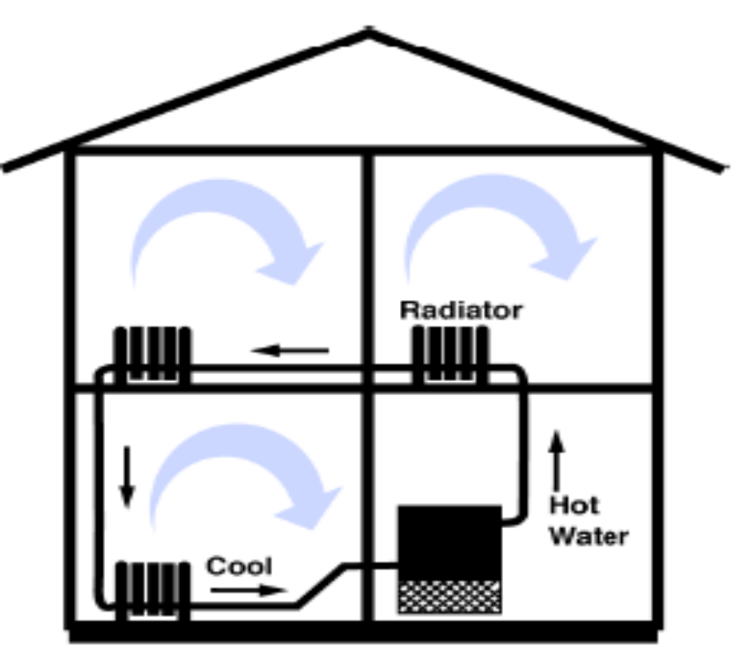
Should a radiator be called a radiator?

Slide 25
Convection questions
Why does hot air rise and cold air sink?
Cool air is more dense than warm air, so the cool air ‘falls through’ the warm air.
Why are boilers placed beneath hot water tanks in people’s homes?
Hot water rises.
So when the boiler heats the water, and the hot water rises, the water tank is filled with hot water.

Slide 26
Heat Vs Temperature
The temperature of an object tells us how HOT it is
Measured in degrees Celsius - °C
It is NOT the same as heat energy although the two quantities are related.
e.g. a beaker of water at 60 °C is hotter than a bath of water at 40 °C BUT the bath contains more joules of heat energy

Slide 27
Heating and Cooling
If an object has become hotter,
it means that it has gained heat energy.
If an object cools down, it means it has
lost energy

Slide 28
Heating and Cooling cont…
Heat energy always moves from:
HOT object COOLER object
e.g. Cup of water at 20 °C in a room at 30°C - gains heat energy and heats up – its temperature rises
Cup of water at 20 °C in a room at 10°C loses heat energy and cools down – its temperature will fall.

Slide 29
Expansion/Contraction
Why are gaps left in pavements, railway tracks, and floor boards?
Why are electricity cables left slack?
Why are bottles of minerals not filled up to the top?
Because materials expand when they
heat up we need to leave room for that.

Slide 30
Expansion V Contraction
The reason materials expand when heated is because the heat gives the molecules energy and as a result they begin to move, leaving them further apart and hence the material expands
Cooling has the opposite effect, the particles move closer together causing the molecules to contract
One exception: water expands when cooled

Slide 31
Revision
1. Which of the following is not a method of heat transfer?
A. Radiation
B. Insulation
C. Conduction
D. Convection

Slide 32
Revision
1. Which of the following is not a method of heat transfer?
A. Radiation
B. Insulation
C. Conduction
D. Convection

Slide 33
2. In which of the following are the particles closest together?
A. Solid
B. Liquid
C. Gas
D. Fluid

Slide 34
2. In which of the following are the particles closest together?
A. Solid
B. Liquid
C. Gas
D. Fluid

Slide 35
3. How does heat energy reach the Earth from the Sun?
A. Radiation
B. Conduction
C. Convection
D. Insulation

Slide 36
3. How does heat energy reach the Earth from the Sun?
A. Radiation
B. Conduction
C. Convection
D. Insulation

Slide 37
4. Which is the best surface for reflecting heat radiation?
A. Shiny white
B. Dull white
C. Shiny black
D. Dull black

Slide 38
4. Which is the best surface for reflecting heat radiation?
A. Shiny white
B. Dull white
C. Shiny black
D. Dull black

Slide 39
5. Which is the best surface for absorbing heat radiation?
A. Shiny white
B. Dull white
C. Shiny black
D. Dull black

Slide 40
5. Which is the best surface for absorbing heat radiation?
A. Shiny white
B. Dull white
C. Shiny black
D. Dull black

Slide 41
Key Words
Temperature
Cold
Insulator
Radiation
Heat
Transfer
Convection
Conduction
Conductor
Absorb
Emit

