Slide 1
Hydrogen
Material: -
Production of hydrogen
properties of hydrogen
Why is hydrogen unique
Test for hydrogen
Uses of hydrogen

Slide 2
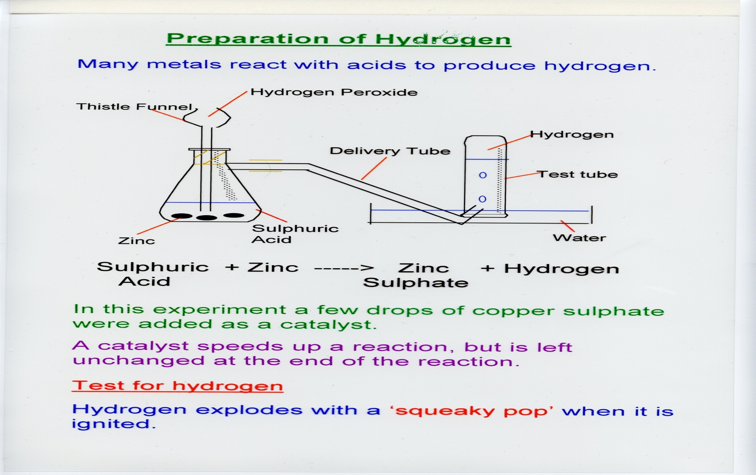
Production of hydrogen
As the reaction between a metal and acid produces hydrogen, we can place this reaction in a flask that is connected to a delivery tube, that will allow hydrogen to pass through it ending up in a water trough, hydrogen will try to escape by bubbling up into the glass jar

Slide 3
Properties of hydrogen
Colorless: - can’t be see
Odorless: - has no small
Tasteless: - doesn’t have a taste
Gas: - found in gas state, not liquid, or solid
Lightest gas: - least density, lighter then air
Explosive: - H2 + O2 H2O + energy
reactants combine causing an explosion

Slide 4
Why is hydrogen unique?
Hydrogen is knows as a very unique element as: -
It is a non-metal in group(I)
- Usually elements in group(I) are metals
2) It tends to form more than one ion
- H1+ is non as a proton (stable)
- H1- is known as a hydride (unstable)

Slide 5
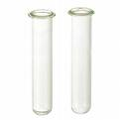
Test for hydrogen
A boy forgets to label contents of 2 tubes, but he remembers that one of them has hydrogen, and the other has carbon dioxide
He asks his teacher, “how do I test for hydrogen?”, and the teacher answers him…
Test: - expose the gas to a lighted splint (in the presence of oxygen)
Result: - it’ll explode with a squeaky “pop sound”
The equation for the rxn is as follows: - H2 + O2 H2O + energy
The problem is that their both
Odorless
Colorless
Tasteless
Gas

Slide 6
Uses of hydrogen
Hydrogen is a very useful gas
It is used as a fuel
It makes ammonia, NH4 (a soil fertilizer)
- 3H2 + N2 2NH4
3) It is used to make plastic (PV)
4) It also turns liquid vegetable oils into margarine

Slide 7
This powerpoint was kindly donated to
www.worldofteaching.com
http://www.worldofteaching.com
Is home to well over a thousand powerpoints submitted by teachers. This a free site. Please visit and I hope it will help in your teaching

