Slide 1
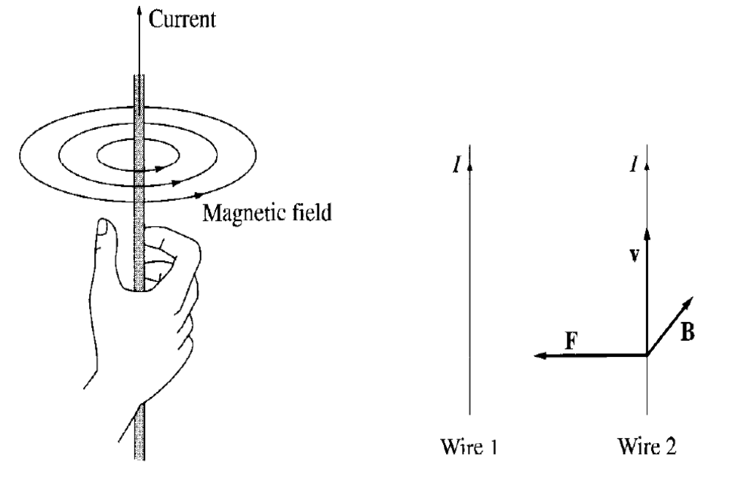
Magneto statics
A stationary charges produces only an electric field E in the space around it, a moving charge generates, in addition a magnetic field B.

Slide 2
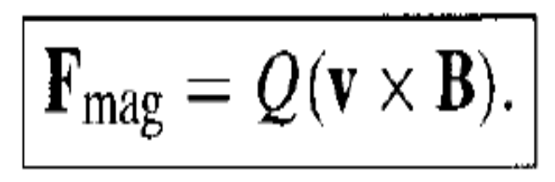
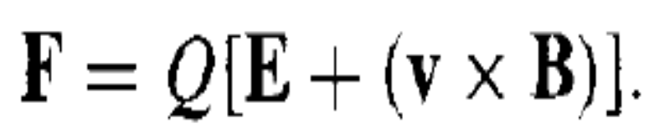
The magnetic force in a charge Q, moving with velocity v in a magnetic field B is
This is known as the Lorentz force Law. In the presence of both electric and magnetic fields, the net force on Q would be

Slide 3
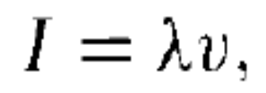
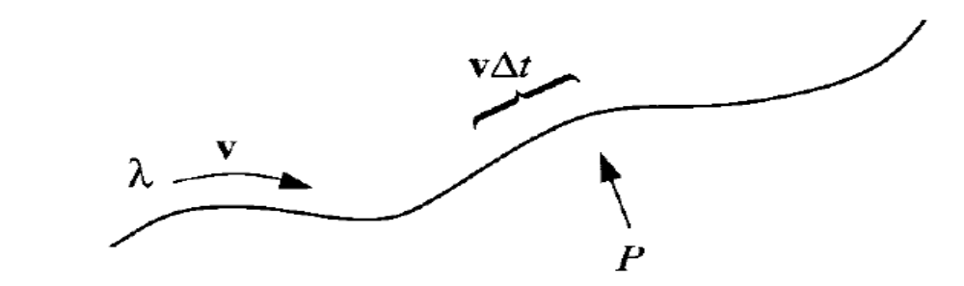
The current I is defined as charge per unit time passing a given point.
A line charge λ traveling down a wire at speed v constitutes a current
The magnetic force on a segment of current- carrying wire is evidently

Slide 4
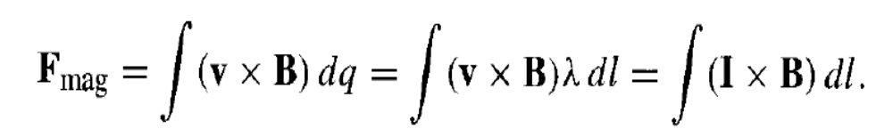
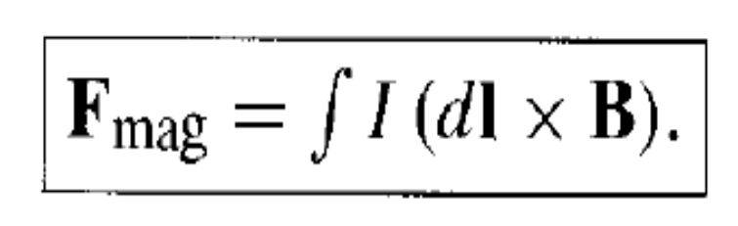
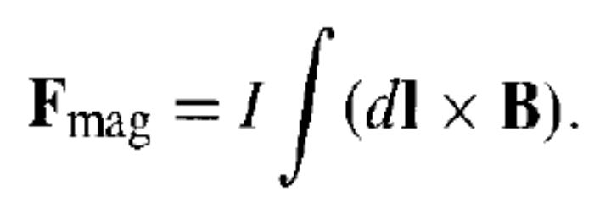
as I and dl both point in the same direction, so, it can be written as
and since current is constant (in magnitude) along the wire therefore,

Slide 5
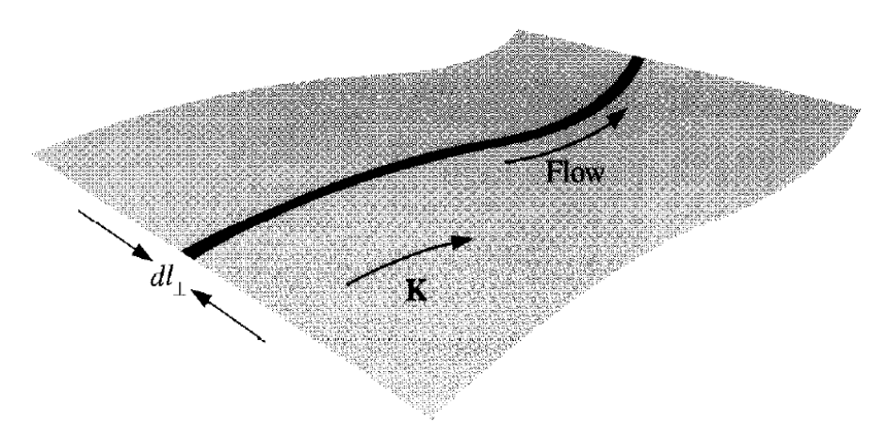
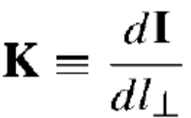

When charges flows over a surface
we define surface current density K
In particular, if the surface charge density is σ and its velocity is v, then

Slide 6
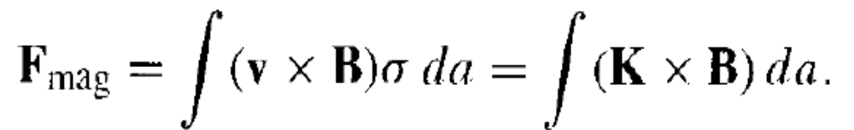
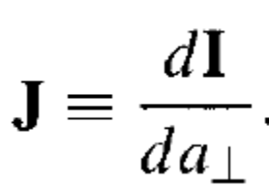
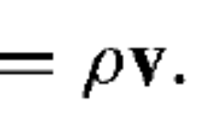
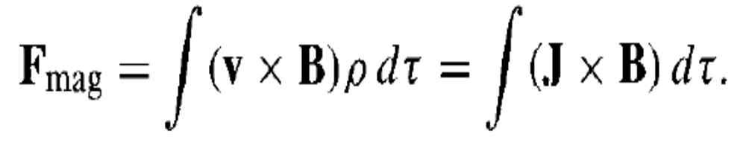
and the magnetic force on the surface current is
Similarly, we can define magnetic force in the form of volume current density

Slide 7
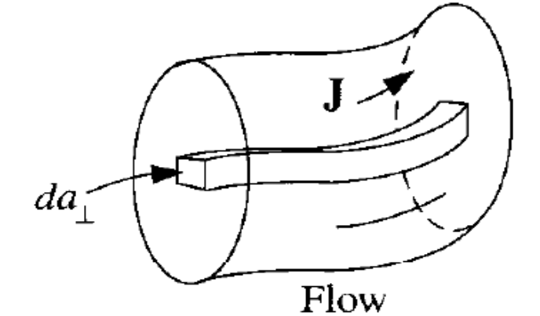
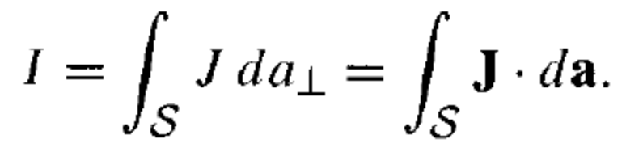
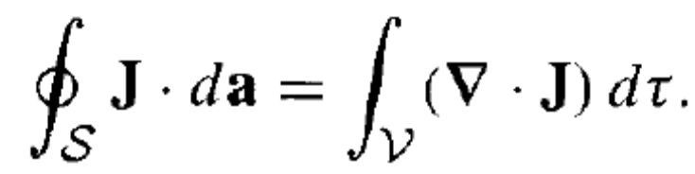
The current crossing a surface can be written as
and the total charge per unit time leaving a volume V is

Slide 8
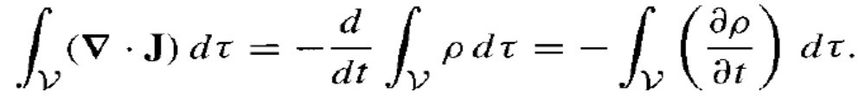
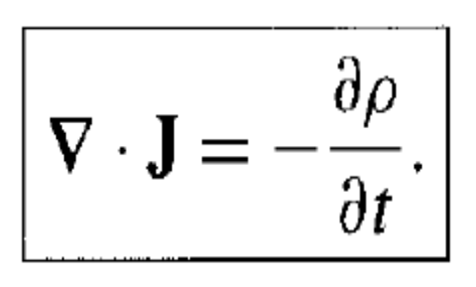
Since charge is conserved, therefore
The minus sign indicated outward flow decreases the charge left in V and since this can be applies to any volume, therefore
It is called Equation of continuity and reflects local charge conservation.

Slide 9
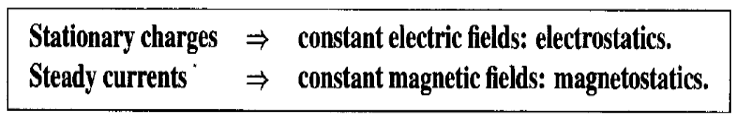
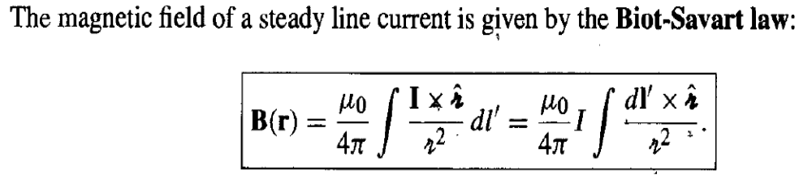
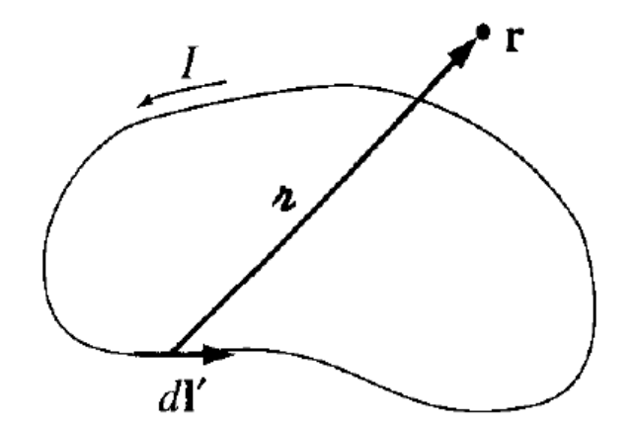
Bio-Savart Law :-

Slide 10
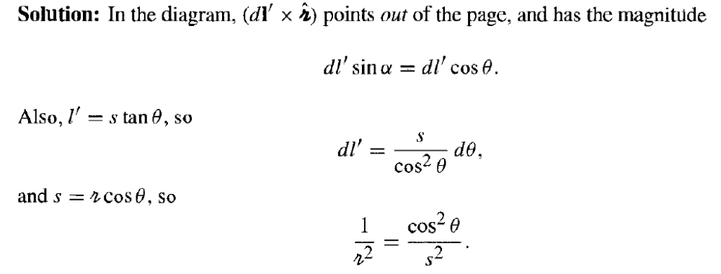
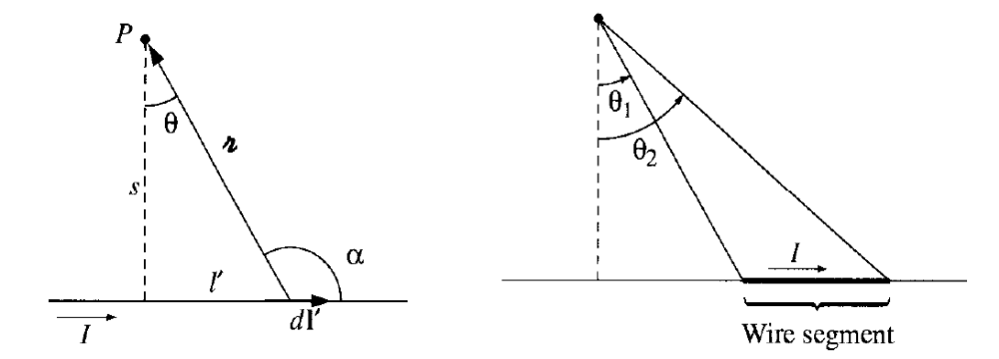
Prob. :-

Slide 11
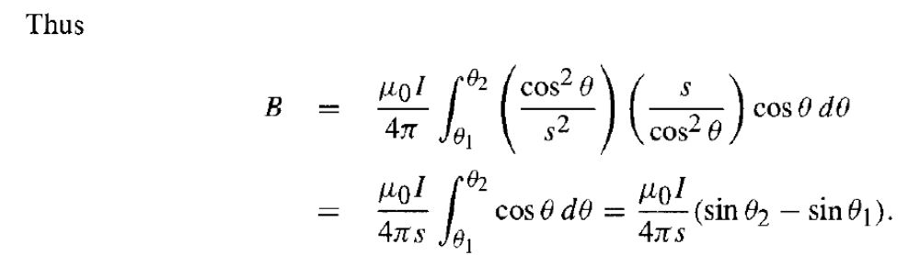

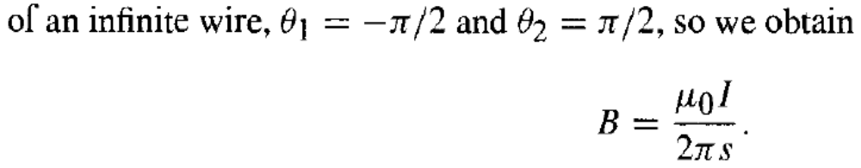
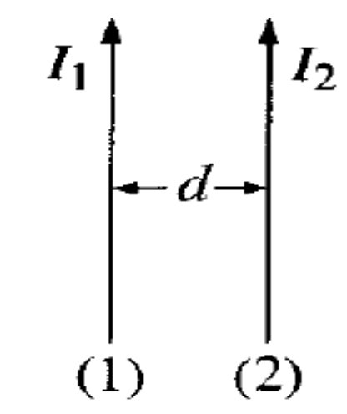
Prob. Find the force of attraction between two long parallel wires at a distance d apart, carrying a current as shown in figure.

Slide 12
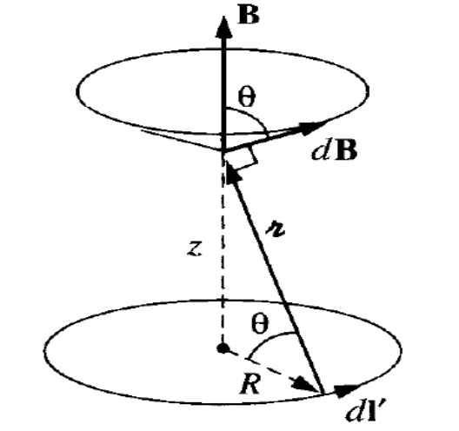
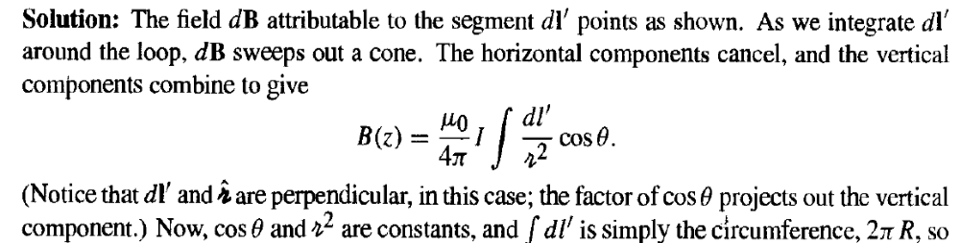
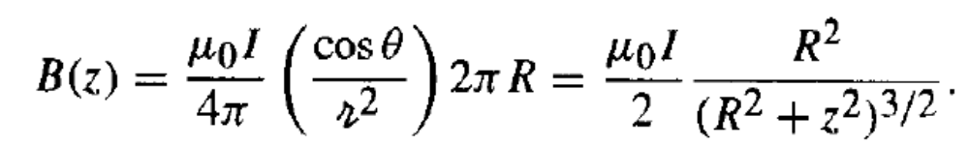
Prob.2:- Find the magnetic field at a distance z above the center of a circular loop of radius R, which carries a steady current I as in fig.

Slide 13
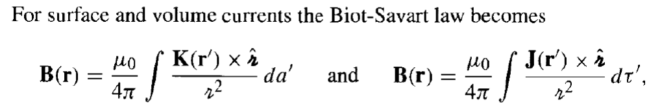
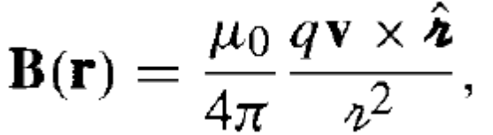
For a moving point charge,
Is it correct ?

Slide 14
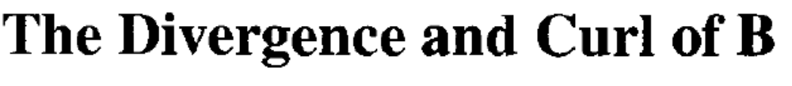
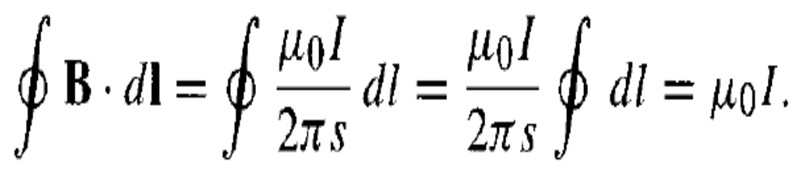
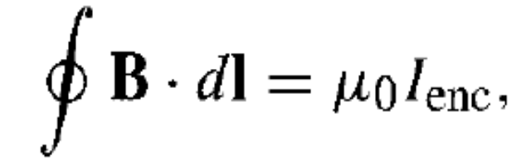
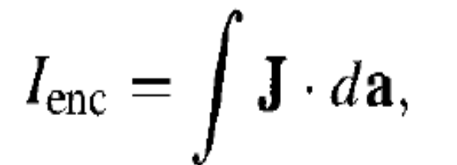
The integral of B around a circular path of radius s, centered at the wire, is
If we have bundle of straight wires, the line integral will then be

Slide 15
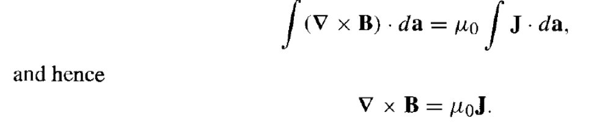
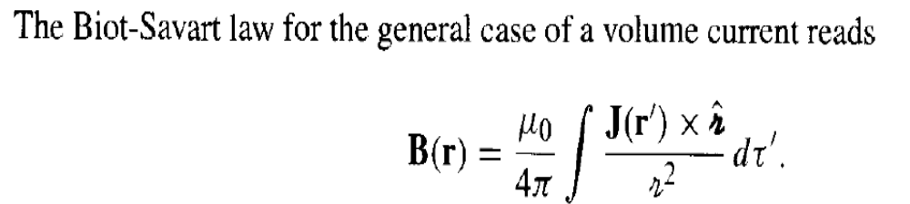
proof is for the simplest case of infinitely long straight wires.
In general case:-

Slide 16
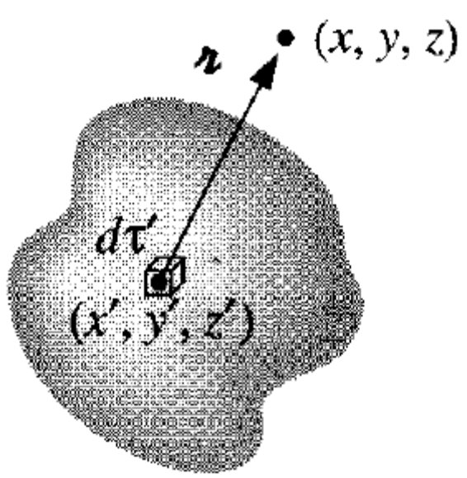
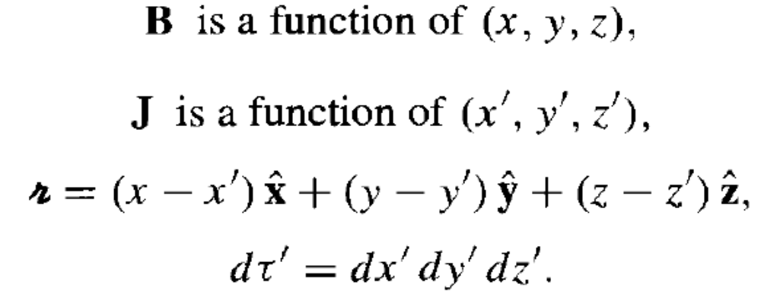
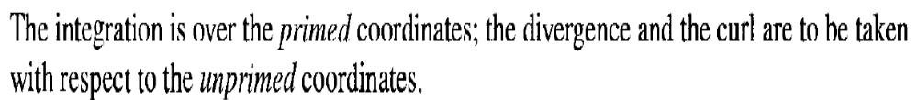
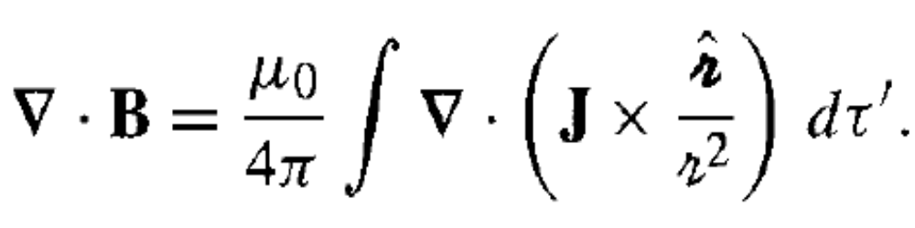
This formula gives the magnetic field at a point r = (x, y, z) in terms of an integral over the current distribution J (x', y', z'). i.e.

Slide 17
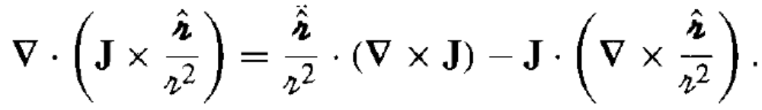

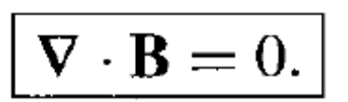
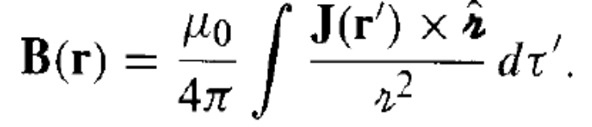

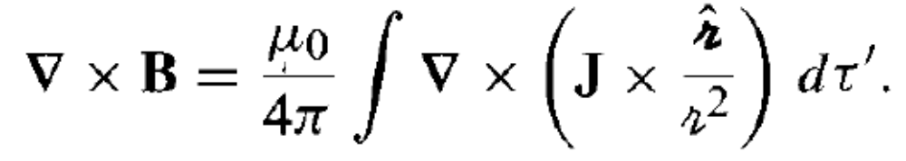
since
and
so,
we get,

Slide 18
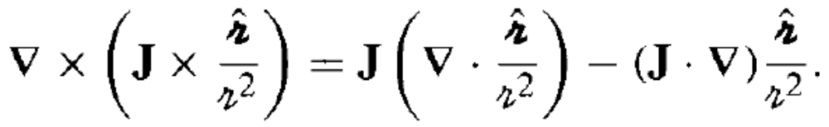
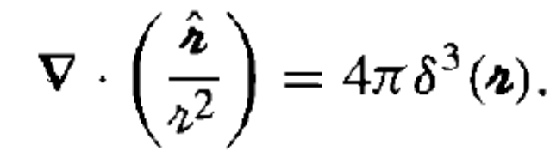

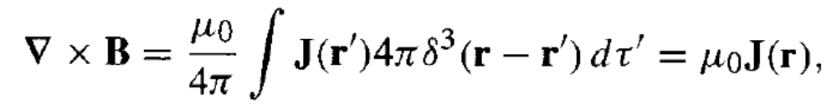
Using the appropriate product rule, expand the integrand
Since J does not depends on x, y, and z, therefore, the second term integrates to zero and

Slide 19

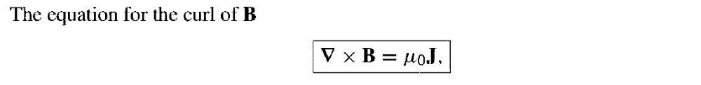



Slide 20

Prob.:- Find the magnetic field at a distance s from a long straight wire (Fig. a), carrying a steady current I .using Ampere's circuital law.

Slide 21



The definition B = curl A specifies the curl of A but it does not say anything about divergence so we have liberty to pick that as we see fit, and zero is ordinarily the simplest choice.
With this condition on A , Ampere's law becomes

Slide 22




Slide 23

All the magnetic phenomena are due to electric charges in motion, i.e. electrons orbiting around nuclei and electrons spinning about their axes. These currents loops are so small that we may treat them as magnetic dipoles. Ordinarily, they cancel each other out because of the random orientation of the atoms. But when magnetic field is applied, a net alignment of these magnetic dipoles occurs, and the medium becomes magnetically polarized, or magnetized.
This equation gives the exact torque on any localized current distribution, in the presence of a uniform field. In a non-uniform

Slide 24



field it is the exact torque (about the center) for a perfect dipole of infinitesimal size.
because the net displacement
around a closed loop vanishes.

Slide 25


Slide 26



any event, total current can be written as
where J_{f} is free current because of actual transport of charge while J_{b} is bound current due to magnetization.
So Ampere's law can be written as

Slide 27



Slide 28



In paramagnetic and diamagnetic materials, the magnetization is sustained by the field, when B is removed, M disappears. In fact, for most substances the magnetization is proportional to the field, provided the field is not too strong. Thus

Slide 29




Materials that obey the relation
is called linear media.

