Slide 1


The Structure and Properties of Polymers
Also known as
Bonding +
Properties

Slide 2
What is a polymer?
A long molecule made up from lots of small molecules called
monomers.

Slide 3
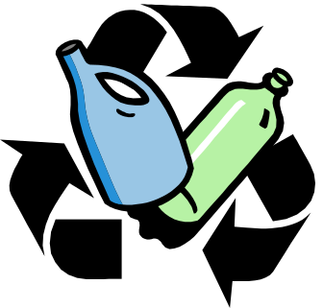
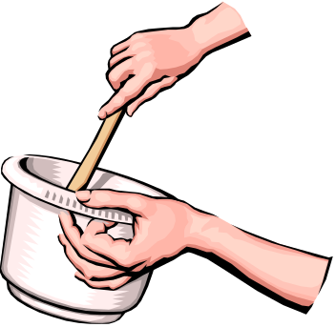
All the same monomer
Monomers all same type (A)
A + A + A + A →
-A-A-A-A-
eg poly(ethene) polychloroethene PVC

Slide 4

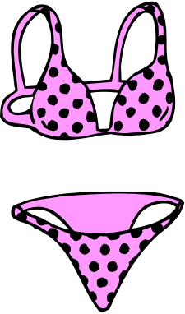
Different monomers
Monomers of two different types A + B
A + B + A + B
→ -A-B-A-B-
eg polyamides
polyesters

Slide 5
Addition polymerisation
Monomers contain C=C bonds
Double bond opens to (link) bond to next monomer molecule
Chain forms when same basic unit is repeated over and over.
Modern polymers also developed based on alkynes R-C C - R’

Slide 6
Copolymerisation
when more than one monomer is used.
An irregular chain structure will result eg propene/ethene/propene/propene/ethene
Why might polymers designers want to design a polymer in this way?
(Hint) Intermolecular bonds!

Slide 7
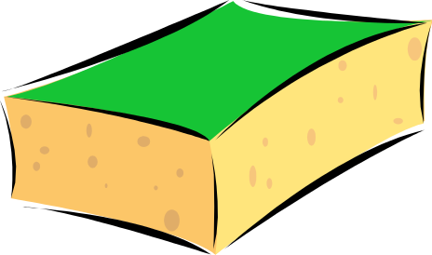
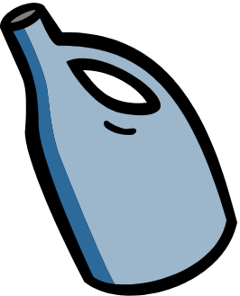

Elastomers, plastics & fibres
Find a definition and suggest your own example of each of these.

Slide 8
What decides the properties of a polymer?
Stronger attractive forces between chains = stronger, less flexible polymer.
Chains able to slide past each other = flexible polymer .
In poly(ethene) attractive forces are weak instantaneous dipole - induced dipole, will it be flexible or not?
Nylon has strong hydrogen bonds, why does this make it a strong fibre?

Slide 9
Getting ideas straight
Look at page 110 -111 of Chemical Ideas.
Take turns in explaining to a partner how the following molecular structures affect the overall properties of polymers :-
chain length, different side groups, chain branching, stereoregularity, chain flexibility, cross linking.

Slide 10
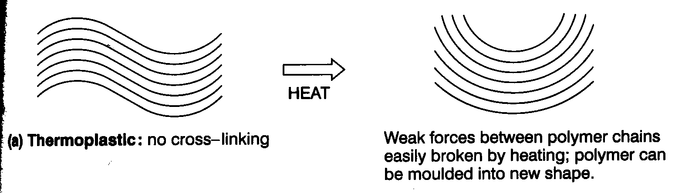
Thermoplastics (80%)
No cross links between chains.
Weak attractive forces between chains broken by warming.
Change shape - can be remoulded.
Weak forces reform in new shape when cold.

Slide 11
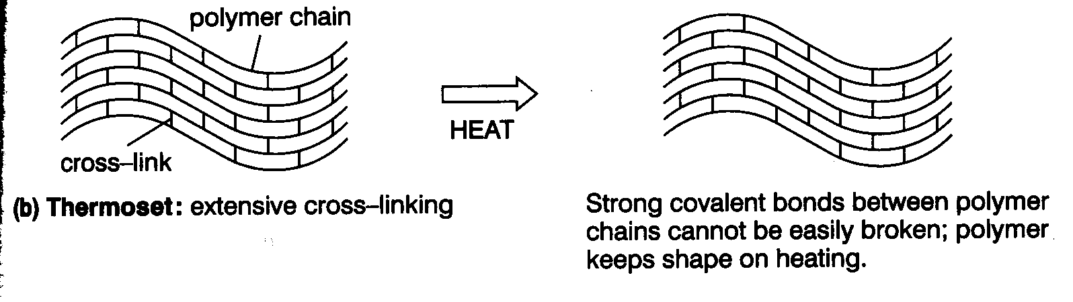
Thermosets
Extensive cross-linking formed by covalent bonds.
Bonds prevent chains moving relative to each other.
What will the properties of this type of plastic be like?

Slide 12
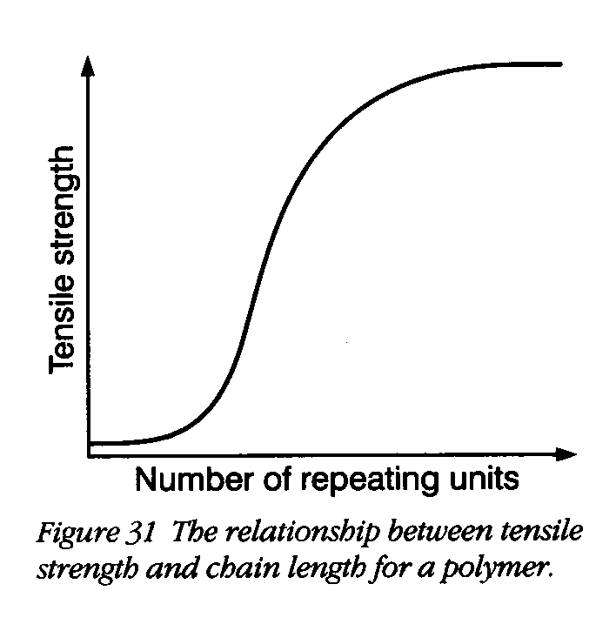
Longer chains make stronger polymers.
Critical length needed before strength increases.
Hydrocarbon polymers average of 100 repeating units necessary but only 40 for nylons.
Tensile strength measures the forces needed to snap a polymer.
More tangles + more touching!!!

Slide 13
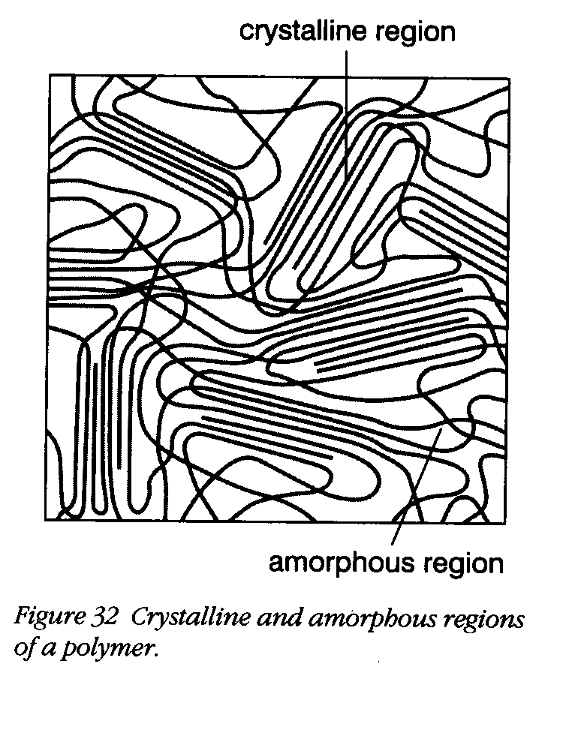
Crystalline polymers
Areas in polymer where chains packed in regular way.
Both amorphous and crystalline areas in same polymer.
Crystalline - regular chain structure - no bulky side groups.
More crystalline polymer - stronger and less flexible.

Slide 14
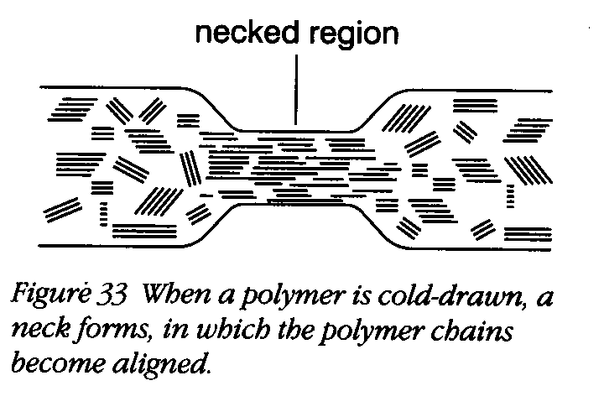
Cold-drawing
When a polymer is stretched a ‘neck’ forms.
What happens to the chains in the ‘neck’?
Cold drawing is used to increase a polymers’ strength. Why then do the handles of plastic carrier bags snap if you fill them full of tins of beans?

Slide 15
This powerpoint was kindly donated to www.worldofteaching.com
http://www.worldofteaching.com is home to over a thousand powerpoints submitted by teachers. This is a completely free site and requires no registration. Please visit and I hope it will help in your teaching.

