Slide 1

ULTRAVIOLET
LET THERE BE (INVISIBLE) LIGHT!
A Presentation Brought To You By REJ
Visit www.worldofteaching.com
For 100’s of free powerpoints

Slide 2
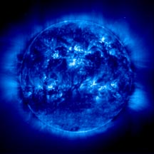
Ultraviolet Radiation
between 400-100 nm on the spectrum.
UV part of spectrum divided into regions.
Produced by high temperature continuous prism

Slide 3
Ultraviolet: The Past
Johann Wilhelm Ritter (1801)
  Silver Chloride
Melloni and Becquerel (1842)
1920’s: Balloon’s
1946: Rocket Man
1962: Orbiting Solar Observatory (NASA)
  First Extreme Data Collection.
1978: International Ultraviolet Explorer
1992: Extreme Ultraviolet Explorer

Slide 4
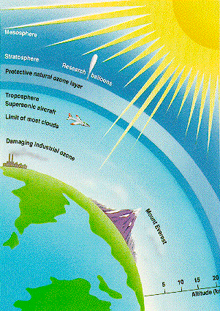
The Ozone Layer
Stratosphere
  10-30 Miles
UV-A, UV-B, UV- C
  99%
Telescopes in space
The future

Slide 5
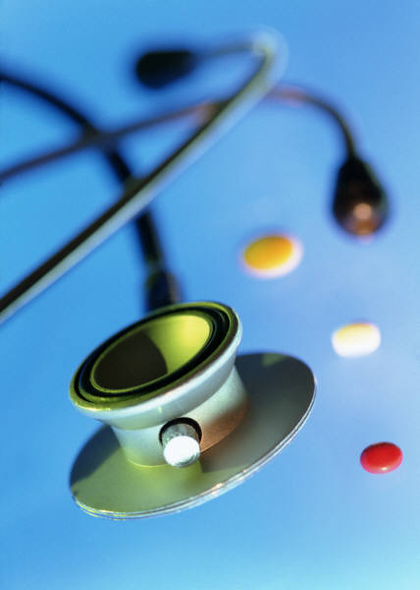
Practical Uses
Black Light
  Authenticate
Fluorescent Lamps
Spectroscopy
Minerals (GFP)
Photolithography
Electrical Insulation
Sterilization
Water

Slide 6
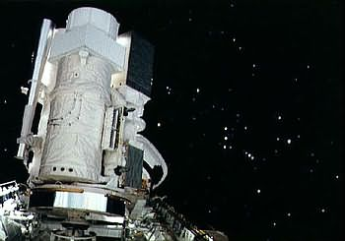
UV in Astronomy
Used since the 1960s
Copernicus
Hopkins UV telescope

Slide 7
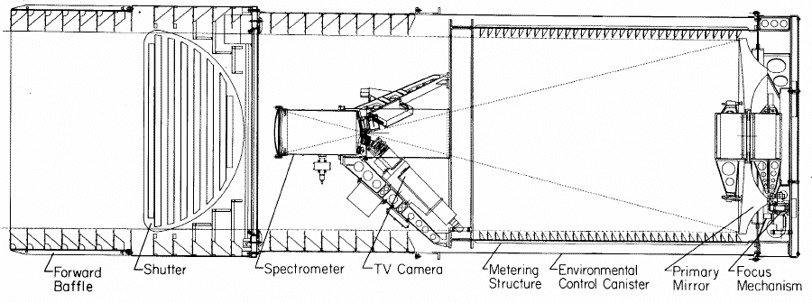
Diagram of HUT

Slide 8
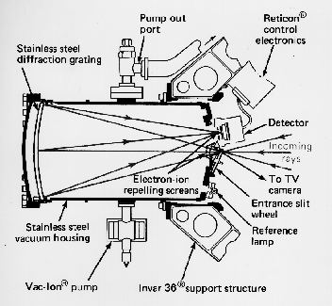

Slide 9
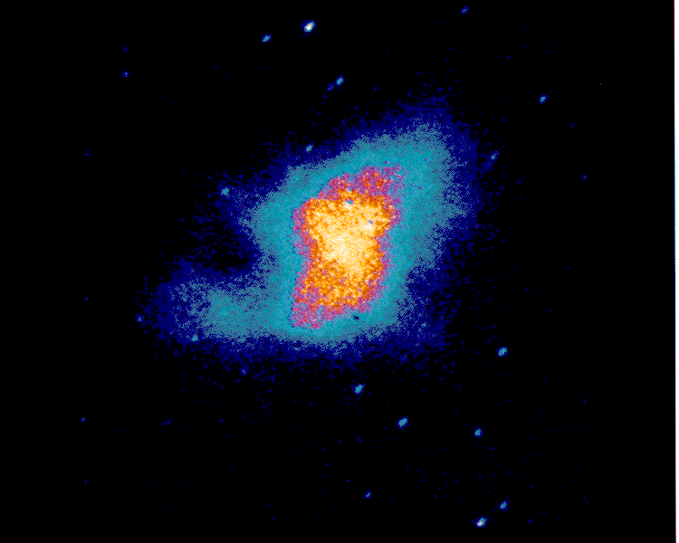

Slide 10
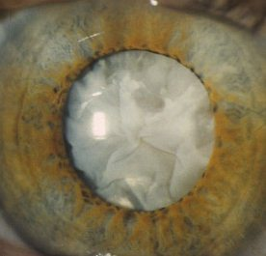
UV’s Effects on Human Body
Minor effects on skin
Cancer
Eye problems
Vitamin D

Slide 11

THE END

