Slide 1
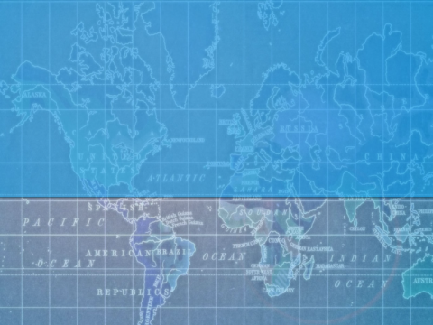
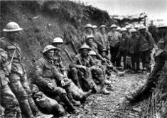
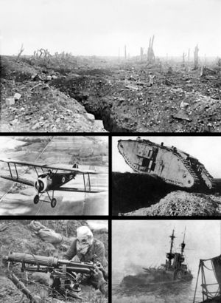
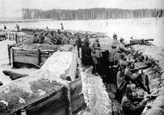
WORLD WAR I
“THE WAR TO END ALL WARS”

Slide 2
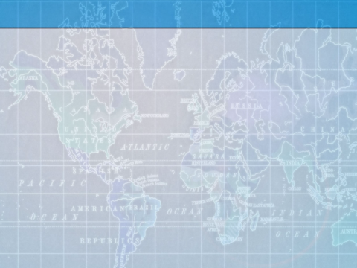
Statistics
World War One included:
3 Continents
31 Countries
65 Million Soldiers
37 Million Casualties
91,198 Deaths by Gas
6,395 Allied and Neutral Ships Lost
$186.3 Billion Financial Losses

Slide 3
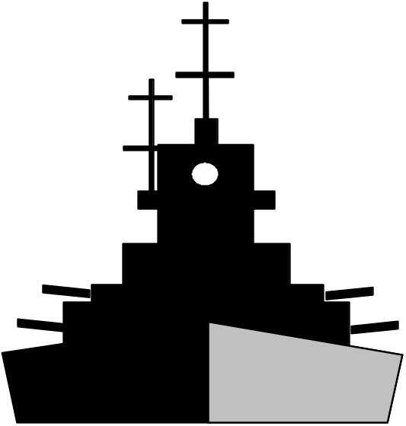

Causes of WWI
Some Causes May Include:
Industrial Revolution
Militarism
  Germany
Nationalism
  Serbia
Alliancism
  Triple Alliance
    Germany, Aus.-Hun., Bulgaria, and Turkey
  Triple Entente
    Serbia, Russia, France, Great Britain, US, ...

Slide 4
Countries Involved
Allied Countries
Central Countries
Austria-Hungary
Germany
Ottoman Empire
Bulgaria
Serbia
Russia
France
Belgium
Great Britain
Liberia
Japan
Montenegro
Italy
San Marino
Portugal
Romania
Greece
China
U.S.
Cuba
Nicaragua
Brazil
Siam
Costa Rica
Guatemala
Haiti
Honduras
Countries that only cut off trade
Bolivia
Ecuador
Peru
Uruguay
That Should Add Up To 31 Countries

Slide 5
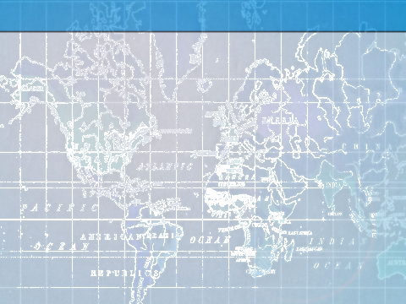
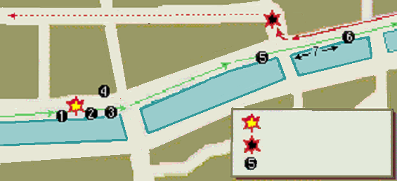
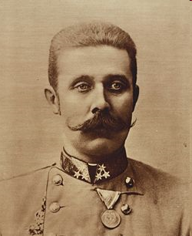
Immediate Cause
Assassination of Archduke Francis Ferdinand
by Gavrilo Princip, June 28th, 1914.
First Bomb
Gunshots
Gav. Princip
Archduke Ferdinand

Slide 6
Escalation
After the Archduke was killed, a series of events was set in motion, to change the world.
1. A-H declared war on Serbia.
2. Russia mobilized to aid Serbia.
3. Germany aids A-H, declares war on Russia.
4. France mobilizes to aid Russia.
5. Germany declares war on France.
6. Germany invades Belgium.
7. UK declares war on Germany.
8. OE mobilizes to aid Germany and A-H.
9. Italy joins France, UK, and Russia.
10. Bulgaria joins OE, Germany, and A-H.
11. US joins Italy, France, UK, and Russia

Slide 7


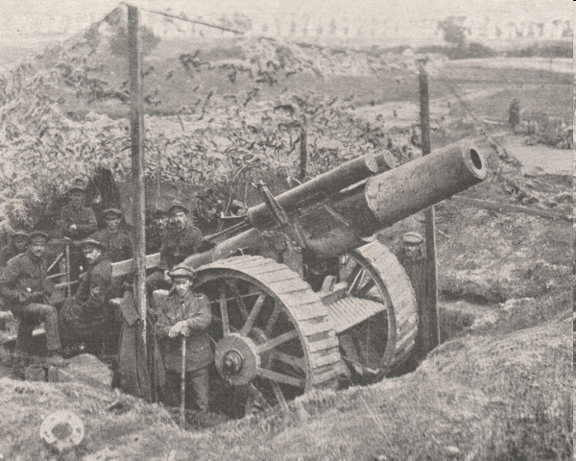

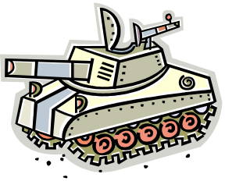

Weapons
Blimps
Airplanes
Long Range Artillery
Tanks
Gas
Ships
Submarines

Slide 8
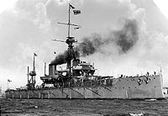
Goals
Triple Entente
Triple Alliance
Hold back the Germans
Prolong the War (until better technology)
Have a Naval Blockade in place
Concentrate on the Western Front
Conquer France
Avoid Two-Front War
Use Unrestricted Submarine Warfare (naval subs could attack non-naval vessels)

Slide 9
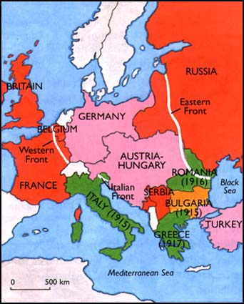
Fighting Fronts
The Western Front was between France and Germany
The Italian Front was between Aus.-Hun. and Italy
The Eastern Front was between Russia and Germany
Germany wanted to avoid fighting on more than one front.

Slide 10
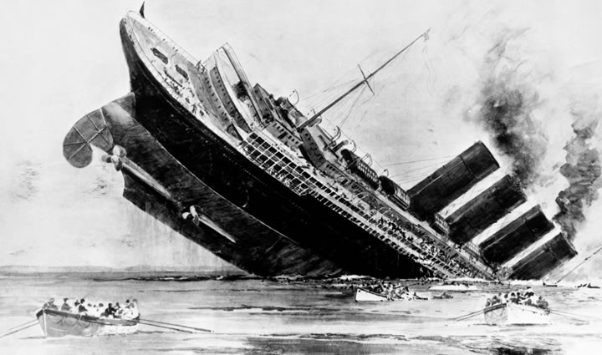
Lusitania
The Lusitania was a British cruise liner, sunk by a German U-boat.
The Sinking of the Lusitania, with 139 Americans on board (128 killed), prompted the United States to join the allies

Slide 11
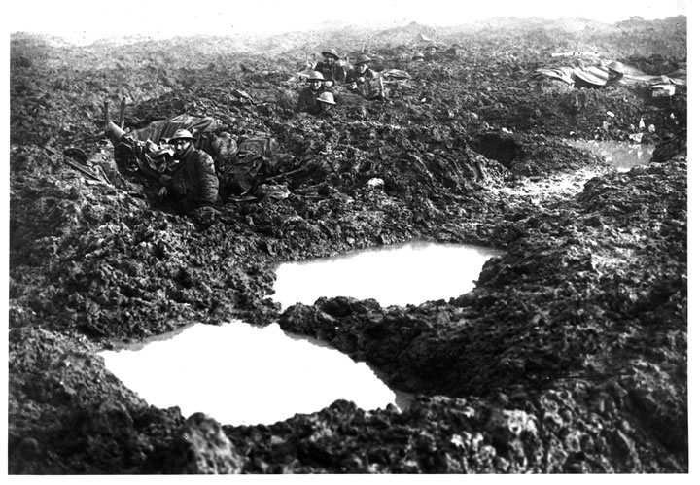
No Man’s Land

Slide 12
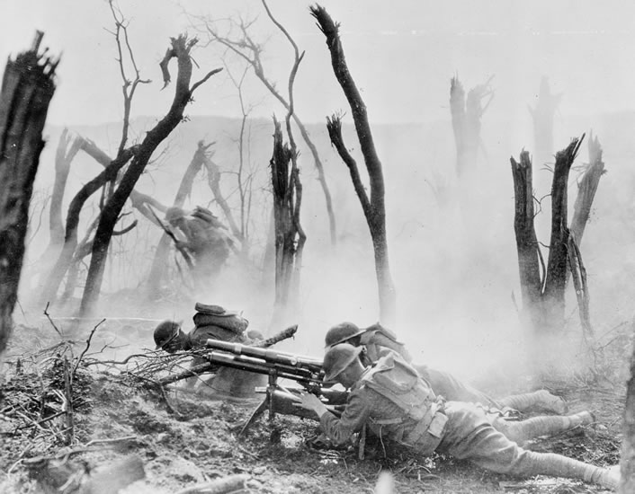
No Man’s Land

Slide 13

End Results
Millions Killed

Slide 14
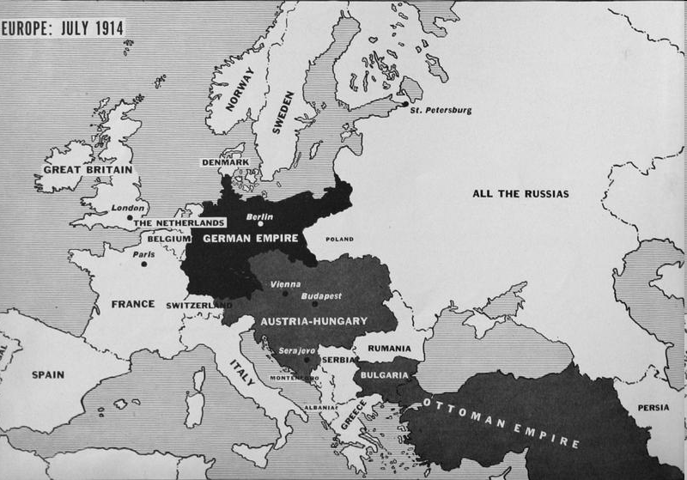
End Results

Slide 15
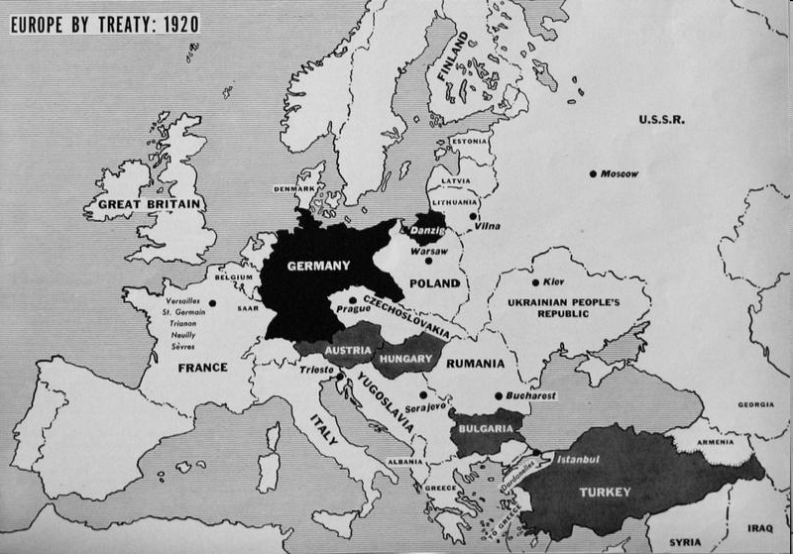
End Results

Slide 16
The End
Thanks For Watching!
“War may sometimes be a necessary evil. But no matter how necessary, it is always an evil, never a good. We will not learn how to live together in peace by killing each other's children.” -Jimmy Carter

Slide 17
This powerpoint was kindly donated to www.worldofteaching.com
http://www.worldofteaching.com is home to over a thousand powerpoints submitted by teachers. This is a completely free site and requires no registration. Please visit and I hope it will help in your teaching.

