Slide 1



Slide 2
Wave
a disturbance that propagates
through a material medium or space.
In order for a mechanical wave to exist, energy is needed to create a disturbance in an elastic medium.
Waves transfer energy without
the bulk transport of matter.

Slide 3
No medium is needed for
ELECTROMAGNETIC waves.
Light, radio, x-rays, and gamma rays
are some examples of e/m waves.
All e/m waves travel through free
space at a speed of approximately
3.00 x 10⁸ m/s or 186,000 miles/sec.
This speed is known as the speed of light.

Slide 4

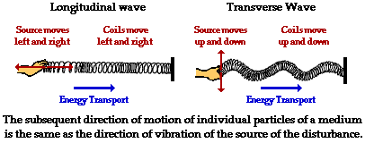

Slide 5
TRANSVERSE
The displacement of the particles
of the medium is perpendicular to
the direction of wave propagation.
LONGITUDINAL
The displacement of the particles
of the medium is parallel to the
direction of wave propagation.

Slide 6
SURFACE
A combination of
transverse and longitudinal.
Click here, here, and here
to view simulations of
transverse and longitudinal waves.

Slide 7
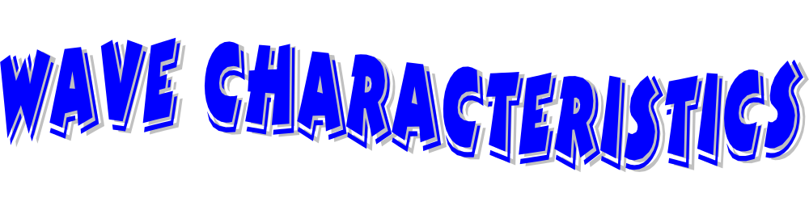
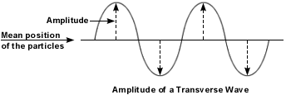
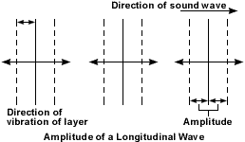
Amplitude
the maximum displacement
of a particle of the medium from
the rest or equilibrium position
denoted by A and measured in units of length

Slide 8
Phase
related to the position and motion
of the particles of the medium

Slide 9
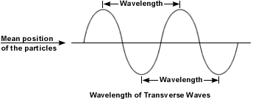
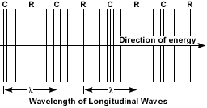
Wavelength
the shortest distance between
two points that are “in phase”
denoted by λ and measured in units of length

Slide 10
Frequency - the number of complete vibrations per unit time
denoted by f and measured in units of Hz
Period - the shortest time interval during
which the motion of the wave repeats itself
denoted by T and measured in units of time
T = 1/f
&
f = 1/T

Slide 11
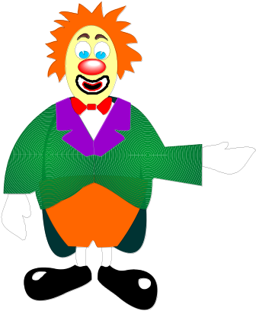
Velocity - the speed of the wave
denoted by v and measured in units of dist/time
The speed of a wave depends on the properties
of the medium through which it is traveling.
v = d/t = λ/T = f λ

Slide 12


Reflection
the turning back of a wave when
it reaches the boundary of the
medium through which it is traveling

Slide 13
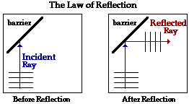
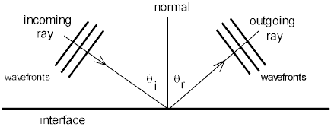
Law of Reflection
the angle of incidence is equal
to the angle of reflection

Slide 14
There are two types of reflection.
Fixed-end Termination
the reflected wave is
inverted when it reflects
from a more dense medium
Free-end Termination
the reflected wave is
upright when it reflects
from a less dense medium
Click here to view these types of reflection.

Slide 15
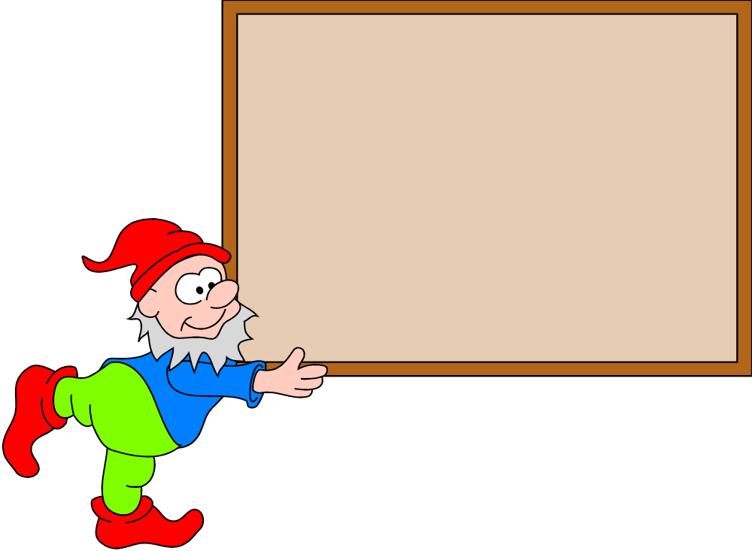
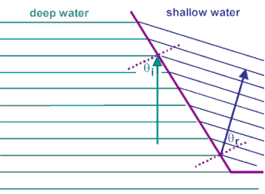
Refraction
the bending of a wave as it passes obliquely from one medium into another of different propagation speed
For refraction to occur, the wave
must change speed and must enter
the new medium at an oblique angle.

Slide 16
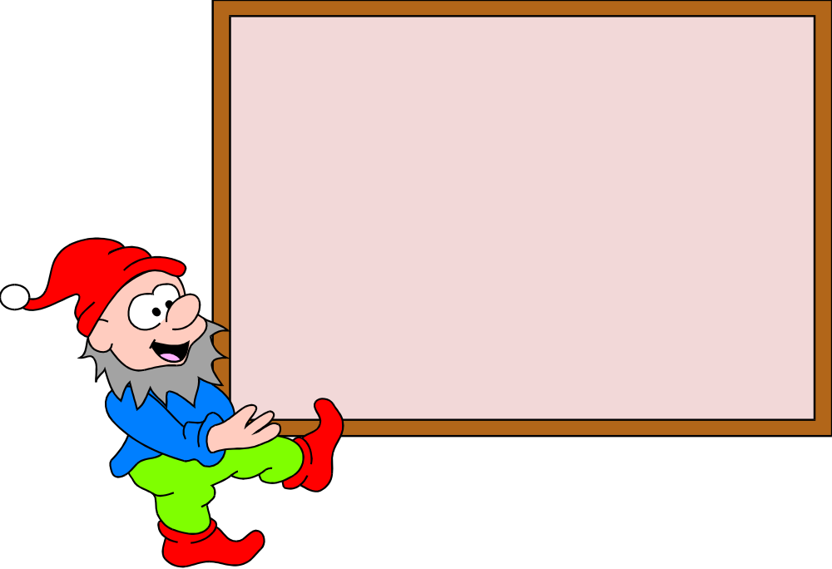
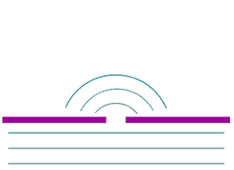
Diffraction
the spreading of a wave
around a barrier or
through an opening

Slide 17
Interference
the result of the superposition
of two or more waves
Superposition Principle
the displacement of the medium when
two or more waves pass through
it at the same time is the algebraic
sum of the displacements caused
by the individual waves

Slide 18
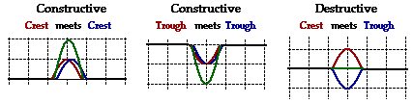
Types of Interference
Constructive
results in a larger amplitude
Destructive
results in a smaller amplitude

Slide 19
Read more about interference here.
Click here to view the interference
pattern resulting from the superposition
of two transverse waves.
Click here and here to view
simulations of the interference of
two circular waves.

Slide 20
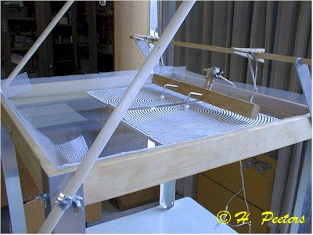
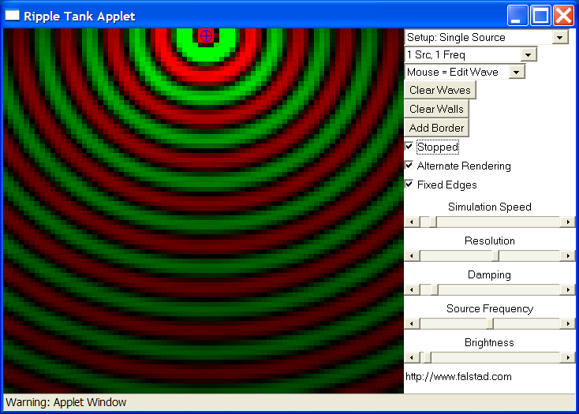
The ripple tank
simulation found
here can be used
to investigate
wave properties.
You can view reflection,
refraction, diffraction,
and interference using both
plane and circular waves.
Click here to view a movie
clip of an actual ripple tank experiment.

Slide 21



A standing wave is the
result of two wave trains of the same
wavelength, frequency, and amplitude
traveling in opposite directions
through the same medium.

Slide 22
Learn more about standing waves
here, here, and here.
Click here to view a simulation of the
interference of two traveling waves
that can result in a standing wave.
Click here to view a simulation
of standing waves on a string.
Standing waves may be produced easily in
water, string, and air columns.

Slide 23
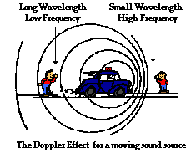
Doppler Effect
the change in frequency due to the relative
motion of the wave source and the observer
The observed frequency is higher when the
source and observer are getting closer.
The observed frequency is lower when the
source and observer are getting farther away.

Slide 24
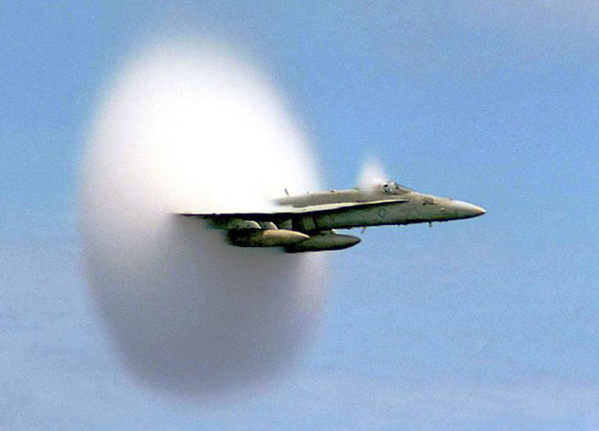
Click here, here, here, and here
to run simulations of the Doppler Effect.
The Doppler Effect
can be evident for
all types of waves –
including light,
sound, water, etc…

