Slide 1
X
Visit www.worldofteaching.com
For 100’s of free powerpoints

Slide 2
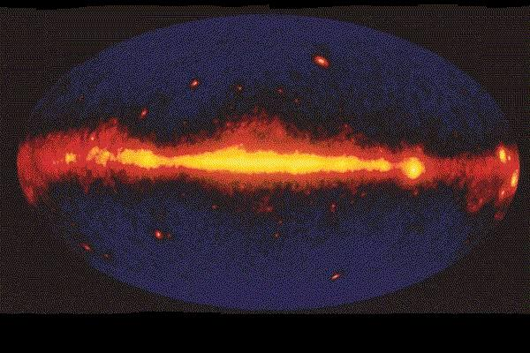
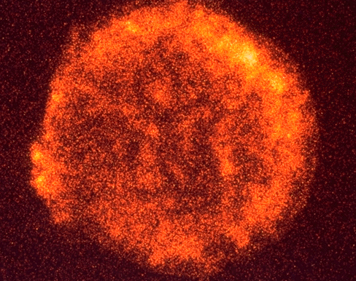
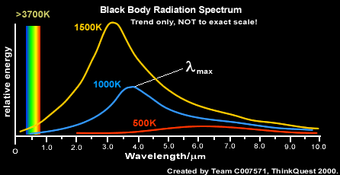
X-Rays
Above left, our galaxy in X-rays, above, a supernova

Slide 3
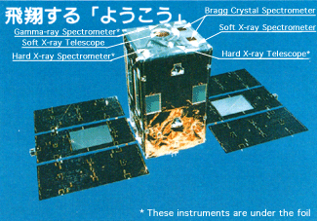
The Observatory

Slide 4
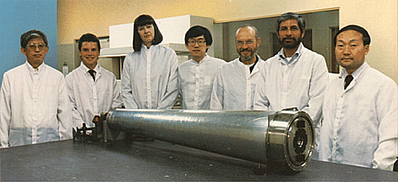
Yohkoh SXT & Team
Specs
1.54m focal length provides images from the .25 to 4.5 keV on a 1024x1024 cdc detector

Slide 5
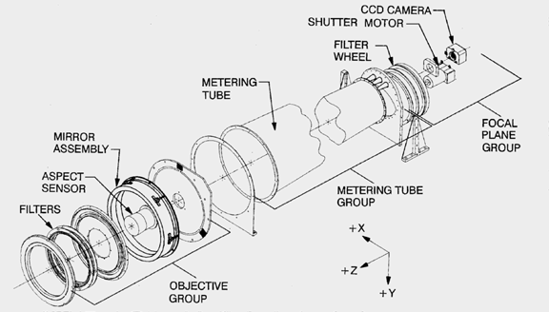
Yohkoh Assembly

Slide 6
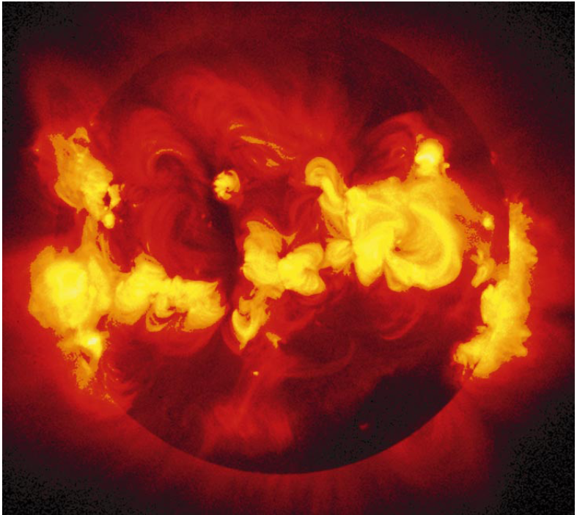
Yohkoh X-Ray Pictures
http://www.sciamarchive.org/qpdf.cfm?ArticleID_CHAR=275CD5E3-0A46-47CE-85FE-83E874D98BB

Slide 7
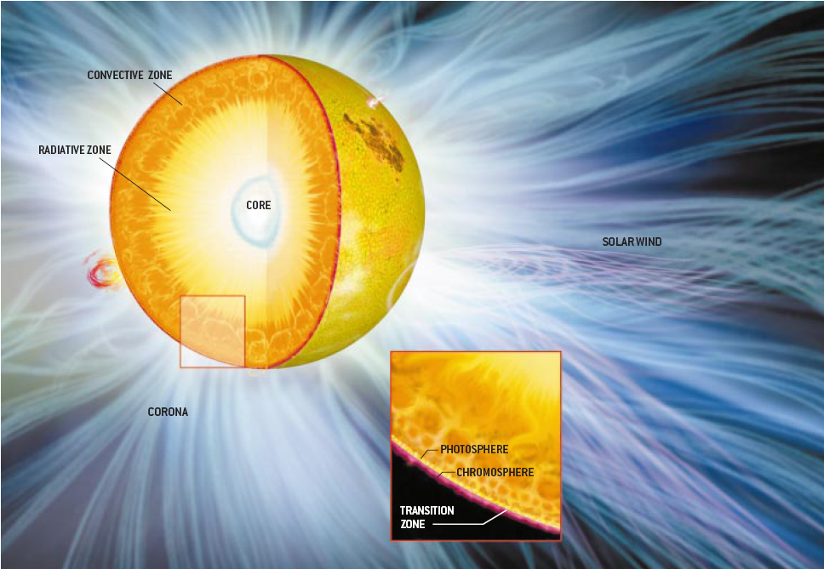
The Corona

Slide 8
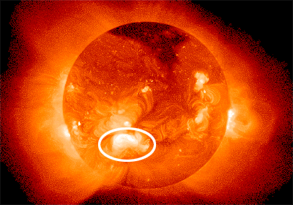
Active Region
Caused by strong magnetic fields that may span up to 500,000 square kilometers

Slide 9
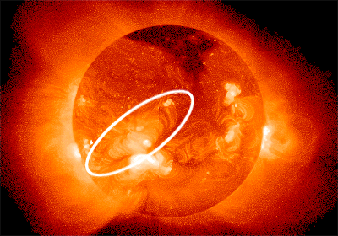
Arcade of loops
“An "arcade" is a system of magnetic loops organized into an elongated cylindrical formation. Often such an arcade will result from a slowly-developing solar flare or a coronal mass ejection (or both). The bright arcade may persist for days or longer.”

Slide 10
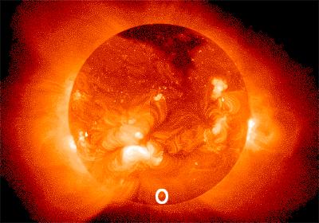
X-Ray Bright Points
These occur anywhere on the Sun at opposition of the active regions.
Caused by magnetic fields that are sucked down into the photosphere

Slide 11
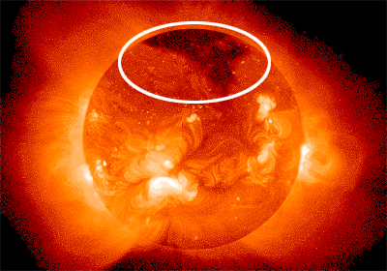
Corona Hole
unipolar magnetic fields
high-speed solar wind streams originate in coronal holes

Slide 12

Interconnecting loops
large-scale magnetic loops connect two active regions
"emerging flux": magnetic loops push their way through the photosphere and appear in the corona

Slide 13

Streamer
The result of two opposed arcades resulting in explosions of x-rays from the sun

Slide 14
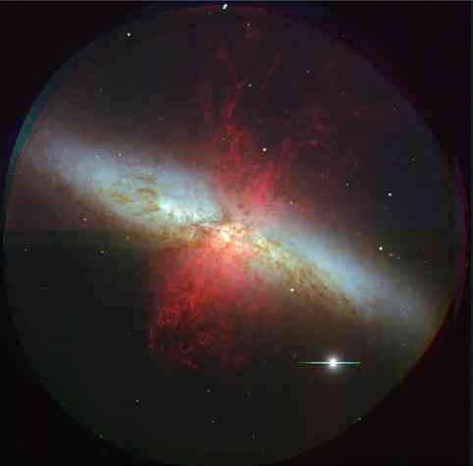
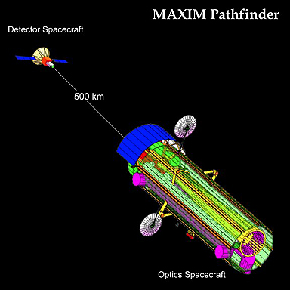
The MAXIM

Slide 15
Notes:
This page is about black holes. Here I will introduce the problem of imaging one.

Slide 16
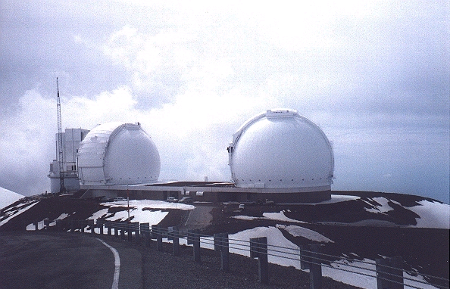
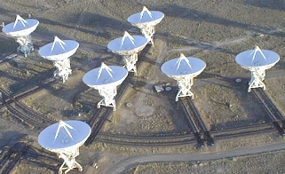
Interferometry
Below: New Mexico’s Very Large Array
Above: Hawaii’s twin Keck observatories

Slide 17
The MAXIM

Slide 18
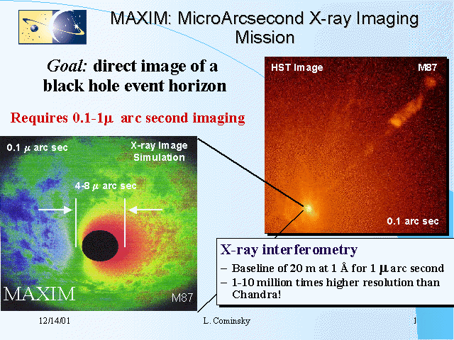
MAXIM

