Slide 1
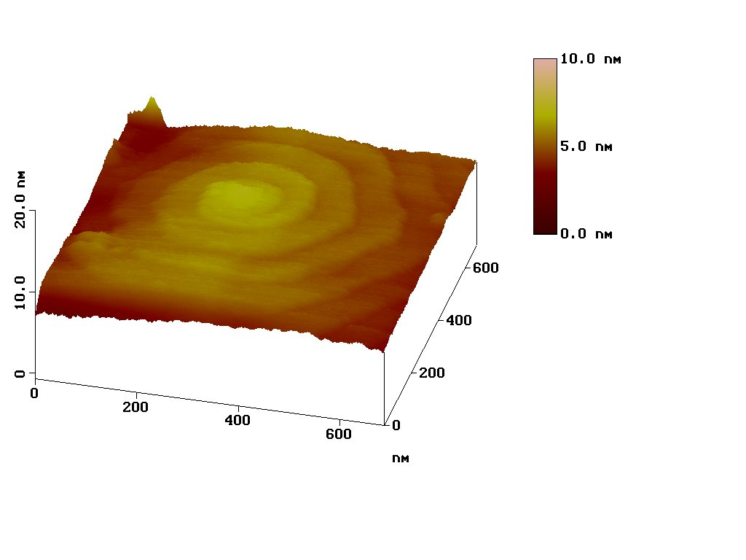
The
Building Blocks
Matter is made up of atoms.
The structure of atoms dictate their properties. How atoms combine dictate what we see in the many minerals in nature.
New technologies allow us to peer ever closer at the minute structures of minerals, down to the scale of individual atoms.

Slide 2
The Stuff That Makes Atoms
Although one can subdivide atoms into numerous
subatomic particles, we will be concerned only with
protons, neutrons and electrons.
Protons and neutrons are together in the nucleus of an atom, whereas electrons are in motion in orbits
around the central nucleus.
Protons carry a positive electrical charge, electrons carry a negative charge, and neutrons carry no charge.
Neutrons work to keep nuclei together.
Most atoms are electrically neutral, meaning that they have an equal number of protons and electrons.

Slide 3
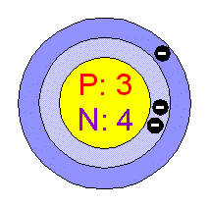
Maintaining Neutrality
Most atoms are electrically neutral, meaning that they have an equal number of protons and electrons.
A schematic model of a lithium (Li) atom in the ground state.
It has 3 protons in the nucleus, and
3 electrons in orbit.
(we will get to the number
of neutrons)

Slide 4
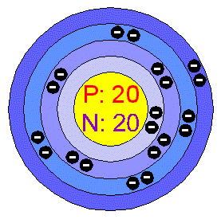
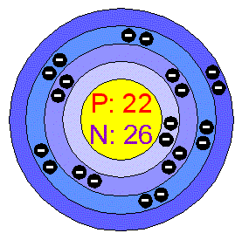
Electronic and Nuclear Properties
Properties of atoms reflect some combination of features related to electrons or to the nucleus.
The electronic properties are those related to how atoms connect to one another: bonding.
The nuclear properties include features like radioactivity.

Slide 5
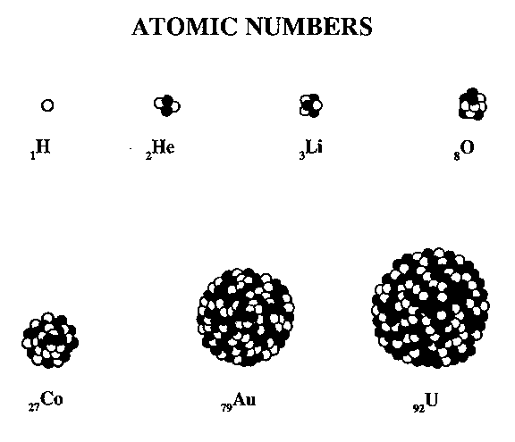
Size of Nuclei
The number of neutrons tends to closely follow the number of protons. Atoms with more of each are bigger and heavier.
A uranium atom, with 92 protons and ~146 neutrons is gigantic compared to dinky helium (2 + 2).

Slide 6
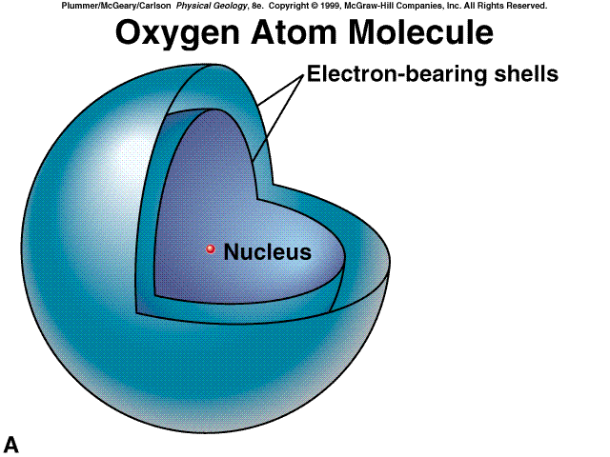
The Spacious Atom
Microcosms of our solar system, atoms are dominantly empty space:
electron orbits
If an oxygen atom had a total radius of 100 km, the nucleus would be a ~1 m diameter sphere in the middle.

Slide 7
Electrons in Orbit
In a simplistic model, electrons float around the nucleus in orbits that are sometimes called shells.
electron orbits
As the number of electrons increases, they start to fill orbits farther out from the nucleus.
In most cases, electrons are lost or gained only from the outermost orbits.

Slide 8
Charged Atoms: Ions
Left to their own devices, atoms are electrically neutral.
That means that they have an equal number of
protons and electrons.
During the course of most natural events,
protons are not gained or lost, but electrons may be.
Atoms with more or fewer electrons than protons are
electrically charged. They are called ions:
an atom that loses electrons takes on a positive charge (cation);
an atom that gains electrons takes on a negative charge (anion).
Complex cations and anions can also occur: (NH₄)⁺¹, (SO₄)⁻²

Slide 9
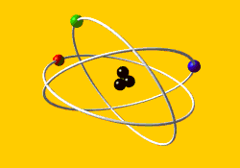
Atomic Number
We distinguish one element from another on the basis of the atomic number, which is the number of protons.
So, an atom of any element can have a variable number of electrons and neutrons, but given the number of protons, the fundamental properties of the element are unchanged.
This is the basis for Dmitri Mendeleev’s organization of the
Periodic Table of the Elements.
The table is a way of organizing elements
on physical grounds,
but also serves to group elements with consistent chemical properties.

Slide 10
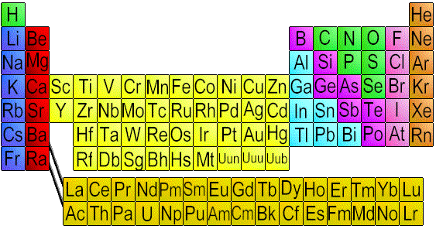
The Periodic Table
The periodic table is read from top to bottom, left to right, as atomic number increases: 1=H, 2=He, 3=Li, 4=Be, 5=B, 6=C, and so on.

Slide 11
The Periodic Table
Elements in columns (groups) have similar
outer-electron configurations,
and so tend to behave similarly.
alkali earths
transition metals
halogens
alkalis
rare earths
noble gases
actinides

Slide 12
Oxidation State
halogens
Most atoms will form the same kinds of ions all the time.
For example, all the alkalis form +1 ions,
and the halogens form -1 ions.
alkalis

Slide 13
Oxidized and Reduced States
transition metals
The transition metals are more electronically complex.
They may form ions of various charges.
For example, iron (Fe) is found as +2 and +3 ions.
A transition metal cation with a higher charge is more oxidized than
one of lower charge. That comes from the fact that materials with
high proportions of Fe⁺³/Fe⁺² form in environments
where oxygen is abundant.
The opposite is also true, and we call Fe⁺² reduced iron.
oxidized
reduced

Slide 14
The Periodic Table: the Bulk Earth
A small number of elements make up >99% of the solid Earth.
O = oxygen
Na = sodium
Mg = magnesium
Al = aluminum
Si = silicon
S = sulfur
Ca = calcium
Fe = iron
Ni = nickel

Slide 15
The Periodic Table: the Crust
The crust is a little more elementally interesting (again, as a result of differentiation), but it is still mainly made of a small number of elements.
C = carbon
P = phosphorus
K = potassium
Ti = titanium
Mn = manganese

Slide 16
Atomic Weight: It’s all in the Nucleus
Since electrons weigh virtually nothing, the mass of an atom is concentrated in its nucleus.
Each atom can be described by its atomic weight (or mass),
which is the sum of the protons and neutrons.
lithium:
atomic number = 3
3 protons
4 neutrons
atomic weight = 3 + 4 = 7
BUT... although each element has a defined number of protons,
the number of neutrons is not fixed.
Atoms with the same atomic number but variable numbers of neutrons are called isotopes.

Slide 17
Isotopes
Carbon (atomic # 6) has three natural isotopes
with atomic weights of 12, 13 and 14.
isotope #p #n
====== == ==
C-12 6 6
C-13 6 7
C-14 6 8
Tin (Sn, atomic # 50) has ten natural isotopes with atomic masses of 112, 114, 115, 116, 117, 118, 119, 120, 122 and 124. How many protons and neutrons do these isotopes have?

Slide 18
Radioactive or Stable?
Radioactivity is a nuclear phenomenon: it comes as a result of a particular structure in a nucleus.
A radioactive atom is considered unstable. All unstable atoms emit radioactivity (usually by ejecting nuclear particles) in order to reach a stable configuration.
This is the process of radioactive decay
(about which we will talk on 6/9).
So, not all atoms will be radioactive, just a small proportion of isotopes with unstable nuclei.
The bulk of isotopes are stable, or non-radioactive.

Slide 19
Stable and Radioactive Isotopes
Carbon (atomic # 6) has three natural isotopes
with atomic weights of 12, 13 and 14.
isotope #p #n
====== == ==
C-12 6 6
C-13 6 7
C-14 6 8
C-14 is a radioactive isotope; C-12 and C-13 are stable.
Over time the proportion of C-12/C-14 and C-13/C-14
will increase until there is no C-14.
(unless some process makes new C-14...)

Slide 20
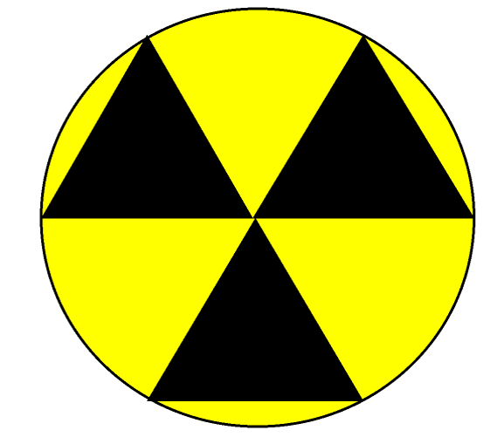
Radioactivity Inside You
Concerned about radioactivity in nature?
To keep things in perspective, consider that 0.01% of all potassium is radioactive K-40.
Potassium is an essential element in the human body.
If your body is about 1% K, this means a 70 kg
(150 pound) person contains around
1x10²¹ atoms (that’s one billion trillion atoms)
of radioactive K-40.

Slide 21
Chemical Bonds
One typical consequence of chemical reactions is the formation of chemical bonds between atoms and complexes.
What kind of bonds form is based on the electronic configuration of the atoms involved.
Atoms with near-full (halogens) and near-empty (alkalis/alkali earths) outer electron shells, as well as transition metals, may form ionic bonds.
Covalent bonds are where atoms share outer shell electrons.
The bulk of minerals are dominantly ionically bonded. However, many minerals have bonds with some covalent
and some ionic components.

Slide 22
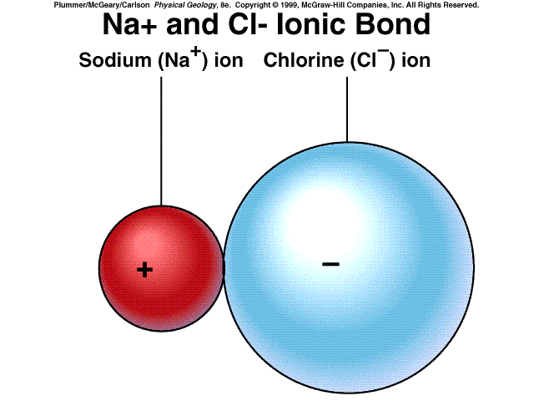
Ionic Bonds
Atoms satisfy themselves by the give and take of outer shell electrons.
Most minerals are held together by primarily ionic bonds.

Slide 23
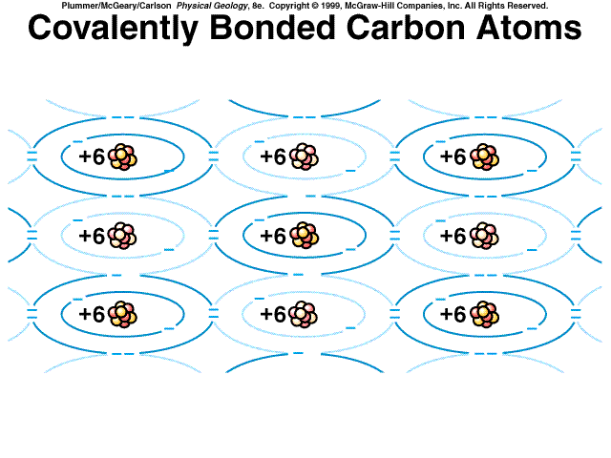
Covalent Bonds: Electron Sharing
These carbon atoms are held together by sharing outer-shell electrons.

Slide 24
Alternative Bonds
Some minerals have metallic bonds,
which are a form of covalent bonds.
One notable weak kind of bond is called the
Van der Waals force, essentially an ionic bond.
When we talk about minerals we will see that these bonds are responsible for the key
physical properties of some minerals.

Slide 25
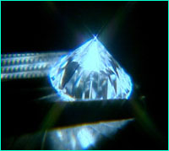
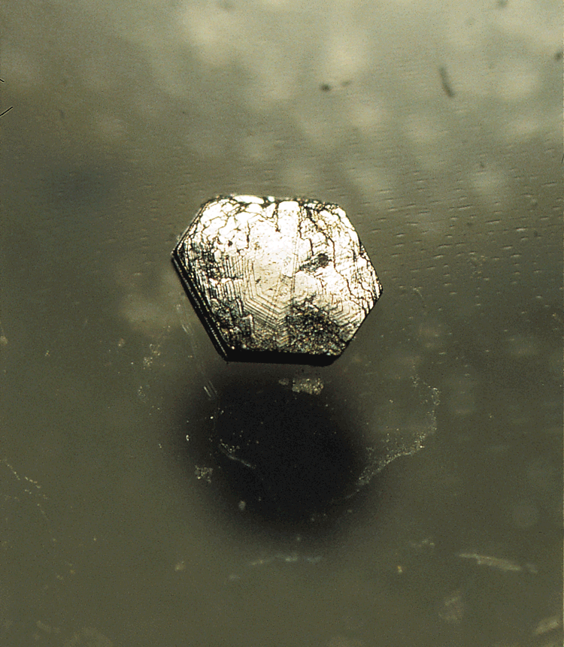
Chemical Reactions: Achieving Stability
Chemical reactions take place in order to achieve a more stable state (lower total energy) under given conditions (pressure, temperature).
Unstable reactants react to form stable products.
[don’t get confused: we’re not talking about nuclear instability here]
To complicate this, the transition from unstable mineral to stable mineral is not necessarily automatic.
Many chemical reactions require
a great deal of energy
to run to completion.

Slide 26
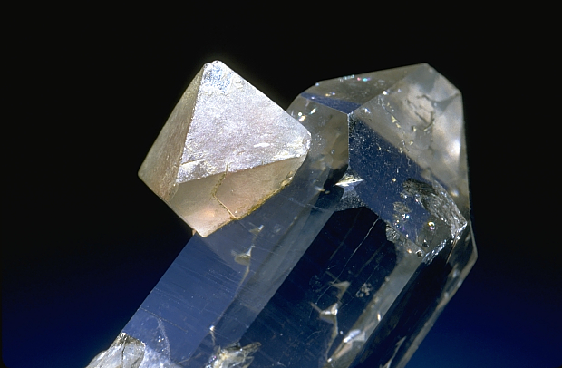
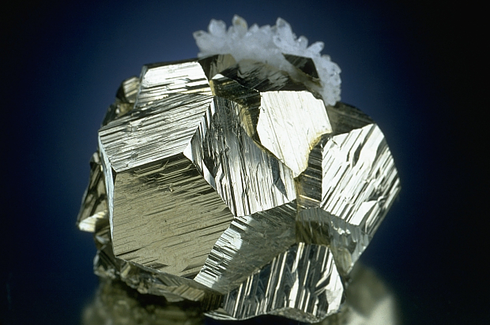
What is a Mineral?
naturally occurring
inorganic compound
specific chemical composition
defined crystal structure
consistent physical properties

Slide 27
Stability
With sophisticated furnaces and presses, we have investigated what chemical compounds (minerals) are stable at given pressures and temperatures
(now achieving pressures of the Earth’s core).
From experiments it is clear that most of the rocks exposed at the Earth’s surface today are not stable at these low temperatures/pressures. The minerals that are the most stable at the Earth’s surface are largely clay minerals.
So why are we not adrift in a sea of mud?

Slide 28
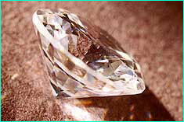
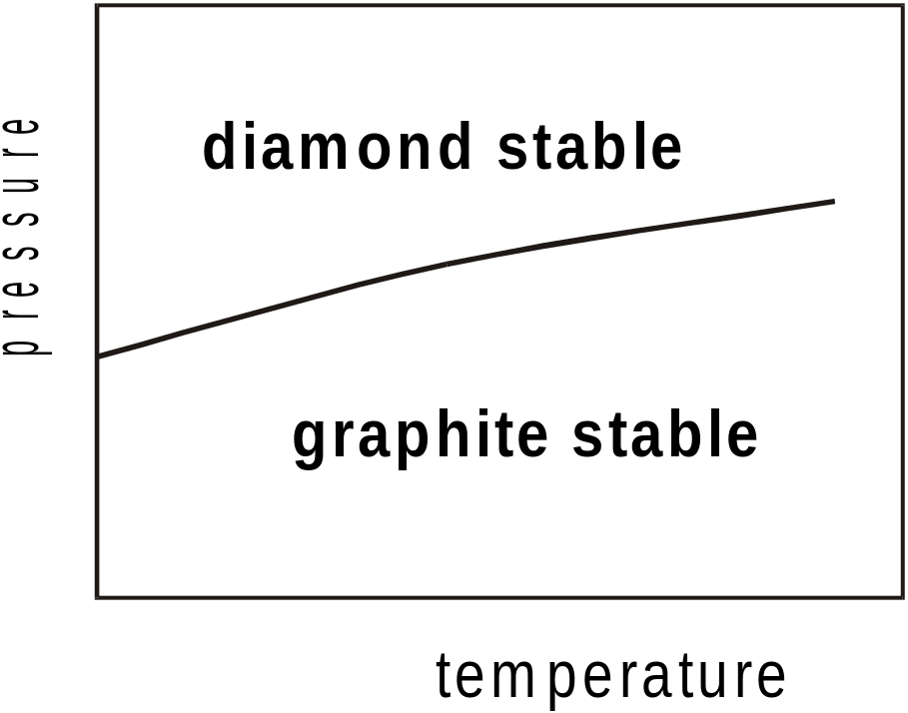
Stability and Metastability
Minerals that persist in an environment in which they are not chemically stable are said to be metastable.
Most of the minerals in the rocks at the Earth’s surface are metastable. Given enough energy (or enough time and the right conditions) they will react to form stable minerals.
Earth’s surface
conditions

Slide 29
Credits
Some images in this presentation from:
J Rakovan, Miami Univ., Ohio
Marshak, Earth: Portrait of a Planet (1st ed.)
Plummer, McGeary and Carlson, Physical Geology (8th ed.)
LBNL
chemicalelements.com
NRC
NOVA

Slide 30
This powerpoint was kindly donated to www.worldofteaching.com
http://www.worldofteaching.com is home to over a thousand powerpoints submitted by teachers. This is a completely free site and requires no registration. Please visit and I hope it will help in your teaching.

